Slide 1

Studying ‘fake news‘
Prof. Richard Rogers
New Media & Digital Culture
Media Studies
University of Amsterdam

Slide 2
Research question (generic):
To what extent does ‘fake news’ (or misinformation) resonate in political spaces across social media in the run-up to the national elections?

Slide 3
Research question:
To what extent does ‘fake news’ (or misinformation)* resonate in political spaces across social media* in the run-up to the presidential election in the U.S.*?
Presidential election as bounded event-based approach - a typical thematic or issue space for study
Political spaces as demarcated ‘sets’ - made by query design techniques resulting in political Facebook, Instagram, Twitter, YouTube, TikTok, Reddit, 4chan (also Google Web Search)
‘Fake news’ (or misinformation) as (politicised) classification problem

Slide 4
Research question:
To what extent does ‘fake news’ (or misinformation)* resonate in political spaces across social media* in the run-up to the presidential election in the U.S.*?
>>Presidential elections as bounded event-based approach - a typical thematic or issue space for study
Political spaces as demarcated ‘sets’ - made by query design techniques resulting in political Facebook, Instagram, Twitter, YouTube, TikTok, Reddit, 4chan (also Google Web Search)
‘Fake news’ (or misinformation) as (politicised) classification problem

Slide 5
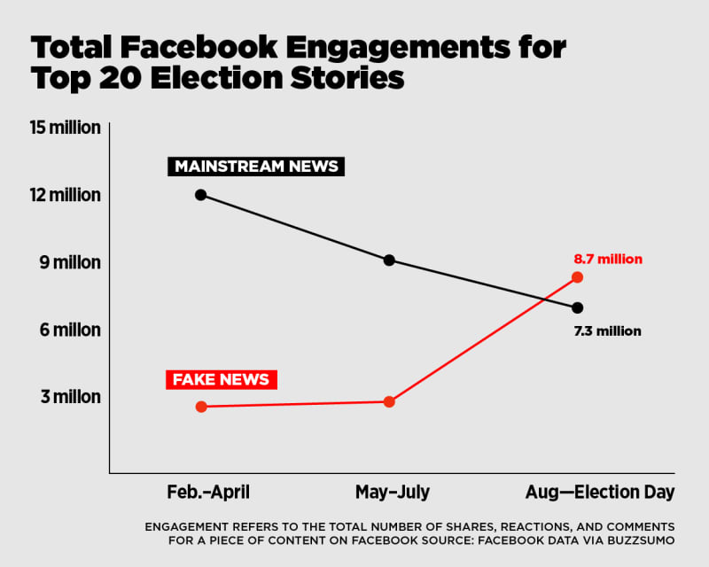
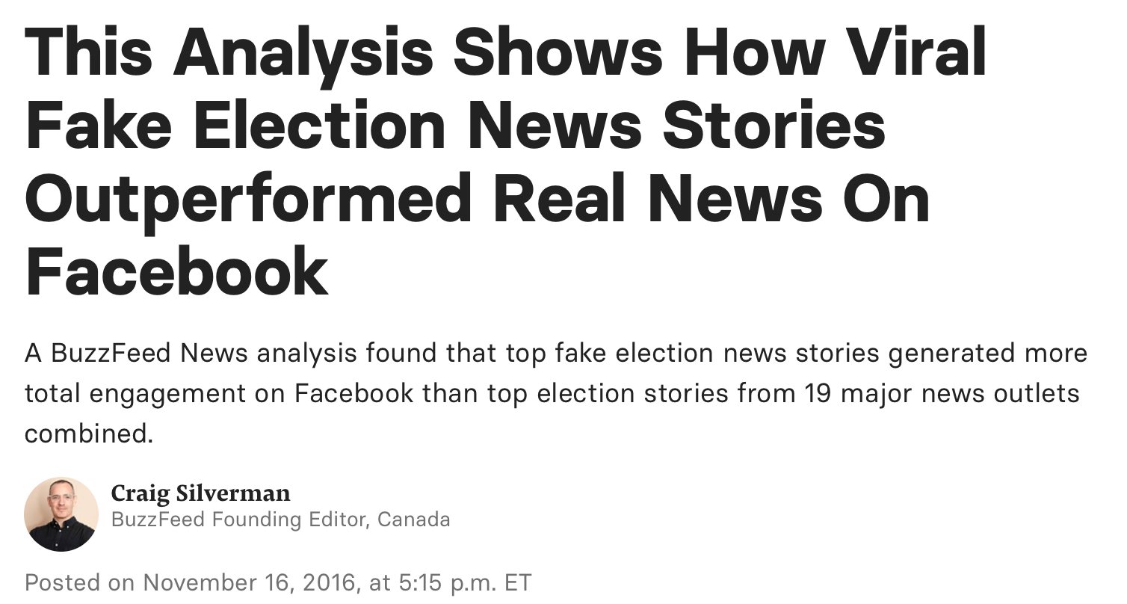
The birth of the ‘fake news’ crisis
or 'fake news' outperforms 'mainstream news' on Facebook, in the run-up to the U.S. elections in 2016.
Misinformation and ‘fake news’
Source: Silverman, 2016.
Note: ‘Fake news’ includes imposter, conspiracy as well as ‘hyperpartisan’ sources. Qualitative determination.

Slide 6
Research question:
To what extent does ‘fake news’ (or misinformation)* resonate in political spaces across social media* in the run-up to the US presidential elections*?
U.S. presidential elections as bounded event-based approach - a typical thematic or issue space for study
>>Political spaces as demarcated ‘sets’ - made by query design techniques resulting in political Facebook, Instagram, Twitter, YouTube, TikTok, Reddit, 4chan (also Google Web Search)
‘Fake news’ (or misinformation) as (politicised) classification problem

Slide 7
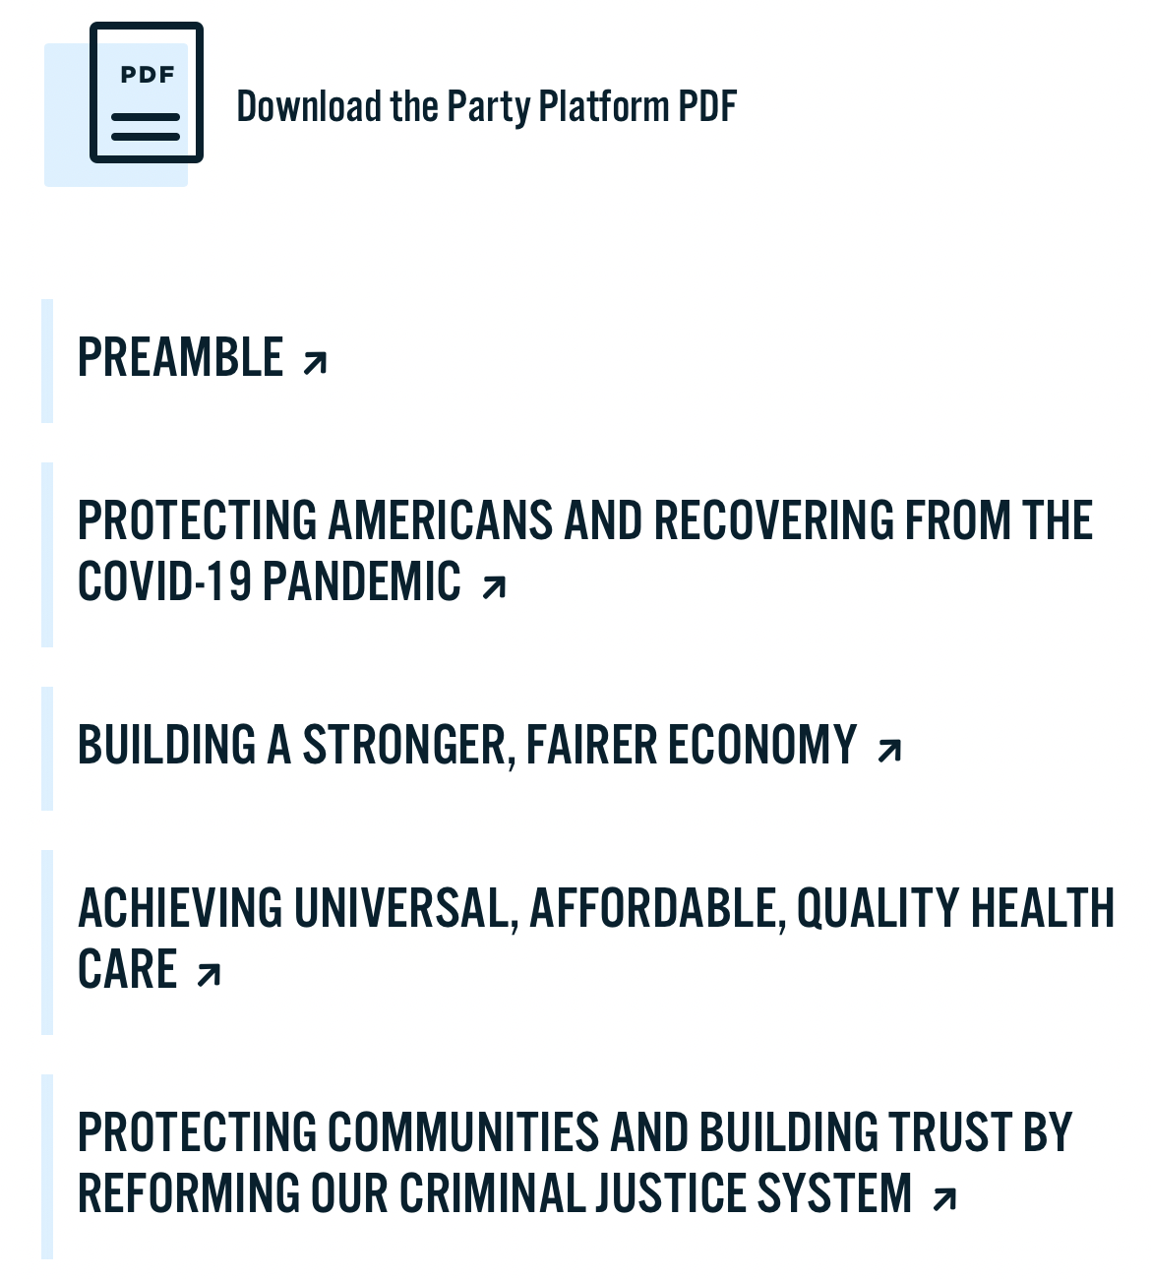
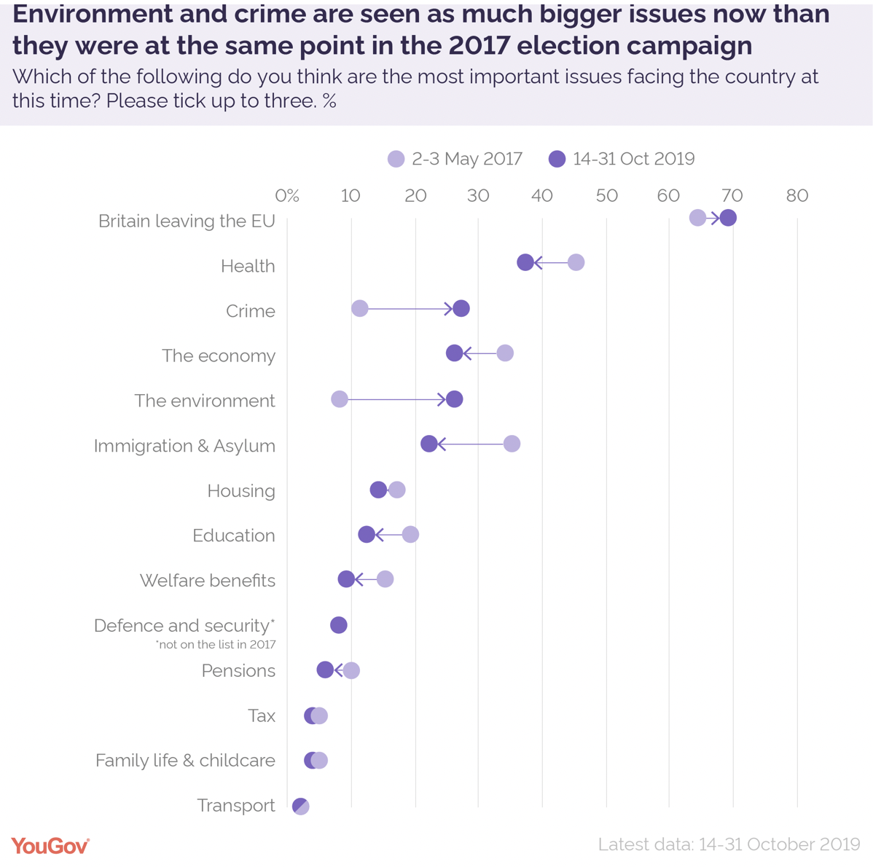
Political spaces within social media
  Build a list of politician names, party names and election issues (with issue language from party platforms and/or election aids)
Party-specific issue list, democrats.org
Generic issue list, YouGov.co.uk

Slide 8
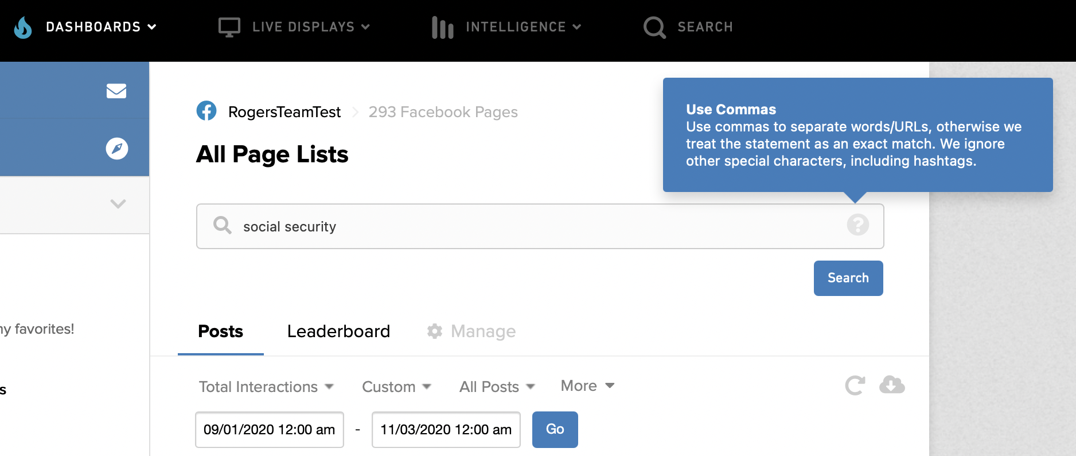
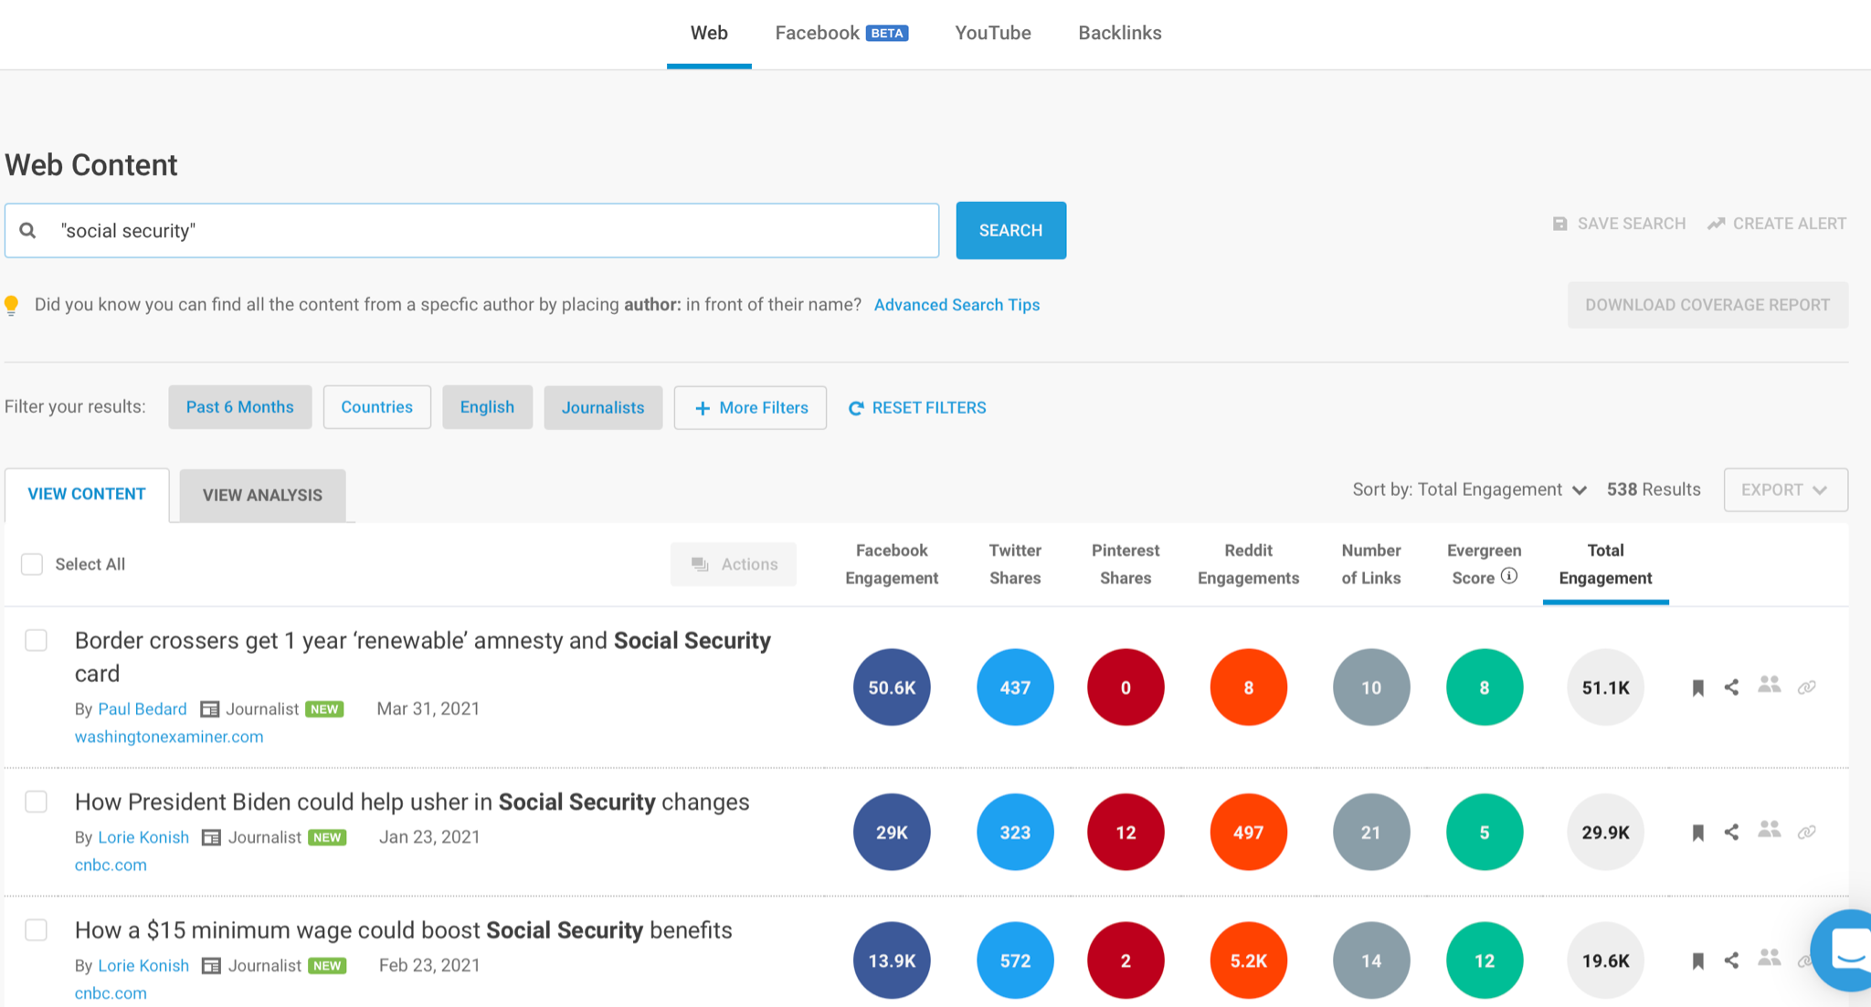
Political spaces within social media
  Query list in each platform outputting ‘sets’
crowdtangle.com
Facebook Page analysis
Buzzsumo.com
Web URL analysis

Slide 9
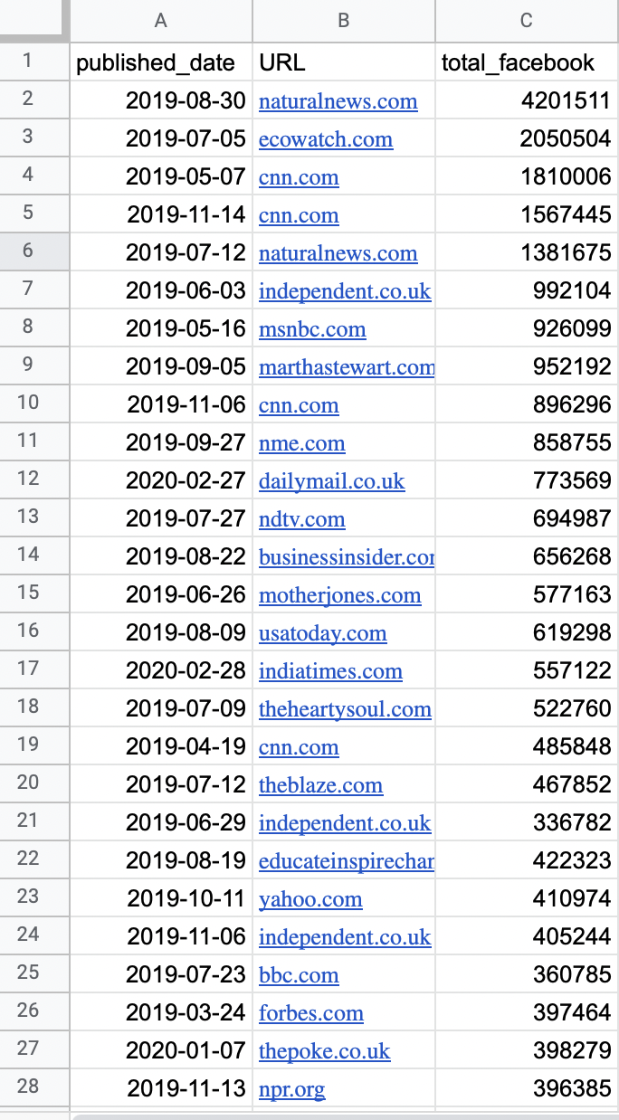
Political spaces within social media
  These sets constitute political Facebook, political Instagram, political Twitter, political TikTok, political Reddit, political 4chan, political Google Web Search
“Climate change” - Buzzsumo output - Web URL approach

Slide 10
Research question:
To what extent does ‘fake news’ (or misinformation)* resonate in political spaces across social media* in the run-up to the US presidential elections*?
U.S. presidential elections as bounded event-based approach - a typical thematic or issue space for study
Political spaces as demarcated ‘sets’ - made by query design techniques resulting in political Facebook, Instagram, Twitter, YouTube, TikTok, Reddit, 4chan (also Google Web Search)
>>’Fake news’ (or misinformation) as (politicised) classification problem

Slide 11
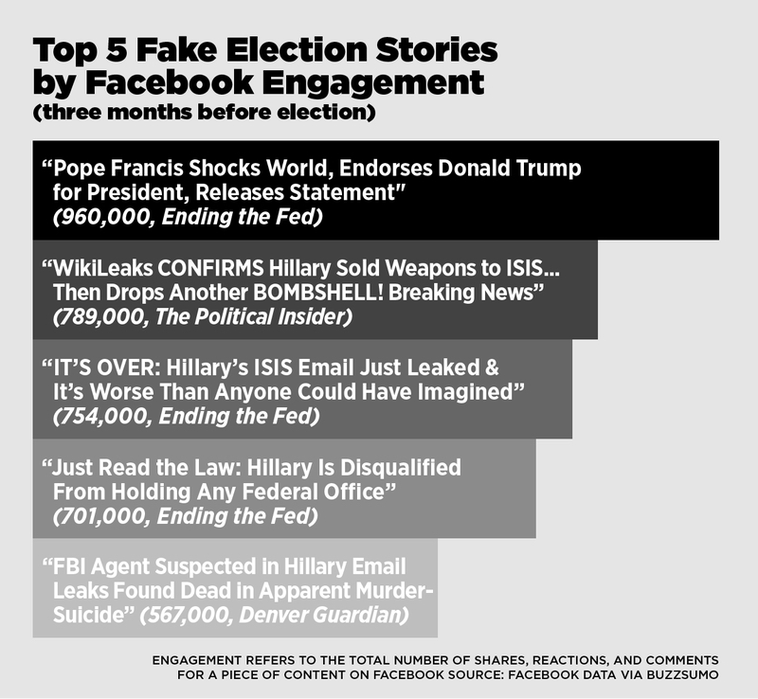
‘Fake news’
‘Fake news’ (Craig Silverman, Buzzfeed News, 2016)
‘fake news websites that only publish hoaxes’
‘hyperpartisan websites that present themselves as publishing real news’
‘misinformation’ (quoting expert)
e.g., Clinton sold weapons to ISIS; and the pope endorsed Trump
Ending the Fed: 'remarkably successful, utterly untrustworthy site', 'does not publicly list an owner or editor' (Silverman)
Denver Guardian: imposter newspaper

Slide 12
Politicising ‘fake news’ with broad definition (Silverman)
• Imposter: Sources feigning to be a news organisation or advocacy group. Terms include ‘pink slime’ - “low-cost, automated news website with a political interest” [Bengani, 2020] and ‘front group’ - "purports to represent one agenda while in reality serves another" [Source Watch, 2015].
• Disinformation: Sources deliberately publishing false information, matter-of-factly, often with harmful intention, and occasionally part of a network or influence campaign.
• Conspiracy: Sources dedicated to propagating a range of explanations to events behind which are often complex, secret plots and multiple actor entanglements.
• Hyper-partisan: Extremely coloured and “openly ideological web operations” reporting or commentary from a far end of the political spectrum [Herrman, 2016].
• Tendentious: Coloured, ‘shocking’, controversial, or ironic reporting from one side of the political spectrum.
• Mainstream: Major public and commercial outlets, including print and TV (and their web presences), also referred to as mass media.
• Other mainstream include sports, lifestyle, etc. but also local news.

Slide 13
Depoliticising ‘fake news’ with narrow definition (Facebook)
• Imposter: Sources feigning to be a news organisation or advocacy group. Terms include ‘pink slime’ - “low-cost, automated news website with a political interest” [Bengani, 2020]) and ‘front group’ - "purports to represent one agenda while in reality serves another" [Source Watch, 2015].
• Disinformation: Sources deliberately publishing false information, matter-of-factly, often with harmful intention, and occasionally part of a network or influence campaign.
• Conspiracy: Sources dedicated to propagating a range of explanations to events behind which are often complex, secret plots and multiple actor entanglements.
• Hyper-partisan: Extremely coloured and “openly ideological web operations” reporting or commentary from a far end of the political spectrum [Herrman, 2016].
• Tendentious: Coloured, ‘shocking’, controversial, or ironic reporting from one side of the political spectrum.
• Mainstream: Major public and commercial outlets, including print and TV (and their web presences), also referred to as mass media.
• Other mainstream include sports, lifestyle, etc. but also local news.

Slide 14
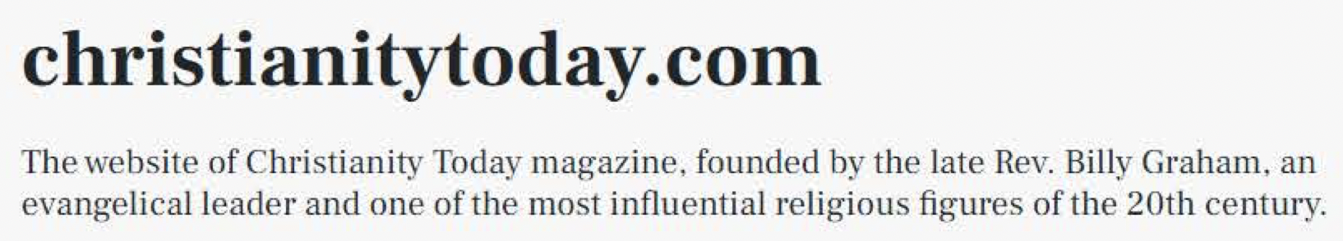
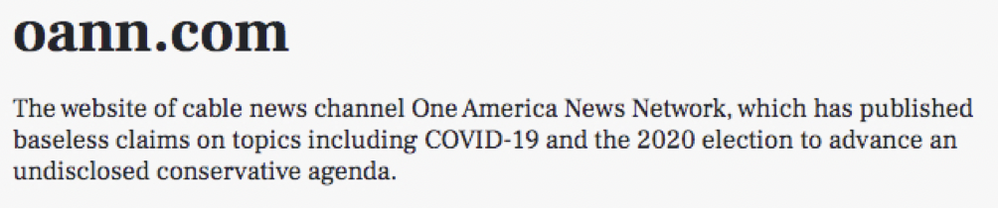
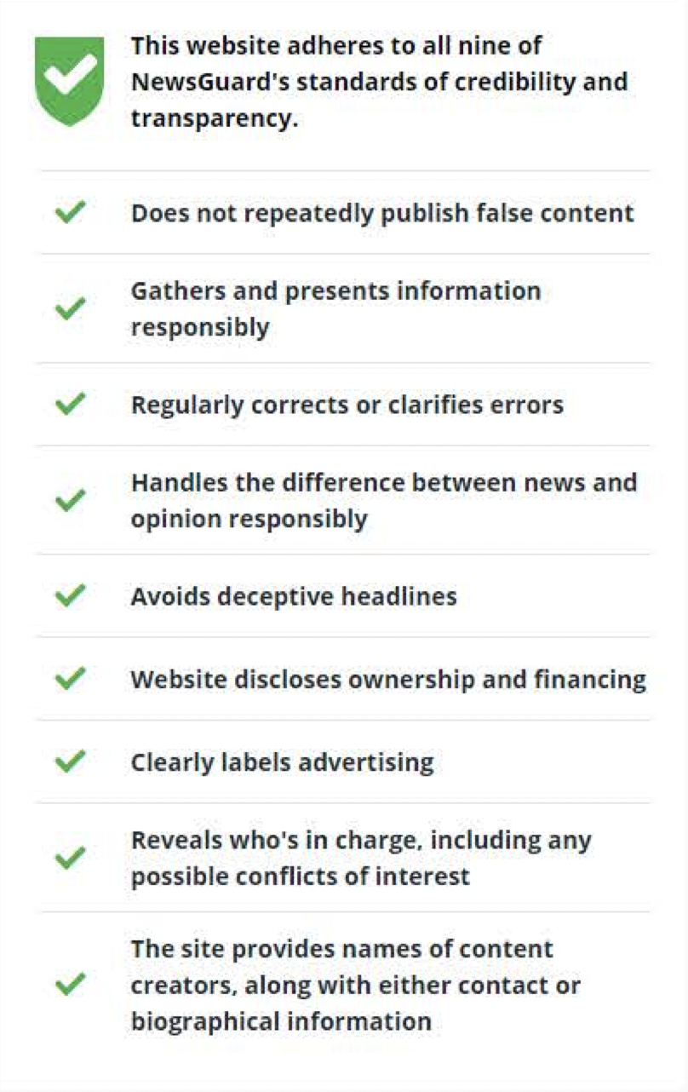
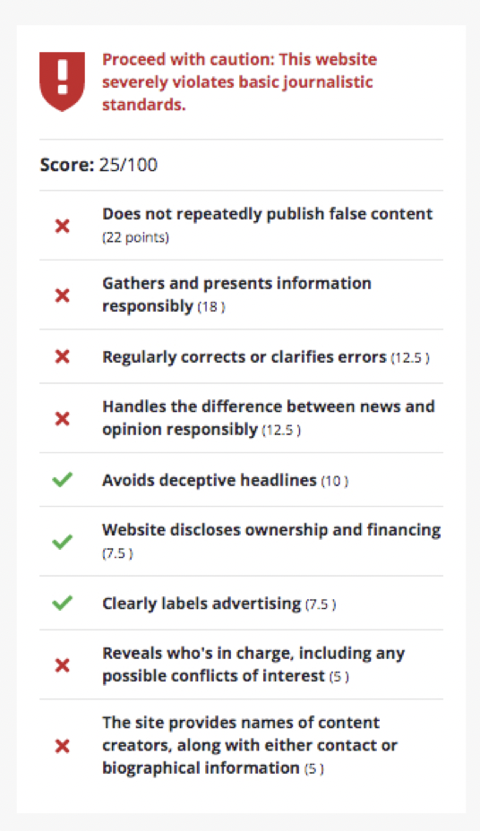
How to decide on a ‘news’ source?
Journalistic standards built into
‘nutrition label’ approach by NewsGuard
Misinformation as (politicised) classification problem
Source: newsguardtech.com, 2021.

Slide 15
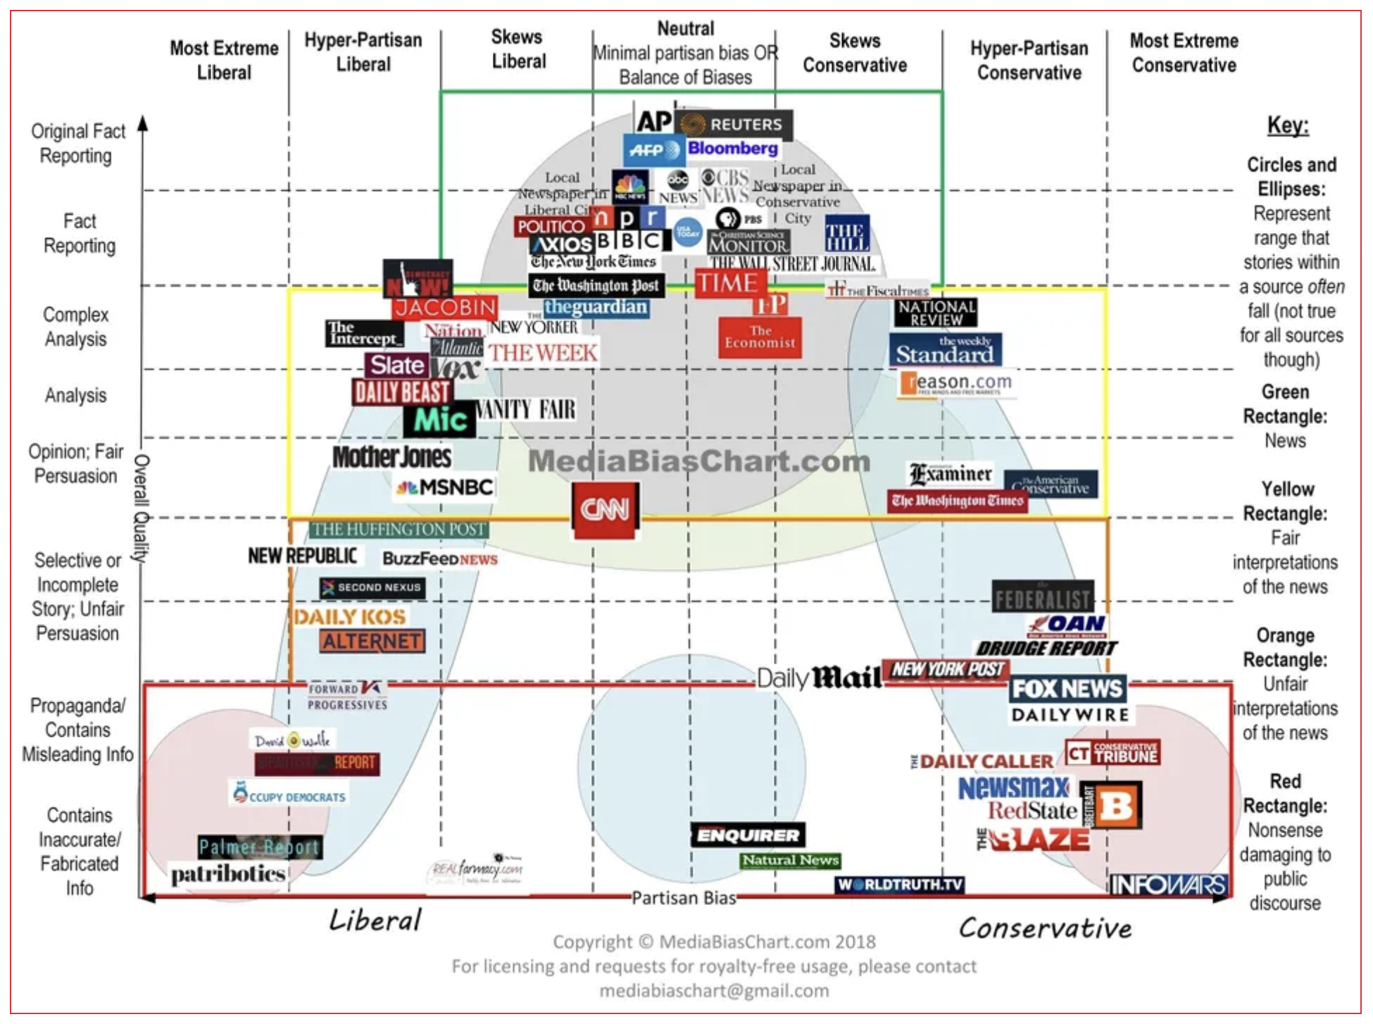
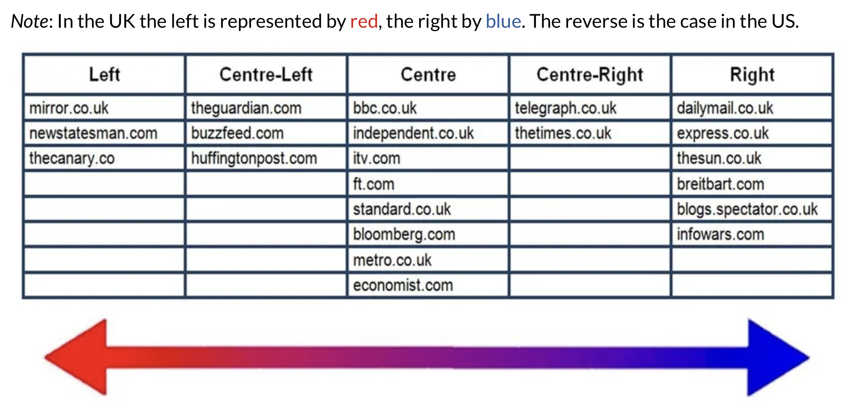
How to decide on a ‘hyper-partisan’ ‘news’ source?
Misinformation as (politicised) classification problem
Source: fightingfake.org.uk, 2021.
Source: mediabiaschart.org, 2018.

Slide 16
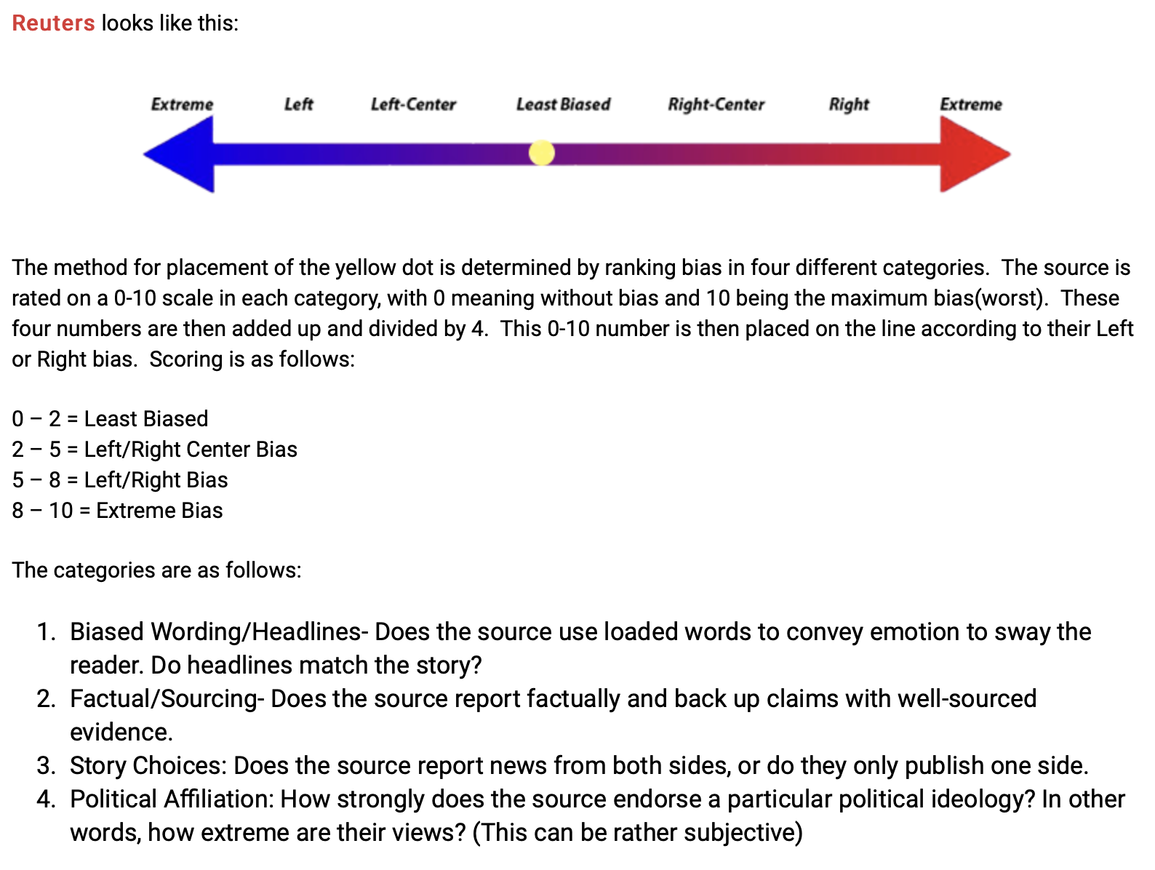
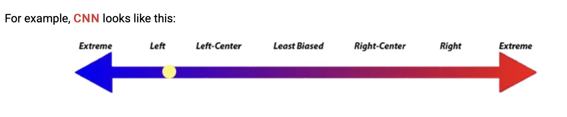
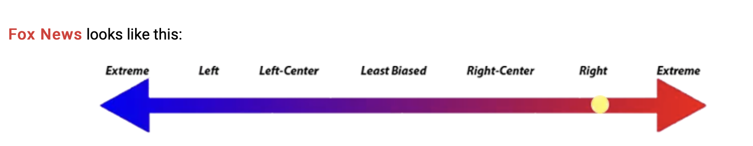
How to decide on a ‘hyperpartisan’ source?
Misinformation as (politicised) classification problem
Source: mediabiasfactcheck.com, 2021.

Slide 17
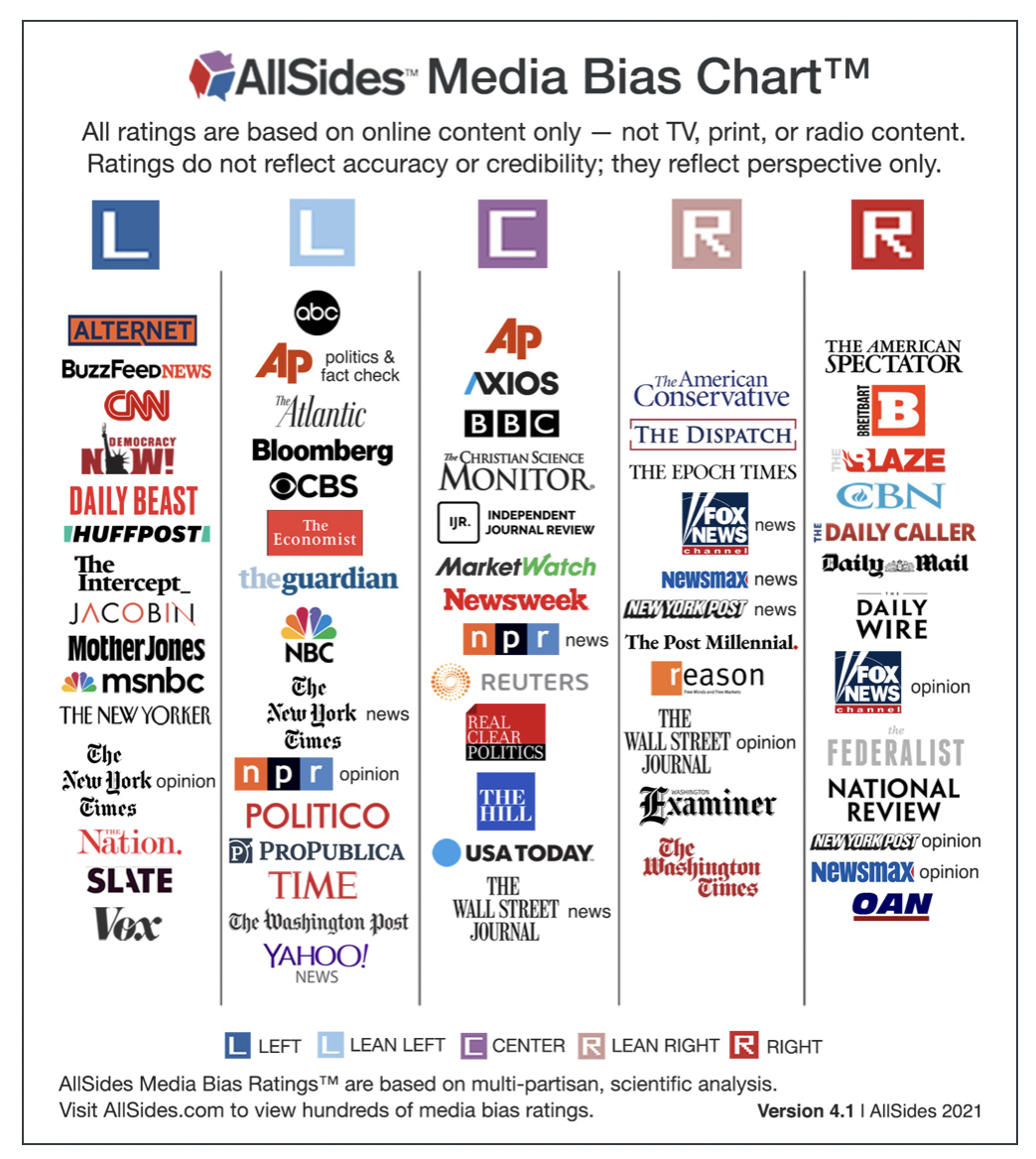
How to decide on a ‘hyper-partisan’ source?
Misinformation as (politicised) classification problem
Note the differentiation between New York Times news and opinion on allsides.com and its different classification on allsides.com and mediabiaschart.org, implying (1) a story-level rather than source-level approach as well as (2) the need to triangulate from multiple, quality classification schemes.
Source: mediabiaschart.org, 2018.
Source: allsides.com, 2021.

Slide 18
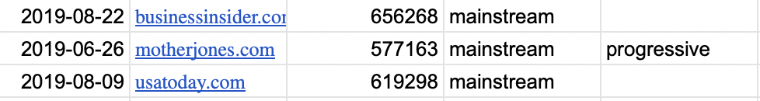
Classify sources (story-level):
Apply source classifications from combination of allsides.com, mediabiasfactcheck.com, newsguardtech.com and mediabiaschart.com
Two-level classification (mainstream vs. problematic) and for mainstream (hyper-partisan conversative/hyper-partisan progressive)

Slide 19
Research question:
To what extent does ‘fake news’ (or misinformation) resonate in political spaces across social media in the run-up to the presidential election in the U.S.?
We can also:
1. Compare scale of the ‘fake news problem’ between 2016 (Silverman) and 2020
2. Compare scale of the problem using broad and narrow definitions of ‘fake news’
3. Compare amount of ‘fake news’ when differentiating between hyper-partisan conversative vs. hyper-partisan progressive and thus discuss the politicisation of ‘fake news’

Slide 20
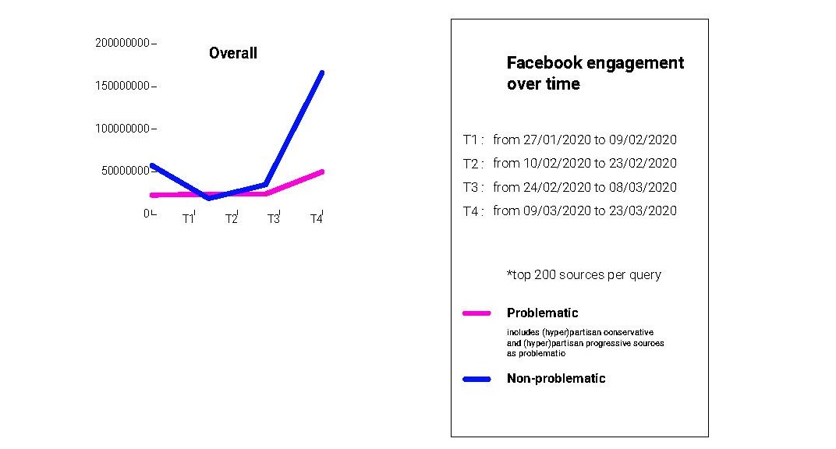
The scale of Facebook's problem depends upon how ‘fake news’ is classified
  The 'fake news' problem around the US elections as observed in 2016 has worsened on Facebook in 2020. In the early months in 2020 the proportion of user engagement with ‘fake news’ to mainstream news stories is 1:3.5, compared to 1:4 during the same period in 2016.
1Q 2016
1Q 2020

Slide 21
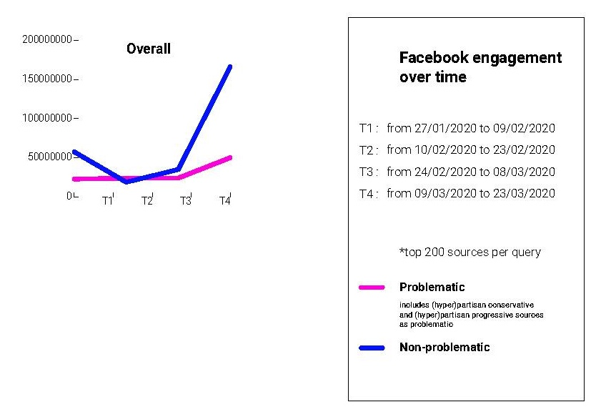
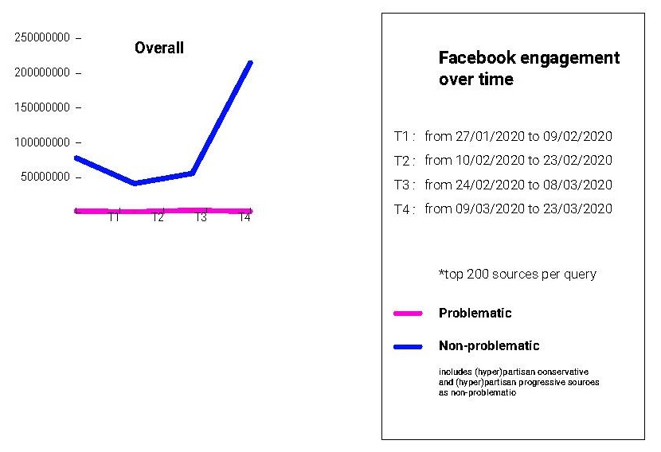
The scale of Facebook's problem depends upon how ‘fake news’ is classified
  If one applies a stricter definition of 'fake news' such as only imposter news and conspiracy sites (thereby removing hyperpartisan sites as in Silverman’s definition), mainstream sources outperform ‘fake’ ones by a much greater proportion.
Original (roomy) definition of fake news
Narrow definition of fake news

Slide 22
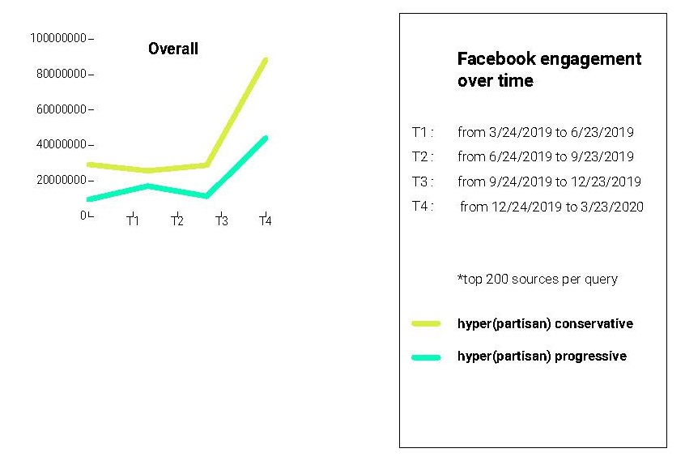
The scale of Facebook's problem depends upon how ‘fake news’ is classified
  Given there are more hyperpartisan conservative sources engaged with than hyperpartisan progressive ones, the research points to how considerations of what constitutes 'fake news' may be politicized.
Method note: Findings made on the basis of Facebook user engagement of the top 200 stories returned for queries for candidates and social issues. Based on existing labelling sites, the stories and by extension the sources are classified along a spectrum from more to less problematic and partisan.

Slide 23
The scale of Facebook's problem depends upon how ‘fake news’ is classified -
Implications
  Narrow classification of ‘fake news’ could depoliticize and also provide opportunities for smaller scale means to address issue (fact-checking) compared to larger scale problem (automated, big data approaches)
  Narrow or broad classifications imply a ‘politics of demarcation’ in the sense that with the narrow one Facebook would be less culpable in mainstreaming the fringe and with the broad the conservative sources are labelled as ‘fake’.

Slide 24
References:
Silverman, Craig (2016) ‘This Analysis Shows How Viral Fake Election News Stories Outperformed Real News On Facebook,’ Buzzfeed News, 16 November.
Herrman, John (2016) ‘Inside Facebook’s (Totally Insane, Unintentionally Gigantic, Hyperpartisan) Political-Media Machine,’ New York Times, 24 August.
Further Reading:
Rogers, Richard and Niederer, Sabine (eds.) (2020) The Politics of Social Media Manipulation. Amsterdam: Amsterdam University Press.
Rogers, Richard (2020) ‘The scale of Facebook’s problem depends upon how “fake news” is classified,’ The Harvard Kennedy School Misinformation Review, 1(6), October, doi: https://doi.org/10.37016/mr-2020-43
Rogers, Richard (2021) ‘Marginalising the mainstream: How social media privilege political information,’ Frontiers in Big Data, 4(689036), doi: 10.3389/fdata.2021.689036.

