Slide 1
Multinomial logistic regression
Part 2: Multiple multinomial regression
Dr Heini Väisänen
University of Southampton

Slide 2
Outline
Multinomial logistic regression model with more than one explanatory variable
Model selection
  Likelihood ratio tests
  Wald-tests

Slide 3
Multiple multinomial logistic regression
In the first video we only used one explanatory variable in our model
However, in most applications we will want to ‘control’ for other variables while examining the others
I will show how to include, interpret and check the statistical significance of the variables in such situations

Slide 4
Example: the association between economic activity, gender, age and marital status
Outcome economic activity has three categories
  Economically inactive
  Unemployed
  In employment

Slide 5
Distribution of the variables
Employment status | N | %
Economically inactive | 442 | 39.32
Unemployed | 55 | 4.89
In employment | 627 | 55.78
Total | 1,124 | 100.0
Gender | N | %
Man | 516 | 45.91
Woman | 608 | 54.09
Total | 1,124 | 100.0
Data source: University of Manchester. Cathie Marsh Centre for Census and Survey Research. ESDS Government, ONS Opinions Survey, Well-Being Module, April 2011: Unrestricted Access Teaching Dataset [computer file]. 2nd Edition. Office for National Statistics. Social Survey Division, [original data producer(s)]. Colchester, Essex: UK Data Archive [distributor], October 2012. SN: 7146.

Slide 6
Distribution of the variables
Age (years) | N | %
16-24 | 89 | 7.92
25-44 | 388 | 34.52
45-54 | 169 | 15.04
55-64 | 184 | 16.37
65-74 | 151 | 13.43
75+ | 143 | 12.72
Total | 1,124 | 100.0
Marital status | N | %
Married or cohabiting | 609 | 54.18
Single | 243 | 21.62
Widowed or divorced | 272 | 24.20
Total | 1,124 | 100.0
Data source: University of Manchester. Cathie Marsh Centre for Census and Survey Research. ESDS Government, ONS Opinions Survey, Well-Being Module, April 2011: Unrestricted Access Teaching Dataset [computer file]. 2nd Edition. Office for National Statistics. Social Survey Division, [original data producer(s)]. Colchester, Essex: UK Data Archive [distributor], October 2012. SN: 7146.

Slide 7
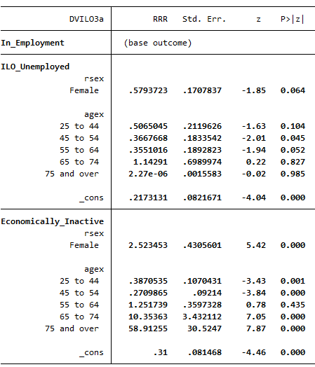
Step 1: add age

Slide 8
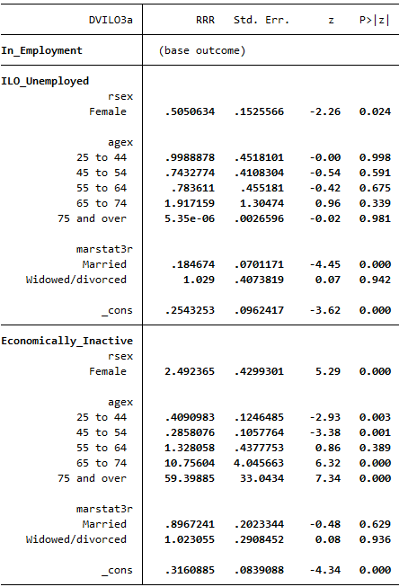


Step 2: add marital status

Slide 9
Example: association between marital status and unemployment
Outcome | Marital status | OR | P-value
Un-employed | Single | 1.00
 | Married/ cohabiting | 0.18 | <0.001
 | Widowed/ divorced | 1.03 | 0.942
Eco-nomically Inactive | Single | 1.00
 | Married/ cohabiting | 0.90 | 0.629
 | Widowed/ divorced | 1.02 | 0.936
When controlling for age and gender, married people have 82% lower odds (0.18 times the odds) of being unemployed rather than employed than single people. The pairwise association is significant (p<0.001)

Slide 10
Example: association between marital status and unemployment
Outcome | Marital status | OR | P-value
Un-employed | Single | 1.00
 | Married/ cohabiting | 0.18 | <0.001
 | Widowed/ divorced | 1.03 | 0.942
Eco-nomically Inactive | Single | 1.00
 | Married/ cohabiting | 0.90 | 0.629
 | Widowed/ divorced | 1.02 | 0.936
When controlling for age and gender, widowed or divorced people have 0.3% higher odds (1.03 times the odds) of being unemployed rather than employed than single people. The pairwise association is not statistically significant at any conventional level of significance.

Slide 11
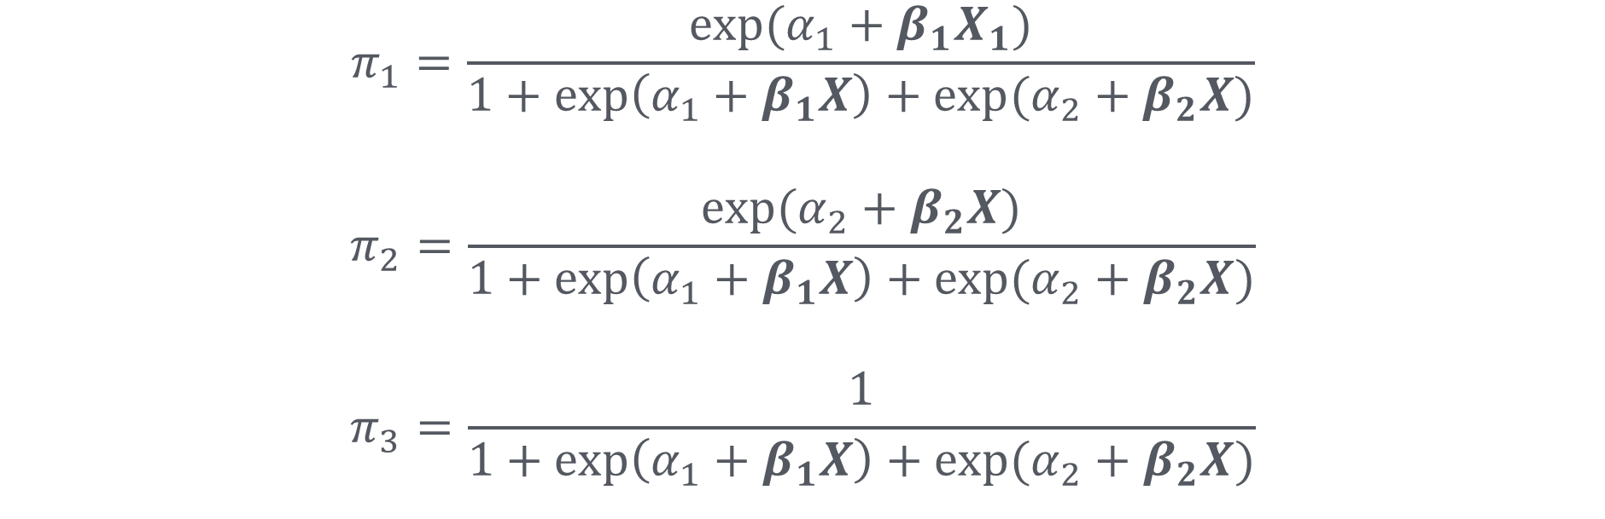
Interpretation using predicted probabilities
$$π_{1}=\frac{exp⁡(α_{1}+β_{1}X_{1})}{1+\exp\left(α_{1}+β_{1}X\right)+exp⁡(α_{2}+β_{2}X)}$$
$$π_{2}=\frac{exp⁡(α_{2}+β_{2}X)}{1+\exp\left(α_{1}+β_{1}X\right)+exp⁡(α_{2}+β_{2}X)}$$
$$π_{3}=\frac{1}{1+\exp\left(α_{1}+β_{1}X\right)+exp⁡(α_{2}+β_{2}X)}$$
The reference category

Slide 12
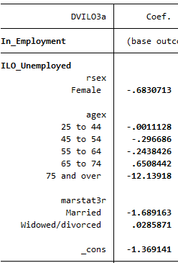
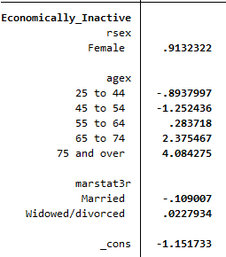
Calculating predicted probabilities
Log-odds plugged into the formulae (see extract here)
Usually software used, for instance margins command in Stata
  See computer workshop materials

Slide 13
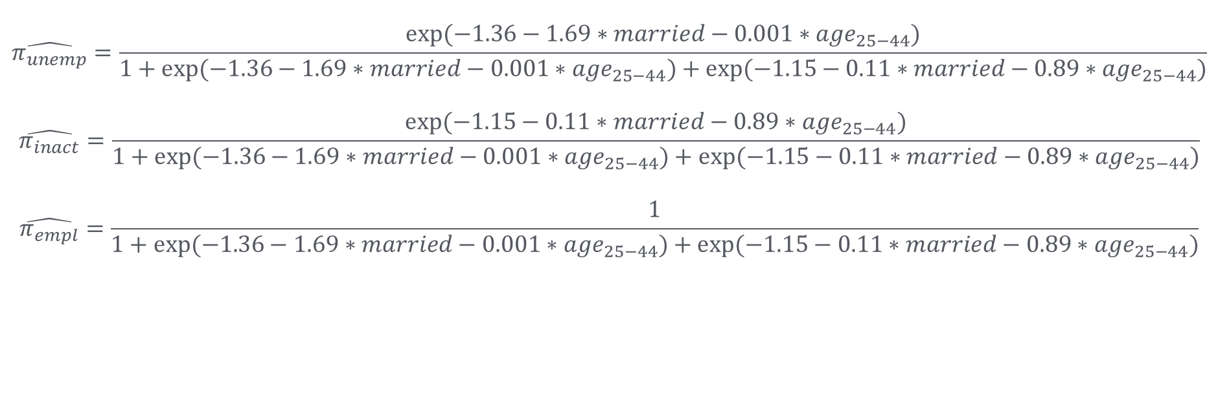
Economic activity and marital status, probabilities for married men aged 25-44 years.
$$\hat{π_{unemp}}=\frac{exp⁡(−1.36−1.69∗married−0.001∗{age}_{25−44})}{1+exp⁡(−1.36−1.69∗married−0.001∗{age}_{25−44})+exp⁡(−1.15−0.11∗married−0.89∗{age}_{25−44})}$$
$$\hat{π_{inact}}=\frac{exp⁡(−1.15−0.11∗married−0.89∗{age}_{25−44})}{1+exp⁡(−1.36−1.69∗married−0.001∗{age}_{25−44})+exp⁡(−1.15−0.11∗married−0.89∗{age}_{25−44})}$$
$$\hat{π_{empl}}=\frac{1}{1+exp⁡(−1.36−1.69∗married−0.001∗{age}_{25−44})+exp⁡(−1.15−0.11∗married−0.89∗{age}_{25−44})}$$

Slide 14
Interpretation using predicted probabilities
Predicted probabilities of employment status by marital status for men aged 25-44.
Married men aged 25-44 have a 86% probability of being employed. Both single and divorced/widowed men in this age group have 72% of being employed. Unemployment is the least likely among married men (4%) compared to almost a 20% probability among the other two groups.
 | Employed | Unemployed | Inactive
Married | 86% | 4% | 10%
Single | 72% | 18% | 9%
Divorced etc. | 72% | 19% | 9%

Slide 15
Model selection
How do we know which variables should be included in the model?
  Theory and background knowledge (as always).
  Likelihood ratio test.

Slide 16
Summary
Multinomial regression used for categorical responses with 3 or more categories (that are not ordered)
Interpretation can be conducted with log-odds, odds ratios or predicted probabilities like for any logistic model
  Odds can get tricky especially for dummy-variables due to multiple comparisons.
  Probabilities can be easier to understand, but need to hold other variables constant at certain values.

Slide 17
Thank you!

