Slide 1
Multinomial logistic regression
Part 1: Introduction
Dr Heini Väisänen
University of Southampton

Slide 2
Outline
Categorical response variables
Multinomial logistic regression model
Interpretation of parameters
  Example: a study of economic activity

Slide 3
Categorical response variables
Often we have a categorical response Y with R ≥ 3 (unordered) categories.
Examples of such outcomes:
  Voting intention (Conservative, Labour, Liberal Democrats, or other).
  Cause of death (e.g. different types of cancer)

Slide 4
Multinomial logistic regression: the basics
Idea: Extension of (binary) logistic regression – use separate logit model for each pair of response categories.
If Y has R categories, there are R(R-1) possible pairwise log-odds.
However, we only need R-1 of these.
  For 3 categories, 3*(3-1)=6 possibilities
  (1,2 1,3 2,3 2,1 3,1 3,2)
  but we only need to model two pairs.

Slide 5
Multinomial logistic regression: interpretation
Interpretation of any log-odds model depends on which response corresponds to the numerator and the denominator
The category corresponding to the denominator is called the reference or baseline category and is usually:
  the first or last category
  the most ‘meaningful’ category
  the most frequent category
  not a ‘rare’ category

Slide 6
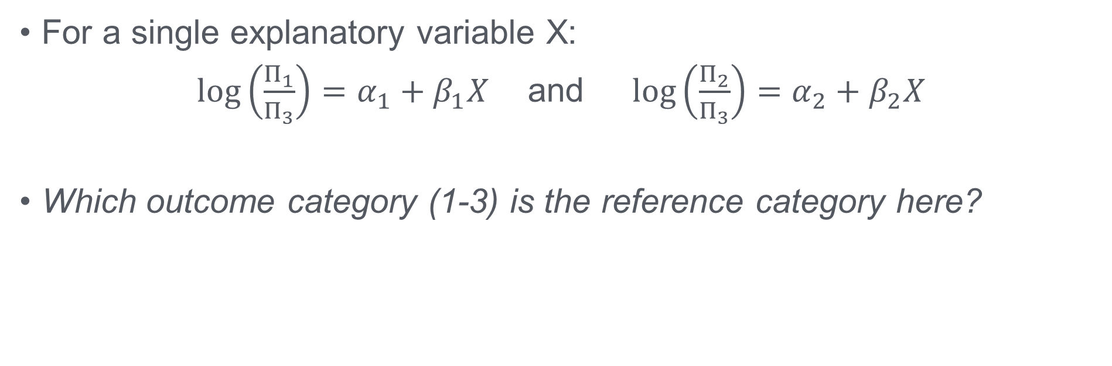
Multinomial logistic regression: interpretation
For a single explanatory variable X:
$\log\left(\frac{Π_{1}}{Π_{3}}\right)=α_{1}+β_{1}X$ and $\log\left(\frac{Π_{2}}{Π_{3}}\right)=α_{2}+β_{2}X$
Which outcome category (1-3) is the reference category here?

Slide 7
Example: the association between economic activity and gender
Outcome economic activity has three categories
  Economically inactive
  Unemployed
  In employment
Our explanatory variable has two categories
  Man
  Woman

Slide 8
Distribution of the variables
Employment status | N | %
Economically inactive | 442 | 39.32
Unemployed | 55 | 4.89
In employment | 627 | 55.78
Total | 1,124 | 100.0
Gender | N | %
Man | 516 | 45.91
Woman | 608 | 54.09
Total | 1,124 | 100.0
Data source: University of Manchester. Cathie Marsh Centre for Census and Survey Research. ESDS Government, ONS Opinions Survey, Well-Being Module, April 2011: Unrestricted Access Teaching Dataset [computer file]. 2nd Edition. Office for National Statistics. Social Survey Division, [original data producer(s)]. Colchester, Essex: UK Data Archive [distributor], October 2012. SN: 7146.

Slide 9
Interpretation of the parameters
Model: log(п₁/п₃)= α₁ +β₁X log(п₂/п₃)= α₂ +β₂X
β₁ is the effect of X on the log-odds of being in category 1 instead of category 3, i.e. ‘binary’ outcome either 1 or 3.
β₂ is the effect of X on the log-odds of being in category 2 instead of category 3, i.e. ‘binary’ outcome either 2 or 3.
Odds ratios can be obtained by calculating exp(β₁) and exp(β₂)
The baseline is category 3 (in employment – the most frequent category).

Slide 10
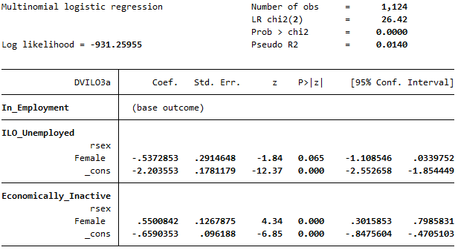
Economic activity and gender, results (Stata)
Notes:
B= log odds
Wald & sig = whether parameter is significant in that pairwise regression (different from whether it is significant in the overall model)
RSEX=1=male

Slide 11
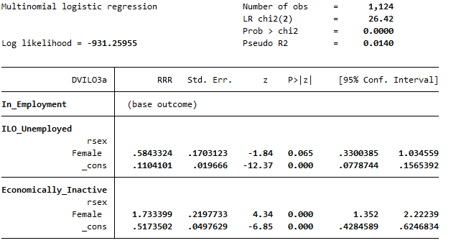
Economic activity and gender, results (odds, Stata)
Notes:
B= log odds
Wald & sig = whether parameter is significant in that pairwise regression (different from whether it is significant in the overall model)
RSEX=1=male

Slide 12
Economic activity and gender, interpretation (odds)
The odds of being economically inactive rather than in employment are 73% higher for women than for men.
  (exp(0.550)-1)*100 = 73.3%
The odds of being economically inactive rather than in employment are 42% lower for women than for men.
  (exp(-0.537)-1)*100 = -41.6%

Slide 13
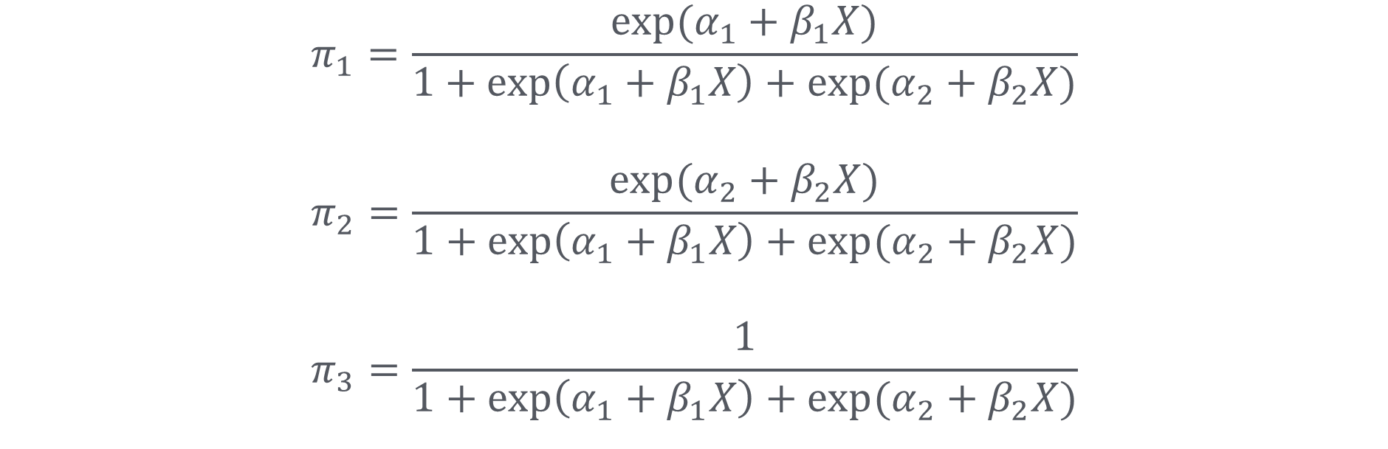
Economic activity and gender, interpretation (probabilities)
$$π_{1}=\frac{exp⁡(α_{1}+β_{1}X)}{1+\exp\left(α_{1}+β_{1}X\right)+exp⁡(α_{2}+β_{2}X)}$$
$$π_{2}=\frac{exp⁡(α_{2}+β_{2}X)}{1+\exp\left(α_{1}+β_{1}X\right)+exp⁡(α_{2}+β_{2}X)}$$
$$π_{3}=\frac{1}{1+\exp\left(α_{1}+β_{1}X\right)+exp⁡(α_{2}+β_{2}X)}$$
The reference category

Slide 14
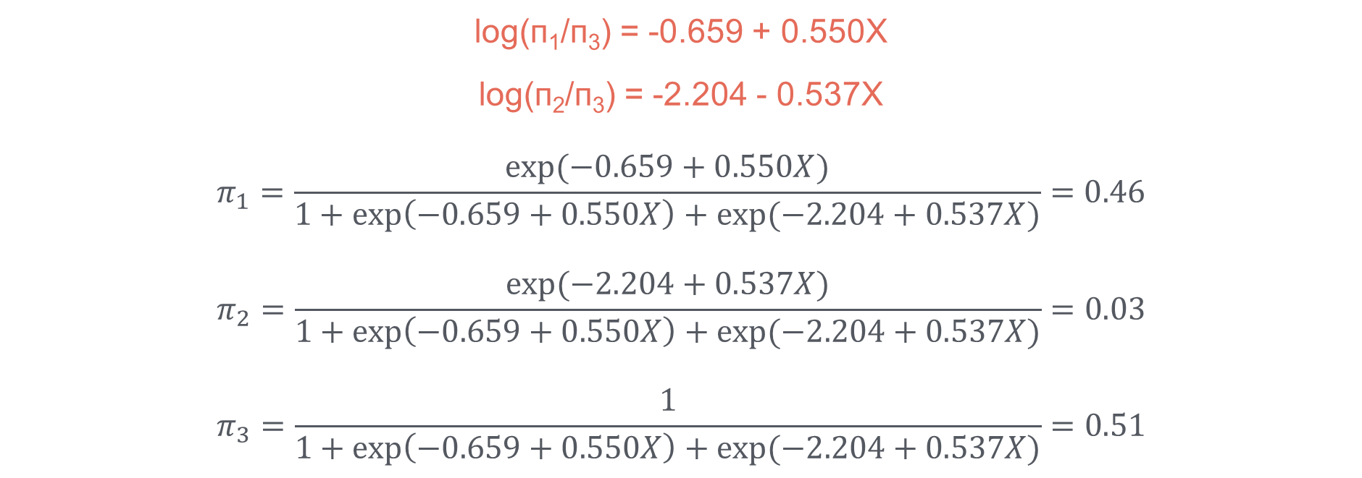
Economic activity and gender, interpretation (probabilities for women)
Economically inactive
log(п₁/п₃) = -0.659 + 0.550X
log(п₂/п₃) = -2.204 - 0.537X
$$π_{1}=\frac{exp⁡(−0.659+0.550X)}{1+\exp\left(−0.659+0.550X\right)+exp⁡(−2.204+0.537X)}=0.46$$
$$π_{2}=\frac{exp⁡(−2.204+0.537X)}{1+\exp\left(−0.659+0.550X\right)+exp⁡(−2.204+0.537X)}=0.03$$
$$π_{3}=\frac{1}{1+\exp\left(−0.659+0.550X\right)+exp⁡(−2.204+0.537X)}=0.51$$
Unemployed

Slide 15
Economic activity and gender, interpretation (probabilities)
Among women, the probability of being economically inactive was 46%, in employment 51% and unemployed 3%.
Among men, the probability of being economically inactive was 32%, in employment 61% and unemployed 7%.

Slide 16
Thank you!

