Slide 1
Introduction to Mixture and Group-Based Trajectory models
(part 3)
Dr Oliver Perra
National Centre for Research Methods
Full tutorial, and contact: https://www.ncrm.ac.uk/resources/online/all/?id=20826

Slide 2
Outline
Growth Mixture Models (GMM) and Latent Class Growth Analysis (LCGA)
  Adding covariates:
    Time Invariant & Time Varying
    Cumulative risk
  Include distal outcomes
  Advanced models:
    Dual trajectory models
    Multiple trajectory models
Notes:
First, I will provide an example of a research problem to illustrate what LTA can do.
I will then illustrate the purposes of LTA.
I will emphasise how LTA is basically a person-centred approach to investigate change across time:
It allows to specify measurement models at each time point that represent the different types or groups of participants in a study, and then to investigate how individuals move from one group to another across time, that is, structural changes across time.

Slide 3
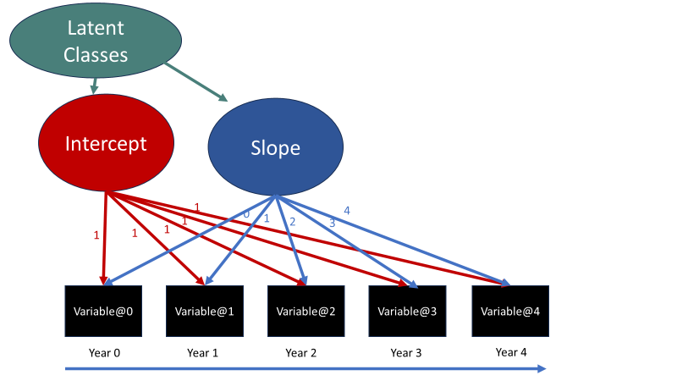
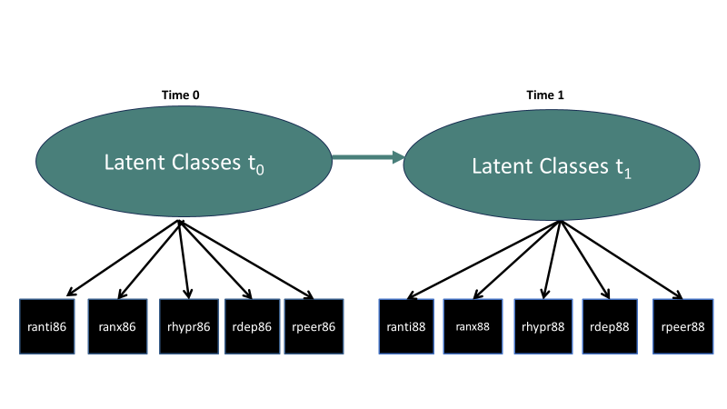
Trajectory-Based Groups vs. Latent Transition
Notes:
I wanted to outline key differences between trajectory-based models and another type of mixture model for longitudinal model, latent transition analysis, and I have also prepared a presentation on LTA for NCRM.
The key difference is that trajectory-based group models represent groups that differ qualitatively in their behaviour over a period of time. In other words, latent classes in trajectory-based group models represent distinct patterns of change that happens over a period of time, in the example on the left over a period of 5 years. Latent Transition analysis instead represent qualitative changes in patterns of responses that happen at each specific measurement occasion. So, Trajectory-Based group models are more akin for investigating individual differences developmental patterns that unfold over a significant period of time, LTA is more adequate to investigate stadial developmental models, models where individuals are supposed to move across different stages of development.

Slide 4
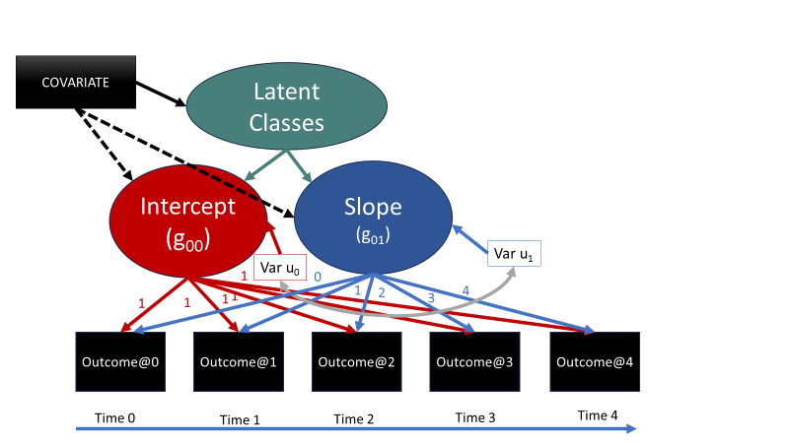
Adding covariates: GMM
Covariates can influence Latent Class affiliation;
They can also influence intra-class growth parameters.
Notes:
In the previous presentations I have introduced the key characteristics of GMM and LCGA. In the second presentation I have provided a more formal description of the models, focusing in particular on cases where we deal with ordered categorical variables. The GMM and LCGA models however can be run with any type of variables, from continuous to nominal.
One of the main purposes of these models is to investigate predictors and covariates that may influence the probability of being in one trajectory group. For example, does family separation affects the probability of adolescents being in a chronic drug use trajectory group?
When we introduce these covariates, since latent classes are nominal variables, i.e. they are not ordered, we run multinomial logistic regressions of the latent classes on the covariates. In the exercises there are examples of how to introduce covariates and interpret the results.
However, since the GMM allows individual variability around the growth parameters within classes, the covariates can also influence intra-class individuals’ variation around the intercept and slopes. For example, within adolescents that show a chronic trajectory of drug use, the specific trajectory of an adolescent within this group may be affected negatively by parental separation and the increase in drug use may be more dramatic for those adolescents that within the chronic use group were exposed to family separation.
In this case models with covariates can be more complex and explore more nuances in mechanisms of influence.
The models can be more complex.

Slide 5
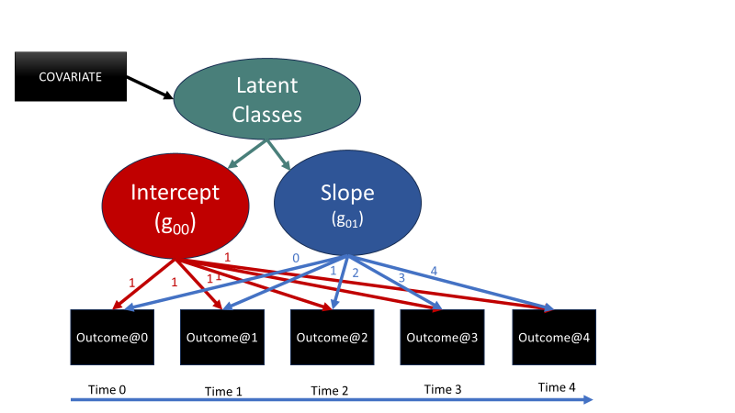
Adding covariates: LCGA
No intra-class variability in growth parameters.
Covariates can influence Latent Class affiliation;
Notes:
In the case of LCGA the intra-class intercepts and slopes are constant, there is no individual variation around the class-specific growth parameters. When we introduce covariates thus, we estimate how covariates influence latent class affiliation, the probability of being in one trajectory group or another. Once again, these associations are modelled by multinomial logistic regressions of latent classes on covariates.

Slide 6
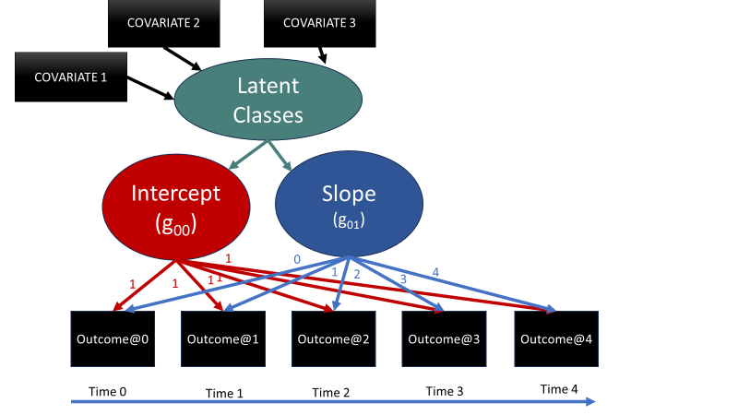
Adding covariates: Cumulative Risk
Association between latent classes and covariates investigated using multinomial logistic regressions.
These allow to calculate probability of being in trajectory groups for different configurations of covariates
Notes:
We can introduce different covariates of interest as predictors of trajectory groups where we estimate the multinomial logistic regression of the latent classes on the covariates. One appealing feature of this method lies in the possibility to calculate probabilities for different configurations of covariates, and there are some exercises on this. This allows to test hypotheses on the role that the cumulative exposure to some risk factors has on trajectory groups.

Slide 7
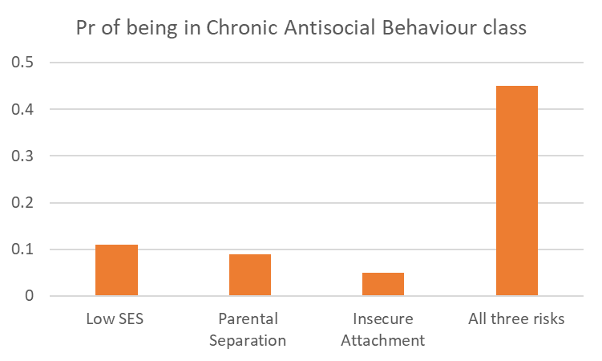
Adding covariates: Cumulative Risk
Association between latent classes and covariates investigated using multinomial logistic regressions.
These allow to calculate probability of being in trajectory groups for different configuration of covariates.
Notes:
Here I display a fictional example, where the vertical axis represents the probability of adolescents being in a chronic antisocial behaviour trajectory group. In this example, the probability of being chronically antisocial is relatively low if adolescents are exposed to only one of these risk factors, low SES, parental separation, insecure attachment. But if adolescents are exposed to all three factors over time, the risk of being in the chronically antisocial trajectory group is significantly higher.

Slide 8
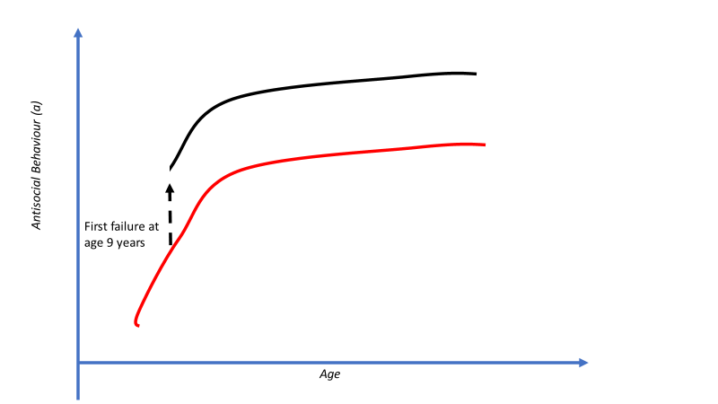


Adding covariates
Covariates can be time-invariant or time-varying.
  E.g.: Nagin et al. (2003) investigated whether school failure (i.e. grade retention) affected child’s trajectory of violent behaviour in adolescence.
  Individual’s i y* score indexed by time and latent class k affiliation:
  $y_{kti}^{∗}$ =$g_{k0}{ +g}_{k1} Aget$ ${ +g}_{k1} Aget$² + a_{1k} Failure_{y6-10} + a2_{k} Failure_{y11-12} + a3_{k} Failure_{y13-15}
Notes:
In many examples and applications covariates used in trajectory-based group models are invariant, for example represent events that happened before the study started. It is however possible to include time-varying covariates. Here I refer to a study by Nagin and colleagues, and the QR code links to this publication. The researchers investigated trajectories of violent behaviour in adolescence, and tested if school failure, which in Quebec where the study was conducted lead to grade retention, was associated with changes in the expected trajectory. Here I described the equation devised by the authors, where the latent response y* displays a quadratic trajectory across participants’ age, the age parameters here, and there way additional parameters for the effect of failing school for the first time between age 6 and 10, failing school for the first time between age 11 and 12, or failing school for the first time between age 13 and 15. Note that the parameters have indexes for different latent classes k estimated, so the effects of these covariates varied across classes, or, in other words, individuals across classes had different trajectories, as well as displaying differences in the effects of school failure.
The graph represents the potential effect of school failure at an early age, say age 9, on a trajectory. In this example, the effect of school failure is to “elevate” the expected trajectory to a higher level.
This is an example of how time-varying covariates can be included in the model.

Slide 9
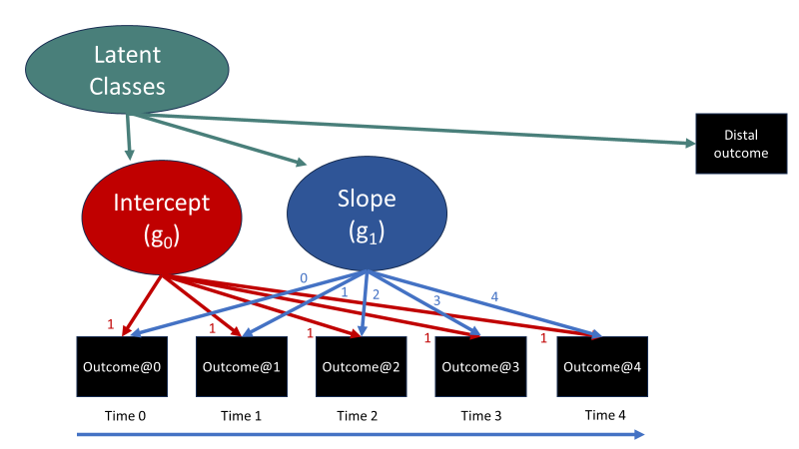
Include Distal Outcomes
The association between Distal Outcome(s) and Latent Classes can be estimated simultaneously with the Growth Mixture or LCGA model.
In this case, the latent class is taking into account the heterogeneity in the distal outcome and other indicators.
This issue can be resolved using Three-Step Approach
Notes:
Another key interest when we use these approaches lies in testing if trajectory groups differ in their distal outcomes or achievements.
It is easy to include distal outcomes in the models, and the exercises provide an example.
However, when we introduce distal outcomes, we introduce further observed variables that vary together. This means that the latent classes are not just modelling the heterogeneity we observe in the observed variables and their trajectories, but also the heterogeneity of these and the distal outcome. Consequently, this means that often the latent class model we had estimated without including distal outcomes will change, and we will have to re-check the latent class model to see how much it has changed and how.
This is often impractical, but also requires some caveats in interpreting the results.
A solution to this problem had been to consider individuals’ latent class affiliation in trajectory groups as variables that could be used as predictors in other analyses, e.g. ANOVAs. The problem with this approach is that latent class affiliations are uncertain, and in the first presentation I gave an example of how one individual could be assigned to one latent class when this individual could have, say 50% probability of being in that class. If we fail to take into account this uncertainty, the analyses we run are biased. An elegant solution to this problem has been provided by the three-step approach.

Slide 10
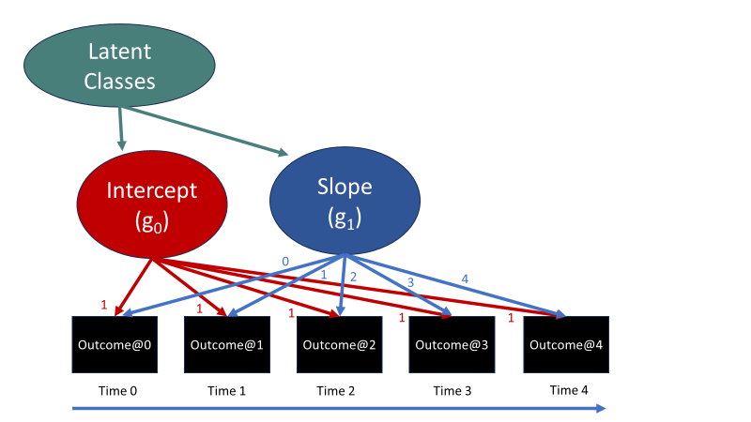
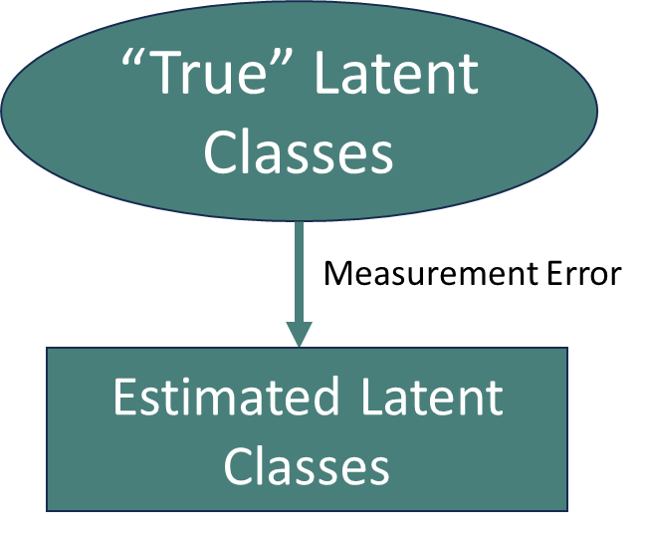
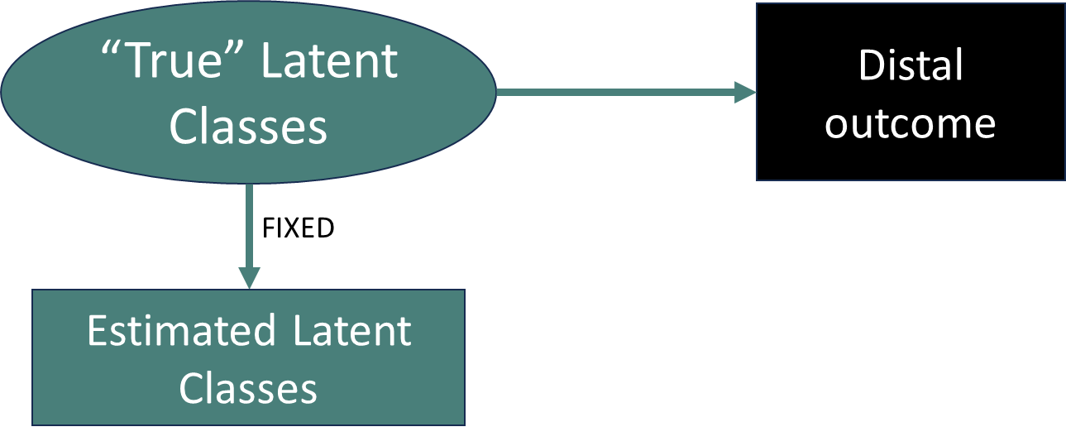
Include Distal Outcomes: Three-Step Approach
    Step 1: Estimate model and assign individuals to most likely class.
    Step 2: Estimate measurement error (i.e. uncertainty in class allocation).
    Step 3: Impose relationships between classes and covariates/distal outcomes, while controlling for uncertainty in class allocation
Notes:
The advantage of the approach lies in separating the step where we estimate latent class affiliations from the step where we impose associations between latent classes and covariates or distal outcomes (or both).
The first step is to estimate the model and decide the number of classes as well as estimate the most likely class of each participant, based on their posterior probability.
The second step involves calculating parameters that represent the uncertaintiy in this latent class allocation, and these parameters are log-odds of being in the assigned latent class rather than another one.
Once we have estimated the most likely class and the parameter that summarises uncertainty around this allocation, we can include the latent class allocation as a variable in the analyses, making sure we feed the calculated uncertainty parameter into the model, thus controlling for this uncertainty. In the online material I provide more details and examples.
This approach however is not adequate if covariates have direct effects on the measurement parameters.

Slide 11
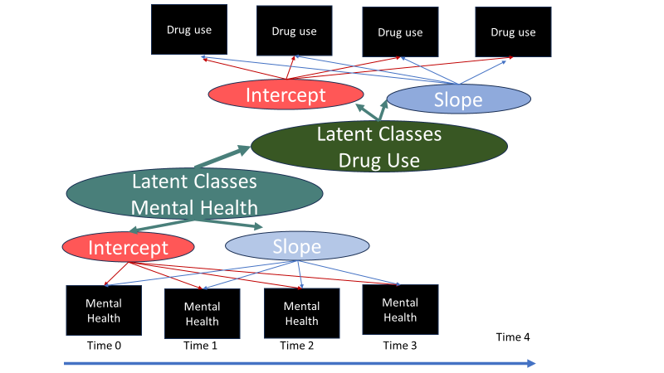
Dual Trajectory Models
Investigate inter-individual variability in development of two related processes (e.g.: Drug use and mental health).
Notes:
Often we are also interested in investigating the associations between trajectories in different proceses, for example mental health and drug use. Using trajectory-based models, we model individual differences in trajectories across the two processes, and we can then test the associations between trajectory groups in one e.g. mental health, and trajectory groups in the other, drug use. In this case one process, mental health, happens slightly before drug use. This type of model would create cross-tabs where we can test if those that show chronic mental health problems are significantly more likely to fall in a chronic drug use trjaecotry group. We can also test hypotheses about these associtions by restricting some of these probabilities between latent classes.

Slide 12
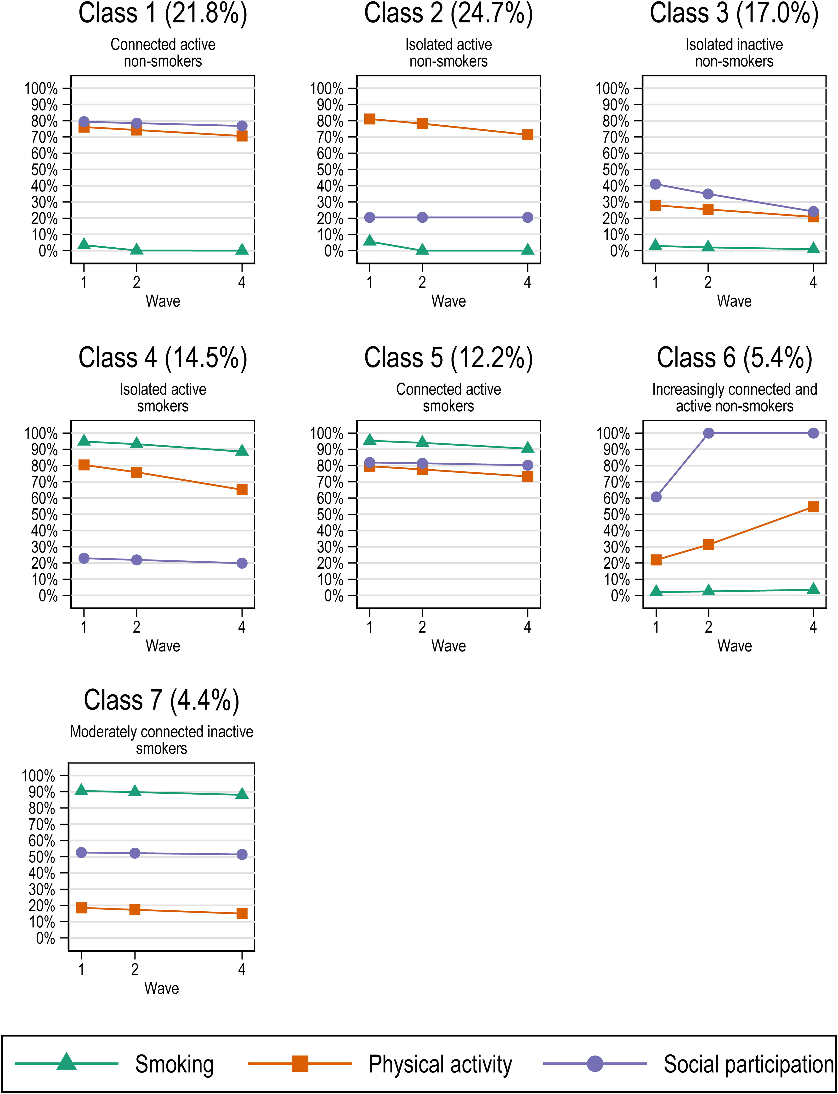

Multi-Trajectory Models
The models can be extended to represent trajectories of different behaviours.
E.g.: Feng et al. (2022). Longitudinal health behaviour patterns among adults aged ≥50 years in China and their associations with trajectories of depressive symptoms.
Notes:
Finally, it is possible to extend the models to represent trajectories in different behaviours. For example, here the researchers identified groups of Chinese elderly people taking part in a longitudinal study that differed in their trajectories of physical activity, smoking, and social participation. You can see a representation of these different trajectory groups. For example, a large group 25% was called “Isolated active non smokers” because they were consisntely physically active across time, but showed consist low levels of smoking but also social participation. The results indicated that trajectory groups characterised by low levels of social participation displayed significantly higher depression scores.

Slide 13
Summary
Growth Mixture Models (GMM) and Latent Class Growth Analysis (LCGA)
  Adding covariates:
    Time Invariant & Time Varying
    Cumulative risk
  Include distal outcomes
  Advanced models:
    Dual trajectory models
    Multiple trajectory models

