Slide 1
Introduction to Mixture and Group-Based Trajectory models
(part 2)
Dr Oliver Perra
National Centre for Research Methods
Full tutorial, and contact: https://www.ncrm.ac.uk/resources/online/all/?id=20826

Slide 2
Summary
GMM and LCGA: person-centred approaches to identify groups with distinctive developmental trajectories.
Models based on probability: Robust and transparent methods for classification.
GMM: Trajectory groups with intra-group variation. LCGA: Groups with same trajectories.
Judgment in model selection.

Slide 3
Outline
Application of latent growth curve to ordered categorical outcomes.
  Logit-Link.
  Latent response formulation.
  Model parameters.
Growth Mixture Models:
  Interpreting parameters.
  Plotting trajectories.
Latent Class Growth Analysis:
  Interpreting parameters.
  Plotting trajectories.

Slide 4
Categorical Variables
In many applications variables are categorical.
Often unevenly spaced.
Cannot be treated using models that assume normality of residuals and similar restrictive assumptions.
Notes:
When studying issues such as drug use or mental health, we often deal with variables that are ordered categorical, as in the example here concerning a question about frequency of low mood. These categories are also often unevenly spaced. This means that we cannot apply models that have been developed for continuous outcomes with means and variances and that often are based on assumptions about the distribution of residuals. We need to use different methods to deal with these variables.

Slide 5
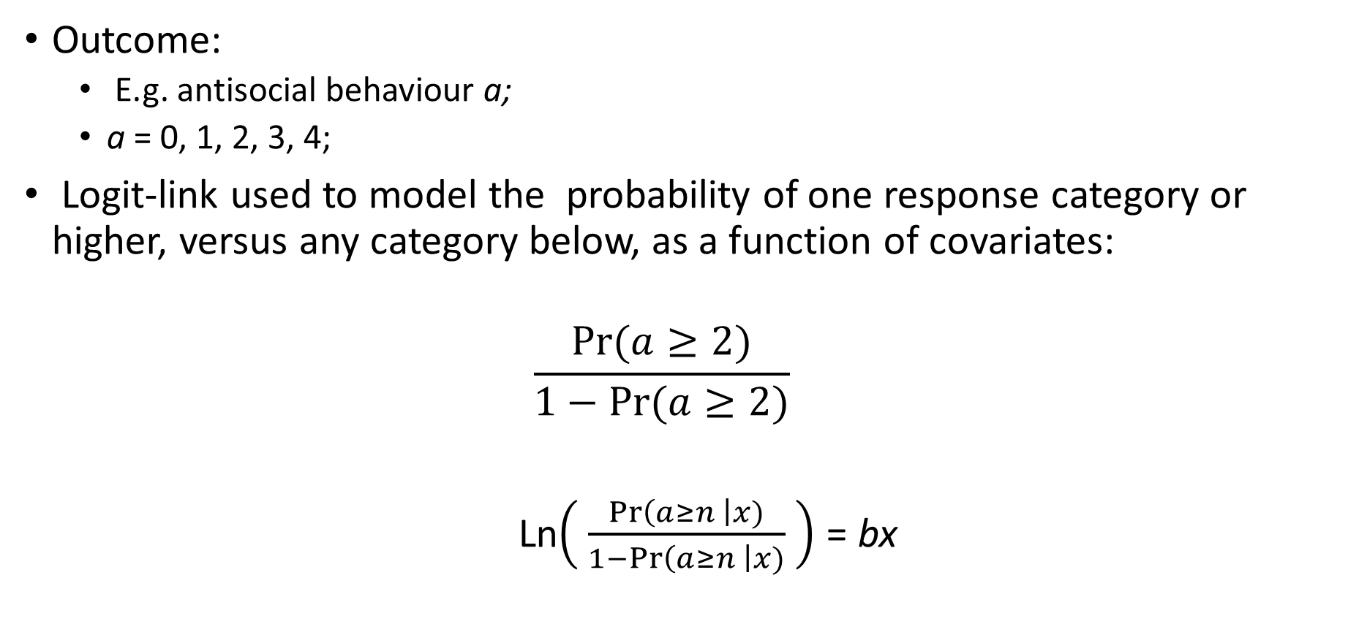
Link function for categorical outcomes
Outcome:
  E.g. antisocial behaviour a;
  a = 0, 1, 2, 3, 4;
Logit-link used to model the probability of one response category or higher, versus any category below, as a function of covariates:
$$\frac{Pr⁡(a≥2)}{1−Pr{(a≥2)}}$$
Ln$\left( \frac{\operatorname{Pr}\left(a≥n \right|x)}{1−\operatorname{Pr}\left(a≥n \right|x)} \right)$ = bx
Notes:
In the rest of this presentation I will consider an outcome like antisocial behaviour, labelled variable a, where a can take five ordered values, from 0 to 4, but these values are not evenly spaced.
In similar case we can use a logit-link to model the association between the probability of category of response, for example 2, or higher, versus the probability of a lower response. This ratio represents the odds of variable being in category 2 or higher, versus the probability of any category below 2.
By calculating the logarithm of these odds, we give to this outcome a symmetric distribution, which allows to model the outcome as a linear function of covariate x

Slide 6
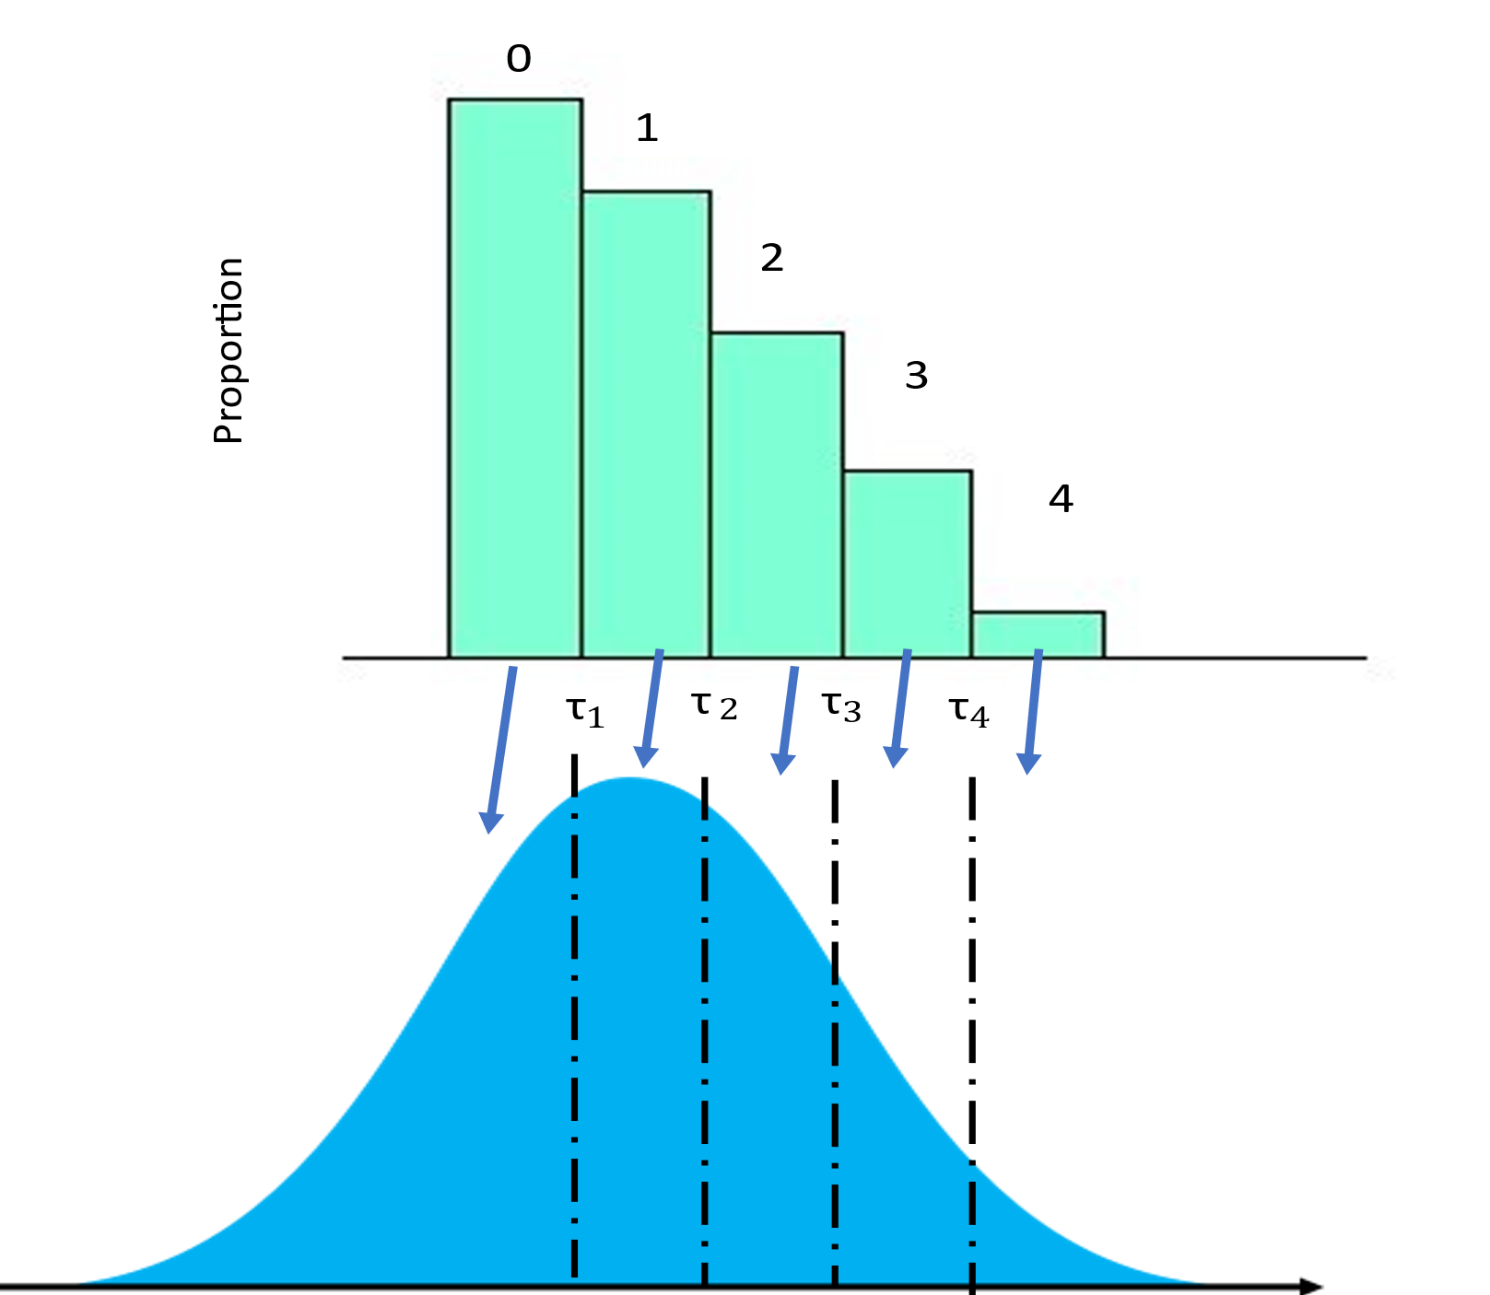
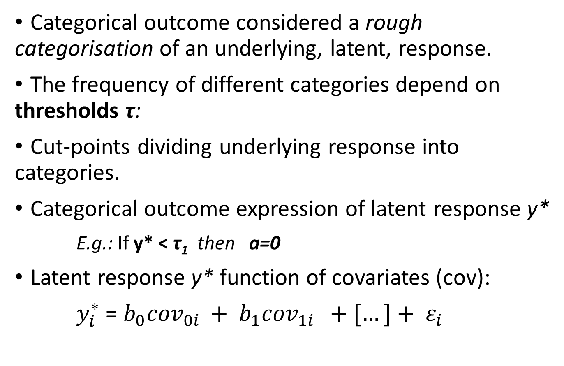
Latent response formulation
Categorical outcome considered a rough categorisation of an underlying, latent, response.
The frequency of different categories depend on thresholds τ:
  Cut-points dividing underlying response into categories.
Categorical outcome expression of latent response y*
  E.g.: If y* < τ₁ then a=0
Latent response y* function of covariates (cov):
$y_{i}^{∗}$ = $b_{0}{cov}_{0i }+ b_{1}{cov}_{1i } +[…]+ ε_{i}$
Observed Categorical Outcome
Latent response
Notes:
The task of modelling categorical outcomes as a function of covariates is also facilitated by the latent response formulation. The categorical outcome is considered a rough categorisation of an underlying latent response. This continuous underlying response is divided into different categories by thresholds, cut-points that divide the latent response into different categories. The frequency of the categories depends on where we cut the latent response.
We call the latent response y*, and depending on the value of the underlying y* value of an individual, the individual will have a corresponding categorical score. If, for example, y* < the first thresholds, the value of the observed categorical variable a will be 0.
In this way, we can express the latent response y* as a function of different covariates, in a formula that is similar to a standard regression model.

Slide 7

Growth model for categorical variables
Latent response y* function of time t for individual i :
$y_{ti}^{∗}$ = $b_{0i}+ b_{1i}{ time}_{ } + ε_{ti}$ ;
Where:
$ε_{ti}$ $\sim logistic \left(0, \frac{π^{2}}{3}\right)$ ;
And where:
$b_{0i}$ = $g_{0}+ u_{0i}$ ;
$b_{1i}$ = $g_{1}+ u_{1i}$ ;
Thus:
$y_{ti}^{∗}$ = $g_{0}+ u_{0i}{ +g}_{1} time+ {u_{1i} time}_{ } + ε_{ti}$ ;
And $u \sim Normal \left(0, Ψ\right)$ ;
Observed Categorical Outcome
Latent response
Notes:
We can expand the previous model to define a growth model for categorical variables.
Here we consider the value of a latent response y* at time t for individual i as a linear function of individuals’ i intercept or initial status, b0, and of individual’s i slope, b1, which represents the amount of change in the outcome by unit of time. We also have an epsilon term that represents variability in individuals’ i score at time t, but this epsilon-ti has a fixed mean and variance, so I will not consider it.
So, individual i has their own intercept b0 and slope b1. How are these defined? The individual intercept is the sum of the sample’s average intercept g0 , plus individual variation above or below this average, represented by term u0. Similarly, the individual slope is the sum of the sample’s average slope g1, plus individual variation above or below this average, represented by u1.
If we put all this together we have this equation. Variation around the sample average intercept and slope are supposed to be normally distributed with mean 0 and variance PSI, which is the covariance matrix of the two individual Us.

Slide 8

Growth model for categorical variables
Latent response y* function of time t for individual i :
$y_{ti}^{∗}$ = $b_{0i}+ b_{1i}{ time}_{ } + ε_{ti}$ ;
Where:
$ε_{ti}$ $\sim logistic \left(0, \frac{π^{2}}{3}\right)$ ;
And where:
$b_{0i}$ = $g_{0}+ u_{0i}$ ;
$b_{1i}$ = $g_{1}+ u_{1i}$ ;
Thus:
$y_{ti}^{∗}$ = $g_{0}+ u_{0i}{ +g}_{1} time+ {u_{1i} time}_{ } + ε_{ti}$ ;
Observed Categorical Outcome
Latent response
Intercept + individual i variation
Notes:
So, these terms here represent the sample average intercept plus the individual’s i variation above or below the sample average.

Slide 9
Growth model for categorical variables
Latent response y* function of time t for individual i :
$y_{ti}^{∗}$ = $b_{0i}+ b_{1i}{ time}_{ } + ε_{ti}$ ;
Where:
$ε_{ti}$ $\sim logistic \left(0, \frac{π^{2}}{3}\right)$ ;
And where:
$b_{0i}$ = $g_{0}+ u_{0i}$ ;
$b_{1i}$ = $g_{1}+ u_{1i}$ ;
Thus:
$y_{ti}^{∗}$ = $g_{0}+ u_{0i}{ +g}_{1} time+ {u_{1i} time}_{ } + ε_{ti}$ ;
Observed Categorical Outcome
Slope + individual i variation around slope
Latent response
Intercept + individual i variation
Notes:
These other terms represent the sample average slope, and the individual’s i variation above or below this slope.

Slide 10
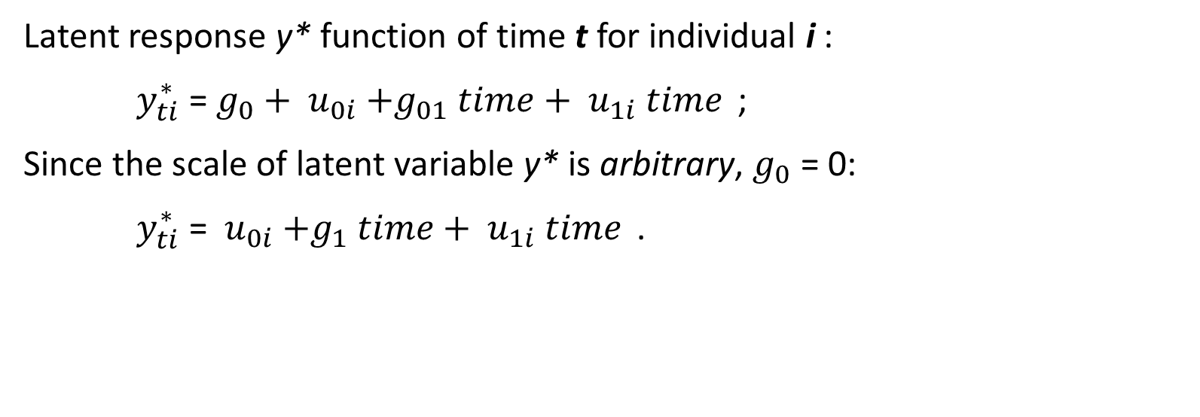
Growth model for categorical variables
Latent response y* function of time t for individual i :
$y_{ti}^{∗}$ = $g_{0}+ u_{0i}{ +g}_{01} time+ {u_{1i} time}_{ }$;
Since the scale of latent variable y* is arbitrary, $g_{0}$ = 0:
$y_{ti}^{∗}$ =$u_{0i}{ +g}_{1} time+ {u_{1i} time}_{ }$.
Observed Categorical Outcome
Latent response
Notes:
When we are defining a growth model for a categorical variable, the scale of the underlying latent variable y* is arbitrary, so to obtain a point where we can “anchor” the distribution, we fix the intercept to 0, so the equation to estimate y* at time t for individual u is even simpler.

Slide 11
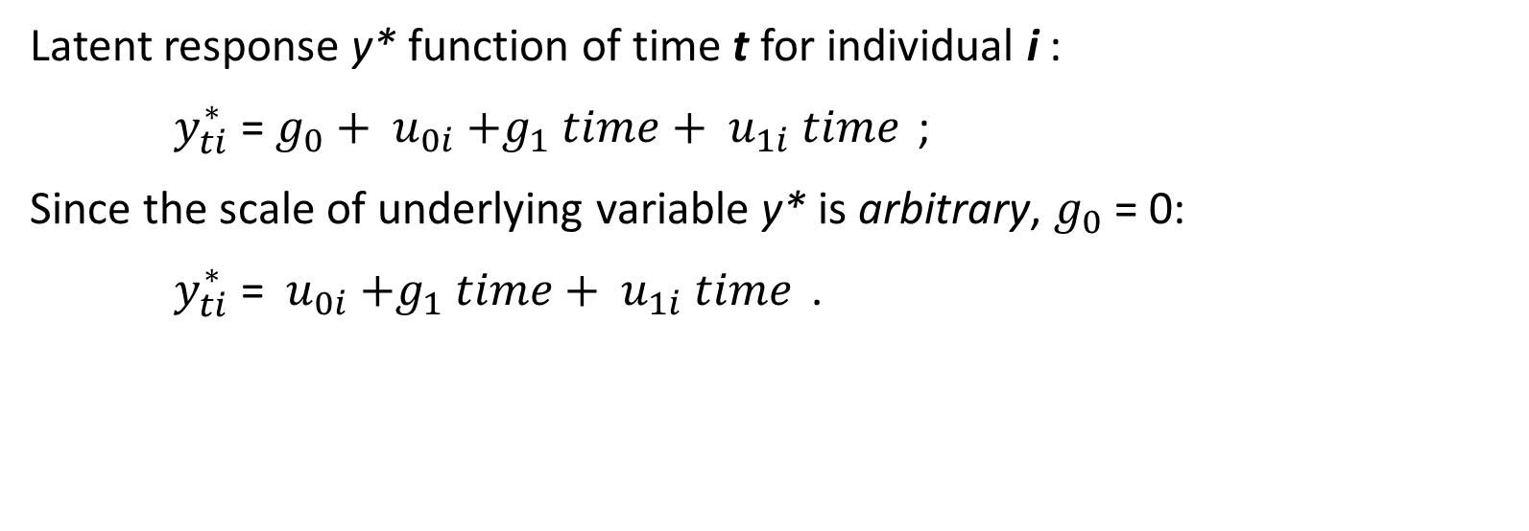
Growth model for categorical variables
Latent response y* function of time t for individual i :
$y_{ti}^{∗}$ = $g_{0}+ u_{0i}{ +g}_{1} time+ {u_{1i} time}_{ }$;
Since the scale of underlying variable y* is arbitrary, $g_{0}$ = 0:
$y_{ti}^{∗}$ =$u_{0i}{ +g}_{1} time+ {u_{1i} time}_{ }$.
Observed Categorical Outcome
Proportional Odds assumption:
The effect of covariates on the odds of being in one category of the observed variables is the same for all categories of the variable.
I.e. there is only one coefficient that describes the association between covariates and ordered variable.
Latent response
Notes:
It is important to mention that this method relies on the assumption of proportional odds. The assumption state that the effects of covariates on the odds of an individual being in one category is the same for all the categories. This allows to have a single coefficient to represent the association between covariate and ordinal outcome.

Slide 12
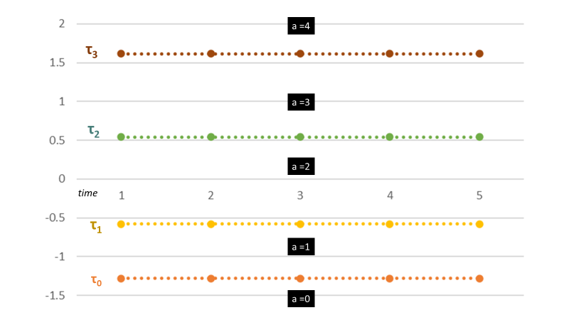

Growth model for categorical variables
Latent response y* function of time t for individual i :
$y_{ti}^{∗}$ =$u_{0i}{ +g}_{1} time+ {u_{1i} time}_{ }$;
Thresholds of latent response variable constrained to be constant across time:
y*
Notes:
The latent response method applied to growth modelling also assumes that the thresholds that cut the underlying latent variable are constant across time: the cut-points that define the categories of response are the same across time or age. In this graph, I have plotted thresholds of a fictional variable a, antisocial behaviour. These thresholds are the same across time, as you can see. If someone score 0 in the latent variable y*, for example, they will be in category 2 of the ordinal variable

Slide 13


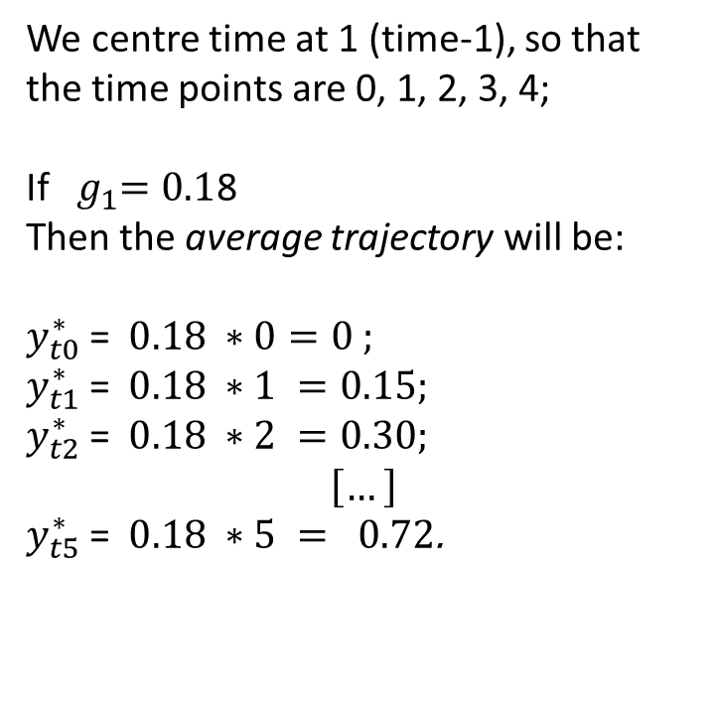
Growth model for categorical variables
Latent response y* function of time t for individual i :
$y_{ti}^{∗}$ =$u_{0i}{ +g}_{1} time+ {u_{1i} time}_{ }$;
Thresholds of latent response variable constrained to be constant across time:
We centre time at 1 (time-1), so that the time points are 0, 1, 2, 3, 4;
If ${ g}_{1}=0.1$8
Then the average trajectory will be:
$y_{t0}^{∗}$ =$0.18 ∗0=0 ;$
$y_{t1}^{∗}$ =$0.18 ∗1 =0.15;$
$y_{t2}^{∗}$ =$0.18 ∗2 =0.30;$
$$\left[…\right]$$
$y_{t5}^{∗}$ =$0.18 ∗5 = 0.72$.
y*
Notes:
We centre time at time point 1, so the different time points are 0, 1, etc.
If we estimated that the sample average slope g1 is equal to .18, using the equation here, we can plot the sample average trajectory by multiplying the slope coefficient by the centred time variable, so that the sample average trajectory will be 0 at time 0, .15 at time 1, .30 at time 2…and so on.

Slide 14
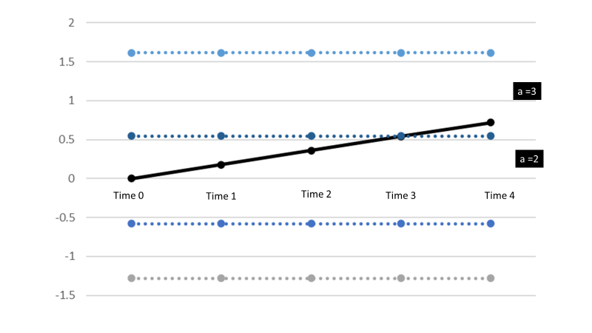

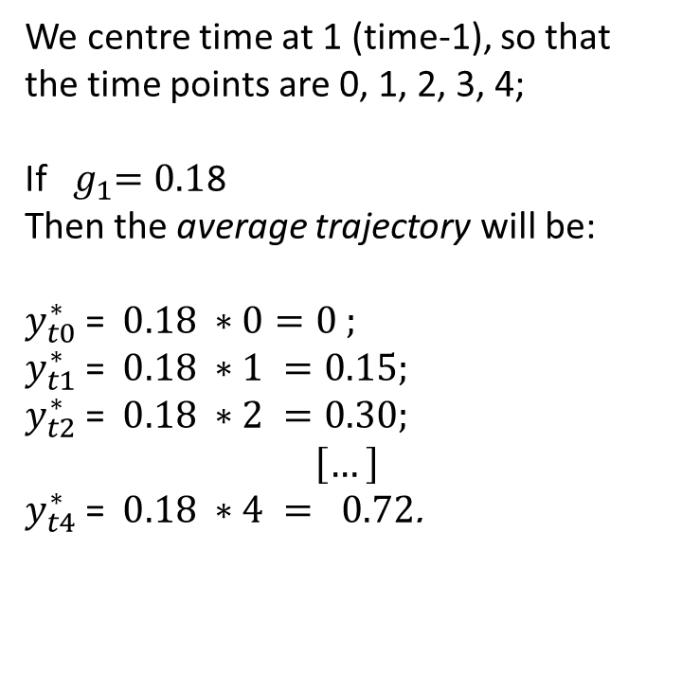
Growth model for categorical variables
Latent response y* function of time t for individual i :
$y_{ti}^{∗}$ =$u_{0i}{ +g}_{1} time+ {u_{1i} time}_{ }$;
Thresholds of latent response variable constrained to be constant across time:
We centre time at 1 (time-1), so that the time points are 0, 1, 2, 3, 4;
If ${ g}_{1}=0.1$8
Then the average trajectory will be:
$y_{t0}^{∗}$ =$0.18 ∗0=0 ;$
$y_{t1}^{∗}$ =$0.18 ∗1 =0.15;$
$y_{t2}^{∗}$ =$0.18 ∗2 =0.30;$
$$\left[…\right]$$
$y_{t4}^{∗}$ =$0.18 ∗4 = 0.72$.
y*
Notes:
So the sample average trajectory will look like this. We can see that on average individuals move from category 2 of the variable to category 3 by the end of the study.

Slide 15
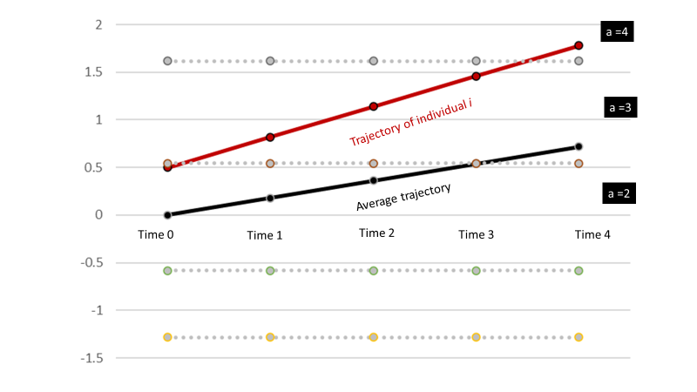

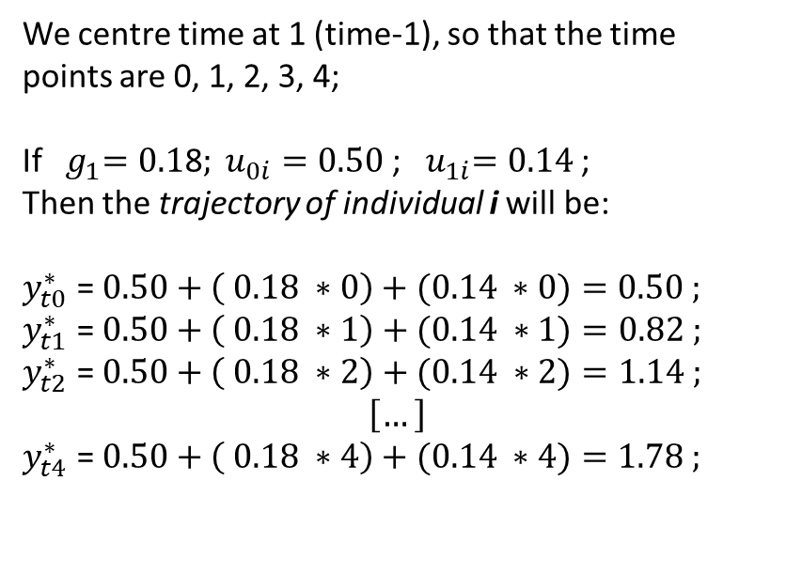
Growth model for categorical variables
Latent response y* function of time t for individual i :
$y_{ti}^{∗}$ =$u_{0i}{ +g}_{1} time+ {u_{1i} time}_{ }$;
Thresholds of latent response variable constrained to be constant across time:
We centre time at 1 (time-1), so that the time points are 0, 1, 2, 3, 4;
If ${{ g}_{1}=0.1\text{8}; u}_{0i}=0.50$ ; ${ u}_{1i}=0.14$ ;
Then the trajectory of individual i will be:
$y_{t0}^{∗}$ =$0.50+\left( 0.18 ∗0\right)+(0.14 ∗0)=0.50 ;$
$y_{t1}^{∗}$ = $0.50+\left( 0.18 ∗1\right)+(0.14 ∗1)=0.82 ;$
$y_{t2}^{∗}$ = $0.50+\left( 0.18 ∗2\right)+(0.14 ∗2)=1.14 ;$
$$\left[…\right]$$
$y_{t4}^{∗}$ =$0.50+\left( 0.18 ∗4\right)+(0.14 ∗4)=1.78 ;$
y*
Notes:
Using the same equation, we can also estimate each individuals’ variation around the sample average intercept and slope. If they variation around the intercept for individual i is 0.50, and that around the slope is .14, we can use these values to estimate individual i’s values of y* at each time point, as I show here.
If we plot these values, we can see the individual trajectory of i, who start by scoring within the range of category 2, but increases and by the of the study scores in category 4.
The important point here is that the equation allows each individual to have different trajectories.

Slide 16
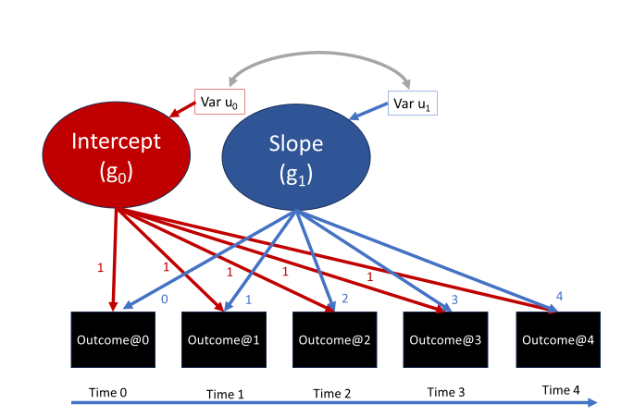

Growth model for categorical variables
Latent response y* function of time t for individual i :
$y_{ti}^{∗}$ =$u_{0i}{ +g}_{1} time+ {u_{1i} time}_{ }$;
We centre time at 1 (time-1), so that the time points are 0, 1, 2, 3, 4;
Notes:
The model described can be represented in this way, were we have the sample average intercept g0 and the sample average slope g1 conceptualised as latent variables that influence the observed categorical outcomes. The Variance u0 and u1 around these sample average parameters represent individual variation above or below these averages, and, as described earlier, they are supposed to be distributed normally with variance represented in their covariance matrix.

Slide 17
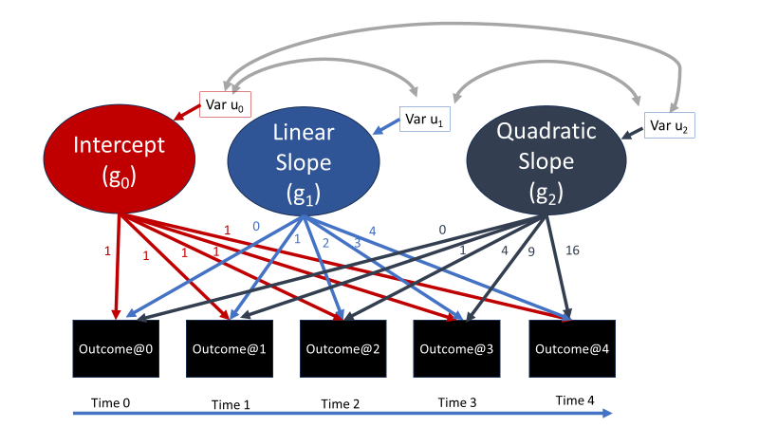

Growth model for categorical variables:
Quadratic growth
Latent response y* function of time t for individual i :
$y_{ti}^{∗}$ =$u_{0i}{ +g}_{1} time+{ g}_{2} time2+ {u_{1i} time}_{ } +u_{2i} time2$ ;
Notes:
If we wanted to define a trajectory that is not linear but can accelerate or decelerate, we consider a further slope, here g2, which is multiplied by the square of time to define patterns of acceleration and deceleration. A similar model could create a trajectory as you see represented here. It is also possible to model individual variation around this quadratic term, so that each individual would have different quadratic trajectories.
In the exercises, there is an example of quadratic growth you can model.

Slide 18
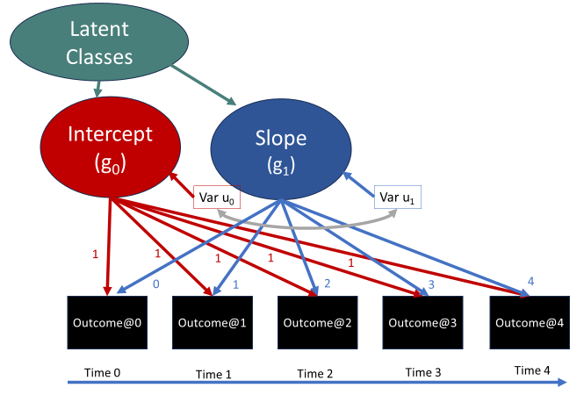

Growth Mixture Model (GMM)
Latent response y* function of time t for individual i indexed by latent class k :
$y_{kti}^{∗}$ =$g_{k0}+u_{k0i}{ +g}_{k1} time+ {u_{k1i} time}_{ }$.
Notes:
We can now extend the growth model to model different trajectory groups. In this case, latent class affiliation affects the average intercept and slope. Furthermore, within each latent class, individuals vary around these class-specific trajectories, i.e. within each class, individuals still show their own trajectories. To represent this model, we index the parameters of the equation by a latent class indicator, k.

Slide 19
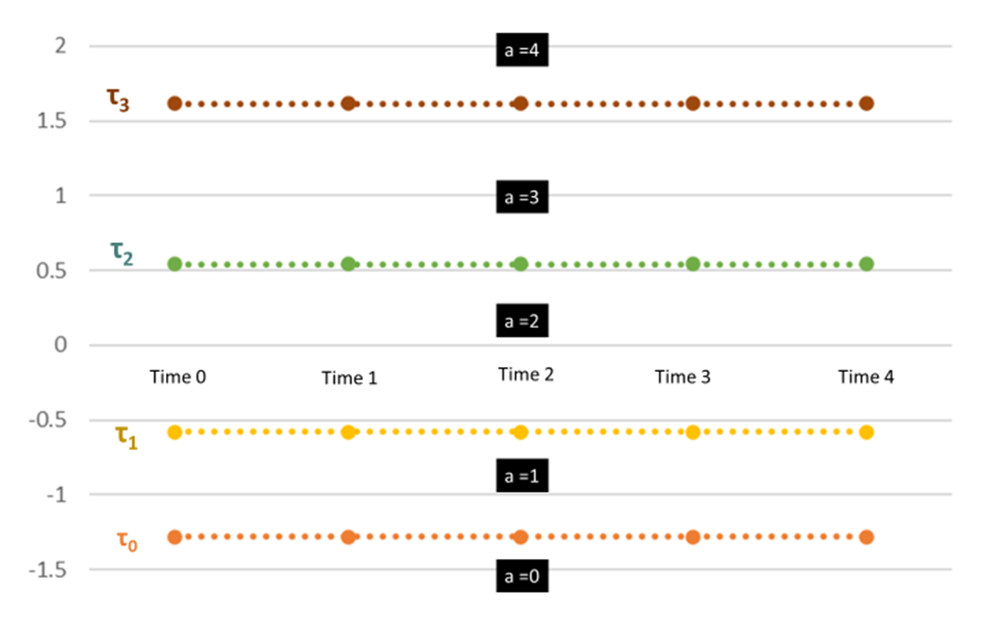

Growth Mixture Model (GMM)
Latent response y* function of time t for individual i indexed by latent class k :
$y_{kti}^{∗}$ =$g_{k0}+u_{k0i}{ +g}_{k1} time+ {u_{k1i} time}_{ }$;
Latent response y* thresholds fixed equal across time and across classes.
y*
Notes:
In this case, we assume that the thresholds that cut the underlying latent response y* are invariant across time AND across classes

Slide 20
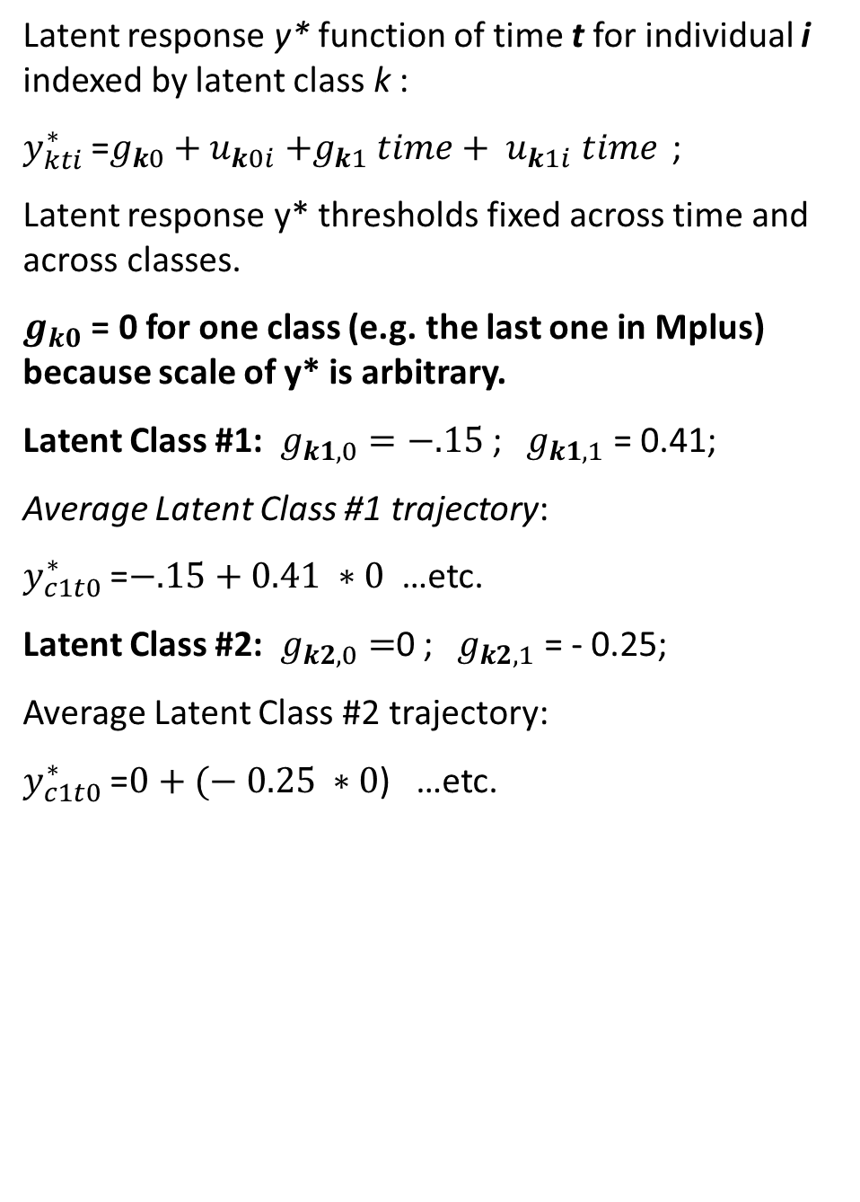
Growth Mixture Model (GMM)
Latent response y* function of time t for individual i indexed by latent class k :
$y_{kti}^{∗}$ =$g_{k0}+u_{k0i}{ +g}_{k1} time+ {u_{k1i} time}_{ }$;
Latent response y* thresholds fixed across time and across classes.
$g_{k0}$ = 0 for one class (e.g. the last one in Mplus) because scale of y* is arbitrary.
Latent Class #1: $g_{k1,0}=−.15$ ; ${ g}_{k1,1}$ = 0.41;
Average Latent Class #1 trajectory:
$y_{c1t0}^{∗}$ =$−.15+0.41 ∗0$ …etc.
Latent Class #2: $g_{k2,0}=$0 ; ${ g}_{k2,1}$ = - 0.25;
Average Latent Class #2 trajectory:
$y_{c1t0}^{∗}$ =$0+(− 0.25 ∗0$) …etc.
y*
Notes:
Because the scale of y* is arbitrary, we fix the average intercept of one of the classes to be 0, leaving the intra-class average of other classes to be estimated freely. In Mplus, for example, the intercept of the last latent class estimated is fixed to 0.
Once we estimated the intercept and slope parameters for different classes, we can calculate the y* scores for the average sample in class 1 at time 0, 1, etc. as well as those of the average individual in class 2.

Slide 21
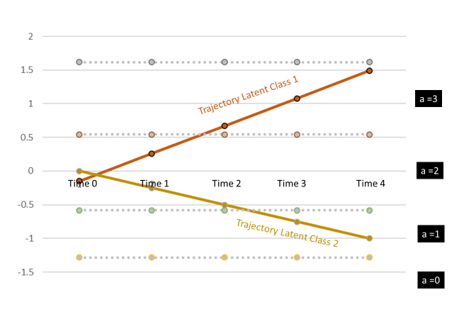
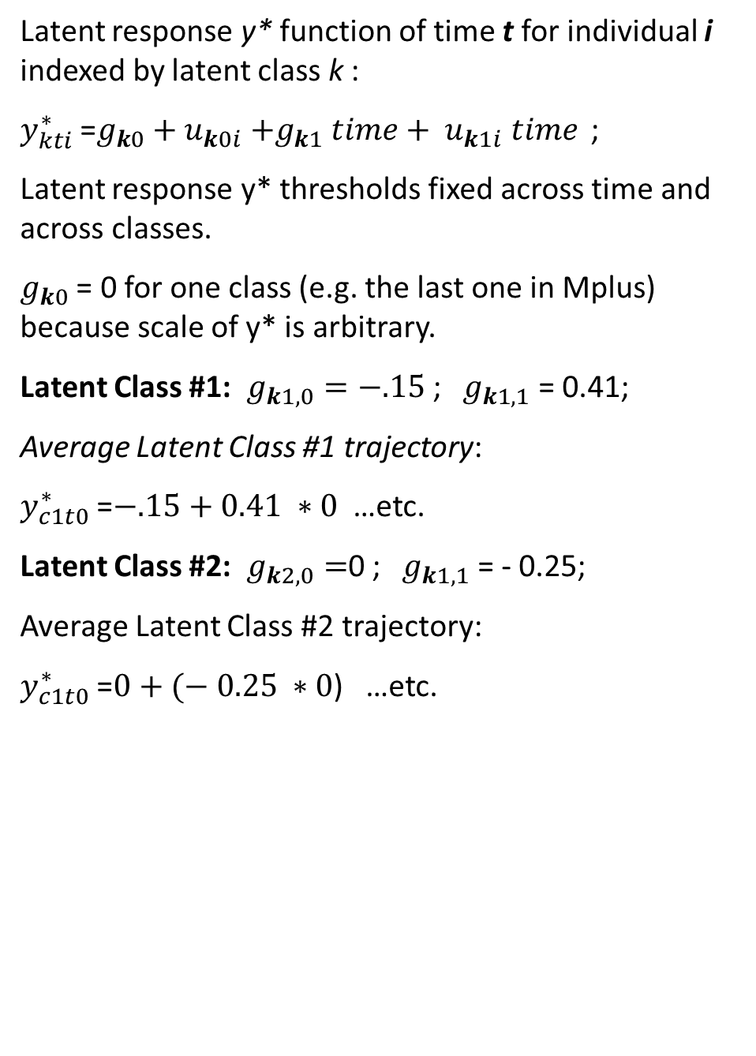
Growth Mixture Model (GMM)
Latent response y* function of time t for individual i indexed by latent class k :
$y_{kti}^{∗}$ =$g_{k0}+u_{k0i}{ +g}_{k1} time+ {u_{k1i} time}_{ }$;
Latent response y* thresholds fixed across time and across classes.
$g_{k0}$ = 0 for one class (e.g. the last one in Mplus) because scale of y* is arbitrary.
Latent Class #1: $g_{k1,0}=−.15$ ; ${ g}_{k1,1}$ = 0.41;
Average Latent Class #1 trajectory:
$y_{c1t0}^{∗}$ =$−.15+0.41 ∗0$ …etc.
Latent Class #2: $g_{k2,0}=$0 ; ${ g}_{k1,1}$ = - 0.25;
Average Latent Class #2 trajectory:
$y_{c1t0}^{∗}$ =$0+(− 0.25 ∗0$) …etc.
y*
Notes:
Here I show the calculations and I plot the average trajectories for individuals in class 1 and in class 2.

Slide 22
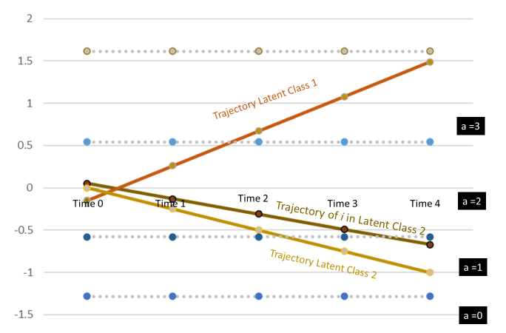
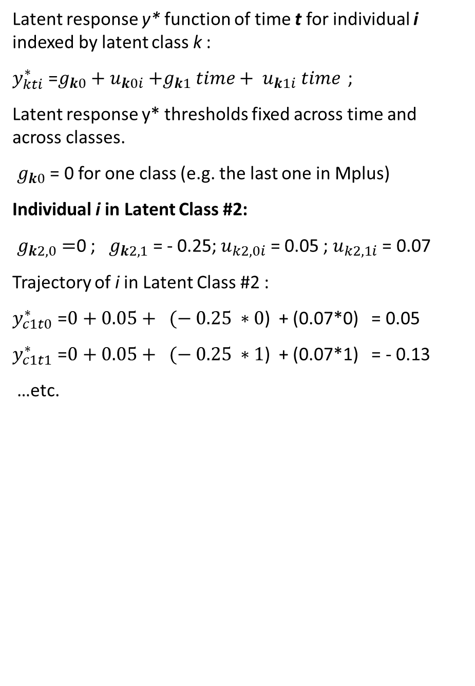
Growth Mixture Model (GMM)
Latent response y* function of time t for individual i indexed by latent class k :
$y_{kti}^{∗}$ =$g_{k0}+u_{k0i}{ +g}_{k1} time+ {u_{k1i} time}_{ }$;
Latent response y* thresholds fixed across time and across classes.
$g_{k0}$ = 0 for one class (e.g. the last one in Mplus)
Individual i in Latent Class #2:
$g_{k2,0}=$0 ; ${ g}_{k2,1}$ = - 0.25; $u_{k2,0i}$ = 0.05 ; $u_{k2,1i}$ = 0.07
Trajectory of i in Latent Class #2 :
$y_{c1t0}^{∗}$ =$0+0.05+ (− 0.25 ∗0$) + (0.07*0) = 0.05
$y_{c1t1}^{∗}$ =$0+0.05+ (− 0.25 ∗1$) + (0.07*1) = - 0.13
…etc.
y*
Notes:
However, there is individual variation within classes. So we can estimate this individual variation and calculate the iscores of an individual in latent class 2, for example, and plot them as I did here. This to show that even within latent classes, individuals have their own expected trajectories that follow a general class-specific pattern but some variation. It’s important to also remind these are expected trajectories, where the actual observed trajectory of the individual will be different due to measurement error. Measurement error may vary and it is important to consider the size of residuals when comparing models.

Slide 23
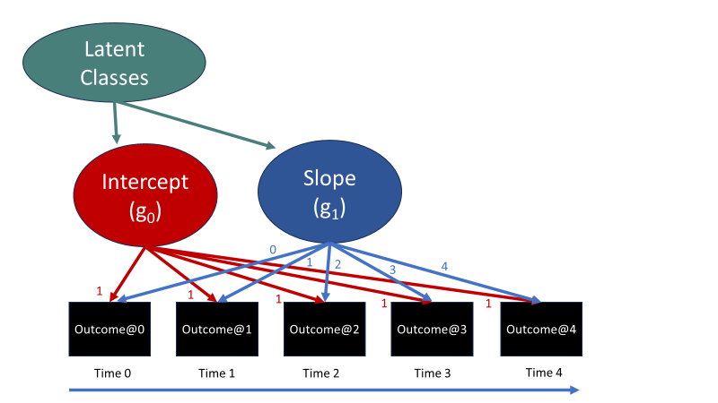

Latent Class Growth Analysys (LCGA)
Variance around growth parameters fixed to 0:
$u_{k0i}$ =0 ; $u_{k1i}$ =0 .
Latent response y* function of time t for individual i indexed by latent class k :
$y_{kti}^{∗}$ =$g_{k0}{ +g}_{k1} time$ .
Notes:
The LCGA is less complex because we assume no individual variation around the intra-class average growth parameters: individuals within a class are supposed to all follow the same trajectory, save for measurement errors.

Slide 24
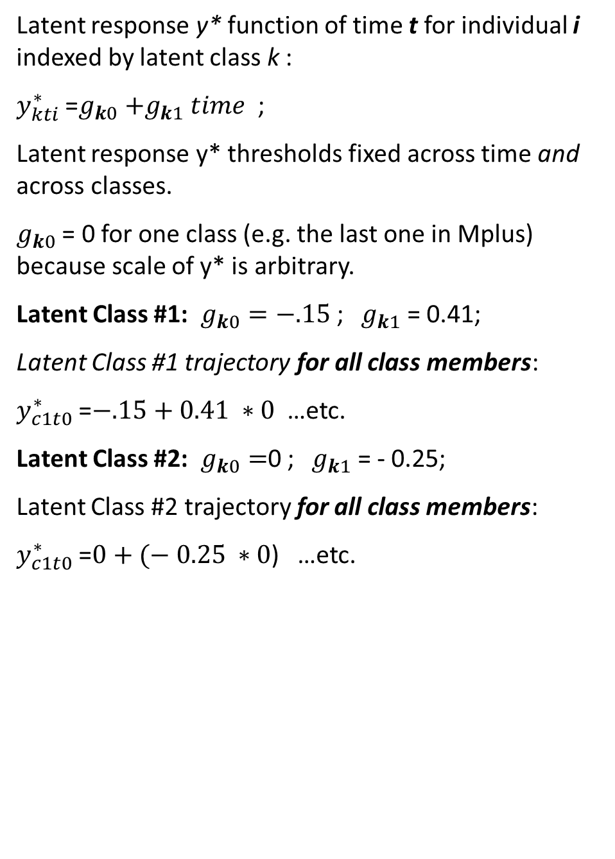
Latent Class Growth Analysis (LCGA)
Latent response y* function of time t for individual i indexed by latent class k :
$y_{kti}^{∗}$ =$g_{k0}{ +g}_{k1} time$ ;
Latent response y* thresholds fixed across time and across classes.
$g_{k0}$ = 0 for one class (e.g. the last one in Mplus) because scale of y* is arbitrary.
Latent Class #1: $g_{k0}=−.15$ ; ${ g}_{k1}$ = 0.41;
Latent Class #1 trajectory for all class members:
$y_{c1t0}^{∗}$ =$−.15+0.41 ∗0$ …etc.
Latent Class #2: $g_{k0}=$0 ; ${ g}_{k1}$ = - 0.25;
Latent Class #2 trajectory for all class members:
$y_{c1t0}^{∗}$ =$0+(− 0.25 ∗0$) …etc.
Notes:
The assumptions regarding the invariance of the thresholds are the same: thresholds are fixed to be invariant across time and across classes. Also, since the scale of y* is arbitrary, we fix the intercept of one class to be 0, freely estimating the other class-specific intercepts. Once we estimate the intra-class growth parameters, we can plot the average class-specific trajectories, but since there is no variation around these trajectories, these averages represent all the individuals in the latent class.

Slide 25
Summary
Logit link and latent response formulation: Categorical variables as linear functions of time and covariates.
Growth parameters are indexed by class in GMM and LCGA.
GMM allows intra-class individuals’ trajectories to vary.
LCGA assumes all individuals within classes follow the same trajectory.
Notes:
Look at exercises where different GMM and LCGA models will be compared.

