Slide 1
Introduction to Latent Transition Analysis (part 3)
Dr Oliver Perra

Slide 2
Summary: Latent Transition Analysis (LTA)
Measurement model at each time point:
Observed behaviours are causally related to underlying categorical differences;
Continuity: Formal tests of measurement invariance;
Discontinuity: New categories may emerge at different time points.
Structural model:
Use 3-step approach to allow for measurement model uncertainty:
Substantive advantages: Measurement model estimation separated from structural model one.
Practical advantages: Less computational costs, easier to estimate more complex models.
Notes:
In the previous presentation I have illustrated the first stages of LTA.
We must investigate the number of classes that adequately explain heterogeneity of behaviour, and we do so separately at each time point.
If we identify latent classes that appear similar across time points, we can test measurement invariance of classes across time.
Once we have selected one or a few optimal measurement models, we can extract the measurement parameters and use the 3-step approach to investigate the associations between latent classes across time and also other variables, and in this presentation I will talk about this in more details.

Slide 3
Stages of LTA https://doi.org/10.4135/9781526421036878157
Stage 1—LCA solutions to data at different time points;
Stage 2—Explore measurement invariance;
Stage 3—Extract latent classes parameters;
Stage 4—Model structural relations across time
Stage 5—Include covariates as predictors of latent classes across time
Stage 6—Include distal outcomes.
Notes:
I am following an outline of the stages of LTA that I have described in the chapter linked here.

Slide 4
Outline
Investigate transition probabilities
Models with covariates and distal outcomes
Models with moderation
Associative Latent Transition models
Notes:
In particular, in this presentation I will talk about these issues.

Slide 5
Investigate Transition Probabilities

Slide 6
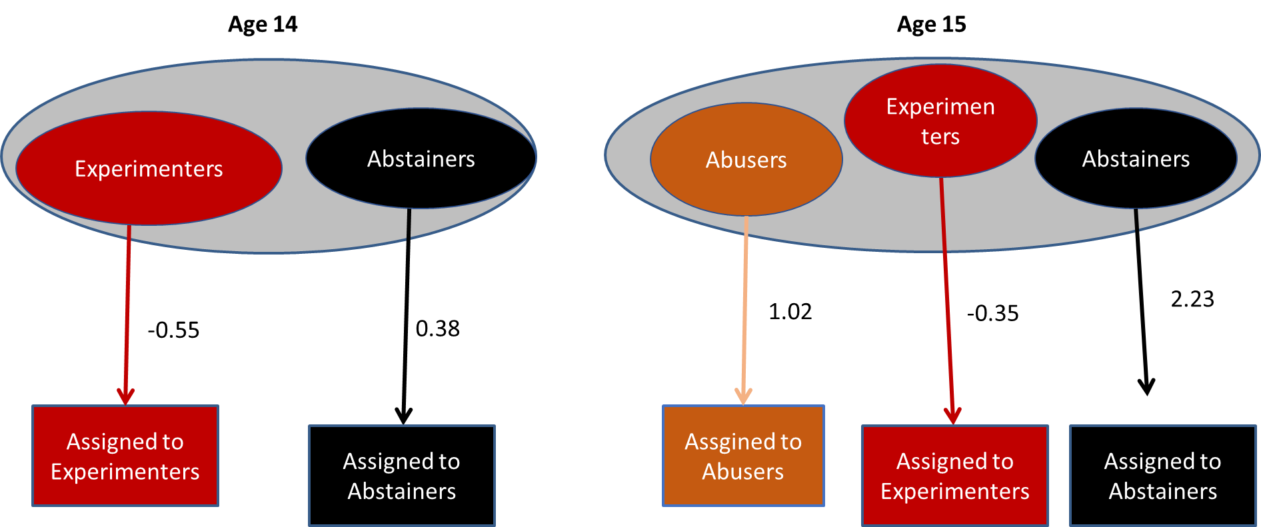
Step 3: Impose relationships between different classes, while controlling for measurement error in class assignment
Notes:
As I illustrated in the previous presentation, once we have chosen optimal measurement models at each time point, we can use the latent class membership as imperfect indicators of latent class, feeding to the model the information about the extent of uncertainty in this membership. This information is represented by the classification log-odds parameters that we have extracted from the optimal measurement models. I had shown how we can calculate these log-odds, but software like Mplus and others provide them for use without the need to calculate them.

Slide 7
Step 3: Impose relationships between different classes, while controlling for measurement error in class assignment
Notes:
Having defined a fixed measurement model, we can now impose structural relationships between latent classes at each time point.
Since the latent classes are considered nominal variables (even when we might think of them as being ordered), the associations between latent classes are expressed by multinomial logistic regressions of the latent classes at age 15 on the latent classes at age 14.
Since we are using logistic regressions, the associations between classes can be expressed by Odds Ratios. For example, we will have the ORs of being an “Abuser” rather than an “Abstainer” at 15 years if someone was an “Experimenter rather than “Abstainer” at 14 years.

Slide 8
Transition Probabilities
Age 14 ↓ / Age15→ | Abusers | Experim. | Abstain. | Total
Experim. | 0.39 | 0.56 | 0.05 | 1.00
Abstain. | 0.07 | 0.25 | 0.68 | 1.00
.
Notes:
As well as the ORs, the other parameters we obtain from a LTA output are the transitions probabilities. These represent the probabilities of being in a latent class at 15 years conditional on LC membership at 14 years. These probabilities sum to 1 in the rows,

Slide 9
Transition Probabilities
Age 14 ↓ / Age15→ | Abusers | Experim. | Abstain. | Total
Experim. | 0.39 | 0.56 | 0.05 | 1.00
Abstain. | 0.07 | 0.25 | 0.68 | 1.00
.
Continuity
Notes:
If we have the same or similar classes at different time points, we can report what are the probabilities of individuals staying the same class across time. For example, we see that Abstainers at age 14 have a 68% probability of remaining Abstainers at 15 years. By considering the number of participants in the study we can calculate the total probability of individuals remaining in the same classes over time.

Slide 10
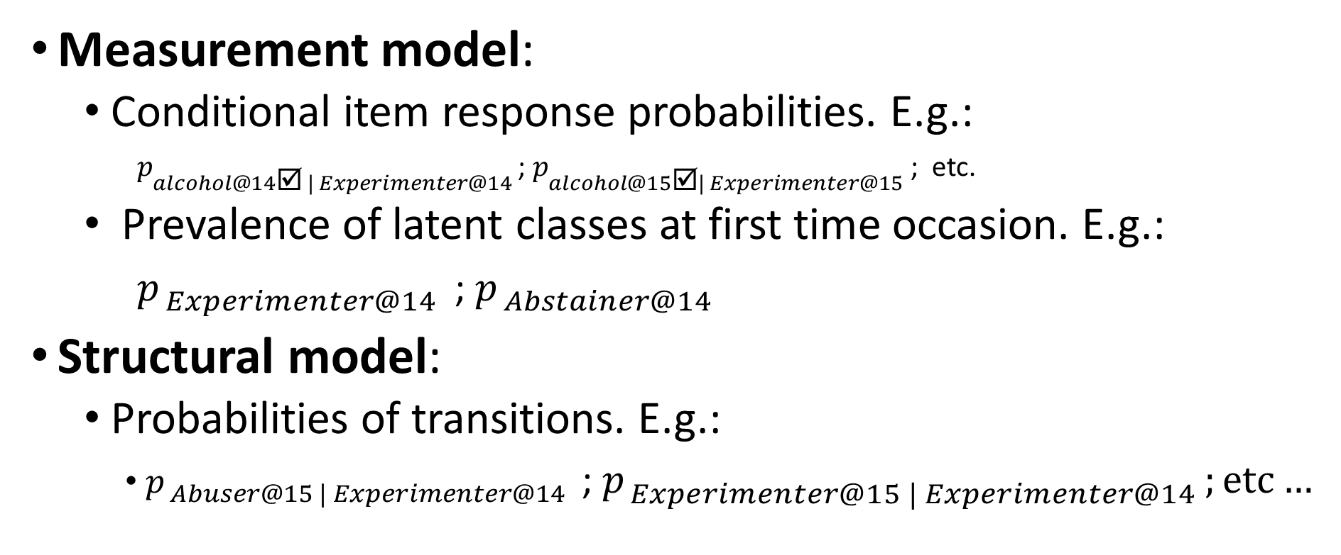
Key parameters in LTA
Notes:
Just a summary of the key parameters of LTA at this stage.
The first two parameters are those produced by the LCA models, conditional item response probabilities at each time point, and the prevalence of latent classes at each time point.
The third set of parameters are unique to LTA and represent the structural model: these are probabilities of being in one latent class at one latent point given membership to latent class at the previous time point.

Slide 11
Constraints on Transition Probabilities
Age 14 ↓ / Age15→ | Abusers | Experim. | Abstain. | Total
Experim. | 0.39 | 0.56 | 0.05 | 1.00
Abstain. | 0.07 | 0.25 | 0.68 | 1.00
.
Notes:
I will discuss it is possible to constrain some of these transition probabilities to test specific hypotheses about developmental patterns.
For example, here we see that the probability of a substance use “Experimenter” becoming an “Abstainer” the following year is quite low.
We can hypothesise that this reported 5% may be due to measurement error and test if the model will provide the same fit if we constrain this probability to be 0, i.e. if we assume that transitions from experimenter to abstainer are just an effect of random variations.

Slide 12
Constraints on Transition Probabilities
Age 14 ↓ / Age15→ | Abusers | Experim. | Abstain. | Total
Experim. | 0.39 | 0.56 | 0.05 | 1.00
Abstain. | 0.07 | 0.25 | 0.68 | 1.00
.
Age 14 ↓ / Age15→ | Abusers | Experim. | Abstain. | Tot.
Experim. | 0.40 | 0.60 | 0.00 | 1.00
Abstain. | 0.07 | 0.25 | 0.68 | 1.00
Model with constrained probability nested within model with free transition probabilities:
Use Likelihood-Ratio Test (LRT) to test H₀ of no difference in fit between models.
Notes:
So we can estimate a model where this transition probability is constrained to 0. Since this model is nested within the model where the transition probabilities were freely estimated, we can formally test our hypothesis by calculating the Likelihood Ratio test between the two models. In the exercises I provide more guidance on how to conduct this test.

Slide 13
Transition Probabilities: No back-sliding
Time 0↓ / Time 1→ | Novice | Learner | Master | Total
Novice | p_{n_t1|n_t0} | p_{l_t1|n_t0} | p_{m_t1|n_t0} | 1.00
Learner | 0 | p_{l_t1|l_t0} | p_{m_t1|l_t0} | 1.00
Master | 0 | 0 | p_{m_t1|m_t0} | 1.00
.
Notes:
In a similar manner, we can formally test other hypotheses on transitions across age. Here I am presenting a fictional example of a stage-like model of Skill Mastery. Individuals may be at different levels, where we have novices, learners, and masters at a particular skill set. Our model may state that we should not observe individuals backsliding, that is, moving from being a Master to a Novice level: similar transitions would be only observed because of random variation. We can test this hypothesis by comparing a model with transitions freely estimated and a model where we constrain these backsliding probabilities to be equal to 0. A Likelihood Ratio test comparing the two models provides this formal test of the hypothesis.

Slide 14
Model structural relations across time
LTA is an autoregressive model: one status directly related to previously status.
First order effects (Classes t0→Classes t1) ;
Classes
t0
Classes t1
Classes t2
@
@
@
E_cl_t0
E_cl_t1
E_cl_t2
Notes:
Having described the transition probabilities, I want to emphasise that LTA is an autoregressive model: individuals’ status at one time point is directly related to the individuals’ previous status.
This also means that, unlike growth models where changes are modelled as a function of time, in LTA time is not usually considered as a variable in the model. In this example of three measurement occasions and latent classes measured at time 0, time 1 and time 2, the time variable does not really matter. Time 0 may be age 10 years, time 1 may be age 11 years, time 2 may be age 18 years.

Slide 15
Model structural relations across time
LTA is an autoregressive model: one status directly related to previously status.
First order effects (Classes t0→Classes t1) ;
Second order effects (Classes t0→classes t2).
Classes
t0
Classes t1
Classes t2
@
@
@
E_cl_t0
E_cl_t1
E_cl_t2
Notes:
While usually we consider that individuals’ status at one time point is directly related to their status at the previous time point, that is first-order effects as described in this model, we can also test hypotheses where we model 2nd order effects, e.g. individuals'’ status at time 2 may be also related to individuals’ status at time 0, or else, there are lagged effects of the initial status.

Slide 16
Include covariates and distal outcomes

Slide 17
Include Covariates
Gender
Notes:
When we use the 3-step approach and therefore we have a fixed measurement model that takes into account uncertainty in class membership, it becomes also straightforward to include covariates in the model and investigate if they are associated with latent class statuses at different time points.
Here, for example, I considered the effect of Gender on latent class status at age 14 and latent class status at age 15.
Since latent classes are considered nominal variables, we use multinomial logistic regressions where the latent classes are regressed on the covariates.
Here I considered a nominal covariate like Gender, but we can include all type of covariates, ordinal, continuous, or latent variables.

Slide 18
Include Covariates
Gender
∗
∗
Parameters Age 14: p_{class_14|gender}
Parameters Age 15: p_{class_15|gender & class_14}
Notes:
I wanted to emphasise that the parameters we will obtain by adding these regressions are these:
We will have the probability of being in one class rather conditional on gender.
The parameters at 15 years of age however report the probability of being in one latent class, conditional on gender and latent class in the previous age point, age 14years. In other words, this parameter represent latent class probabilities adjusted based on previous class membership.

Slide 19
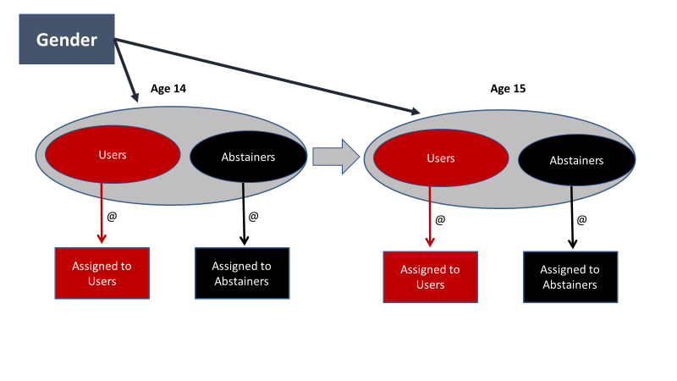
Include covariates
Females
t0 ↓ / t1→ | Users | Non Users
Users | 0.40 | 0.60
Non Users | 0.28 | 0.72
Males
t0 ↓ / t1→ | Users | Non Users
Users | 0.51 | 0.49
Non Users | 0.38 | 0.62
Notes:
Let’s simplify the example to two classes at each time point, and, for the sake of example, consider Gender as a dichotomous variable where we have females and males.
Based on the parameters of the model we can create probabilities matrices like these: these represent the probabilities of staying in the same class or transition into a different one for females and males respectively.

Slide 20
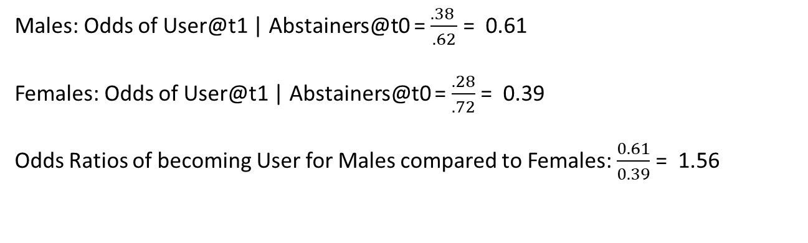
Include covariates
Females
t0 ↓ / t1→ | Users | Abstainers
Users | 0.40 | 0.60
Abstainers | 0.28 | 0.72
Males
t0 ↓ / t1→ | Users | Abstainers
Users | 0.51 | 0.49
Abstainers | 0.38 | 0.62
Males: Odds of User@t1 | Abstainers@t0 = $\frac{.38 }{.62}$ = 0.61
Females: Odds of User@t1 | Abstainers@t0 = $\frac{.28}{.72}$ = 0.39
Odds Ratios of becoming User for Males compared to Females: $\frac{0.61}{0.39}$ = 1.56
Notes:
We can see, for example, that Males have a higher probability 0.38 of becoming users between time point 0 to time point 1, compared to females, 28%.
We can use these probabilities to calculate the odds of becoming a user for females and males, and use these to calculate the Odds Ratios of becoming an user. Compared to females, males displayed a 56% increase in the odds of becoming users.

Slide 21
Include covariates
Females
Probability of being User @t1
t0 ↓ / t1→ | Users | Abstainers
Users | 0.40 | 0.60
Non Users | 0.28 | 0.72
Males
t0 ↓ / t1→ | Users | Abstainers
Users | 0.51 | 0.49
Non Users | 0.38 | 0.62
Notes:
SO, The ORs indicate that males have a higher likelihood of becoming an user. I will illustrate here that, however, the sign and the strength of the association between latent status in Year 2 and Year 1 is the same across gender. For example, In this graph I report the probabilities of being a User across gender, conditional on previous latent class membership. You can see that while males have higher probabilities of being users, the lines here are parallel, indicating that the strength of the association between latent variables was similar for males and females.

Slide 22
Moderation
Gender
Notes:
However, we may be interested in testing more complex models where covariates may moderate the associations between the latent classes at different time points.
T

Slide 23
Moderation
Females
Probability of being User @t1
t0 ↓ / t1→ | Users | Abstainers
Users | 0.40 | 0.60
Abstainers | 0.29 | 0.71
Males
t0 ↓ / t1→ | Users | Abstainers
Users | 0.35 | 0.65
Abstainers | 0.44 | 0.56
Notes:
To illustrate, we can look at the probability matrices for Females and Males when we model a moderation effect of gender. In this case we can see that Males have a higher probability of becoming users, compared to females, but males also reported lower probabilities of remaining users compared to Females. Overall, this moderation effect indicates that the association between latent classes is stronger for females, and –consequently- males have a higher likelihood to change substance use status between age 14 and age 15.

Slide 24
Include Distal Outcomes
Gender
Age 16
School Attainment
Notes:
Finally, using the 3-step approach is also straightforward to include distal outcomes in the model while we have fixed the LC measurement model and take into account uncertainty in this measurement model. We can for example investigate the association between substance use categories at 15 years and school attainment at 16 years, while controlling for covariates, e.g. gender. We would do this by comparing the adjusted average school attainment across individuals in the 3 latent classes at age 15.

Slide 25
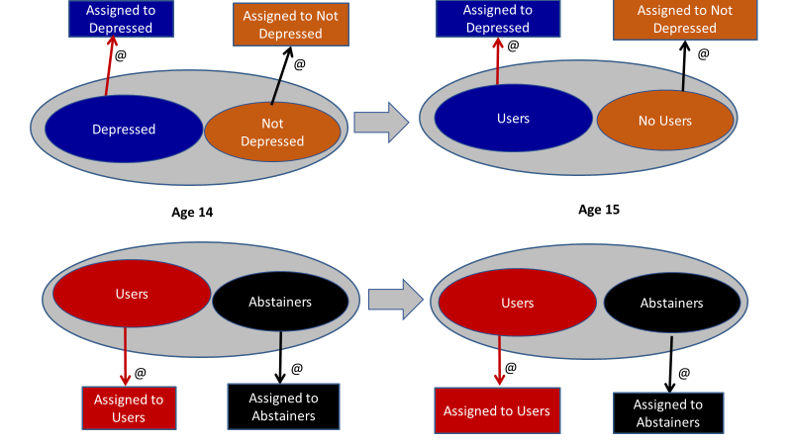
Associative LTA
Depression
Substance Use
Notes:
The 3 step-approach makes it also possible and straightforward to develop more complex models where associative LTA, that is a model where we investigate changes in two different processes, in this example, Substance Use and Depression. We can then identity different categories of substance users and different categories of depression. We investigate both processes at 14 and 15 years. We develop the measurement models for these processes, and using the 3-step processes we assign individuals to latent classes controlling for the uncertainty in the measurement models. The questions we may ask concern how the Depression status may affect Substances use status across age.

Slide 26
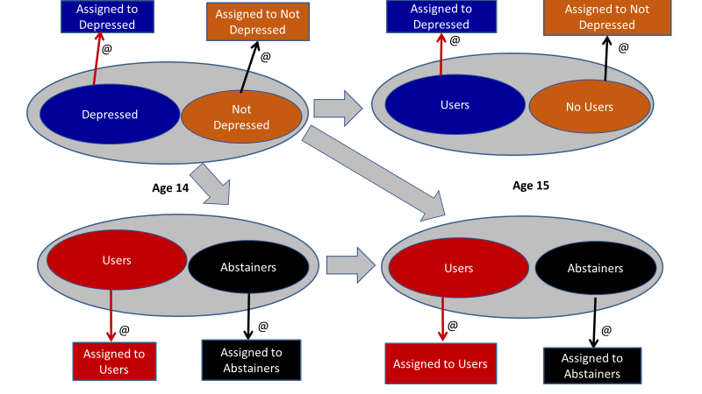
Associative LTA: Cross-Lagged Model
Depression
Substance Use
Notes:
For example, we may assume a cross-lagged model were the depression status at age 14 may affect changes in substance use classes in age 14: by adding this regression and controlling for the substance use class at the earlier age, we are effectively testing if depression status at 14 years affects changes in substance use class at age 15 years. We can test the cross-lagged model with a model without this effect, and since these are nested, using the LR to formally test if there is a difference in the fit of the two models.
Similarly, we can develop more complex models, where we may have more measurement points, covariates of different nature, and distal outcomes.

Slide 27
Summary
Investigate Transition Probabilities
E.g.: No “backsliding” ?
Include covariates
Investigate moderation effects
Include distal outcomes
More complex models:
Associative LTA

Slide 28
www.ncrm.ac.uk

