Slide 1
An Introduction to Mediation and Moderation
Part #3
Dr. Oliver Perra

Slide 2
Moderation
Moderator: Qualifies the association between predictor and outcome.
Mod
X
Y
Notes:
A moderator is a variable that qualifies the association between a predictor and an outcome. What it means is that the strength of the association or even the sign of the association between predictor and outcome changes depending on the values of the moderator.

Slide 3
Moderation
Moderator: Qualifies the association between predictor and outcome.
+ Social Capital
Trauma
Major Depression
- Social Capital
Trauma
Major Depression
Notes:
A fictional example: Social capital refers to personal relationships, social network support, trust etc. The relation between being exposed to traumatic events and the onset of major depressive disorder may depend on the availability of social capital so that people exposed to traumatic events may be less likely to develop major depression if they have a higher level of social capital.

Slide 4
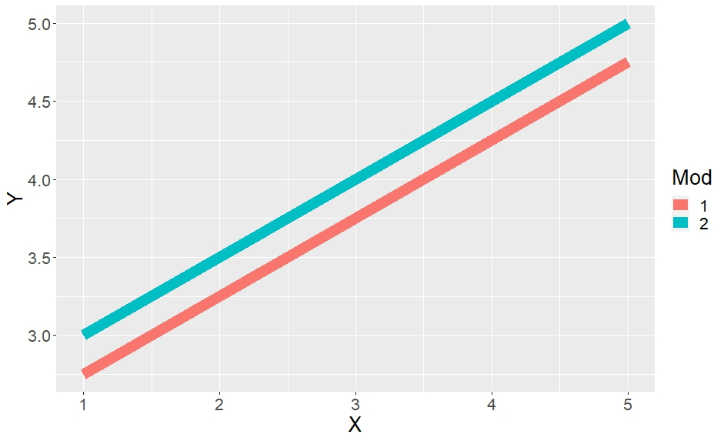
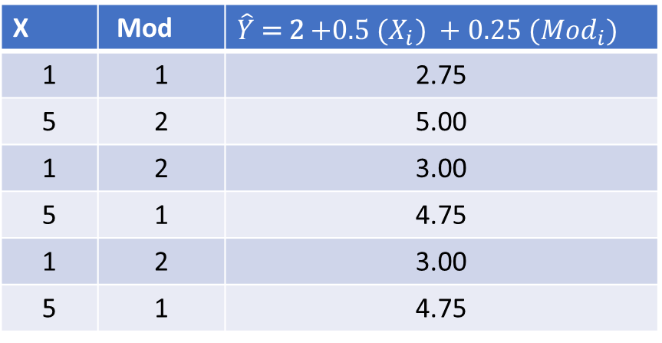


Moderation
Factorial ANOVA involves moderation: interactions of predictors.
Regression procedures provide a more general and flexible procedure to include, test, and represent moderation.
$Y_{i}$ = $a+ b1 {(X}_{i}) +b2 \left({Mod}_{i}\right)+e_{i}$
$\hat{Y}$ = 2 $+0.5 {(X}_{i}) +0.25 ({Mod}_{i})$
X | Mod | $\hat{Y}$ = 2 $+0.5 {(X}_{i}) +0.25 ({Mod}_{i})$
1 | 1 | 2.75
5 | 2 | 5.00
1 | 2 | 3.00
5 | 1 | 4.75
1 | 2 | 3.00
5 | 1 | 4.75
Notes:
If you are familiar with Factorial ANOVA you have already dealt with tests of moderation. The interactions between predictors in a Factorial Anova, are testing moderation of the effects of a predictor on an outcome. Mathematically factorial ANOVA is identical to the regression procedures I will illustrate. The advantage of using regression procedures is that these are more general and flexible in including, testing and representing moderation by different types of variables.
So, let’s start with a standard regression model, where the value of an outcome Y for individual “i” is the result of an intercept “a” which represents the predicted value of Y when other variables are equal to 0, then we have then parameter “b1” that represents the change in Y associated with a one-unit change in predictor X, and a parameter “b2” that represents the predicted change in Y associated with a 1-unit increase in variable Mod. Then we have an error term “ei” which represents variation in the Y scores that is not accounted for by the predictors. This variation is supposed to be normally distributed around mean = 0 and a variance we estimate.
Since here I am considering the predicted values of Y ,I am not representing the error variance in the estimation. In this simple example, X takes two values, 1 and 5, and Mod two values, 1 and 2. Using the equation above we can these values of Y for each row.
If we plot these predicted values putting X on the horizontal axis and outcome Y on the vertical axis, and use different lines for different values of Mod, we can see these lines are always going to be parallel. This is because the effects of the predictors are independent: any change in Y associated with one unit of X is not dependent on values of Mod. No Matter what the value of Mod, a 1-unit change in X will result in a change in Y equivalent to “b1” (i,.e. 0.5 points). On the other hand, the changes in Y associated with increasing Mod values are also not dependent on X.

Slide 5
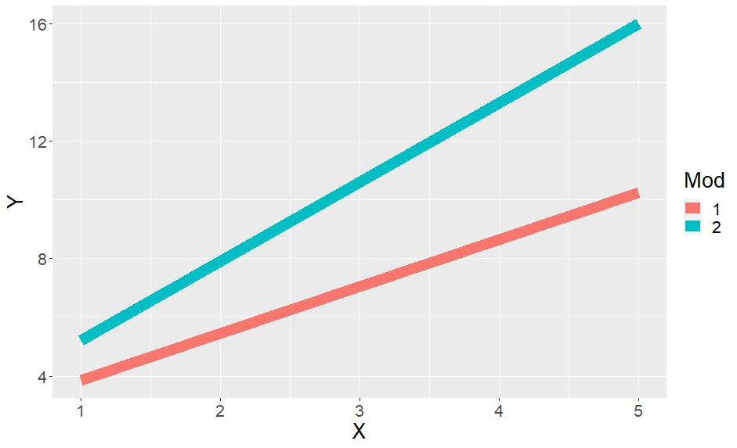
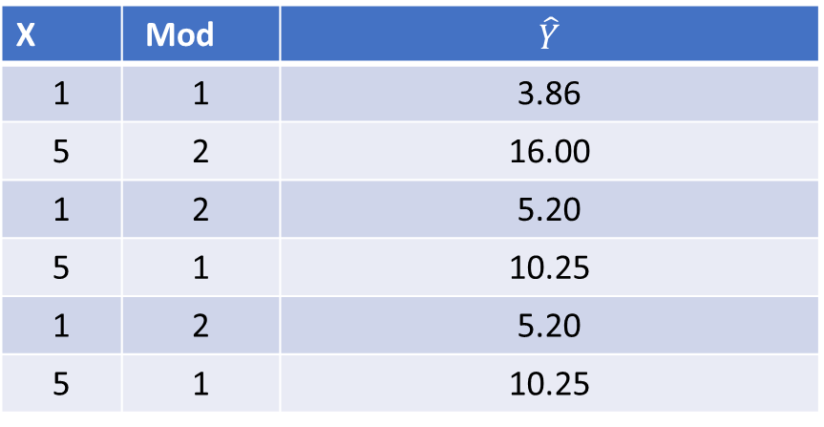
Moderation
Factorial ANOVA involves moderation: interactions of predictors test moderation.
Regression procedures provide a more general and flexible procedure to include, test, and represent moderation.
$Y_{i}$ = $a+ b1 {(X}_{i}) +b2 \left({Mod}_{i}\right)+b3 {(X}_{i }∗ {Mod}_{i}$) $+e_{i}$
$\hat{Y}$ = 2 $+0.50 {(X}_{i}) +0.25 ({Mod}_{i})$ + 1.10${(X}_{i }∗ {Mod}_{i}$)
X | Mod | $$\hat{Y}$$
1 | 1 | 3.86
5 | 2 | 16.00
1 | 2 | 5.20
5 | 1 | 10.25
1 | 2 | 5.20
5 | 1 | 10.25
Notes:
If, however, we assume that the effect of X on Y depends on the value of Mod, we have to add a term that represents changes in Y for different combinations of X and Mod. Thus, we assume there is a third coefficient b3 that represents how much the values of Y will vary as a function of different combinations of X and Mod. The different combinations of X and Mod are obtained by multiplying the values of the two variables, see the terms highlighted in red.
In this case, when we estimate predicted values of Y for different individual values of X and Mod in the rows, and we plot these values, we can see that the lines are no longer parallel. The way in which the two lines diverge or converge depends on the sign and value of the coefficient “b3”.
In this example the increase in values of the dependent variable Y when X increases is particularly more marked when Mod is 2.

Slide 6
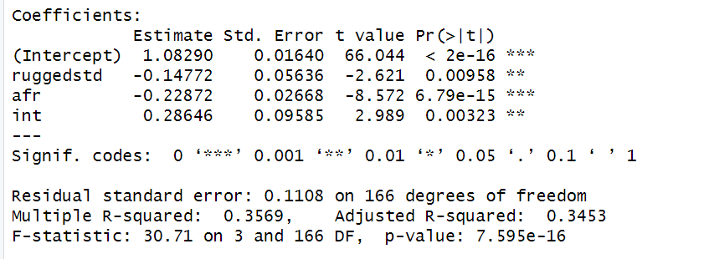
An example: GDP and “Ruggedness”
Data on countries across the world in year 2000:
  Ruggedness: landscape topographic diversity;
  Log of Gross Domestic Product (GDP) per person.
#### Binary for African Countries
dd$afr<- ifelse(dd$cont_africa==1, 1, 0)
#### Create term for interaction
dd$int<-dd$afr*dd$ruggedstd
summary(lm(logGDPstd~ruggedstd+afr+int, data=dd))
Notes:
I will use a dataset used by McElrath in Statistical Rethinking.
The data represent information on country’s log of GDP per capita in the year 2000 across different continents. Ruggedness is an index of the topographic diversity of the landscape. In most countries higher ruggedness is associated with lower GDP, most likely because transport is more challenging or expensive in rugged terrain, and this can hinder access to markets. However, the association between ruggedness and GDP is positive in African countries.
You can follow the example using the R script in the online material. The log of GDP is standardised so that the variable in the dataset represents the ratio of the log GDP: a country with value 1 has GDP equal to the world average. Ruggedness is also standardised so that it varies from 0 (a completely flat country) to 1 (the most rugged country).
Having loaded the dataset, I created a dummy variable to indicate if a country is in Africa or not.
I also create an interaction term that represent the different combinations of values of the predictor Ruggedness and the other covariate, the dummy for countries in Africa.
I then run the regression as you can see here: the outcome, std Log(GDP) is regressed on Ruggedness, the dummy for African countries, and their interaction.
Here you can see the results. The coefficient for the interaction is significantly different from 0, so we accept the supposed moderation effect is not negligible.

Slide 7
An example: GDP and “Ruggedness”
Data on countries across the world in year 2000:
  Ruggedness: landscape topographic diversity;
  Log of Gross Domestic Product (GDP) per person.
Std Log GDP = $a+ b1 (Rugged) +b2 \left(Afr\right)+b3 (Afr∗Rugged$)
a
b1
b2
b3
Std GDP of African Country (afr=1) with max
Ruggedness (rugged=1):
1.08 + (-0.15)* (1) + (-0.23) *(1) + (0.29)* (1*1) =
1.08 + (-0.15) + (-0.23) + 0.29 =
0.99
Std GDP of African Country (afr=1) with no Ruggedness (rugged=0):
1.08 + (-0.15)* (0) + (-0.23) *(1) + (0.29)* (0*1) =
1.08 + (-0.23) =
0.85
Notes:
How to interpret these parameters?
Remember the equation for this model. The coefficient for the interaction is approx. 0.29. This represents the change in the outcome associated with different combinations of the predictor X (Ruggedness) and the moderator (being in Africa).
This represents the change in the slope of the line that links predictor and outcome for values of the moderator. Since in this case we only have two values of the moderator, this means that line linking Ruggedness and GDP will tilt 0.28 units higher with increasing values of Ruggedness for African countries.
However, the interpretation of this parameter cannot be made separately from the other parameters. We are talking about contextual effects here, and indeed, saying that the slope of the association between Ruggedness and GDP is higher for African countries than countries in other continents does not mean much if we do not consider this with the other effects.
The other effects in fact tell us that Ruggedness is negatively associated with GDP, so more rugged countries tend to have lower GDP, and African countries tend to have lower GDPs. In this context, the coefficient b3 indicates that across African countries the reduction of 0.15 units in GDP associated with increasing ruggedness is contrasted, even inverted, by the fact that in Africa increasing Ruggedness is associated with a GDP increase equivalent to 0.29 units.
It is also important to remember that the other parameters b1 and b2 cannot be interpreted in isolation from the interaction. Here, b1 cannot be interpreted as the “main effect” of Ruggedness (as it may sometime referred to in factorial ANOVA), nor is it the effect of ruggedness while controlling for continent: it is instead the conditional effect of ruggedness on GDP when the moderator, continent is 0, i.e. NOT Africa. If the moderator was a continuous variable, it would be the conditional effect of predictor X on outcome Y when moderator = 0.
The point is that this is a conditional effect, an effect that represents associations between the two variables the context of the moderator being equal to 0.
Similarly, the term b2 is not the effect of continent while controlling for Ruggedness, but rather the conditional effect on GDP for an African country when ruggedness is equal 0.
I want to emphasise once again that adding an interaction term changes the interpretation of the individual parameters of the variables that make up the interaction, so that these parameters cannot be interpreted in isolation as “main effects” of the variable : they should be interpreted as conditional effects, the effects of the variable in a scenario whereby the other variable is equal to 0.

Slide 8
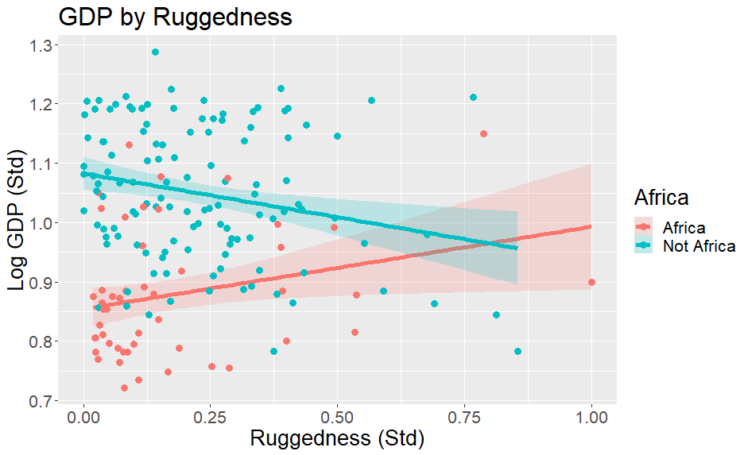
Visualising the predictions by the model
Std Log GDP = $a+ b1 (Rugged) +b2 \left(Afr\right)+b3 (Afr∗Rugged$)
Notes:
Most of the time the best way to provide a clear idea about what the moderation means is by plotting the predicted outcomes.
In this figure I represented a scatterplot where each point represents a country. The horizontal axis represents the standardised values of Ruggedness, while the horizontal one represents the standardised Log(GDP) values. Remember that 1 is the general mean.
I used colours to differentiate between African and Non-African countries. I then added a lines representing the regression of Log(GDP) on Ruggedness for the African and non-African countries. The shaded area around the lines represent 90% Confidence Intervals of the predicted values.
The graph illustrates effectively that while for non-European countries increasing Ruggedness is associated with lower GDP, the opposite relation is observed across African countries.
We can interpret this result invoking historical reasons and the legacy of colonialism: more rugged African countries were more difficult to reach, and this probably protected them against the exploitation of their resources by colonial powers and, also, from the slave trade.

Slide 9
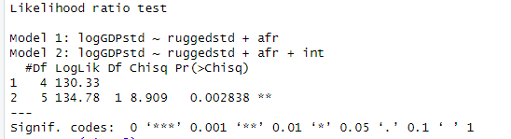
Why splitting data is a bad idea !
Parameters in the model (e.g. variances) do not depend on the moderators.
Models can use information from other groups to learn about phenomena in a specific group.
It hinders the possibility to compare models.
m1<-lm(logGDPstd~ruggedstd+afr, data=dd)
m2<-lm(logGDPstd~ruggedstd+afr+int, data=dd)
library(lmtest)
### Likelihood-Ratio Test of the two models
lrtest(m1, m2)
Notes:
Since moderation describes situations in which associations between two variables vary across the values of a 3rd variable, would not be sensible to split the participants in groups to check if the associations between variables are different across these groups? For example, wouldn’t be sensible to investigate the association between Ruggedness and GDP across African countries first and then across all the other continents?
It is a bad idea firstly because parameters in the model like variances are not dependent on the moderators, hence their accuracy of their estimates is going to be negatively affected. If we split the data between African and Non-African countries we would effectively be assuming that the variance in estimating the outcome differ among these two groups, but there is nothing to justify this assumption.
we may want to compare models that include moderation effects against models that treat all covariates as having independent effects. To run these comparisons, we need to estimate the models on the same data.

Slide 10
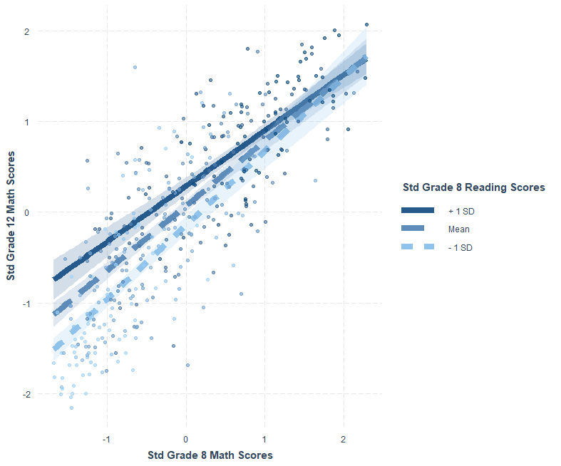
Symmetry of Predictors
Students assessed in standardised scores of Maths and Reading at grade 8 and grade 12.
Some attended private High Schools.
Math12 = $a+ b1 (Math8) +b2 \left(Read8\right)+b3 (Math8∗Read8$)
Install package ‘Interactions’ in R to explore and visualise moderation models.
Notes:
Here I provide an example where the moderators are both continuous. I use the dataset that reports results in Maths and Reading tests of children in Grade 8 and Grade 12.
Here I test a model where the association between math scores in grade 8 and grade 12 is supposed to be mediated by reading scores in grade 8.
The example is provided with the material of this course, and you can look at that that to see how I created this graph.
The graph shows a scatterplot where the horizontal axis represents Grade 8 Math scores and the vertical one Grade 12 math scores. Since the moderator, reading scores, is continuous, the easiest way to represent the interaction is to select some meaningful values in the distribution of the moderator and plot the predicted scores for these values. In this graph, the package automatically selected the values of the moderator that correspond to 1 SD below the mean, the mean, and 1 SD above the mean. So these lines represent the association between math scores for adolescents have above average, average, or below average READING scores. The shaded areas represent confidence intervals of these predictions.
This shows that the association between maths scores tends to be stronger for adolescents with worse reading scores.
This example also provides a chance to illustrate a property of moderation models, their symmetry. We may say that reading scores are moderating the strength of the association between math scores, so that this association depends on the reading scores. However, in the same way we may say that Grade 8 math scores are moderating the association between grade 8 reading and grade 12 math results. From a statistical and mathematical point of view the two possibilities are equivalent, there is nothing in the equation that says grade 8 reading is the moderator rather than grade 8 maths!
The interpretation of one construct as a mediator does not come from the model or the analyses, but it comes from designing studies that give support to these causal interpretations, as well as substantive knowledge about the issues. The point is once again that the statistical models cannot tell us everything we need to know, and the correct interpretation of the results necessitates further reflection and collation of information.

Slide 11
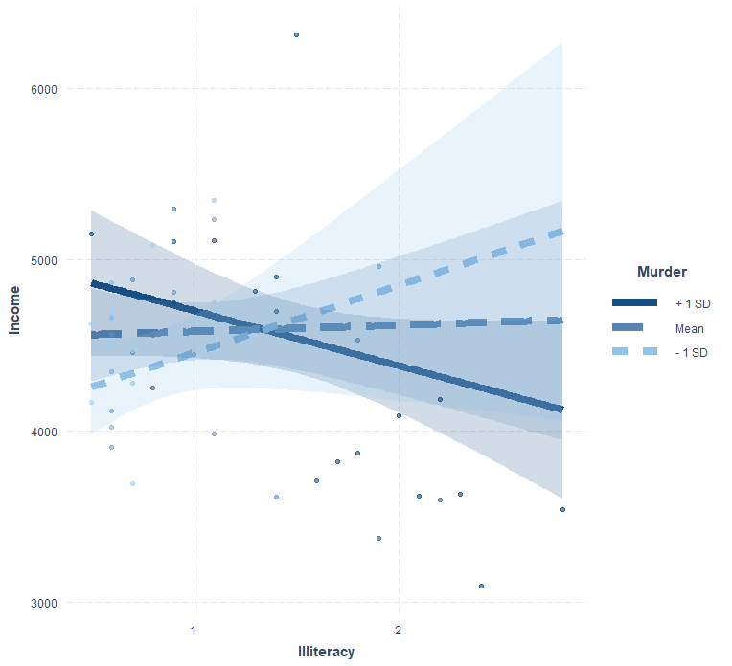
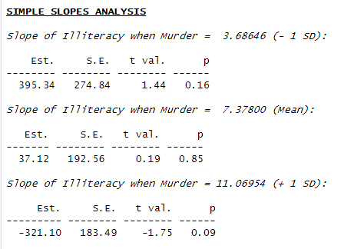
“Probing” an interaction
Dataset on Income, Illiteracy, Murder Rate, and percentage of people with High School degree across USA states.
MODEL→ Income = $a+ b1 (Illiteracy) +b2 \left(Murder\right)+b3 (Illiteracy∗Murder$) $+b4 ($HS Degree)
sim_slopes(model, pred = Illiteracy, modx = Murder)
Notes:
When running a moderation model the test can tell us that the interaction term is significant, so that the strength or the sign of the association between a predictor and the outcome depends on the values of a third variable.
However, it is not always evident at which values of the moderator does the association between predictor X and outcome Y becomes significantly stronger.
Here for example, I used data from the 1977 Census in the USA, data built in into R. These data report information on Imcone, Illiteracy, Murder rate and percentages of people with High School degrees by state.
In the model here the level of income is a function of HS Illiteracy, murder rate, and an interaction between Illiteracy and Murder rate
The interaction is significant, and I plot the predictions of this interaction. This shows that the association between Illiteracy and Income goes from positive to negative with increasing murder rate. We can also see that when murder rate is average, the association between illiteracy and income seems very weak.
By “probing” the interaction we can test if these slopes are significantly different from 0, i.e. if the association between predictor and income is different from 0 at these different values of the moderating variable.
Here I report the estimated slopes corresponding to different values of the moderator, rate of murder. As you can see, none of these slopes is significantly different from 0, although the slope appears to become larger (and negative) with increasing values of murder. We could change these values of the Moderator to include points that correspond to +2 SD units in Murder rate and check if the value of the slope and its stastical significance.

Slide 12
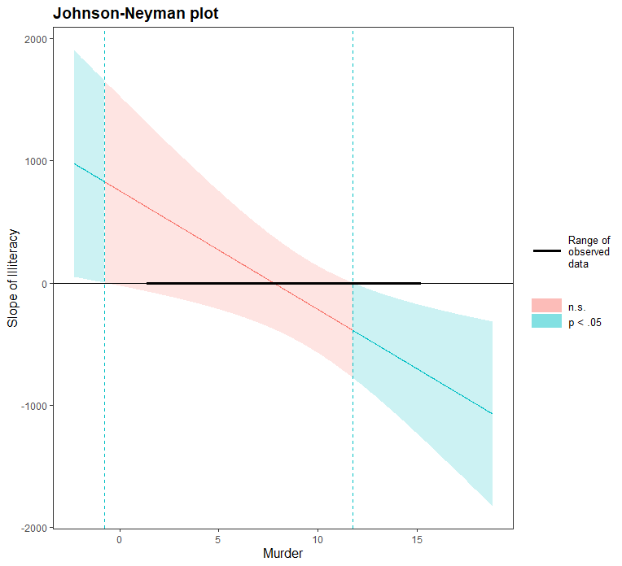

“Probing” an interaction
Income = $a+ b1 (Illiteracy) +b2 \left(Murder\right)+b3 (Illiteracy∗Murder$) $+b4 ($HS Degree)
johnson_neyman(fiti, pred = Illiteracy, modx = Murder, alpha = .05)
Notes:
The plot shows where the conditional slope differs significantly from zero, that is, where in the distribution of the moderator Murder does the association between Income and Illiteracy is significantly different from zero.
The graph shows that when murder rate is higher than 11.74, the association between Illiteracy and Income is significantly different from 0, and in this case negative. The interpretation of the interaction would thus be that the association between State income and illiteracy is non-significant, except in cases where Murder rate is higher than 11.74, whereby Illiteracy predicts lower income.
Further care needs to be applied when using these analyses and particularly graphs such as this one. The graph is showing that the model suggests that if Murder rate was negative the slope will become positive. But these values are observe and –indeed- they are not even possible. The model applies its computations, but we need to think and interpret them.

Slide 13
More Complex Models
Moderated Mediation:
M
W+
X
Y
M
W-
X
Y

Slide 14
More Complex Models
Causal Mediation Analysis:
  General approach for the definition, identification, estimation of causal mediation effects without reference to specific statistical models (e.g., linear SEM).
  Based on counterfactual framework of causal inference.
  More flexible: Can accommodate different types of relationships between variables; parametric and non-parametric models; different types of mediators and outcomes.
    E.g.: Imai, Keele, & Tingley (2010). Psychological Methods, 15(4), 309.
Notes:
https://ademos.people.uic.edu/Chapter15.html

Slide 15
www.ncrm.ac.uk

