Slide 1
Introduction to Mediation and Moderation
Part #2
Dr Oliver Perra

Slide 2
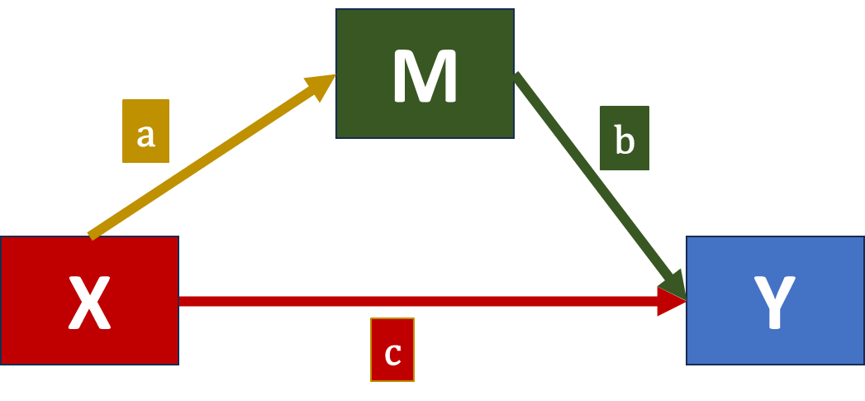
Summary
Mediation:
  Answers questions about how predictors influence outcomes.
Simple OLS-based mediation model:
  Partition total effect X→Y into:
    Direct effect c;
    Indirect effect a*b;
    Key inferential tests concern indirect effect a*b;
      These require resampling methods, e.g. bootstrapping.
Notes:
I will firstly recap some of the key concepts from part #1.

Slide 3
Outline
Confounding
Multiple mediators
Longitudinal mediation models

Slide 4
Confounding
Mediation models are causal models
Notes:
It is important to always keep in mind that mediation models are causal models, they make some assumptions about causal mechanisms and causal links.
Therefore it is important to think carefully about the causal mechanisms assumed by the model and how we can control for threats to the validity of the arguments we are putting forward with our models.
If the predictor X in a model is an experimental variable, for example a treatment that participants receive if they are randomly selected to receive it, as long as participants who receive the treatment and those who don’t are otherwise treated in the same way during the study, we can be confident that the treatment is the only plausible cause for differences in the outcomes between two groups.
But often we cannot run experimental studies. Furthermore, while the predictor in experimental studies can be randomly allocated, the mediators are not, and the mediators are assumed to causally influence the outcome.
The association between the mediator and the outcome may be due to a third variable that influence both.

Slide 5



Example of confounder
pH
Treatment
Notes:
Take the example of a treatment that applied on our soil promotes successful growth of plants. This treatment may work partly because it effectively eliminates fungi and other organisms that hinders plants growth.
However, there are some possible confounders that may explain this causal link. For example, the pH or acidity in the terrain can negatively influence fungi, and, on the other hand, the same level of pH that is negative for fungi may be optimal for plants.
In this case, the indirect effect of treatment through fungi reduction would be biased and confounded. We would argue that the mechanism of action of the treatment involves reducing fungi, but this is would be not true if some other uncontrolled mechanism can explain the link between mediator and outcome.

Slide 6
Example of confounder: what is being confounded?
pH
Treatment
Notes:
I take this chance to add an important clarification. We need to be clear about what is being confounded in this example.
In the example, the pH confounder is a confounder of the indirect effect from treatment to outcome. That is, if you are interested in better understanding the mechanism of action of the treatment, than you want to make sure you control for counter-arguments that may indicate that the treatment is not actually working by acting on fungi or other mediators.
However, if your main interest is testing if treatment works and promotes flower growth, whether the mechanisms of action are through fungi or involve pH does not really interest you, all you are asking is whether the treatment will make your plant grow: if the treatment was tested using an experimental procedures in a substantial number of samples, you can be confident it works.
The point is that pH in the example does not confound the total effect of Treatment on Outcome. If your interest is in estimating the total effect, or whether the treatment works, you do not need to adjust for these confounders. However, if your interest is in understanding the mechanisms of action of the treatment, than pH is an important source of confounding of your supposed indirect mechanism of action.

Slide 7
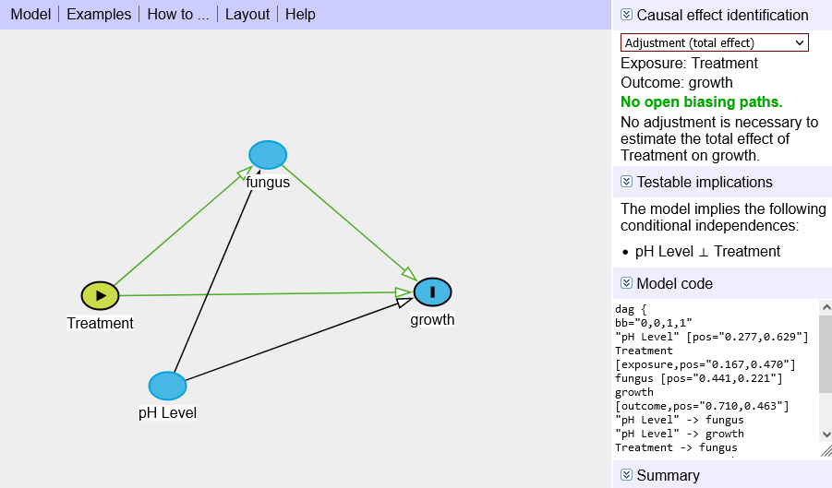
Example of confounder: what is being confounded?
Daggity (also available as R package) : daggity.net
Notes:
I will point out an important resource for reflecting about the causal models you are building and the controls you need. Directed Acyclic Graphs are ways to represent directions of causal influences between variables. These graphs are called directed acyclic because edges represent a direction of causality between variables and do not flow back onto themselves.
These graphs are useful in representing conditions in which we can correctly estimate a causal effect of a predictor on an outcome.
Taking the example before, I can specify treatment as the Exposure and Growth as the outcome of interest. In the right menu I can select what type of causal effect I want to identify. If I want to identify the total effect, there are no adjustments necessary. If I wanted to know about whether the treatment works, provided there are no other mechanisms that influence treatment and outcome, then I do not need to adjust for other possible intervening mechanisms.

Slide 8
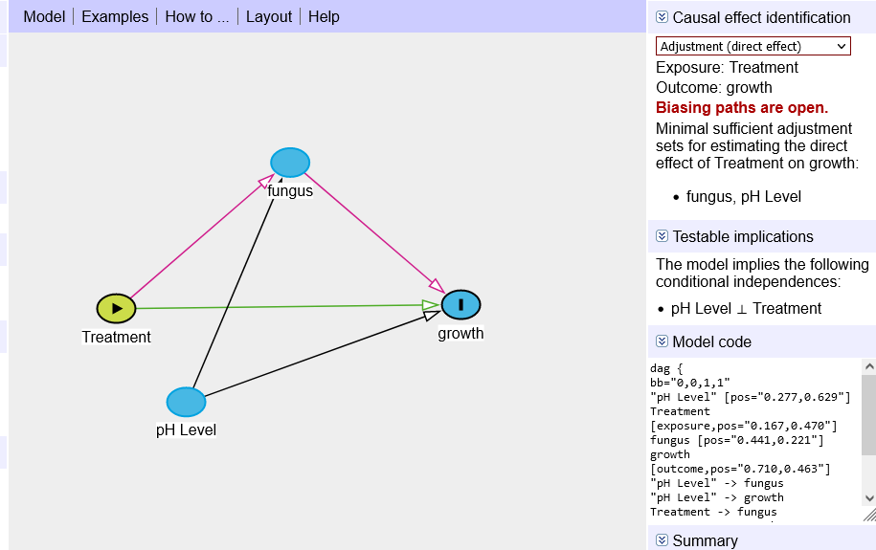
Example of confounder: what is being confounded?
Daggity (also available as R package) : daggity.net
Notes:
However, if I want to estimate the direct effect of the treatment, or conversely, the indirect effect, I will have to control for fungus and pH level.
The point is that DAGs can help you describe the supposed causal pathways in the phenomena you are studying in a qualitative way and check the type of adjustment and tests you need to be able to investigate causal hypotheses.

Slide 9


Example: Confounding
Students assessed in standardised scores of Maths and Reading at grade 8 and grade 12.
Some attended private High Schools.
$$e_{R8}$$
Maternal Educ.
Read8
$$e_{M12}$$
HighInc8
Math12
Notes:
So, in a previous example I tested a model whereby the effect of family income on grade 12 maths scores was supposed to be mediated by grade 8 reading scores.
We could think of many factors that might act as confounders of this supposed pathway. For example, Maternal educational attainment may influence the child’s scores in grade 8 and grade 12. So the supposed effect of family income through grade 8 scores may be a spurious one, whereby the mechanism of influence involves maternal education instead.
Another variable that may bias this supposed mechanism through grade 8 scores is gender: girls may be more academically driven and do better in grade 8 and 12.

Slide 10
Example: Confounding
Students assessed in standardised scores of Maths and Reading at grade 8 and grade 12.
Some attended private High Schools.
$$e_{R8}$$
process (data=d,
y="math12",x="highinc",m="read8", cov=c("male","mated"),
total=1, boot=10000, model=4, seed=90460)
Maternal Educ.
Read8
Male
$$e_{M12}$$
HighInc8
Math12
Notes:
Using the PROCESS macro it is easy to control for similar confounders. All you do is add an option “cov” for covariate, where you can list a set of covariates, in this case male and maternal education.
Adding controls for this confounders, the indirect estimated effect of high income on math 12 scores is 2.84, whereas it was about 2.82 without those controls.
Note that in the PROCESS macro the total effect of High Income on Math scores is estimated assuming the covariates are held constant, or else, it is estimated while controlling for the covariates.

Slide 11



Parallel mediators
The predictor influences the outcome through two or more mediators. The mediators do not influence one other. However, they may be correlated.
$$e_{R8}$$
Read8
$$e_{M12}$$
HighInc8
Math12
Math8
$$e_{M8}$$
Notes:
Another common scenario in mediation is when parallel mediators are hypothesised. In this scenario, the predictor influences the outcome through two mediators or more, and these mediators are supposed not to causally influence each other. This does not mean they are independent; the mediators can be correlated with each other for example.
This scenario is useful in testing the different size of indirect effects across different putative mechanisms.
In the example, the effect of family high income on grade 12 math scores is supposed to be mediated by grade 8 reading scores and by grade 8 math scores.

Slide 12
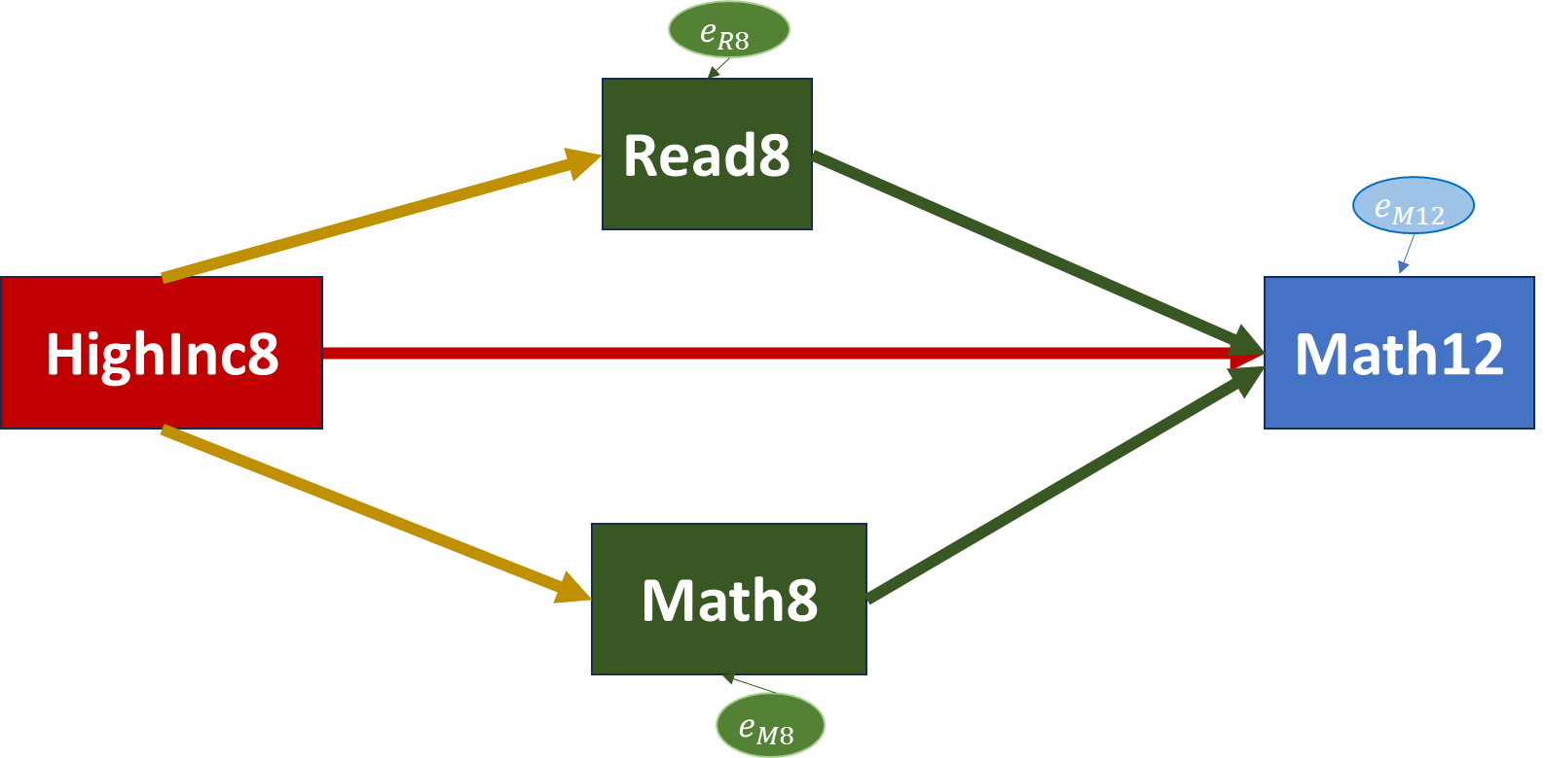
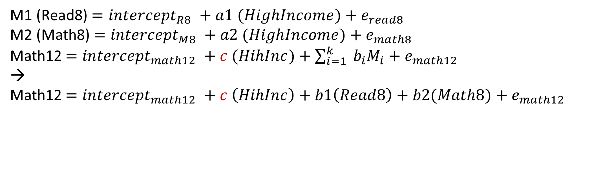
Parallel mediators
The predictor influences the outcome through two or more mediators. The mediators do not influence one other. However, they may be correlated.
b1
a1
c
a2
b2
M1 (Read8)$={intercept}_{R8} +a1 (HighIncome){+ e}_{read8}$
M2 (Math8)$={intercept}_{M8} +a2 (HighIncome){+ e}_{math8}$
Math12$={intercept}_{math12} +c (HihInc)+\sum_{i=1}^{k}{ b_{i}M_{i}}{+ e}_{math12}$
→
Math12$={intercept}_{math12} +c \left(HihInc\right)+b1\left(Read8\right)+b2(Math8){+ e}_{math12}$
Notes:
Taking this scenario and using OLS estimation, the values of these mediators are estimated as a linear function of the predictor.
The outcome scores are estimated as a linear function of the predictor High Income, and the sum of coefficients for the different parallel mediators.
Thus, if we have two predictors as in this case, the Grade 12 math scores are estimated as a linear function of a direct effect of High Income, the “c” path, and the sum of coefficients, the “bs”, that represent the effect of the putative mediators on the outcome.
Thus, the b1 coefficient, for example, represents the change in Grade 12 Math scores for one unit increase in Grade 8 reading scores, for children within the same family income group and keeping the Grade 8 math scores, the other mediator, constant.

Slide 13
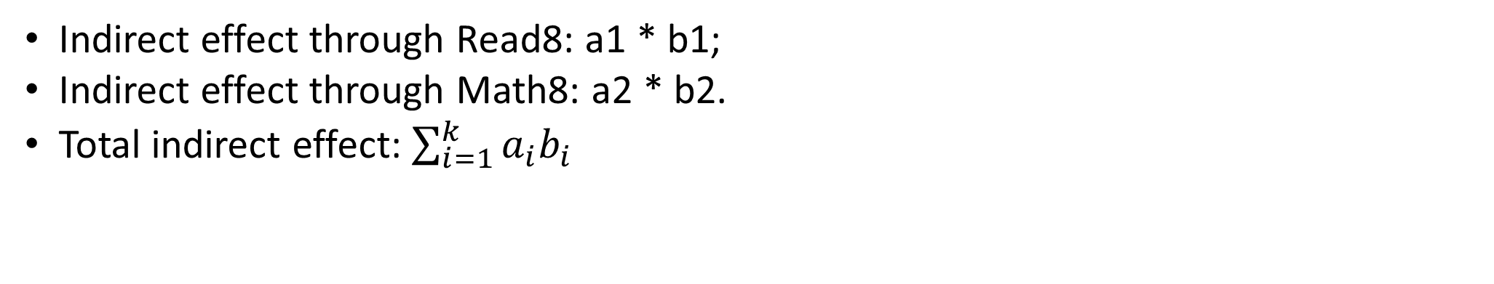
Parallel mediators
The predictor influences the outcome through two or more mediators. The mediators do not influence one other. However, they may be correlated.
b1
a1
c
a2
b2
Indirect effect through Read8: a1 * b1;
Indirect effect through Math8: a2 * b2.
Total indirect effect: $\sum_{i=1}^{k}{a_{i}b_{i}}$
Notes:
There are two specific indirect effects in this model, one through Grade 8 Reading scores, which is given by the product of the paths a1 and b1.
Similarly, the indirect effect through Grade 8 Math scores is the product of a2 and b2.
In this model, the specific indirect effect through Grade 8 reading score represents the effect of family income through reading scores while controlling for the Math 8 scores, the other parallel mediator in the model.
A total indirect effect is given by the sum of all specific indirect effects, in the example the sum of a1*b1 and a2*b2.

Slide 14
Parallel mediators
The predictor influences the outcome through two or more mediators. The mediators do not influence one other. However, they may be correlated.
process (data=d,
y="math12",x="highinc",
m=c("read8",”math8”),
contrast=1, modelres=1,
cov=c(“mated”, “male”),
total=1, model=4, seed=90460)
b1
a1
c
a2
b2
Indirect effect through Read8: a1 * b1;
Indirect effect through Math8: a2 * b2.
Total indirect effect: $\sum_{i=1}^{k}{a_{i}b_{i}}$
Notes:
Using the PROCESS macro in R it is easy to include parallel mediators by following the “m” option, where m stands for mediators, with a list of parallel mediators to be included in the model.
Note that in the model I also kept covariates MATernal Education and male.
I have also highlighted the option Contrast = 1, which instructs PROCESS to conduct a test of differences between the specific indirect effects.

Slide 15
Parallel mediators
The predictor influences the outcome through two or more mediators. The mediators do not influence one other. However, they may be correlated.
process (data=d,
y="math12",x="highinc",
m=c("read8",”math8”),
contrast=1, modelres=1,
cov=c(“mated”, “male”),
total=1, model=4, seed=90460)
4.63
0.15
1.21
4.64
0.69
Indirect effect through Read8: a1 * b1 → 4.63*0.15 = 0.72
Indirect effect through Math8: a2 * b2 → 4.64*0.69= 3.20
Test of difference of indirect effects:
  C1= -2.48, bootstrapping 95% CI -2.82 to -2.14
Notes:
Using the estimates taken from this example, we can substitute the paths with their estimated values.
We can also calculate the specific indirect effects from these estimates, or rather from the PROCESS output, which will return these values. For example, the indirect effect through Grade 8 reading scores while controlling for covariates and the parallel mediator Math 8 is 0.72, that is we expect an increase of 0.72 units in Math12 scores for 1-unit increase in reading scores while controlling for math8 scores and other covariates.
The output also returns the results of a test C1, which is a test of the null difference that the indirect effect through Grade 8 reading is no different from the indirect effect of the effect through Grade 8 maths. The result for this test is -2.48, which confidence intervals firmly in the negative range and not including 0, so we can reject the null hypothesis that the difference of these two indirect effects is 0, or else, there is no difference between these two indirect effects.
Note that in this case the two indirect effects have the same sign, they are both positive. In cases where the two effects have different signs, e.g. one mediator reduces the values of the outcome, the other one increases then, you may want to test the absolute value of the difference in effects. This option is allowing in PROCESS macro by selecting contrast=2.

Slide 16
Serial multiple mediators
Series of mediators through which the predictor influences the outcome
process (data=d,
y="math12",x="highinc",
m=c("read8",”math8”),
contrast=1, modelres=1,
cov=c(“mated”, “male”),
total=1, model=6, seed=90460)
Notes:
It is also possible to build models that include pathways of influence from one mediator to another. In this example, we assume that Reading grades in Grade 8 causally influence Math scores in the same year. Once again, please note that I am making this assumption just to illustrate how the modelling works, but from a substantive point of view a similar assumption of a causal link is difficult to justify.
Model 6 in the options invokes models with serial multiple mediators. The order of the variables after “m” for mediator indicates the order of influence, in this case from read8 to math8.
In this case there are 3 indirect effects of family High Income on Grade 12 math scores:
One indirect effect through Grade 8 reading scores, another through Grade 8 math scores, a third one through Reading and Math scores in Grade 8. The contrast=1 option also provides tests that compare if the difference of these tests is significantly different from 0. The results would indicate a significant difference of the indirect effect through reading and maths compared to the other two indirect effects.
That said, I should stress once again that one has to be very careful in using the results of the statistical models as proof of causal links. The fact that the results of the model show this model fits with the data does not prove in any way that reading scores positively influence math scores in the same year.

Slide 17
Mediation models for longitudinal data
Mediation models are causal models:
Assume mechanisms of influence from one variable to another;
Mechanisms necessarily need time to unfold.
X₀
a
M₁
c
b
Y₂
Time 0
Time 1
Time 2
Notes:
In fact, as one of the references provided with these resources highlight, estimating mediation models with cross-sectional studies can only provide accurate estimates of mediation effects in very restrictive conditions. When these conditions are not met, which is often, cross-sectional studies will provide biased estimates of mediation effects, and the results can be very misleading.
This makes sense because, as I emphasised on different occasions, mediation models are causal models, they assume some processes of influence and mechanism of change that take time to unfold. If, for example, we apply a treatment to our soil to promote plant growth, we would need some time to observe the effect of the treatment on the supposed mediator, fungi reduction, and some time to observe the consequential effect that reduction of fungi has on plant growth.
Really and truly, mediation models entail longitudinal data –in most cases.

Slide 18
Mediation models for longitudinal data
Mediation models are causal models:
Assume mechanisms of influence from one variable to another;
Mechanisms necessarily need time to unfold;
X₀
a
M₀
M₁
b
b
Y₀
Y₁
c
Y₂
Time 0
Time 1
Time 2
Notes:
With longitudinal data, we can also consider more complex situations. While X0 affects M1, and M1 affects Y2, M0 can also affect M1, and Y1 affects Y2.
These are autoregressive effects that reflect the stability of individual differences across time. These more complex models can be estimated using Structural Equation Modelling, which provides a more flexible approach to mediation analysis, one where different types of variables can be included.
By controlling for these effects, we test if the predictor is associated with significant changes in the mediator, once controlling for the mediator variable at a previous time point, and if treatment is associated with significant changes in the outcome, once controlling for the status of this outcome at previous time points.

Slide 19


Full Cross-Lagged Panel Model
Mediation models are causal models:
Assume mechanisms of influence from one variable to another;
Mechanisms necessarily need time to unfold;
Longitudinal data are better suited to investigate the unfolding of these processes
X₀
X₁
X₂
a
a
M₀
M₁
M₂
b
b
Y₀
Y₁
c
Y₂
Time 0
Time 1
Time 2
Notes:
Panel data indeed can be used to test models like this. The three variables are collected at three time points. Not that, unless the predictor X is a variable controlled experimentally, then we need model the correlation between the predictor and the other variables at time 0, the start of the study. We can then assess the autoregressive effects of the three processes, here indicated by the dotted lines.
The effects from X to M “a” are assessed on two occasions, as are those from M to Y. While the indirect effect is estimated by regressing Y2 on X0, while controlling for stability of individual differences and other processes.
Using path analysis, we can also use this model to test the STATIONARITY of the causal process, e.g. if the magnitude of effects from Predictor X to Mediator M and from Mediator M to outcome Y are similar across time.
We can also test for “equilibrium”: do the cross-sectional variances , here represented by the grey circles and arrows, remain similar over time or do they change?

Slide 20
Full Cross-Lagged Panel Model
Paulus et al., (2021). Reciprocal longitudinal associations between anxiety sensitivity and alcohol consumption/problems across adolescence: Examining anxiety as a
mediator and race/ethnicity as a moderator. https://doi.org/10.1016/j.brat.2021.103861
Anxiety Sensitivity
Anxiety Sensitivity
Anxiety Sensitivity
Anxiety Sensitivity
Anxiety
Anxiety
Anxiety
Anxiety
Alc. Probs
Alc. Probs
Alc. Probs
Alc. Probs
Time 1
Time 2
Time 3
Time 4
Notes:
Anxiety sensitivity is the tendency to interpret unpleasant physiological sensations as dangerous.. AS prospectively predicted alcohol problems (β′ s = 0.05–0.07) but not alcohol consumption (β′ s = 0.02–0.04) across high school. Anxiety mediated AS’s predictive effects on alcohol problems (βindirect’s = 0.01, 95% CI [0.003, 0.03]) across high school.

Slide 21





Mediation models for longitudinal data
Latent Growth Curve Models:
$$e_{M1}$$
$$e_{M2}$$
$$e_{M3}$$
$$e_{M4}$$
M_{t1}
M_{t2}
M_{t3}
M_{t4}
i
s
a₁
$$e_{Y}$$
b₂
a₂
b₁
Y
X
Time 1
Time 2
Time 3
Time 4
Time 0
Time 5
Notes:
The use of SEM also allows to integrate other types of models into mediation analysis. For example, if the moderator is observed over repeated periods of time, we can use latent growth curve models to estimate the intercept and slope, i.e. initial stutus and rate of change of the moderator. These parameters that represent change in the moderator can then be included in the mediation model to test if changes in the mediating variable transmit the effect of the independent variable on the outcome.

Slide 22
Mediation models for Multilevel Data
Class j
Intervention_{j}
a
Teacher Communication_{j}
b
Child i
C
Child’s Results _{ij}
Time 0
Time 1
Time 2
An intervention delivered across j classes of a School. Effects on i children’s educational attainment may be mediated by improved teacher-student communication in class
Notes:
Finally, it is also possible to adapt mediation models to situations where the predictor and the mediators are at different levels compared to the outcome. For example, in this scenario we have children who are clustered within classes in a School. We may have an intervention that can promote better school results. The intervention is delivered at the class level. The moderating mechanisms here may be also at the class level. For example, the intervention may work by improving teacher-pupil communication, so the intervention influences a moderator that is also the class-level,
There are some packages that can run these types of analyses. However, structural equation models that integrate Generalised Linear Models provide a more flexible approach, one that allows to consider observed as well as latent variables in the mediation model, and can include different types of variables, e.g. binary, ordered categorical, counts.
https://stats.oarc.ucla.edu/stata/faq/how-can-i-perform-mediation-with-multilevel-data-method-1/
https://stats.oarc.ucla.edu/stata/faq/how-can-i-perform-mediation-with-multilevel-data-method-2/
https://stats.oarc.ucla.edu/r/faq/how-can-i-perform-mediation-with-multilevel-data-method-2/
https://cran.r-project.org/web/packages/mlma/vignettes/MLMAvignette.html

Slide 23
www.ncrm.ac.uk

