Slide 1
An Introduction to Mediation and Moderation Part #1
Dr. Oliver Perra

Slide 2
Summary
Mediation vs. Moderation
Example of simple mediation model
Practical example of mediation model
The case against the “causal approach”

Slide 3
Mediation vs. Moderation
Mediator: Accounts for the relation between predictor and outcome
Notes:
Let’s start by providing a definition of what is mediation and what is moderation, and what differentiates these concepts.
A mediator is a variable that accounts , at least in part, for the relation between a predictor and an outcome.

Slide 4
Mediation vs. Moderation
Mediator: Accounts for the relation between predictor and outcome
Med
X
Y
Notes:
In other words, in mediation we assume that a predictor X influences the outcome indirectly Y by influencing a mediating variable M, which in turn influences the outcome Y.

Slide 5



Mediation vs. Moderation
Mediator: Accounts for the relation between predictor and outcome
Treatment
Notes:
For example, the predictor may be a treatment we apply on our terrain to ensure our plants grow and flourish. The mediator may be the presence of fungi and other organisms in the terrain that prevent growth of plants. The treatment works by removing fungi and thus by removing factors that hinder the growth of our plants.

Slide 6



Mediation vs. Moderation
Mediator: Accounts for the relation between predictor and outcome
Self-efficacy
Depression
Peer-Support
Notes:
Another example: Peer support may reduce symptoms of Major Depression by increasing self-efficacy, the sense that someone has in their own ability to tackle some issues, which in turn can reduce symptoms of depression.

Slide 7
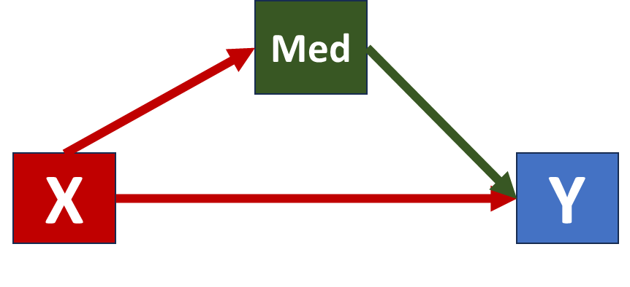
Mediation vs. Moderation
Mediator: Accounts for the relation between predictor and outcome
Moderator: Qualifies the association between predictor and outcome
Mod
X
Y
Notes:
A moderator is a variable that qualifies the association between a predictor and an outcome. What it means is that the strength of the association or even the sign of the association between predictor and outcome changes depending on the values of the moderator.

Slide 8

Mediation vs. Moderation
Moderator: Qualifies the association between predictor and outcome
Personal involvement
Strength of Argument
Changes in Attitudes
Environmental taxes
Notes:
For example, one can manipulate the strength of an argument in favour of environmental taxes, e.g. highlighting key benefits that may accrue from this policy, and test if stronger arguments influence changes in attitudes. Stronger arguments may lead to greater changes in attitudes.
However, the relation between strength of arguments and attitude changes may depend on how an individual is personally engaged by these issues, how much the individual care and is affected by these issues. For example, people that may be more affected by these taxes, may be more engaged and consider the arguments more attentively and carefully. Because of their deeper processing of the message, they may be more influenced by the strength of the argument.

Slide 9
Mediation vs. Moderation
Moderator: Qualifies the association between predictor and outcome
+ Personal involvement
Strength of Argument
Changes in Attitudes
- Personal involvement
Strength of Argument
Changes in Attitudes
Environmental taxes
Notes:
In the example, the situation may take this form: personal involvement varies, that is, how much these taxes will affect a person varies. Depending on this, the person may be more responsive to strong arguments when they are more involved, but may be less responsive and less likely to change attitudes when they are less engaged. In other words, the strength of the association between predictor and outcome, here represented by the red arrows, changes conditionally on the context, the moderator variable.

Slide 10
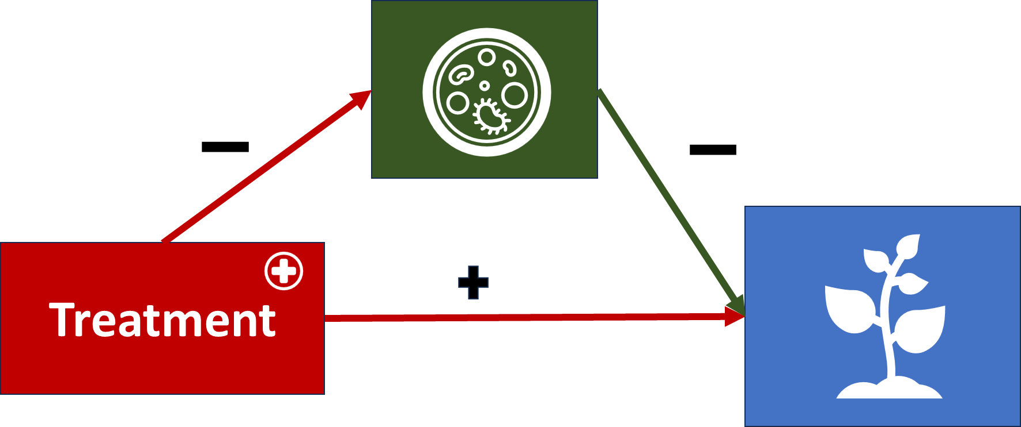
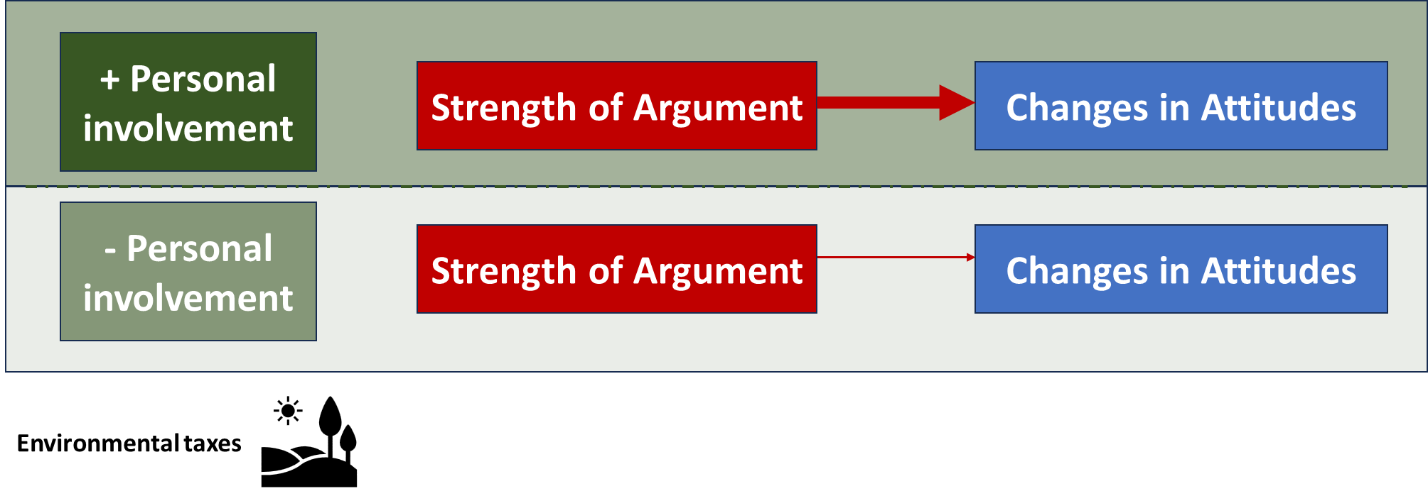
Mediation vs. Moderation
Mediation: How predictors influence outcomes
Moderation: When and for whom predictors influence outcomes
Notes:
So, it should be clear at this point that the study of mediation involves questions about how predictors influence outcomes. What are the chains of events that lead from a predictor to an outcome? I have provided some simple examples where a predictor like a treatment influences an outcome like plant growth through the elimination of fungi, but mediation can deal with examples where the predictor is the first step in a chain of events that are causally related.
Moderation instead concerns the study of how contextual factors influence relations between predictors and outcomes, In other words, in which situations do predictors influence outcomes, or what are the characteristics of people for whom a predictor leads to a certain outcome.

Slide 11
Simple Mediation Model
Med
X
Y
Notes:
I will now present a simple mediation model, introducing some formulae and concepts regarding mediation.

Slide 12
Simple mediation model
Mediator: Accounts for the relation between predictor and outcome
M
X
Y
Notes:
In the simplest mediation model we have three variables. X is a predictor. In this example X is an exogenous variable: its value does not depend on other variables in the model. X may be an experimental variable, e.g. a treatment that a randomly-selected group of participants receive and which is withheld among a second group of participants. Or it may be an exposure, some event that participants have experienced in their life, e.g. traumatic experiences. The predictor is supposed to influence the other two variables in the model, the outcome Y and the mediator M. In this sense, these variables are endogenous in the model. In turn, the mediator also influences Y. So, X can influence outcome Y directly, but can also influence Y indirectly, by influencing M, which in turn exerts an effect on Y.

Slide 13
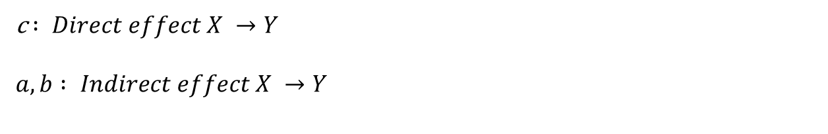
Simple mediation model
M
a
b
X
Y
c
c $: Direct effect X →Y$
$$a, b : Indirect effect X →Y$$
Notes:
I will call “c” the direct effect from X to Y. But X can also influence Y through an indirect pathway, one that involves “a”, the effect of X on M, and one that involves “b”, the effect of M on Y.
Note that, for the time being, I am not considering when these variables have been measured. In principle mediation models can be applied to cross-sectional as well as longitudinal data. In cross-sectional studies the three variables are observed at the same time.
However, mediation models are causal models, they are making assumptions about which variables are causes of other variables. This means that, while it is possible from a mathematical point of view to assume that X causes Y and the influence of X on Y is exerted through M even when we measure these variables on the same occasion, arguing that these variables are causally related requires more than just statistics. I will talk more about this, but for the time being it is important to remember that in a mediation model we are making assumptions about causality, and these assumptions need to have further justifications beyond the statistical model.

Slide 14
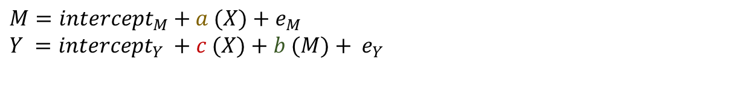


Simple mediation model: Ordinary Least Squares
$$e_{M}$$
M
a
b
$$e_{Y}$$
X
Y
c
$$M={intercept}_{M}+a (X)+e_{M}$$
$Y ={intercept}_{Y} +c (X)+{b (M)+ e}_{Y}$
Notes:
Given this model, if endogenous variables M and Y are continuous variables, we can apply Ordinary Least Squares methods to estimate the values of these variables as a function of X, in a similar way in which we do in linear regression.
So, we have a first endogenous variable, M, which is a function of X. We assume this variable has an intercept M, which represents the value of M when X = 0. We observe this variable M with error: The uncertainty in our measurement of M is thus represented by the term “em”, which ordinarily we assume is normally distributed with mean 0 and a variance that we can estimate.
We can build a similar model for Y, but in this case the values of Y are influenced by those of M, as well as X. So, as well as an intercept, which represents the value of Y when M and X are equal to 0, we have term “c” that represents the rate of change in Y for a 1-point increase in X, a term “b” that represents the rate of change in Y for a 1-point increase in Y, and a term “ey” that represents the uncertainty in the measure of Y.

Slide 15
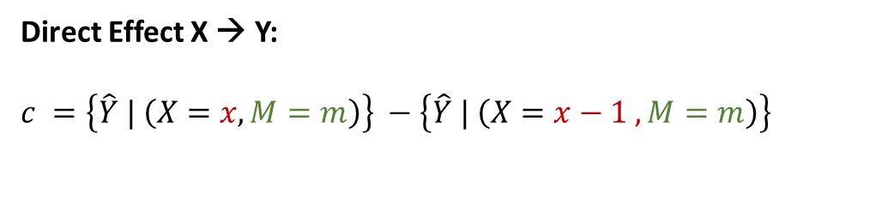
Simple mediation model: Ordinary Least Squares
$$e_{M}$$
M
a
b
$$e_{Y}$$
X
Y
c
Direct Effect X → Y:
$c =\left\{\hat{Y} | \left(X=x, M=m\right)\right\} −$ $\left\{\hat{Y} | \left(X=x−1 , M=m\right)\right\}$
$$M={intercept}_{M}+a (X)+e_{M}$$
$Y ={intercept}_{Y} +c (X)+{b (M)+ e}_{Y}$
Notes:
Now, we can use these equations to give a more formal definition of the Direct and Indirect effects represented in the graph here.
The direct effect from X to Y is represented by path “c”, which is formally defined as the difference in estimated values of Y associated with a 1-unit change in X, while keeping M constant, or else, while controlling for M. You can see this definition here, where Y^ represents estimated values of Y. The first part says that “c” is equal to the estimated value of Y conditional (|) on X taking value x and M taking value m, minus the estimated value of Y when X is reduced by one unit, and M is still equal “m”, i.e. is constant.

Slide 16
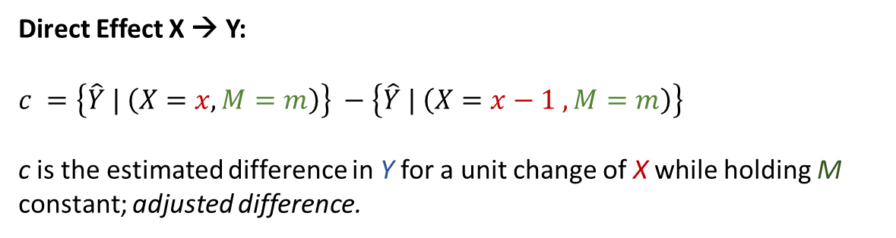
Simple mediation model: Ordinary Least Squares
$$e_{M}$$
M
a
b
$$e_{Y}$$
X
Y
c
Direct Effect X → Y:
$c =\left\{\hat{Y} | \left(X=x, M=m\right)\right\} −$ $\left\{\hat{Y} | \left(X=x−1 , M=m\right)\right\}$
c is the estimated difference in Y for a unit change of X while holding M constant; adjusted difference.
$$M={intercept}_{M}+a (X)+e_{M}$$
$Y ={intercept}_{Y} +c (X)+{b (M)+ e}_{Y}$
Notes:
In simpler terms “c” represents the difference in estimated values of Y for a 1-unit change in X while keeping M constant. That is, it is the adjusted difference between levels of X.
If X were a treatment that has only 2 values, 1 for treatment, 0 for control condition, “c” represents the expected adjusted treatment effect, adjusted while controlling for the mediator M.

Slide 17
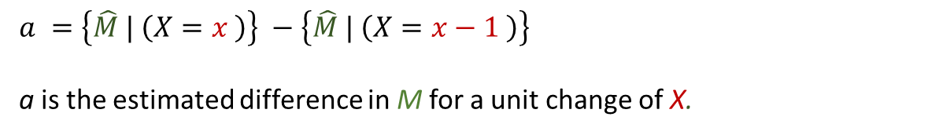
Simple mediation model: Ordinary Least Squares
$$e_{M}$$
M
a
b
$$e_{Y}$$
X
Y
c
$a =\left\{\hat{M} | \left(X=x \right)\right\} −$ $\left\{\hat{M} | \left(X=x−1 \right)\right\}$
a is the estimated difference in M for a unit change of X.
$$M={intercept}_{M}+a (X)+e_{M}$$
$Y ={intercept}_{Y} +c (X)+{b (M)+ e}_{Y}$
Notes:
Using the same principles we can say that “a” represents the estimated difference in M associated with a 1-unit change in X

Slide 18
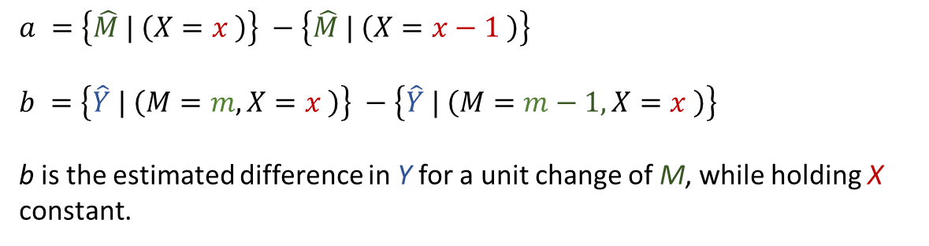
$$e_{M}$$
M
a
b
$$e_{Y}$$
X
Y
c
$a =\left\{\hat{M} | \left(X=x \right)\right\} −$ $\left\{\hat{M} | \left(X=x−1 \right)\right\}$
$b =\left\{\hat{Y} | \left(M=m, X=x \right)\right\} −$ $\left\{\hat{Y} | \left(M=m−1, X=x \right)\right\}$
b is the estimated difference in Y for a unit change of M, while holding X constant.
$$M={intercept}_{M}+a (X)+e_{M}$$
$Y ={intercept}_{Y} +c (X)+{b (M)+ e}_{Y}$
Notes:
b represents the estimated difference in Y associated with a 1-unit change in M while holding X constant

Slide 19
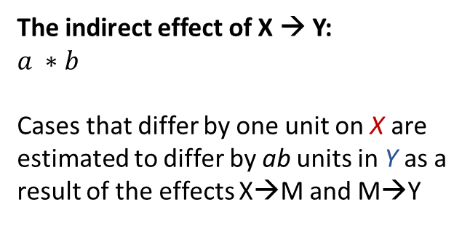
Simple mediation model: Ordinary Least Squares
$$e_{M}$$
M
a
b
$$e_{Y}$$
X
Y
c
The indirect effect of X → Y:
$$a ∗b$$
Cases that differ by one unit on X are estimated to differ by ab units in Y as a result of the effects X→M and M→Y
$$M={intercept}_{M}+a (X)+e_{M}$$
$Y ={intercept}_{Y} +c (X)+{b (M)+ e}_{Y}$
Notes:
The indirect effect from X to Y , the effect through M, is represented by the product of “a” and “b”.

Slide 20
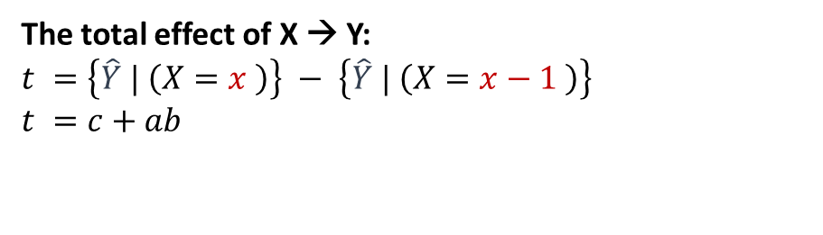
Simple mediation model: Ordinary Least Squares
$$e_{M}$$
M
a
b
$$e_{Y}$$
X
Y
c
The total effect of X → Y:
$$t =\left\{\hat{Y} | \left(X=x \right)\right\} − \left\{\hat{Y} | \left(X=x−1 \right)\right\}$$
$t =c+ab$
$$M={intercept}_{M}+a (X)+e_{M}$$
$Y ={intercept}_{Y} +c (X)+{b (M)+ e}_{Y}$
Notes:
We can also calculate the total effect from X to Y, which is the sum of the direct effect c, and the indirect effect a * b. Formally, the total effect is the estimated difference in Y for a 1-unit change of X.

Slide 21
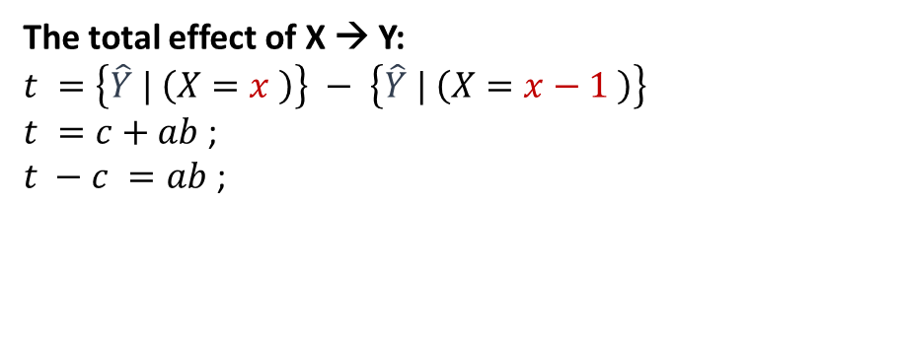
Simple mediation model: Ordinary Least Squares
$$e_{M}$$
M
a
b
$$e_{Y}$$
X
Y
c
The total effect of X → Y:
$$t =\left\{\hat{Y} | \left(X=x \right)\right\} − \left\{\hat{Y} | \left(X=x−1 \right)\right\}$$
$t =c+ab$ ;
$t −c =ab$ ;
$$M={intercept}_{M}+a (X)+e_{M}$$
$Y ={intercept}_{Y} +c (X)+{b (M)+ e}_{Y}$
Notes:
Using these formulae we can also see that the indirect effect from X to Y, a*b, is equal to the difference between the total effect and the direct effect c.
However, keep in mind this formulae to estimate the total effect works as long as we are dealing with continuous outcomes M and Y as well as generalised linear models like these, where M and Y are estimated to be linear functions of X and other variables. If these variable were estimated using other functions, e.g. logit or poisson, the partition of the total effect will be more complicated.

Slide 22
Practical Example
Med
X
Y
Notes:
I will now provide a practical example

Slide 23

Example: Students in Grade 8 and 12
Students assessed in standardised scores of Maths and Reading at grade 8 and grade 12.
Some attended private High Schools.
Let’s focus on Family Income at Grade 8 and reading:
Family Income was dichotomised to represent families with higher income.
$$e_{M12}$$
HighInc8
Math12
c
Notes:
I am going to use the data that you can upload in R using the command here.
The script to run this example is available with the material of the course.
In the example, I will focus on high family income when children where in grade 8. This represents children whose family was in the highest bands of income. The outcome is standardised Maths scores in grade 12.
The model assumes that Higher Family Income in grade 8 is related to math scores in grade 12.

Slide 24

Example: Students in Grade 8 and 12
Students assessed in standardised scores of Maths and Reading at grade 8 and grade 12.
Some attended private High Schools.
Let’s focus on maths and reading:
$$e_{R8}$$
Read8
a
b
$$e_{M12}$$
HighInc8
Math12
c
Notes:
However, I also assume that part of the effect of Higher Family Income on math scores in grade 12 is transmitted through reading scores in grade 8. Reading scores in grade 8 here is a mediator of the effect of family income.

Slide 25
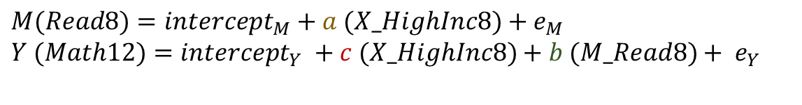
Example: Students in Grade 8 and 12
Students assessed in standardised scores of Maths and Reading at grade 8 and grade 12.
Some attended private High Schools.
Let’s focus on maths and reading:
$$e_{R8}$$
Read8
a
b
$$e_{M12}$$
HighInc8
Math12
c
$$M(Read8)={intercept}_{M}+a (X_HighInc8)+e_{M}$$
$Y (Math12)={intercept}_{Y} +c (X_HighInc8)+{b (M_Read8)+ e}_{Y}$
Notes:
Using the Ordinal Least Squares equations, we assume the Reading scores in Grade 8 are a linear function of High family Income,
And math scores in Grade 12 are a linear function of High family Income and reading scores in grade 8.

Slide 26
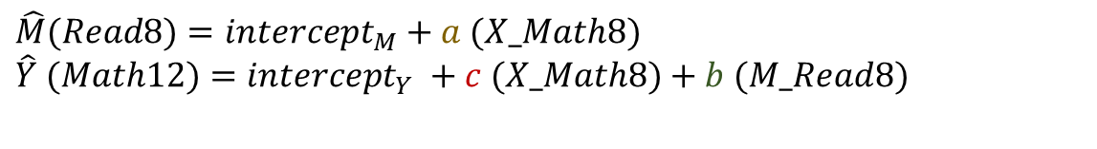
Example: Students in Grade 8 and 12
Students assessed in standardised scores of Maths and Reading at grade 8 and grade 12.
Some attended private High Schools.
Let’s focus on maths and reading:
summary(lm(read8~highinc, data=d))
$$e_{R8}$$
Read8
4.67 ***
b
$$e_{M12}$$
HighInc8
Math12
c
$$\hat{M}(Read8)={intercept}_{M}+a (X_Math8)$$
$\hat{Y} (Math12)={intercept}_{Y} +c (X_Math8)+b (M_Read8)$
Read8 = 48.59 + 4.67 (HighInc8)
Notes:
Using the R functions for estimating these regressions, we can estimate the regression of Reading on High Income, and obtain these estimates for Reading. Since we are dealing with estimates, we do not report the error term.
These results indicate that children from high income families have on average reading scores that are 4.67 units higher than children from lower income families.

Slide 27
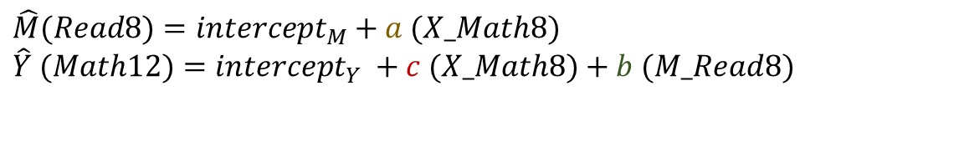
Example: Students in Grade 8 and 12
Students assessed in standardised scores of Maths and Reading at grade 8 and grade 12.
Some attended private High Schools.
Let’s focus on maths and reading:
summary(lm(math12~highinc+read8, data=d))
$$e_{R8}$$
Read8
4.67 ***
0.60***
$$e_{M12}$$
HighInc8
Math12
2.43***
$$\hat{M}(Read8)={intercept}_{M}+a (X_Math8)$$
$\hat{Y} (Math12)={intercept}_{Y} +c (X_Math8)+b (M_Read8)$
Read8 = 48.59 + 4.67 (HighInc8)
Math12 = 18.39 + 2.43 (HighInc8) + 0.60 (Read8)
Notes:
The “b” effect in green indicates that for children from the same family income group, a 1-unit increase in reading scores in Grade 8 are associated with 0.60 units higher scores in Maths in Grade 12.
On the other hand, the “c” path in read indicates that while controlling for Grade 8 reading scores, children from High Income families will have 2.43 higher scores in Grade 12 maths than children from lower income families. This is the direct effect of High Income, that is the adjusted effect while controlling for the values of the mediator.

Slide 28
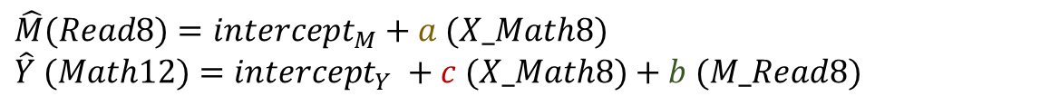
Example: Students in Grade 8 and 12
Students assessed in standardised scores of Maths and Reading at grade 8 and grade 12.
Some attended private High Schools.
Let’s focus on maths and reading:
$$e_{R8}$$
Read8
4.67 ***
0.60***
$$e_{M12}$$
HighInc8
Math12
2.43***
$$\hat{M}(Read8)={intercept}_{M}+a (X_Math8)$$
$\hat{Y} (Math12)={intercept}_{Y} +c (X_Math8)+b (M_Read8)$
Read8 = 48.59 + 4.67 (HighInc8)
Math12 = 18.39 + 2.43 (HighInc8) + 0.60 (Read8)
Indirect effect = ab = (4.67 * 0.60) ≈ 2.80
Notes:
When we use Ordinary Least Square methods, as in this case, the indirect effect is calculated by multiplying the “a” and “b” paths.
This means that compared to children from lower income families, children from high income families will display approximately 2.80 higher Maths score on average as a result of the relation that higher income has on reading scores in Grade 8, which, in turn we assumed affects maths scores in Grade 12. The approximation is because of rounding errors.
As a result of this indirect effect and the direct effect represented in red, children from high income families are estimated to have maths scores in Grade 12 that will be 5.23 units higher, on average, compared to lower income children.

Slide 29
Example: Students in Grade 8 and 12
Students assessed in standardised scores of Maths and Reading at grade 8 and grade 12.
Some attended private High Schools.
Let’s focus on maths and reading:
$$e_{R8}$$
process (data=d,
y="math12",x="highinc",m="read8",
total=1, normal=1, model=4, seed=90460)
Read8
4.67 ***
0.60***
Assumption of normal sampling distribution and use of Sobel test
$$e_{M12}$$
HighInc8
Math12
2.43***
Read8 = 48.59 + 4.67 (HighInc8)
Math12 = 18.39 + 2.43 (HighInc8) + 0.60 (Read8)
Indirect effect = ab = (4.67 * 0.60) ≈ 2.80
Notes:
The same effects can be estimated using Hayes’ macro “Process” available for R, SPSS and SAS. This is the example that you find in the course material.
The data= indicate the dataset to be used, the outcome, predictor, and mediator are selected as y, x, and m respectively.
Total = 1 means we are requesting to estimate the total effect from X to Y: if we didn’t want this, we would write total=0.
Note that here we report the unstandardized effects, i.e. they are in the metric of outcomes, but we can also ask PROCESS to report standardized results whereby the effects are expressed in the outcome’s SD units.
I will focus on the Normal option here.
When running this model in this way we are testing for the statical significance of these effects, e.g., whether the effect of reading on maths is significantly different from 0.
In the case of the indirect effect ab however, this effect is not estimated from linear regression equations, and thus there is a problem of how we should estimate its standard error and what underlying sampling distribution we should assume for this effect created by multiplying two separate OLS estimates. Traditionally the solution has been to derive the standard error of AB from estimates of standard errors of a and b respectively and to assume that the sampling distribution of ab is normal. In the literature you will find these assumptions referred to as the “Sobel test”.
However, this approach is no longer recommended for different reasons. Firstly, the assumption that the sampling distribution of ab is normal has been proved to be not tenable in many cases. This approach has also been proven to have less power to detect effects compared to other approaches.

Slide 30
Example: Students in Grade 8 and 12
Students assessed in standardised scores of Maths and Reading at grade 8 and grade 12.
Some attended private High Schools.
Let’s focus on maths and reading:
$$e_{R8}$$
process (data=d,
y="math12",x="highinc",m="read8",
total=1, boot=10000, model=4, seed=90460)
Read8
4.67 ***
0.60***
Requests 10k draws in bootstrapping
$$e_{M12}$$
HighInc8
Math12
2.43***
Read8 = 48.59 + 4.67 (HighInc8)
Math12 = 18.39 + 2.43 (HighInc8) + 0.60 (Read8)
Indirect effect = ab = (4.67 * 0.60) ≈ 2.80
Notes:
So, a different approach is needed. One that is often used is bootstrapping, a resampling method where the observations from our sample are re-sampled with replacement in order to derive a representation of the sampling distribution of the parameter of interest.
In this case the sample is re-sampled 10k times, creating a sampling distribution of the observed statistic. This sampling distribution is used to estimate confidence intervals of the statistic, which we can use to test if we can reject the null hypothesis that this statistic is equal to 0. Because the sampling distribution is estimated from resampling, no assumptions about the shape of underlying sampling distribution of the statistic are necessary.
In the example you can see that the 95% CI of the indirect effect are 2.51 – 3.13, which do not include 0, so we can reject the null hypothesis of the indirect effect being = 0.
Another option available is to use other resampling methods like Monte Carlo to estimate confidence intervals.

Slide 31
The case against the “Causal Steps Approach”
Med
X
Y
Notes:
I will now talk about an approach to testing mediation that has been quite popular in the recent past

Slide 32

The case against the “Causal Steps Approach”
e
M
a
b
$$e_{}$$
X
Y
c
t
Notes:
This approach was based on a paper by Baron & Kenny 1986 is dubbed the Causal Step Approach.
This approach asks to first test if there is a significant total effect from x to y. If this effect is not significantly different from 0, then all testing and modelling stops.
However, if this test is statistically significant, then a second pre-condition for mediation is that X affects M, and path “a” is significantly different from 0.
If this precondition is also met, then we test if M affects Y while controlling for X. If this is not the case, then M is not considered a mediator of X.
If the third criterion is also met, then the direct effect of X on Y is compared to the total effect, and if the direct effect is closer to zero than the total effect and the direct is not statistically significant, it is said that the mediator M completely mediate the effect of X on the outcome.

Slide 33
The case against the “Causal Steps Approach”
Cumbersome→ too many tests;
Indirect effect a*b may be ≠ 0 even if a and b are not;
Investigation stops if total effect is not significant: However, there may be mediation even if total effect is not significantly ≠ 0
e
M
a
b
$$e_{}$$
X
Y
c
t
Notes:
The problem with this approach is that it is cumbersome: there are too many tests. If we want to test mediation the key test we need is that of the indirect effect.
Furthermore, the indirect effect ab may be significantly different from 0 even if effects “a” and “b” are not. The inference regarding a*b should be based on this effect, not on singular estimated of a and b.
Finally, the Causal Step approach stops if there is not a total effect that is significantly different from 0. However, it is still possible that there may be an indirect effect even if the total effect is not significantly different from 0. Firstly, one has to keep in mind that the total effect is the sum of different effects that may have different signs. That said, it may also happen that the indirect effect is estimated more precisely than the direct effect, whereas the direct effect may be estimated with more uncertainty. If this is the case, the estimated total effect would also have larger uncertainty, which makes it more difficulty to reject the null hypothesis. So, it is possible to identify significant indirect effects even when the total effect is not significantly different from 0.

Slide 34
Summary
Mediation vs. Moderation
Example of simple mediation model
The case against the “causal approach”
Notes:
So, in this first presentation, I have introduced the key distinction between mediation and moderation, highlighting that mediation concerns question about causal mechanisms, how a treatment or an exposure influence an outcome through different processes that involve other constructs. Moderation instead investigates the contexts in which effects from a predictor to an outcome may change in their strength or their sign.
I have introduced a simple mediation model and provided examples of how estimate the different effects in the model using OLS methods. I have also emphasised that the key test is the test of significance of the indirect effect “ab”, the indirect effect through the mediator. So we do not need to apply the cumbersome causal approach to the study of mediation.
A final warning concerns the fact that mediation models are causal models, they make assumptions about causal relations between variables. But causality cannot be proven by statistical models alone, so it is important to apply retrain and consideration in building mediation models.

Slide 35
www.ncrm.ac.uk

