Slide 1

For accessibility, use this PDF version

Slide 2


Slide 3
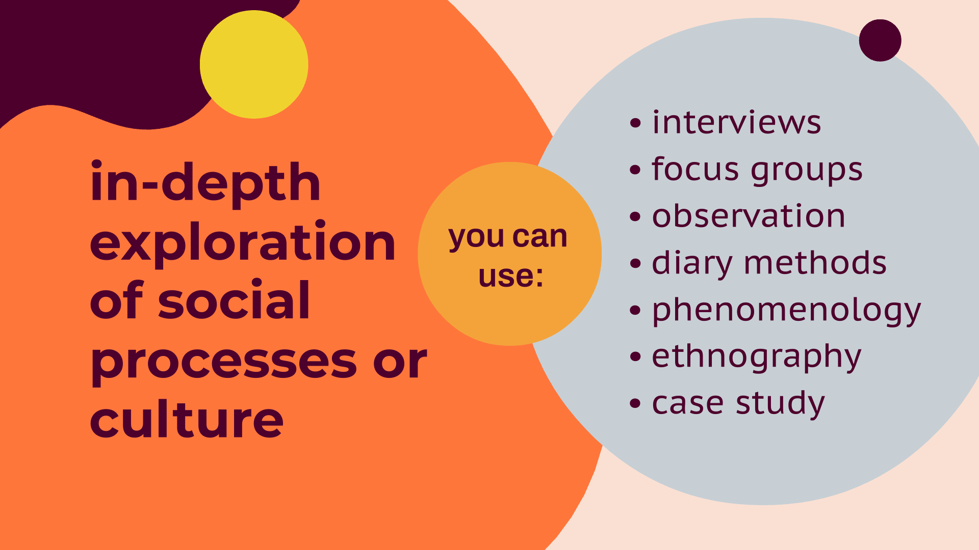

Slide 4


Slide 5


Slide 6
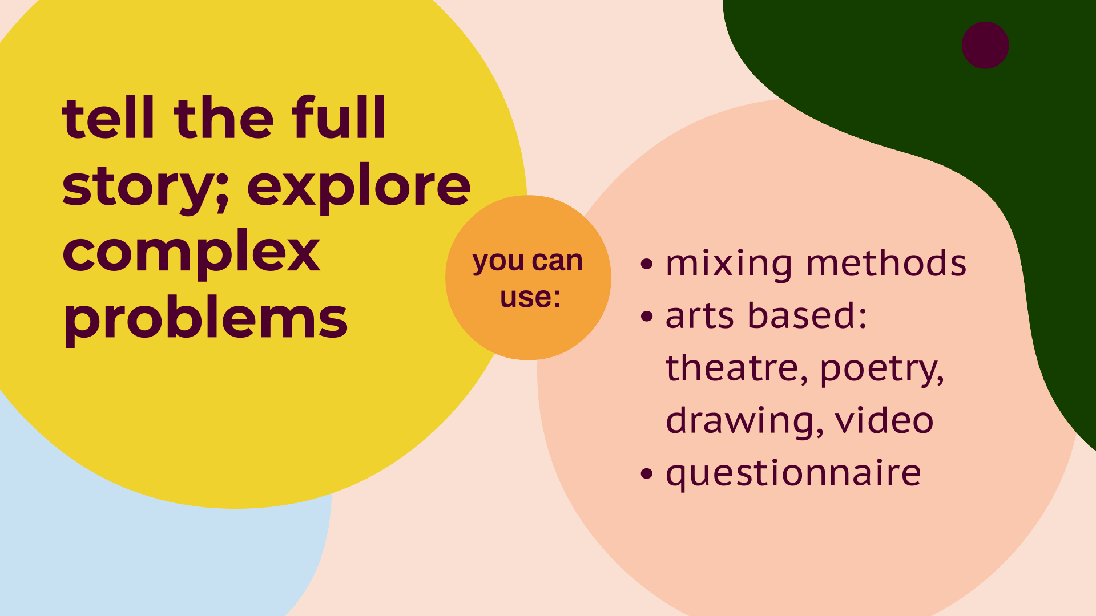

Slide 7
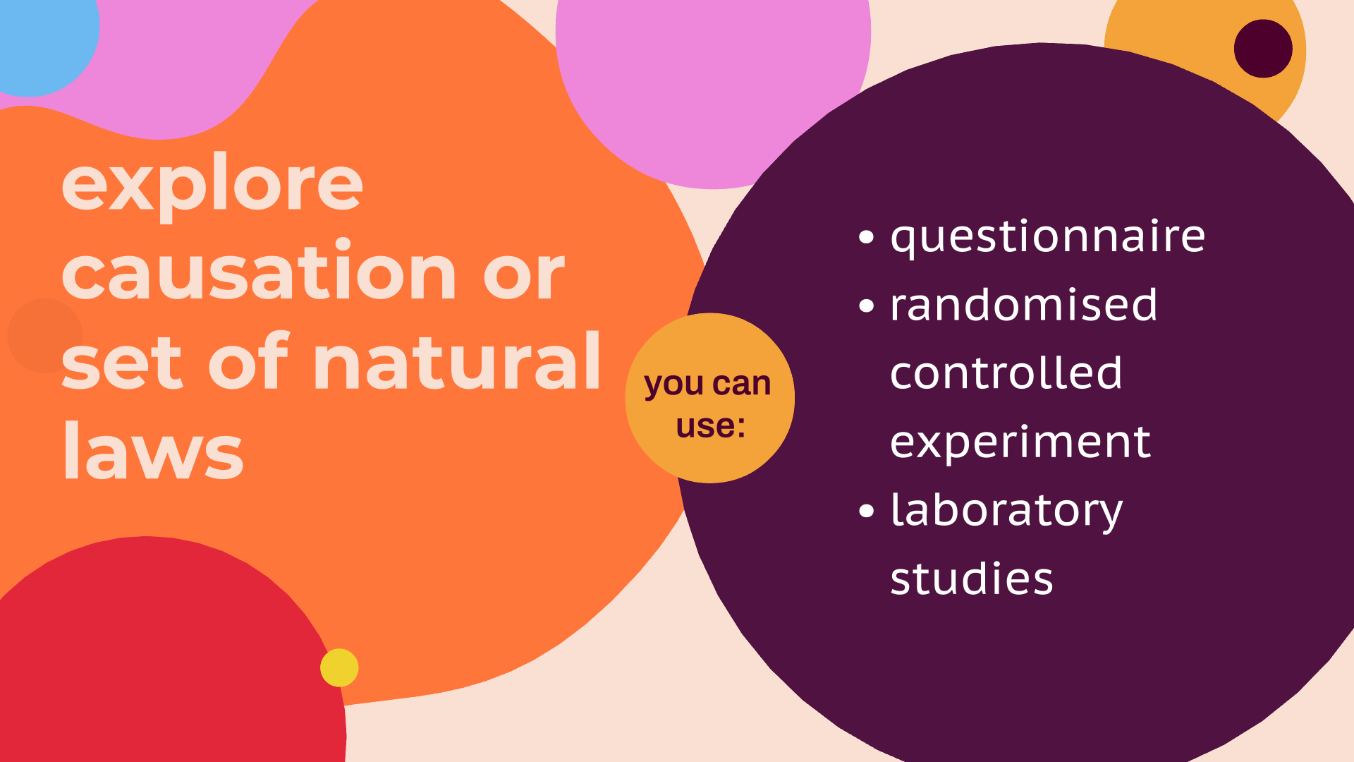

Slide 8


