Slide 1

A guide to accessing the multi-omic data in Understanding Society
Yanchun Bao
28.10.2021
University of Essex, Understanding Society

Slide 2
Overview
Accessing the data
What is available to you?
Where to get the data?
Questions and clarification

Slide 3
Understanding Society
Genetic Data : Single Nucleotide Polymorphism (SNP)
Sample size: 9920
Genotyped (measured): 50,000+ SNPs
Imputed: 8,000,000+ SNPs
Illumina HumanCoreExome-12v1-0 chip performed at Sanger Institute.
Imputation using the combined UK10K + 1000 Genomes reference panel.
Population: England, Scotland and Wales, white European.
56%
44%

Slide 4
Understanding Society
Epigenetic Data : DNA methylation
Batch 1: 1174 individuals, 857,071 sites after QC
Batch 2: 2480 individuals, 860,950 sites after QC
Illumina Infinium Methylation Epic Arrays performed at University of Exeter Medical School (Professor Jonathon Mill).
Data Normalised and cleaned in Biological Sciences (Professor Leo Schalkwyk, Tyler Gorrie-Stone)
Population: England, Scotland and Wales, white European.
Also available: five epigenetic clocks for age.
56%
44%

Slide 5
Understanding Society
Proteomic Data
Cardiometabolic panel: 6169 individuals, 92 proteins
Neurology panel: 6077 individuals, 92 proteins
Proximity Extension Assay (PEA) methods, performed at Olink.
Population: England, Scotland and Wales, 92% white.
60%
40%

Slide 6
Understanding Society
Applying for the multi-omic data
2 Avenues depending on what is required:
Avenue 1
  1. European Genome-phenome Archive (EGA)
    Genetic data
  https://www.ebi.ac.uk/ega/studies/EGAS00001001232
    Epigenetic data
  https://www.ebi.ac.uk/ega/studies/EGAS00001002836
  Genetic/Epigenetic data NOT linked to each other or any of the main survey data
  2. Understanding Society updated nurse visit data where proteomic and epigenetic clocks are included.
https://www.ebi.ac.uk/ega/studies/EGAS00001001232

Slide 7
Understanding Society
Applying for the multi-omic data
2 Avenues depending on what is required:
Avenue 2
  Understanding Society
  https://www.understandingsociety.ac.uk/documentation/health-assessment/accessing-data/genetics-application
  Genetic or/and Epigenetic data linked to any of our main survey data, plus linking to proteomic data or/and epigenetic clocks.
https://www.ebi.ac.uk/ega/studies/EGAS00001001232

Slide 8
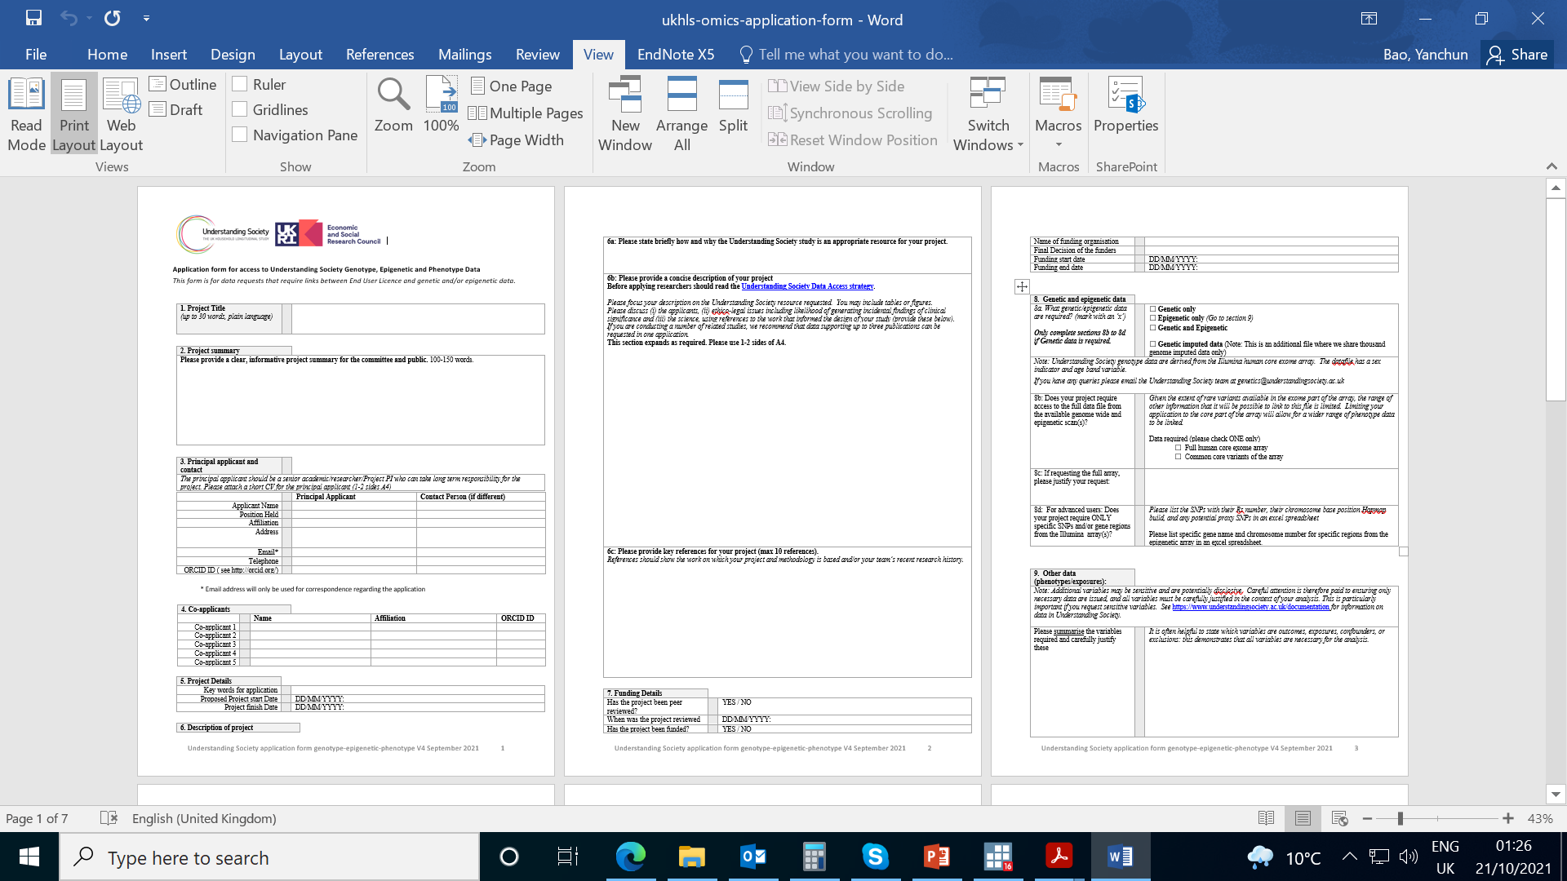
Understanding Society
Application form
https://www.understandingsociety.ac.uk/sites/default/files/downloads/documentation/health/ukhls-omics-application-form.docx
Application forms need to be accompanied by a list a of variables, specifying which file they are from and which waves are required.

Slide 9
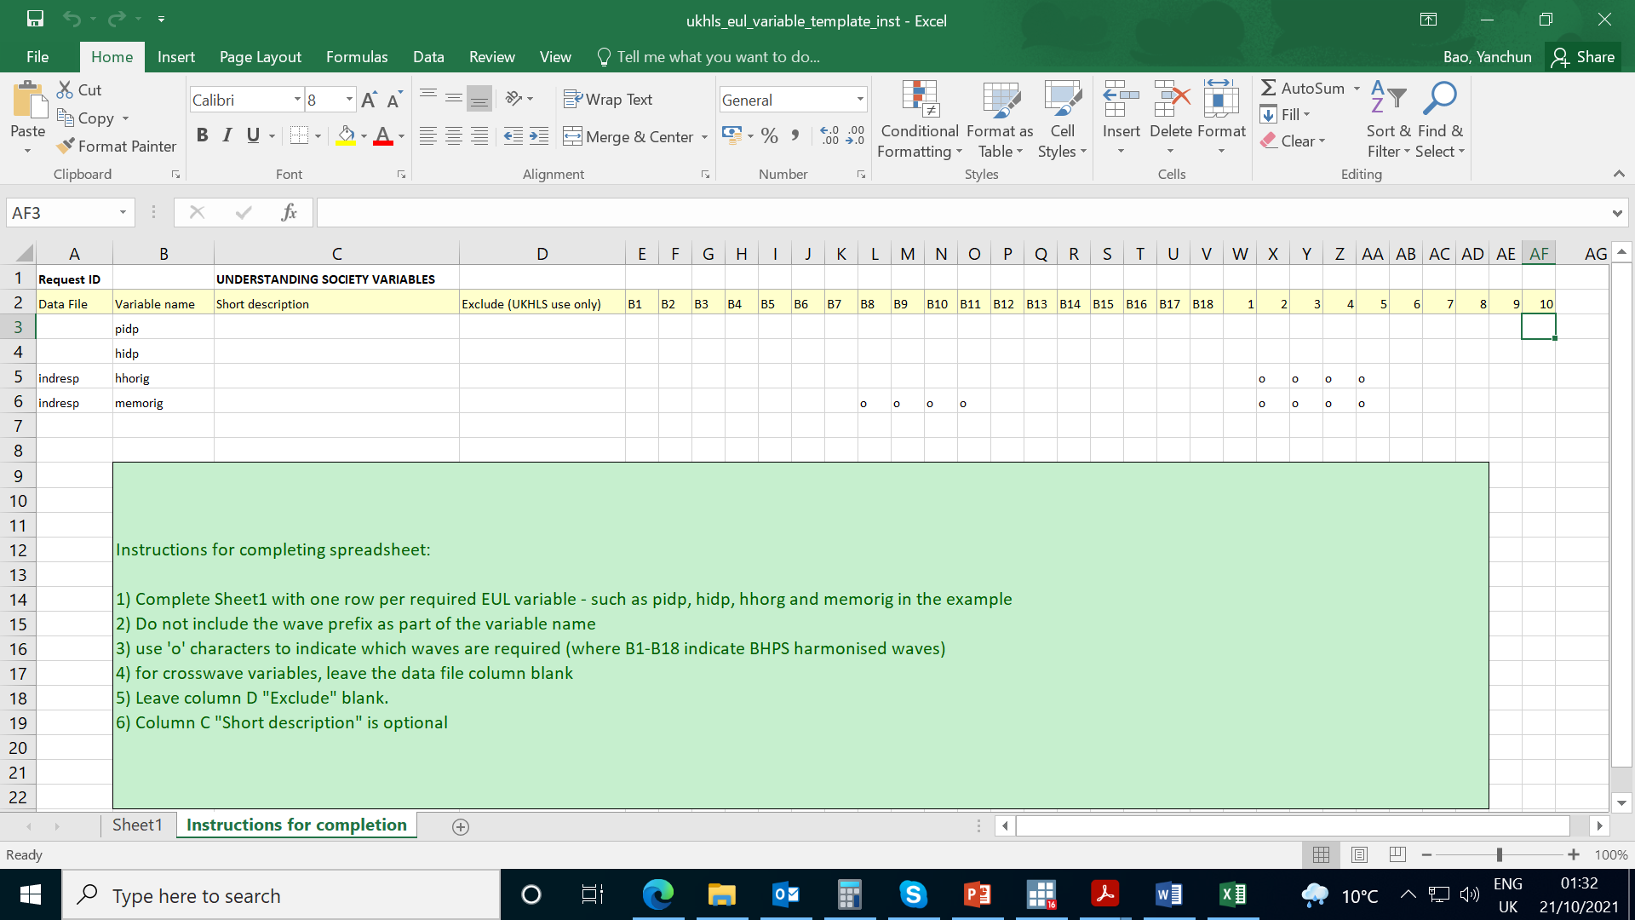
Understanding Society
Variable list form

Slide 10
The Data You Receive
Password protected data is sent via ‘Zendto’ and password protected FTP website
Genetic data or imputation, up to 95GB , can be opened in R or plink
Epigenetic, GDS file, up to 23.4GB, can be opened in R
Survey data, in STATA or text format
+ Proteomic data or Epigenetic clocks if applied, in STATA or text format
Unique id, cannot link to survey data
Understanding Society Epigenetic Workshop | December 4th 2018

Slide 11
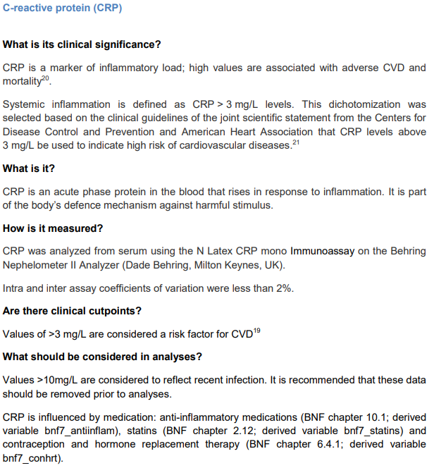
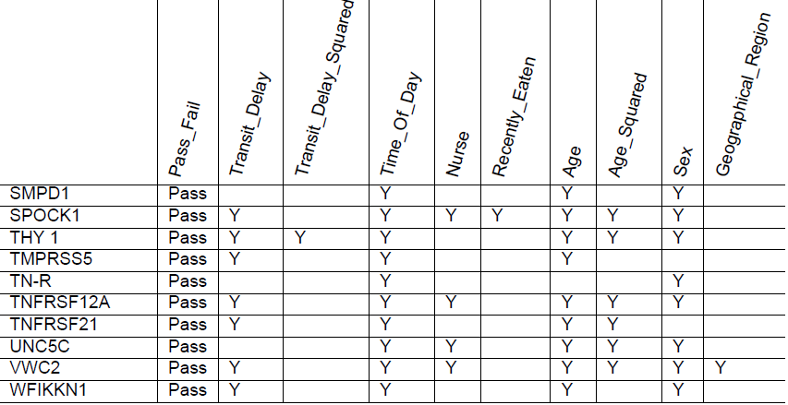
User guides
Biomarker user guides
  https://www.understandingsociety.ac.uk/sites/default/files/downloads/documentation/health/user-guides/7251-UnderstandingSociety-Biomarker-UserGuide-2014.pdf
Readme files of genetic/epigenetic data will be sent along with the data
Proteomics user guide coming online soon!
Notes:
Understanding Society’s biological data comes from blood samples collected from non-fasting individuals, at different times of day.
It’s worth checking whether the biomarkers you’re interested in are known to vary with the time of day or after eating.
Also, some biomarkers have a well-defined role in the blood, so we know what a high or low level “means” to some extent,
but some of the proteins are still being researched, so we have less idea what a high or low level in the blood means.
We have user guides for the biomarker and proteomics dataset, wherein we list some of the factors that are associated with blood concentrations.

Slide 12
Questions???
Useful email address
General consultant: Professor Meena Kumari, mkumari@essex.ac.uk
Genetic team : genetics@understandingsociety.ac.uk
Please email if you have any queries on how to access the data from Understanding Society
Understanding Society Epigenetic Workshop | December 4th 2018

