Slide 1

Multi -omics

Slide 2
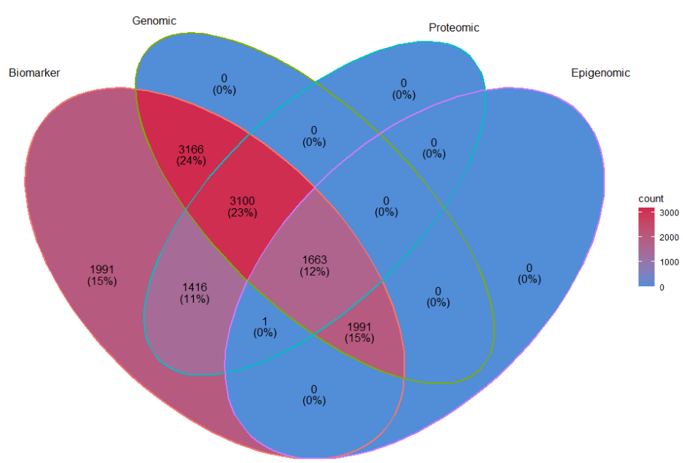
Multi -omics
Biomarkers (~13K)
Genomic (~10K)
Proteomic (~6K)
Epigenomic (~3.5K)
New!

Slide 3
Integrated -omics

Slide 4
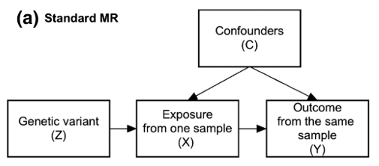
Integrated -omics
Causal inference
  Mendelian Randomization (MR)
    Genetic variants
      are nature’s randomization
      are not subject to reverse causation
      can be used as proxies for exposures
  There are many new variations on MR
Recommended reading: Burgess S, Davey Smith G,
Davies NM et al. Guidelines for performing Mendelian
randomization investigations [version 2; peer review:
2 approved]. Wellcome Open Res, 4:186 (2020)
https://doi.org/10.12688/wellcomeopenres.15555.2
Image credit / recommended reading: Zheng J,
Baird D, Borges MC et al. Recent Developments
in Mendelian Randomization Studies. Curr
Epidemiol Rep 4, 330–345 (2017)
https://doi.org/10.1007/s40471-017-0128-6

Slide 5


Mendelian Randomization
Statins, etc
Genetics
Known
Known
Blood cholesterol (LDL)
?
Confounders
Possible
Risk of dementia

Slide 6
Mendelian Randomization
Example: Dementia and LDL-cholesterol
Statins, etc
-
+ ?
Blood cholesterol (LDL)
Risk of dementia
Benn M, Nordestgaard BG, Frikke-Schmidt R,
Tybjærg-Hansen A. Low LDL cholesterol, PCSK9 and
HMGCR genetic variation, and risk of Alzheimer's
disease and Parkinson's disease: Mendelian
randomisation study [published correction appears
in BMJ. 2017 Jun 29;357:j3170]. BMJ. 2017;357:
j1648. Published 2017 Apr 24.
https://doi.org/10.1136/bmj.j1648

Slide 7
Mendelian Randomization
Example: Dementia and LDL-cholesterol
Statins, etc
-
Blood cholesterol (LDL)
+ ?
Benn M, Nordestgaard BG, Frikke-Schmidt R,
Tybjærg-Hansen A. Low LDL cholesterol, PCSK9 and
HMGCR genetic variation, and risk of Alzheimer's
disease and Parkinson's disease: Mendelian
randomisation study [published correction appears
in BMJ. 2017 Jun 29;357:j3170]. BMJ. 2017;357:
j1648. Published 2017 Apr 24.
https://doi.org/10.1136/bmj.j1648
Risk of dementia

Slide 8
Mendelian Randomization
Example: Dementia and LDL-cholesterol
Statins, etc
-
Blood cholesterol (LDL)
Confounders
+ ?
Benn M, Nordestgaard BG, Frikke-Schmidt R,
Tybjærg-Hansen A. Low LDL cholesterol, PCSK9 and
HMGCR genetic variation, and risk of Alzheimer's
disease and Parkinson's disease: Mendelian
randomisation study [published correction appears
in BMJ. 2017 Jun 29;357:j3170]. BMJ. 2017;357:
j1648. Published 2017 Apr 24.
https://doi.org/10.1136/bmj.j1648
Risk of dementia

Slide 9
Mendelian Randomization
Example: Dementia and LDL-cholesterol
Genetics
“if a low LDL cholesterol level has a causal effect on risk of Alzheimer’s disease, vascular dementia, any dementia, and Parkinson’s disease, genetic variants that lower LDL cholesterol levels lifelong would be expected to also increase the risk of disease”
-
Blood cholesterol (LDL)
Benn M, Nordestgaard BG, Frikke-Schmidt R,
Tybjærg-Hansen A. Low LDL cholesterol, PCSK9 and
HMGCR genetic variation, and risk of Alzheimer's
disease and Parkinson's disease: Mendelian
randomisation study [published correction appears
in BMJ. 2017 Jun 29;357:j3170]. BMJ. 2017;357:
j1648. Published 2017 Apr 24.
https://doi.org/10.1136/bmj.j1648

Slide 10

Mendelian Randomization
Example: Dementia and LDL-cholesterol
Genetics of
lower
“if a low LDL cholesterol level has a causal effect on risk of Alzheimer’s disease, vascular dementia, any dementia, and Parkinson’s disease, genetic variants that lower LDL cholesterol levels lifelong would be expected to also increase the risk of disease”
Blood cholesterol (LDL)
+ ?
Benn M, Nordestgaard BG, Frikke-Schmidt R,
Tybjærg-Hansen A. Low LDL cholesterol, PCSK9 and
HMGCR genetic variation, and risk of Alzheimer's
disease and Parkinson's disease: Mendelian
randomisation study [published correction appears
in BMJ. 2017 Jun 29;357:j3170]. BMJ. 2017;357:
j1648. Published 2017 Apr 24.
https://doi.org/10.1136/bmj.j1648
Risk of dementia

Slide 11
Mendelian Randomization
Example: Dementia and LDL-cholesterol
Genetics of
lower
“Genetic evidence suggested that low LDL cholesterol levels may lead to a low risk of Alzheimer’s … low LDL cholesterol has no harmful causal effect on risk of Alzheimer’s dementia, vascular dementia, any dementia, and Parkinson’s disease”
Blood cholesterol (LDL)
no
association
-
Benn M, Nordestgaard BG, Frikke-Schmidt R,
Tybjærg-Hansen A. Low LDL cholesterol, PCSK9 and
HMGCR genetic variation, and risk of Alzheimer's
disease and Parkinson's disease: Mendelian
randomisation study [published correction appears
in BMJ. 2017 Jun 29;357:j3170]. BMJ. 2017;357:
j1648. Published 2017 Apr 24.
https://doi.org/10.1136/bmj.j1648
Risk of dementia
Risk of Alzheimer’s

Slide 12
Mendelian Randomization
Example: Dementia and LDL-cholesterol
Blood cholesterol (LDL)
Risk of dementia
Benn M, Nordestgaard BG, Frikke-Schmidt R,
Tybjærg-Hansen A. Low LDL cholesterol, PCSK9 and
HMGCR genetic variation, and risk of Alzheimer's
disease and Parkinson's disease: Mendelian
randomisation study [published correction appears
in BMJ. 2017 Jun 29;357:j3170]. BMJ. 2017;357:
j1648. Published 2017 Apr 24.
https://doi.org/10.1136/bmj.j1648

Slide 13
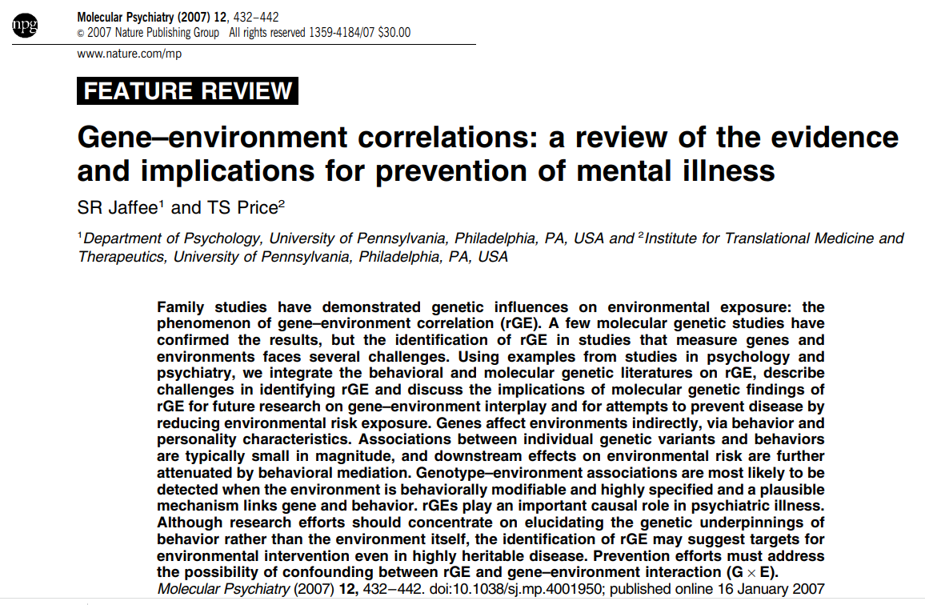

Slide 14
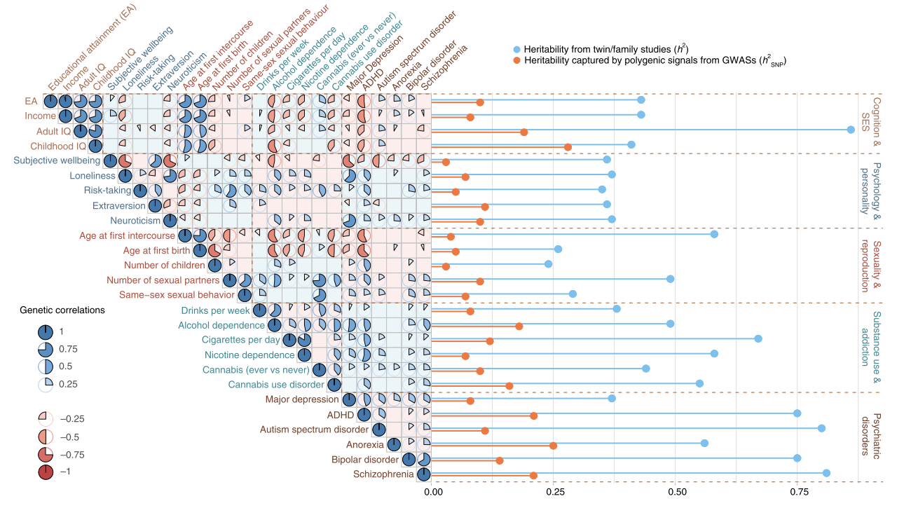
Abdellaoui, A., Verweij, K.J.H. Dissecting polygenic signals from genome-wide association studies on human behaviour. Nat Hum Behav 5, 686–694 (2021). https://doi.org/10.1038/s41562-021-01110-y

Slide 15
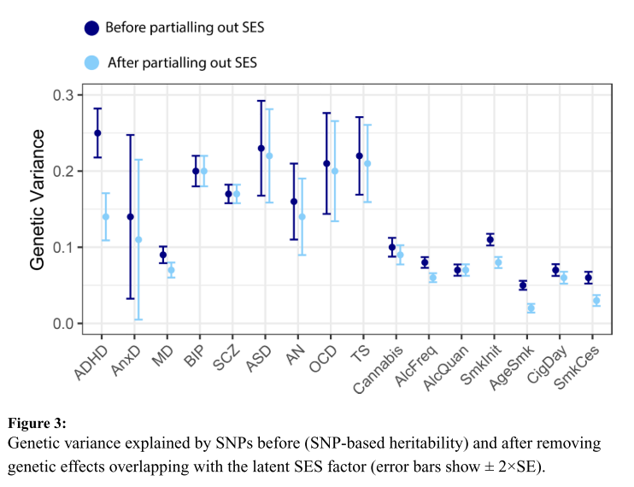
Marees, A.T., Smit, D.J.A., Abdellaoui, A. et al. Genetic correlates of socio-economic status influence the pattern of shared heritability across mental health traits. Nat Hum Behav 5, 1065–1073 (2021). https://doi.org/10.1038/s41562-021-01053-4

Slide 16

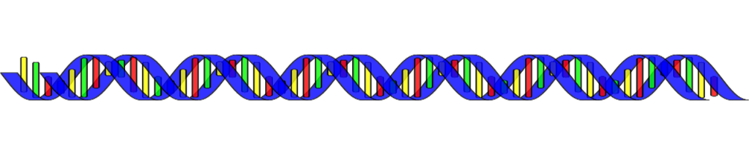



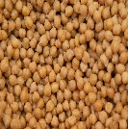
Integrated -omics
  Previous studies have found DNA SNPs affecting
      RNA levels
      DNA methylation levels
      Protein levels
      Other quantitative outcomes/traits

Slide 17
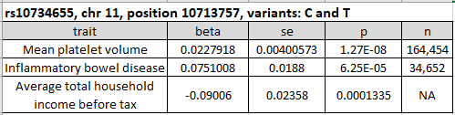
Integrated -omics
  Previous studies have found DNA SNPs affecting
      RNA levels / gene expression (eQTLs)
      DNA methylation levels (mQTLs)
      Protein levels (pQTLs)
      Other quantitative outcomes/traits
  QTL = quantitative trait locus
  https://www.mrbase.org/
  http://www.phenoscanner.medschl.cam.ac.uk/
  https://www.eqtlgen.org/

Slide 18
Examples

Slide 19
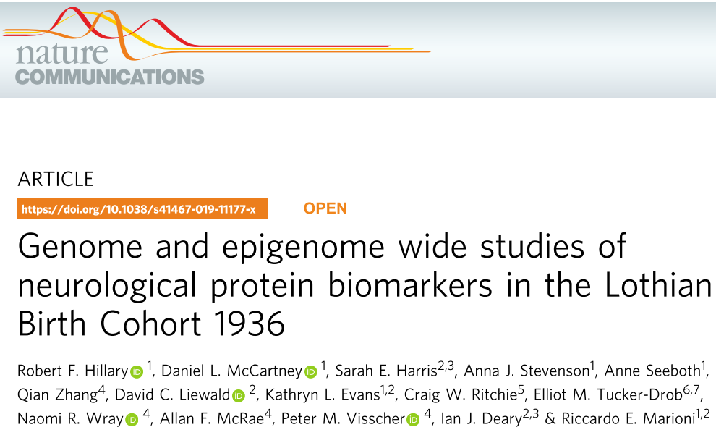
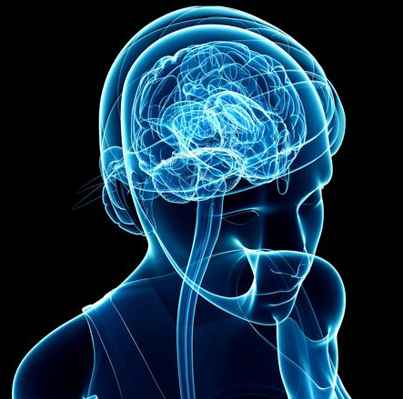
Integrated –omics example
Aim: explore causal relationships between biomarkers and neurological diseases

Slide 20
Integrated –omics example
Main findings:
  41 DNA SNPs linked to concentrations of 33 proteins
  Methylation levels of 26 DNA sites linked to concentrations of 9 proteins
  Identified the biological pathways of the methylation sites
    neurological, immunological and extracellular matrix metabolism
    annotation databases: KEGG and GO
  Mendelian randomization
    MDGA1 and KYNU RNA levels alter protein levels
    DRAXIN protein levels alter RNA levels
    MATN3, MDGA1 and NEP DNA methylation levels
    alter protein levels and vice versa

Slide 21


Integrated –omics example
PVR gene region
Also explored: Poliovirus receptor (PVR) protein
  PVR gene is already implicated in Alzheimer’s Disease
  Present study found a SNP (near PVR gene) linked to PVR protein levels
  Is one SNP driving both associations between
    gene and PVR protein levels
    gene and Alzheimer’s Disease?
  Mendelian randomization:
    Do PVR protein levels cause Alzheimer’s disease or vice versa?
2.
1.
3. Is it the
same SNP?
PVR gene
PVR protein
levels
SNP
SNP
SNP
SNP
pQTL
linked
to
disease
4.
Alzheimer’s Disease

Slide 22
Integrated –omics example
Genetic factors
Is it the
same SNP?
Do genetics
influence
protein levels?
Known
Protein
level
Direction
of
causality?
Outcome

Slide 23
Integrated –omics example
Point of intervention
Genetics
Known
Known
Exposure
?
Confounders
Possible
?
Outcome

Slide 24

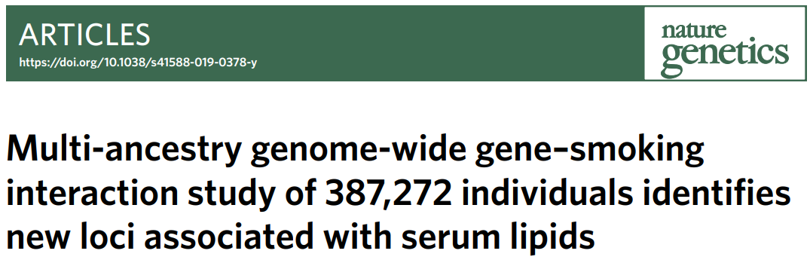
Integrated -omics
Genetic factors
Known
Known
?
Known
Known
Blood lipids
Behaviours
Known
Known
“Do genetic associations with serum lipids
differ by smoking status?”
Health outcomes

Slide 25
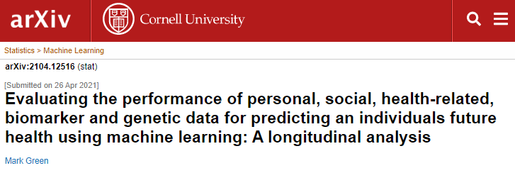
Integrated -omics
Personal,
Social
and
Health-related
variables
Genetic factors
Bio markers
Machine learning model
“Can these factors predict limiting long-term illness one and five years from baseline,
using machine learning models?”
Outcomes

