Slide 1

Biological Datasets

Slide 2
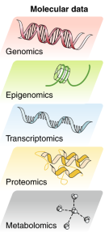
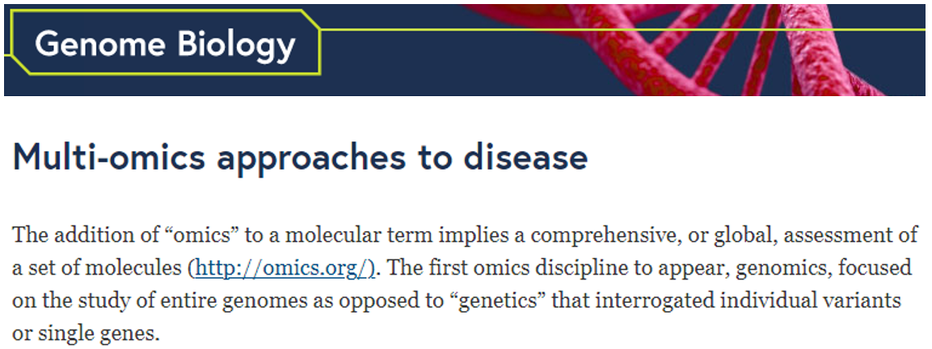

Lipidomics
etc!
Hasin, Y., Seldin, M. & Lusis, A. Multi-omics approaches to disease. Genome Biol 18, 83 (2017). https://doi.org/10.1186/s13059-017-1215-1

Slide 3
Biological Datasets
Genomic
Epigenomic
Biomarker
Proteomic
New!

Slide 4
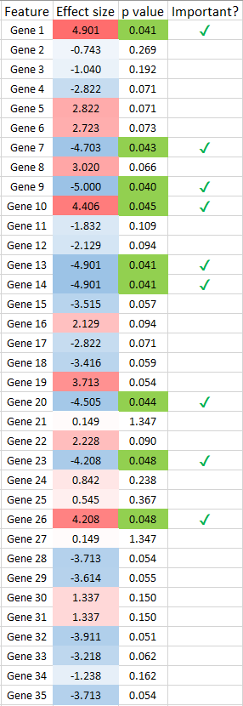
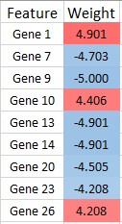

Basic principles of applying -omics
Biological mechanisms?
Objective measure of health?
Predict outcomes?
(Direction of causality??)
Are any of these
associated with
my variable of
interest?
Which are
the most
important?

Slide 5
Biology overview

Slide 6
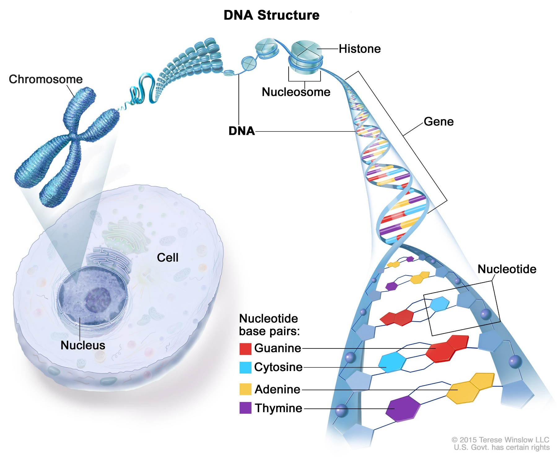
DNA

Slide 7
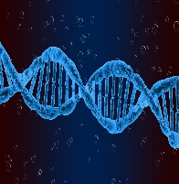
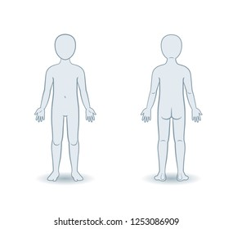
DNA in the nucleus

Slide 8
C-reactive protein RNA;
C-reactive protein gene expression

Slide 9
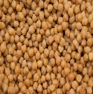
C-reactive protein

Slide 10

C-reactive protein

Slide 11
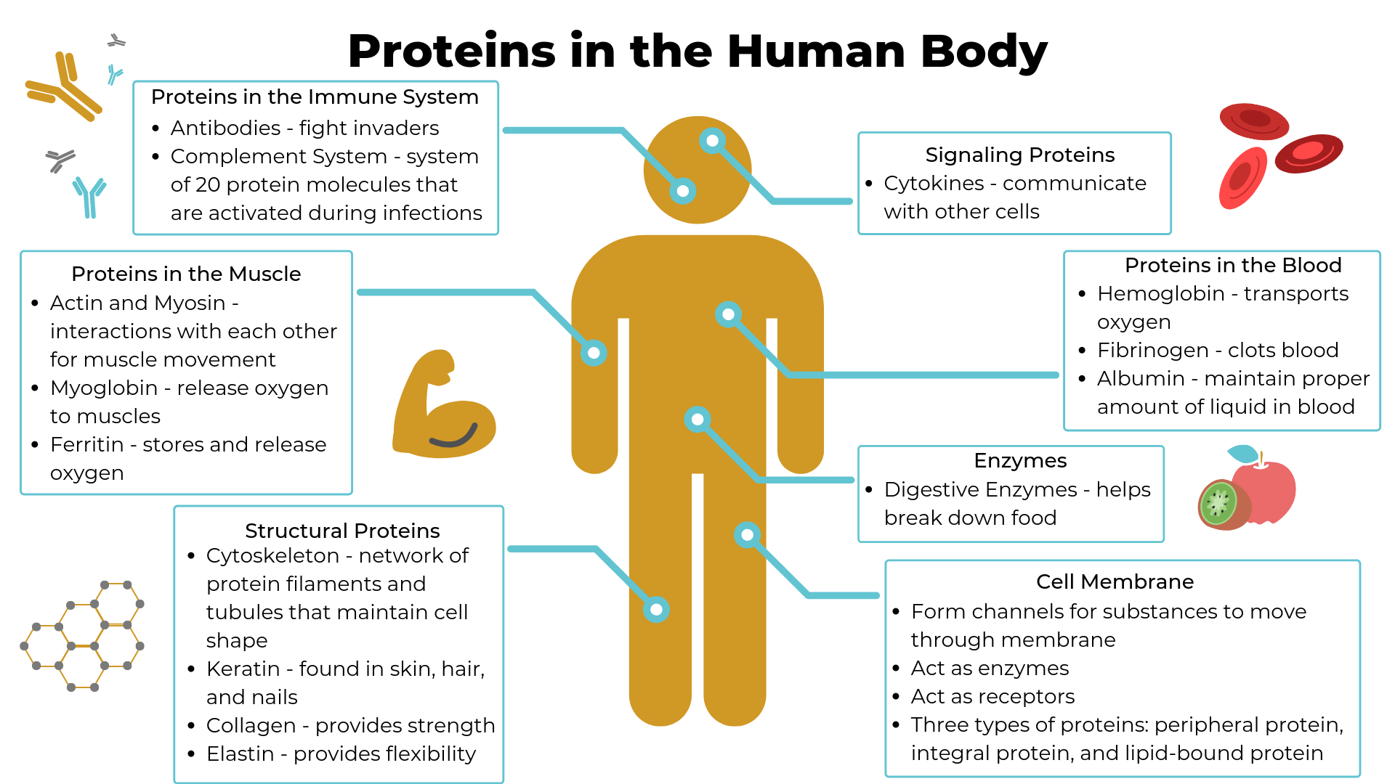

Slide 12
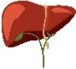
C-reactive protein gene
C-reactive protein RNA;
C-reactive protein gene expression
C-reactive protein
Gene expression

Slide 13
Methylated
C-reactive protein gene
Less C-reactive protein RNA;
Less C-reactive protein gene expression
Less C-reactive protein
Control of gene expression
Epigenetics
DNA methylation
Other mechanisms
Other mechanisms
DNA methylation:
One of several mechanisms to control
gene expression

Slide 14
Genetic dataset

Slide 15
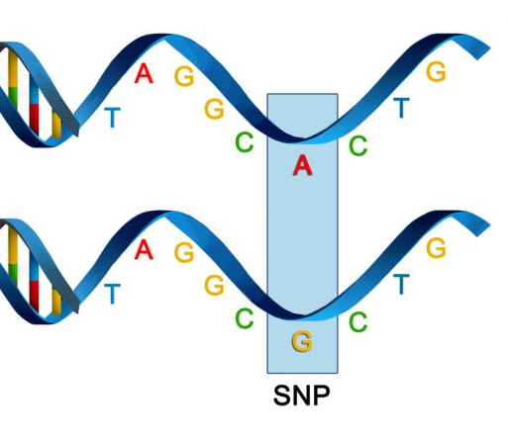

Person
A
Possible
genotypes:
AA
AG
GG
Person
B
Anna Dearman

Slide 16
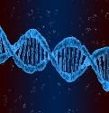
Genetics
DNA
from
blood
cells
500,000 variants
10,000 participants
SNP ID | Chromosome | DNA base | Variant 1 | Variant 2 | Genotype for Person A | Genotype for Person B | Genotype for Person C
rs3645 | 1 | 3 | A | T | AA | AA | AA
rs780978 | 1 | 46 | C | G | CG | CC | CC
rs15674 | 1 | 500 | G | C | CC | GC | GC
rs585678 | 1 | 729 | T | A | TA | TA | TA
rs1344534 | 1 | 1001 | A | T | AT | AT | AT
rs1357435 | 1 | 1702 | A | C | AA | AA | AA
rs453536 | 1 | 2064 | C | G | CG | CC | GG
rs36456 | 1 | 2617 | T | A | AA | AA | AA
rs7801578 | 1 | 2662 | G | A | GG | GG | GG
rs815674 | 1 | 3185 | G | C | GC | GC | GC
rs594678 | 1 | 7659 | A | T | AT | AA | AT
rs1454534 | 1 | 11288 | T | A | TT | TA | TT
rs173645 | 1 | 12681 | T | G | TT | TT | TG

Slide 17
Genetics
DNA
from
blood
cells
500,000 variants
10,000 participants
SNP ID | Chromosome | DNA base | Variant 1 | Variant 2 | Genotype for Person A | Genotype for Person B | Genotype for Person C
rs3645 | 1 | 3 | A | T | 2 | 2 | 2
rs780978 | 1 | 46 | C | G | 1 | 2 | 2
rs15674 | 1 | 500 | G | C | 0 | 1 | 1
rs585678 | 1 | 729 | T | A | 1 | 1 | 1
rs1344534 | 1 | 1001 | A | T | 1 | 1 | 1
rs1357435 | 1 | 1702 | A | C | 2 | 2 | 2
rs453536 | 1 | 2064 | C | G | 1 | 2 | 0
rs36456 | 1 | 2617 | T | A | 0 | 0 | 0
rs7801578 | 1 | 2662 | G | A | 2 | 2 | 2
rs815674 | 1 | 3185 | G | C | 1 | 1 | 1
rs594678 | 1 | 7659 | A | T | 1 | 2 | 1
rs1454534 | 1 | 11288 | T | A | 2 | 1 | 2
rs173645 | 1 | 12681 | T | G | 2 | 2 | 1

Slide 18
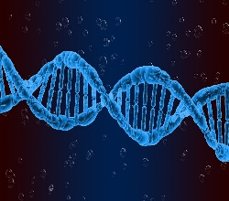
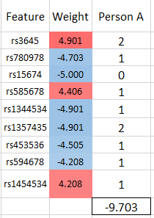
Genetics
Genetic factors
Genome-wide association studies (GWAS)
Polygenic scores
  Body mass index
  Educational attainment
  Testosterone level
  Personality traits
  etc…
Outcomes

Slide 19
Polygenic scores
DNA
from
blood
cells
2 polygenic scores (for now)…
PGS | Polygenic score for Person A | Polygenic score for Person B | Polygenic score for Person C
Body Mass Index PGS | 5.0 | 6.3 | 7.7
Testosterone PGS | 7.8 | 4.1 | 3.2

Slide 20
Epigenetic dataset

Slide 21
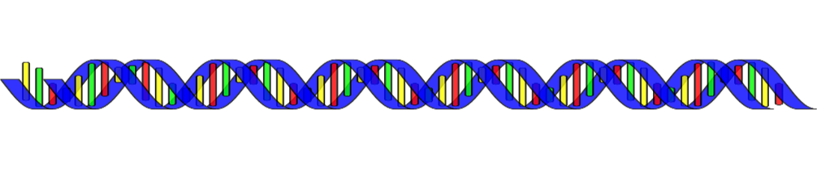

Person
A
White blood cells DNA
Person
B
Anna Dearman

Slide 22
Person
A
100% methylation
White blood cells DNA
Person
B
Anna Dearman
50% methylation

Slide 23
Epigenetics
Methylated
DNA
from
blood
cells
850,000 methylation sites
3,650 participants
CpG ID | Chromosome | DNA position | Methylation % for Person A | Methylation % for Person B | Methylation % for Person C
cg3645 | 1 | 3 | 0.35 | 0.05 | 0.21
cg780978 | 1 | 46 | 0.62 | 0.02 | 0.55
cg15674 | 1 | 500 | 0.64 | 0.84 | 0.45
cg585678 | 1 | 729 | 0.98 | 0.64 | 0.45
cg1344534 | 1 | 1001 | 0.26 | 0.24 | 0.18
cg1357435 | 1 | 1702 | 0.37 | 0.84 | 0.16
cg453536 | 1 | 2064 | 0.83 | 0.18 | 0.92
cg36456 | 1 | 2617 | 0.50 | 0.18 | 0.17
cg7801578 | 1 | 2662 | 0.94 | 0.16 | 0.39
cg815674 | 1 | 3185 | 0.96 | 0.81 | 0.20
cg594678 | 1 | 7659 | 0.92 | 0.04 | 0.67
cg1454534 | 1 | 11288 | 0.67 | 0.22 | 0.05
cg173645 | 1 | 12681 | 0.22 | 0.83 | 0.86

Slide 24
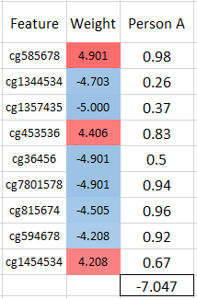
Epigenetics
Exposures
Epigenome-wide association studies (EWAS)
  exposures
  outcomes
DNA methylation signatures/scores
  Biological ageing (epigenetic clocks)
  Smoking
  Inflammation
  etc…
Epigenetic factors
Outcomes

Slide 25
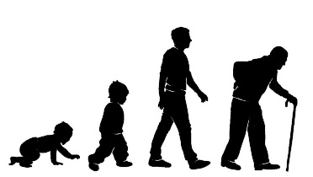
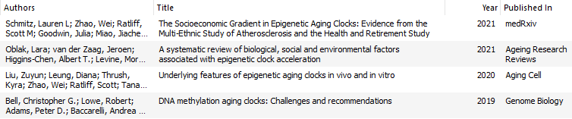
Epigenetic clocks
Methylated
DNA
from
blood
cells
5 epigenetic clocks
3,650 participants
Clock | Epigenetic age for Person A | Epigenetic age for Person B | Epigenetic age for Person C
Horvath 2013 | 43 | 81 | 78
Hannum | 44 | 82 | 79
PhenoAge | 42 | 80 | 77
Horvath skin & blood | 40 | 79 | 75
Lin | 43 | 81 | 78

Slide 26
Biomarker dataset

Slide 27
Biomarkers
21 biomolecules that are routinely used in hospital blood tests
Includes measures of
  fat in the blood
  diabetes
  inflammation and the immune system
  anaemia (e.g. haemoglobin)
  liver and kidney function
  hormones (e.g. testosterone)
13,000 participants
Non-blood biomarkers
  Lung function, grip strength, BMI, etc
plasma
serum
blood

Slide 28
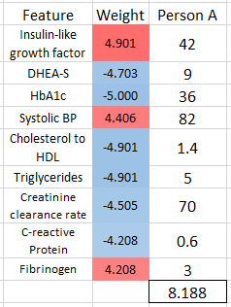
Biomarkers
Exposures
Associations between biomarkers and
  exposures
  outcomes
Allostatic load index
Metabolic syndrome index
Frailty index
etc
Bio
markers
Outcomes

Slide 29
Proteomic dataset

Slide 30

Person
A
More protein
Clotted blood Serum
Person
B
Less protein

Slide 31
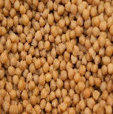
Proteomics
Protein
from
serum
184 proteins
6,180 participants
Protein | Abundance for Person A | Abundance for Person B | Abundance for Person C
ANG | 0.7 | 4.6 | 5.0
ANGPTL3 | 3.7 | 2.7 | 0.1
AOC3 | 2.5 | 1.6 | 1.5
APOM | 5.8 | 1.3 | 3.0
C1QTNF1 | 1.9 | 0.4 | 3.2
C2 | 3.5 | 3.3 | 2.6
CA1 | 0.5 | 0.3 | 2.6
CA3 | 2.6 | 1.5 | 5.8
CA4 | 3.8 | 1.1 | 4.7
CCL14 | 3.4 | 0.2 | 2.5
CCL18 | 2.9 | 0.9 | 0.8
CCL5 | 1.1 | 3.5 | 5.1
CD46 | 4.7 | 4.0 | 4.7

Slide 32
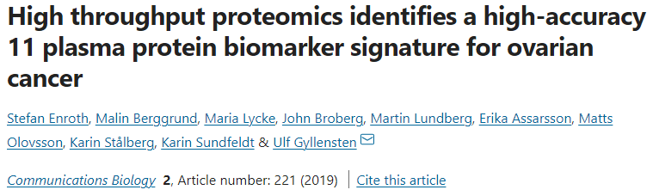
Proteomics
Exposures
Associations between protein levels and
  exposures
  outcomes
Protein signatures
Proteins
Outcomes

Slide 33
Proteins and sociology?

Slide 34
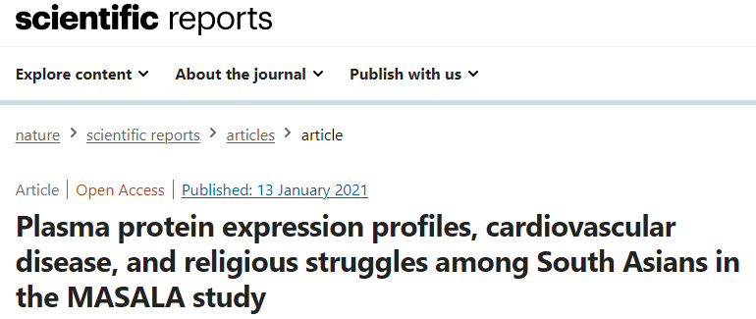
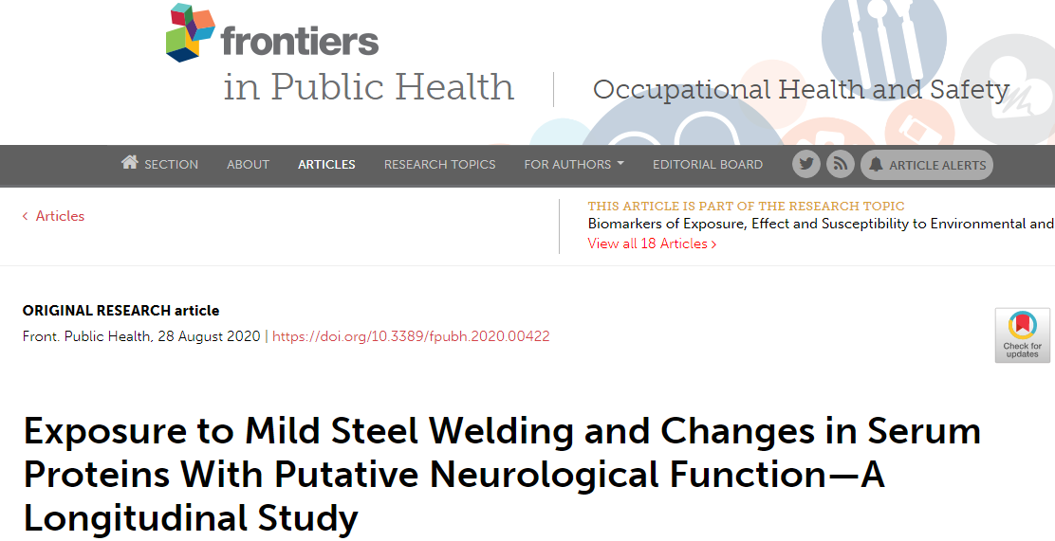
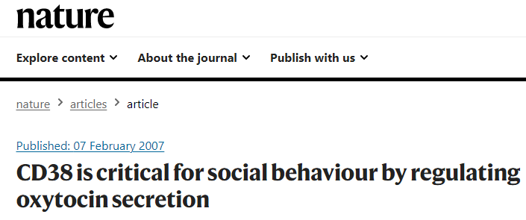
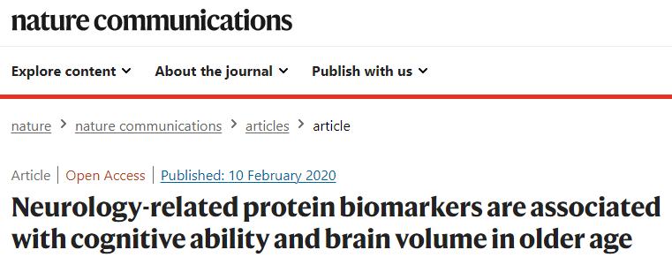
https://doi.org/10.1038/s41598-020-79429-1
https://doi.org/10.3389/fpubh.2020.00422
https://doi.org/10.1038/nature05526
https://doi.org/10.1038/s41467-019-14161-7

