Slide 1
Genetic and Protein data in Understanding Society Genomics and proteomics for social scientists
Meena Kumari
ISER, University of Essex
Festival of Science
28th October 2021

Slide 2
Overview
Understanding Society
Health and biological content
Definition of terms
Examples of the use of biological data in social science

Slide 3


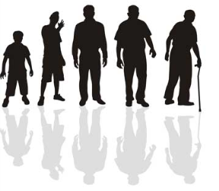
What is Understanding Society (UK Household Longitudinal Study)
Understanding Society surveys a sample of individuals representing the UK population, who are interviewed within a household context:
starts with randomly selected sample of households
collects information about all residents of these households
These residents and their off-springs form the core sample
These core sample members are followed over their life course at 1 year intervals and within UK
Basic design is similar to household panel surveys in other countries e.g., PSID (US), SOEP (Germany), HILDA (Australia), SoFIE (New Zealand)
3

Slide 4
About the Study
Began in 2009, building on British Household Panel Survey (1991)
Different types of information collected:
what people are experiencing: health, circumstances and key events in their lives as they happen
attitudes, identity and subjective well-being
how individuals and households respond to policies and key events (changes in behaviour and outcomes)
Research possibilities
Measurement of change over time and across the life course
Role of household context, parental and family background on individual behaviour and outcomes
Inter-generational changes in behaviour and attitudes
Policy applications, e.g. KPI monitoring, impact, etc.
…..

Slide 5
Initial sample consists of:
General Population Sample: 30,000 UK households in 2009 (58% household response; 82% adult response = 41,047 interviews)
Ethnic Minority Boost: 1,000 adult individuals across five main ethnic groups (Indian, Pakistani, Bangladeshi, Caribbean, African) (52% household response; 72% adult response = 6,685 interviews)
British Household Panel Survey (1991 - ): approximately 8,000 households, 13,454 adults consenting to continue
An Innovation Panel: 1500 households, 2568 adults for methodological research
TOTAL: 39,805 households: 101,087 individuals: 63,755 adults, 5,788 youths
New Migrant Boost = 4500 households
www.understandingsociety.ac.uk

Slide 6
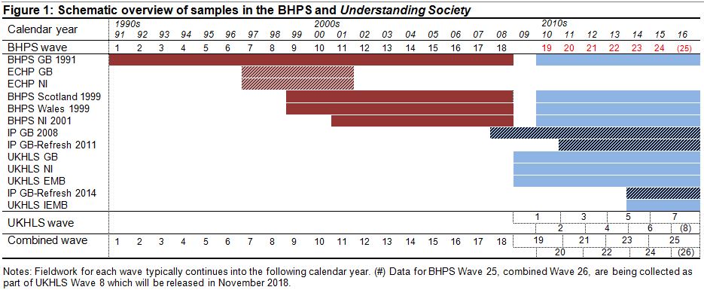
Fieldwork Schedule
6

Slide 7
Measuring the full richness of lives
Multi-topic
Annual
Core, rotating and event/age-triggered content
Key topics
Education
Employment
Family and household
Health and well-being
Income, wealth, expenditure and deprivation
‘Civics’: political, groups, neighbourhood, environment, etc.
Supporting topics
Characteristics
Preferences and expectations
Social networks, support, reciprocity
Transport
Time use
Personality traits, identity, beliefs
Smaller topics of interest
Environmental behaviours
Leisure activities
Neighbourhood participation
Political behaviour
Understanding Society: The UK Household Longitudinal Study https://www.understandingsociety.ac.uk/

Slide 8
Health & wellbeing
Health data from two sources:
1. Questionnaire i.e. individual reports it, e.g.
Current prescriptions
Currently has chronic condition
GHQ measures mental health
2. Objective data measured by a nurse (in Wave 2 & 3):
Height/weight
Lung function, grip strength
Blood analytes – for cholesterol, raised glucose, kidney & liver function, anaemia
Genetic data
8

Slide 9
Self report annual health questions
Census questions - subjective assessment of health, limiting long term illness
Functional capability – mobility, lifting, use of hands, balance or coordination, sight, speech, memory, personal care, continence
Conditions – asthma, arthritis, congestive heart failure, angina, myocardial infarction, stroke, emphysema, thyroid problems, chronic bronchitis, liver, cancer, diabetes, epilepsy, high blood pressure, clinical depression
SF-12 – physical and mental health
GHQ 12 - psychological distress
Health behaviours
Social care
Consent to HES linkage
Biomarker and biomeasure data (subset n=20,000)
Anthropometry, blood pressure, grip strength, lung function, blood sample collection, 21 blood analytes (lipids, endocrine markers, eGFR, LFTs, inflammatory markers: www.understandingsociety/biomarkerglossary), GWAS (n=10K), DNA methylation (n=1,200 + 2000 in progress)

Slide 10
(Non health) content
Annual questions
Basic demographic characteristics
Changes between waves – education, employment, fertility, partnering, geographic mobility
Current job characteristics
Childcare, other caring within and outside household
Income and earnings
Life satisfaction
Transport and communication access
Consumption expenditure
Housing
Household facilities, car ownership
Rotating content
Environmental attitudes & behaviour
Psychological attributes
Well being
Cognitive ability measures
Well-being
Quality of marital relationships
Risk and trust
Collection of data about younger children < 10
Social support
Wealth
www.understandingsociety.ac.uk

Slide 11
COVID-19 questionnaires
Questionnaire content of April and May questionnaires
Coronavirus symptoms and test results
Management of long-term health conditions
Housing
Caring responsibilities
Loneliness
Employment and financial situation
Partnership changes and 'living apart together'
Division of domestic labour
Relationships within the household
Life satisfaction
Mental wellbeing
Home schooling
Food and alcohol consumption
Exercise and smoking

Slide 12
Long term content
Questions are repeated, which is what allows us to measure change over time.
Due to time cost and respondent burden not every question is asked every year
Rotating Modules (2-3-4-6 year intervals)
Event triggered
Age triggered questions
12

Slide 13
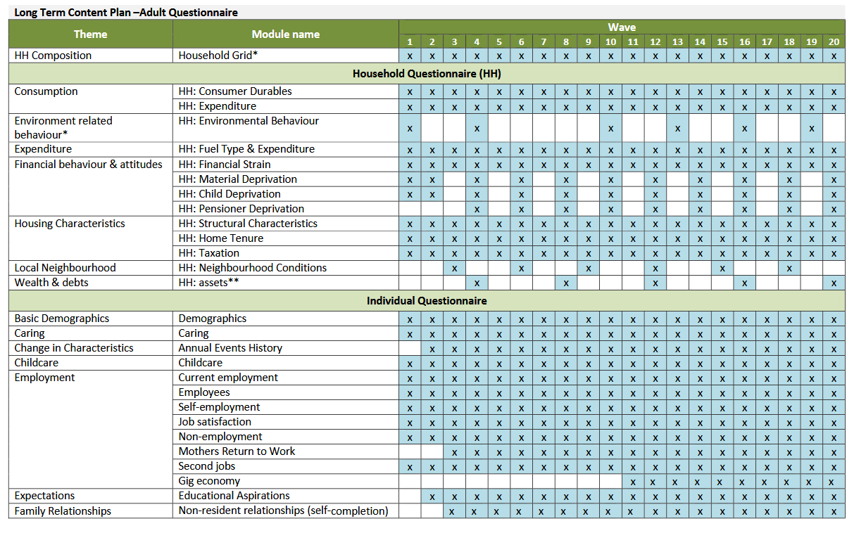
Long term content plan
Understanding Society Workshop, Bristol
08.06.2011

Slide 14
Nurse assessments (waves 2 and 3)
Measure | Applications
Height and weight Waist circumference Percent body-fat (bioelectrical impedance) | BMI and assessment of excess body fat: obesity and risk factor for range of major chronic conditions and social outcomes
Respiratory function (Spirometry) (FVC,FEV₁, PF, FEV₁/FVC) | To detect both obstructive and restrictive respiratory diseases including COPD.
Diastolic and systolic blood pressure, resting pulse rate | Risk factor for stroke and heart conditions Risk cardio-vascular disease
Grip strength | Indicator muscle strength. Functional limitations and disability in older ages.
Blood samples (non-fasting), 19.8ml) | For the extraction of analytes and DNA
Short questionnaire on health on day of measurement, medications etc | Factors that may need to be considered in analysing physical measures and bloods
www.understandingsociety.ac.uk
www.understandingsociety.org.uk

Slide 15
Criteria for choice of blood analytes
Environmental (socioeconomic, physical, psychosocial) and/or behavioural effect on marker
Evidence of pathways to important health outcomes
Affects reasonable proportion of general population
Has reasonable prevalence among those affected
Can be measured given the way our blood was collected and stored
Core markers for main diseases
Useful as individual measures and/or in combined risk scores
Some novel markers – around biological ageing and stress
www.understandingsociety.org.uk

Slide 16
Why are social scientists interested in biological data?
Understanding the pathways by which social circumstances and health are linked
Understanding causality to disability and disease
Sub-clinical disease
Objective markers of behaviour/disease
Clinical ‘iceberg’
Identifying populations at risk
Contribution to the research: data sharing and consortia
-omic science is consortium science
Data sharing still not normative in more medical/clinical settings

Slide 17
-omics
Blood samples (non-fasting), 19.8ml) | For the extraction of analytes and DNA
‘totality’ approach vs candidate/pathway approach
Today
Other terms you might hear
‘Proteomics’
184 proteins
‘Genomic’
‘Genome’ wide scan
Single Nucleotide polymorphisms (14M after imputation)
‘epigenome’ wide scan
Methylation (850k sites)
‘multi-omics’
‘exposome’
Everything you’ve ever been exposed to…..
‘culturomics’
Use of big data in the study of culture

Slide 18
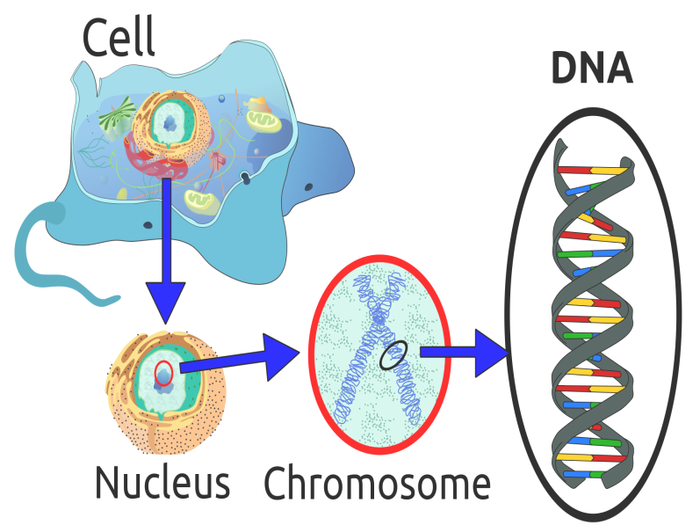
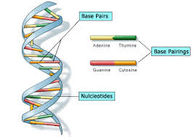
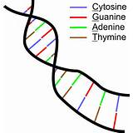
Genetics:
Genes, which are made up of DNA, act as instructions to make molecules called proteins.
In humans, genes vary in size from a few hundred DNA bases to more than 2 million bases.
The Human Genome Project has estimated that humans have between 20,000 and 25,000 genes.
Gene promoter
Code for protein
on/off, when, how much
mRNA
Protein
DNA = structural variation

Slide 19
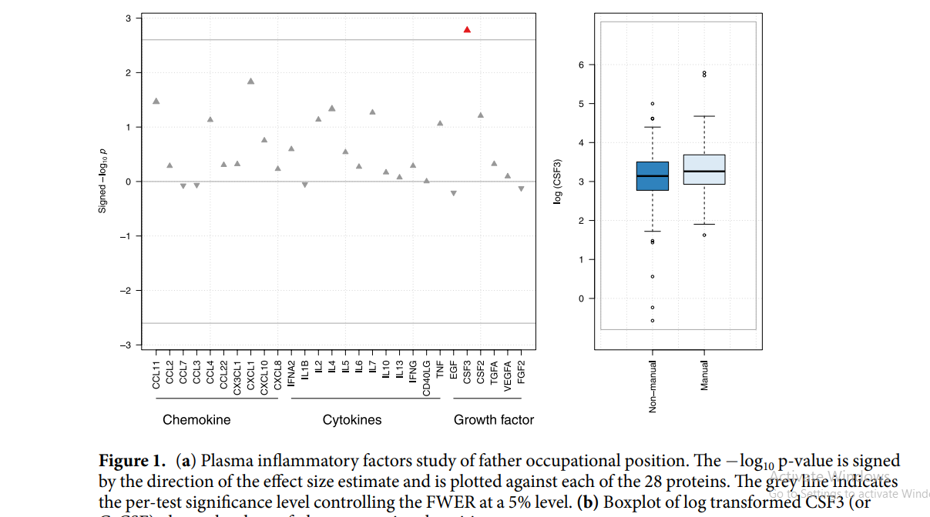
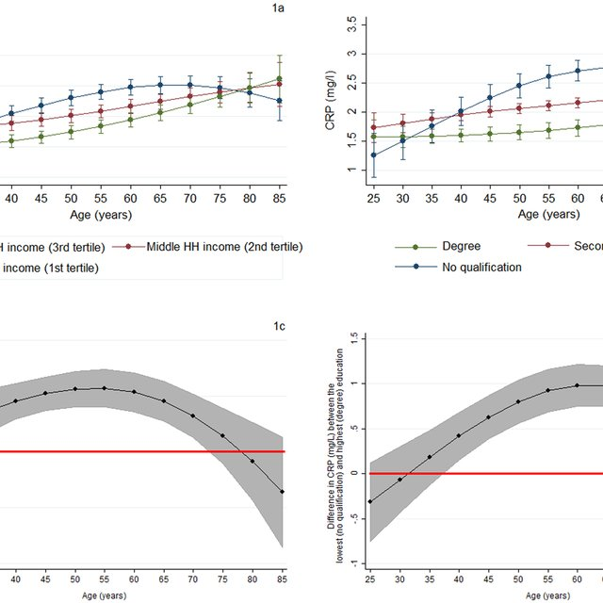
Candidate pathways
Davillas et al., 2017 n=2
inflammatory markers
Castagne et al., 2017
N=28 inflammatory markers
and a ‘score’

Slide 20
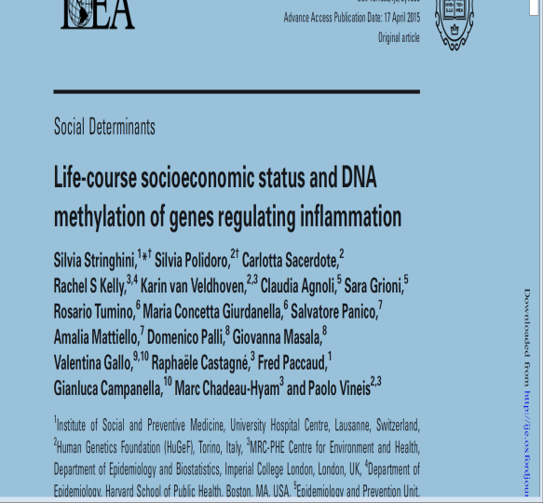
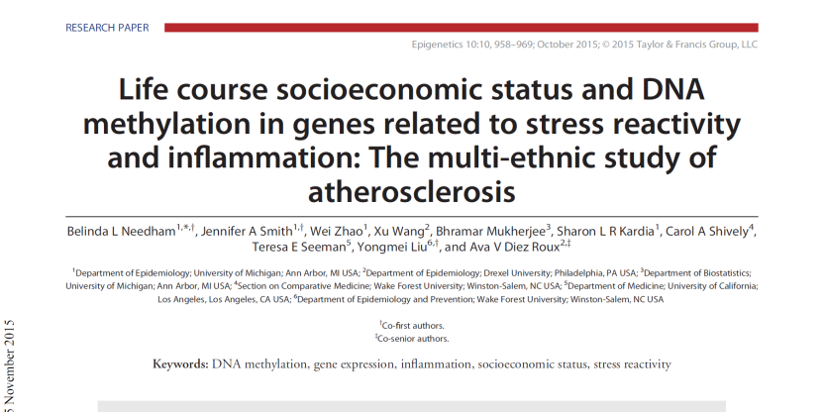
Environment and genome: modification of genetic expression
Epigenetic modification (methylation) and gene expression is socially patterned

Slide 21
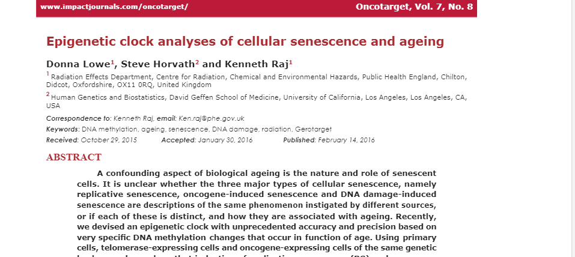
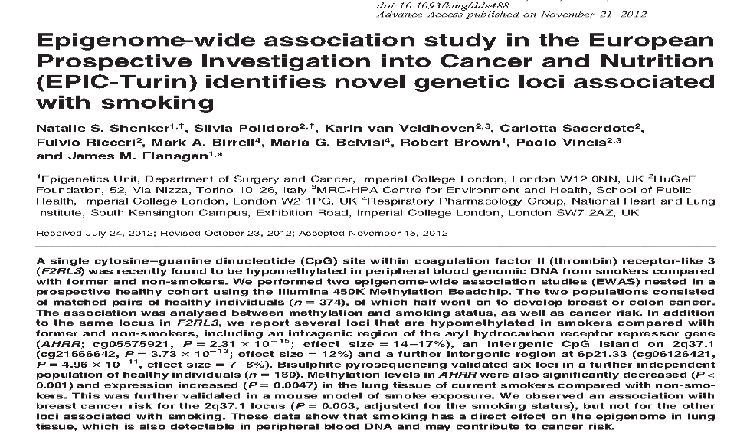
Objective markers: Genomic approaches
‘biological age’
Smoking biomarkers

Slide 22
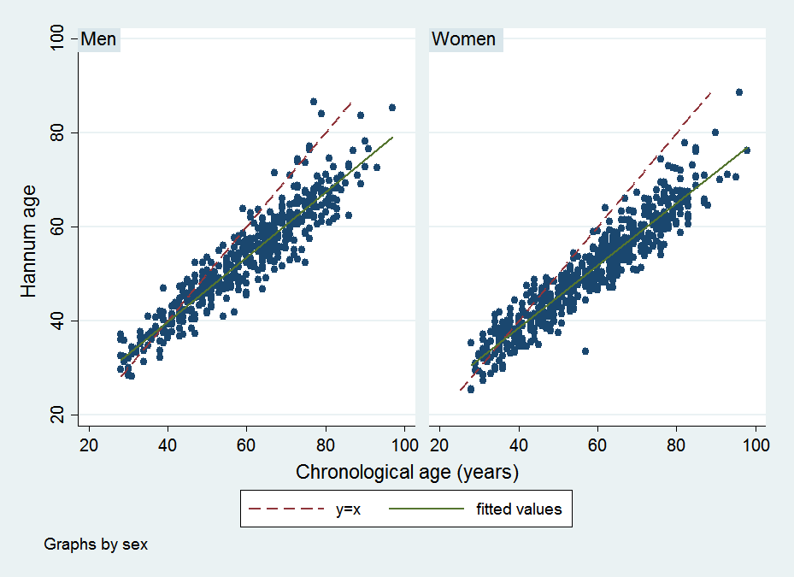
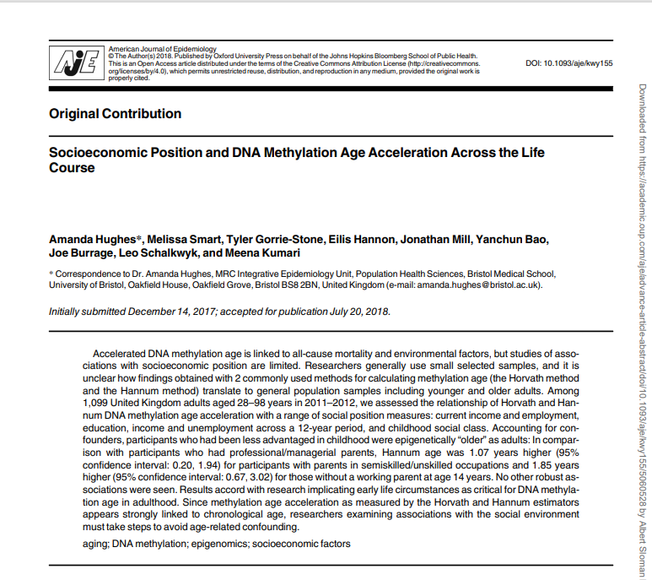
Genomics: biomarkers
Father’s social class associated
with ‘accelerated age’
More educated people appear
to be mismatching in a
comparison of biomarker and
self report (Andrayas et al, in prep)

Slide 23
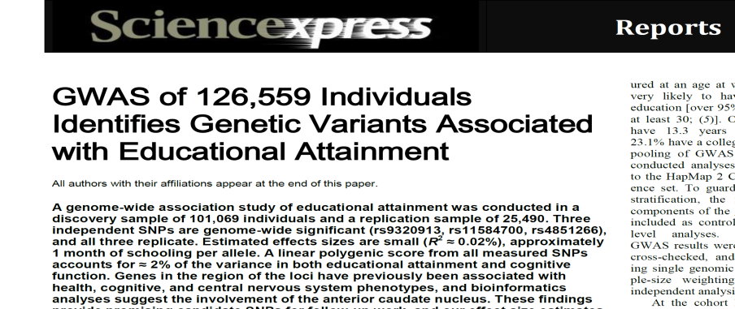
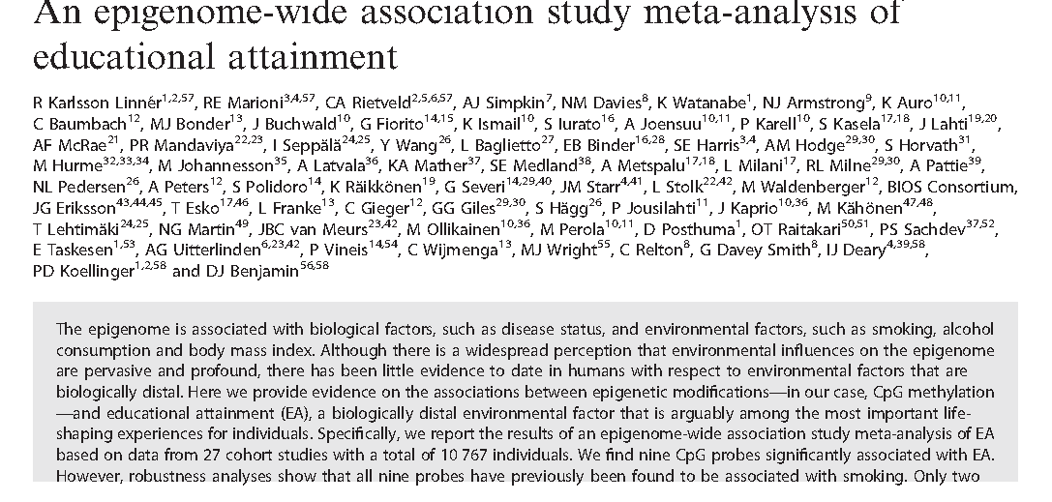
-omic data in social science
GWAS
EWAS
Scores and Mendelian Randomisation

Slide 24
To come:
Background to the biology measured in Understanding Society
genetics
methylation
proteins
Methodological approaches to the data
Potential examples
Dataset and how to access them

