Slide 1
Cross – Classified Models
Part 1 – Introduction
Professor William Browne
Centre for Multilevel Modelling
University of Bristol

Slide 2
Lecture outline
What are Cross-classified models?
Recap of nested models
History and Estimation
Example for practical – the Fife education dataset
In lecture 2 we will fit models to the Fife dataset
In lecture 3 we will look at extensions to different application areas and more levels of crossing.

Slide 3
Traditional (Nested) Multilevel Model
Models that account for the underlying structure in the dataset.
Originally developed for nested structures (multilevel models), for example in education, pupils nested within schools.
An extension of linear modelling with the inclusion of random effects. Linear models assume independence and so are TOO confident when there is clustering in the data
A typical 2-level model is
Here i might index pupils and j index schools.
Alternatively in another example i might index cows and j index herds.
The important thing is that the model and statistical methods used are the same!

Slide 4
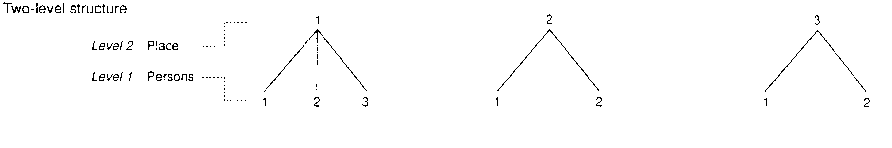
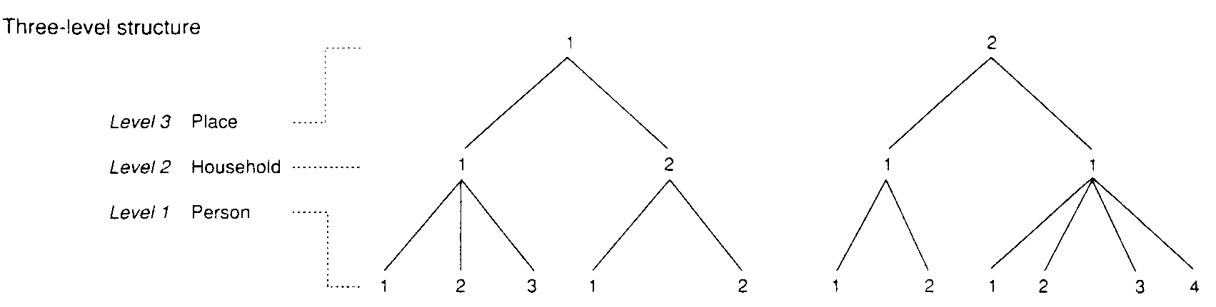
Nested Data Structure
a) People nested within places: two-level model
b) People nested within households within places: three-level model

Slide 5
Cross-classified data structure
The data have a two-way cross-classified non-hierarchical data structure
  Each school draws their students from several different neighbourhoods
  Children living in the same neighbourhood often attend different schools
  The school and neighbourhood hierarchies are crossed with one another
Other examples include
  Students within primary schools crossed with secondary schools*
  Occasions within students crossed within schools
  Scores within students crossed with raters
* Example we will cover in the practical
n1
n2
n3
n4
Level-2
i1
i2
i3
i4
i5
i6
i7
i8
i9
i10
i11
i12
Level-1
s1
s2
s3
Level-2

Slide 6
History
Many nested applications, and as a result specialist software packages developed in education (MLwiN, HLM, VARCL) in the 1990s due to the obvious hierarchies in education data – students nested within classes nested within schools.
Cross-classified applications appeared earlier in animal breeding experiments and some of the first algorithms were produced by Thompson and colleagues on the back of pioneering work on REML (Paterson and Thompson, 1971, Gilmour, Thompson and Cullis, 1995).

Slide 7
Estimation
Markov chain Monte Carlo (MCMC) methods (used in this lecture)
  Implemented in MLwiN:MCMC, R:MCMCglmm, Stata:bayes, WinBUGS
  Computationally efficient and can handle big datasets and complex multiple membership models easily
Maximum likelihood estimation (MLE)
  Implemented in all software, but can usually only fit hierarchical models (an exception is R:lme4)
  However, it turns out that it is possible in some software (e.g., MLwiN:IGLS and Stata:mixed) to reformulate and therefore fit cross-classified models as constrained hierarchical models (Rasbash and Goldstein, 1994)
  Unfortunately, this reformulation is computationally cumbersome for all but the smallest of datasets and simplest of multiple membership models

Slide 8
Example: Fife Education Dataset
Dataset from Fife in Scotland that was used by Rasbash and Goldstein (1994) when they first introduced extensions of the IGLS algorithm for cross-classified models.
Dataset contains 3,435 students from 19 secondary schools and 148 primary schools
The response is a total attainment score based on national examinations taken at the end of compulsory schooling (age 16) which ranges from 1 to 10
Dataset has several student level predictors (mother and father education, verbal reasoning intake score, choice of school, social class, gender) that can be used to explain variation in attainment.

Slide 9
Data frame for attainment data
Data frame for eight selected students who attended secondary schools 1 and 2
In cross-classified data, we must use unique identifiers for every higher classification
attain: exam score (grade converted to number and treated as normal)
Higher-level IDs |  | Level-1 ID | Response | Level-1 covariates
sid | pid | pupil | attain | vrq | med | choice
1 | 1 | 17 | 9 | 101 | 1 | 1
1 | 1 | 8 | 6 | 89 | 1 | 1
1 | 5 | 46 | 10 | 112 | 0 | 1
1 | 5 | 44 | 2 | 84 | 0 | 1
2 | 12 | 3 | 3 | 76 | 1 | 1
2 | 12 | 8 | 5 | 103 | 0 | 1
2 | 14 | 28 | 3 | 102 | 0 | 2
2 | 14 | 1 | 2 | 94 | 0 | 1

Slide 10
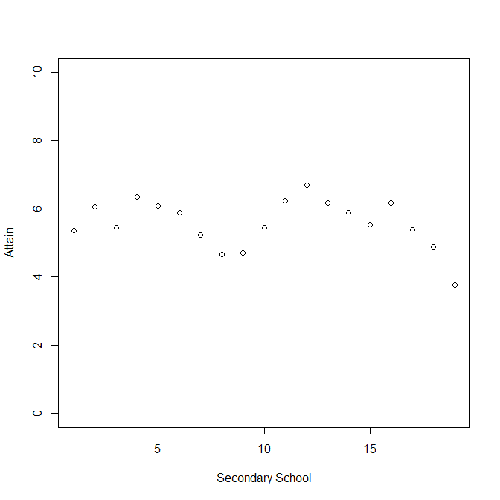
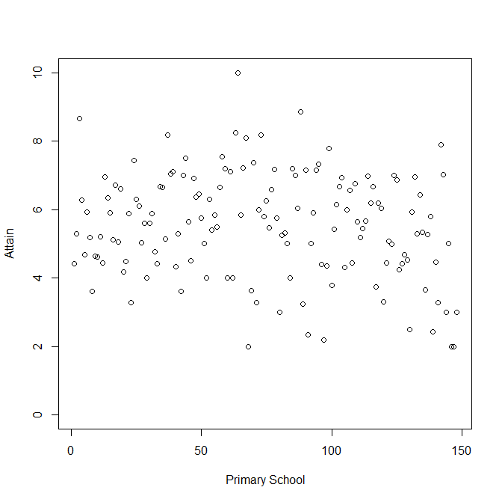
Scatterplot of the attainment data by secondary school and by primary school

Slide 11
Cross-tabulation of primary schools by secondary schools
It is always helpful to visualise cross-classified data as a cross-tabulation
  Here we examine 4 secondary schools and 10 primary schools
Students are nested within the cells of a two-way cross-classification of primary schools-by-secondary schools.
  Secondaries draw their students from many different primary schools
  Primary schools send their children to different secondary schools though many are feeder schools with the bulk of children going to 1 secondary.
The cross-classification is sparse, most cells are empty
 |  | Primary School
 |  | 1 | 2 | 4 | 8 | 10 | 16 | 24 | 25 | 27 | 28
Sec School | 6 | − | − | 1 | − | − | − | 55 | 35 | 43 | 15
 | 7 | − | 7 | − | − | − | − | − | − | − | 1
 | 8 | − | − | − | − | 17 | 36 | − | − | 1 | 4
 | 9 | 45 | − | 6 | 13 | − | − | − | − | − | −

Slide 12
How cross-classified are the data?
The 19 secondary schools draw their students from as few as 7 primary schools to as many as 32 primary schools
The 148 primary schools send their students to between 1 and 6 secondaries
38.5% of primary schools sent their children to a single secondary school
  Suggests a system of ‘feeder schooling’ rather than ‘school choice’
Only 8.4% of students would have to ‘change’ secondary school for the data to become a strict hierarchy (i.e., students within primary within secondary)
Number of schools | Number of primaries | Percentage of primaries
1 | 57 | 38.5
2 | 50 | 33.8
3 | 26 | 17.6
4+ | 15 | 10.1

Slide 13
Summary
In this first lecture on the topic we have recapped the idea of multilevel models and shown how not all data structures have a hierarchical or nested structure
We have given a little bit of historical background to modelling non-nested data
We have introduced an example from education research that has a cross-classified structure
In the second lecture we will fit models to this structure before introducing extensions and additional applications in the third lecture.

