Slide 1
Binary logistic regression
Part 2: Multivariate binary logistic regression
Dr Heini Väisänen
University of Southampton

Slide 2
Outline
Multiple logistic regression
Model selection
Wald-tests
Likelihood ratio test

Slide 3
Multiple logistic regression
We can add more than one explanatory variable to the binary logistic regression model
The interpretation of the coefficients is conducted while ‘controlling for’ or ‘holding constant’ the other coefficients.
Interpretation can be made in log-odds scale, as odds or as predicted probabilities, like before

Slide 4
Example: Assistance at birth
Which characteristics are associated with having received assistance from a health care professional at last birth in Ghana in 2008?
Following characteristics of the mother are studied:
Quintile of wealth (1=poorest to 5=richest)
Total number of children
Place of residence (urban/rural)
Education (None, primary, secondary or higher)

Slide 5
Descriptive statistics
Variable | % or mean (N) | Variable | % or mean (N)
Health professional present at birth | 58.07% (1245)
Number of children | Mean 3.48 (2144) | Wealth: poorest | 29.52% (633)
Urban residence | 35.59% (763) | Wealth: poorer | 21.97% (471)
No education | 36.01% (772) | Wealth: middle | 17.49% (375)
Primary education | 23.69% (508) | Wealth: richer | 18.19% (390)
Secondary education | 38.06% (816) | Wealth: richest | 12.83% (275)
Higher education | 2.24% (48)

Slide 6
Regression results
Variable | Log-odds | Odds ratio | P-value
PoR: Rural (ref.) | 0 | 1.00
PoR: Urban | 0.95 | 2.59 | <0.001
Wealth: poorest (ref.) | 0 | 1.00
Wealth: poorer | 0.86 | 2.36 | <0.001
Wealth: middle | 1.11 | 3.05 | <0.001
Wealth: richer | 1.72 | 5.60 | <0.001
Wealth: richest | 2.62 | 13.75 | <0.001
No education | -1.55 | 0.21 | 0.041
Primary education | -1.32 | 0.27 | 0.081
Secondary education | -0.82 | 0.44 | 0.276
Higher education (ref.) | 0 | 1.00
Number of children | -0.06 | 0.95 | 0.021

Slide 7
Interpretation in odds scale
Wealth:
When controlling for education, number of children and place of residence, those in the richest quintile have 13.7 times higher odds of having had assistance at the most recent birth than those in the poorest quintile.
Number of children:
When controlling for […] each additional child reduced the odds of having had assistance at the most recent birth by 5%
[0.95-1*100=-5%]

Slide 8
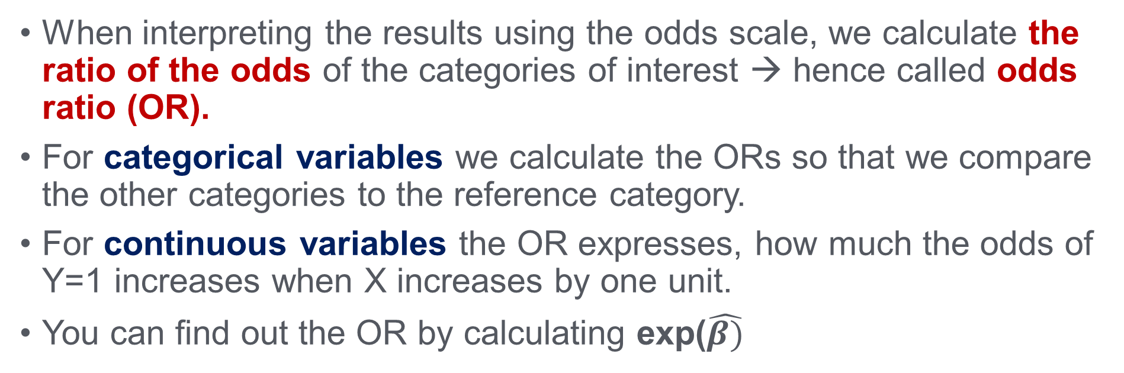
Interpretation: odds ratios more generally
When interpreting the results using the odds scale, we calculate the ratio of the odds of the categories of interest → hence called odds ratio (OR).
For categorical variables we calculate the ORs so that we compare the other categories to the reference category.
For continuous variables the OR expresses, how much the odds of Y=1 increases when X increases by one unit.
You can find out the OR by calculating exp($\hat{β)}$

Slide 9
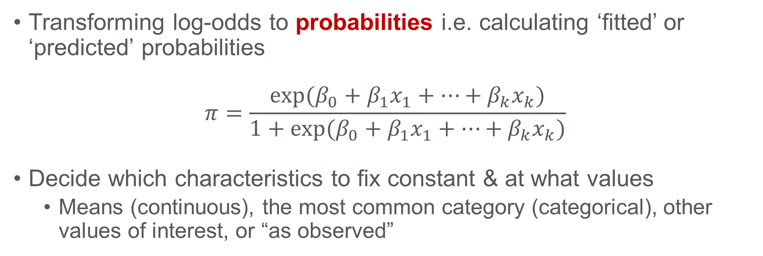
Interpretation: probability scale
Transforming log-odds to probabilities i.e. calculating ‘fitted’ or ‘predicted’ probabilities
$$π=\frac{exp⁡(β_{0}+β_{1}x_{1}+…+β_{k}x_{k})}{1+exp⁡(β_{0}+β_{1}x_{1}+…+β_{k}x_{k})}$$
Decide which characteristics to fix constant & at what values
Means (continuous), the most common category (categorical), other values of interest, or “as observed”

Slide 10
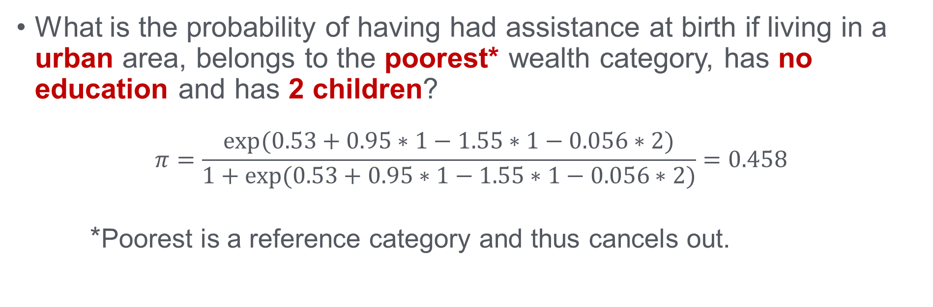
Interpretation: probability scale
What is the probability of having had assistance at birth if living in a urban area, belongs to the poorest* wealth category, has no education and has 2 children?
$$π=\frac{exp⁡(0.53+0.95∗1−1.55∗1−0.056∗2)}{1+exp⁡(0.53+0.95∗1−1.55∗1−0.056∗2)}=0.458$$
*Poorest is a reference category and thus cancels out.

Slide 11
Regression results
Variable | Log-odds | Odds ratio | P-value
PoR: Rural (ref.) | 0 | 1.00
PoR: Urban | 0.95 | 2.59 | <0.001
Wealth: poorest (ref.) | 0 | 1.00
Wealth: poorer | 0.86 | 2.36 | <0.001
Wealth: middle | 1.11 | 3.05 | <0.001
Wealth: richer | 1.72 | 5.60 | <0.001
Wealth: richest | 2.62 | 13.75 | <0.001
No education | -1.55 | 0.21 | 0.041
Primary education | -1.32 | 0.27 | 0.081
Secondary education | -0.82 | 0.44 | 0.276
Higher education (ref.) | 0 | 1.00
Number of children | -0.06 | 0.95 | 0.021

Slide 12
Summary of interpretation of multiple binary logistic regression
Log-odds not very intuitive
Odds ratios tell about the relative differences and apply to the entire scale (for continuous variables)
Probabilities tell about the absolute levels of ‘risk’
Need to decide at which values the variables are held
Does not apply to the entire scale of a continuous variable
Often the most intuitive option
Usually calculated using software (Stata, SPSS, R…)

Slide 13
Model selection: Wald-tests
Wald-test is analogous to t-test in OLS regression
For continuous and binary variables can be used to assess statistical significance
For dummy variables with 3+ categories Wald-test shows whether each category significantly different from the reference category.

Slide 14
Regression results
Variable | Log-odds | Odds ratio | P-value
PoR: Rural (ref.) | 0 | 1.00
PoR: Urban | 0.95 | 2.59 | <0.001
Wealth: poorest (ref.) | 0 | 1.00
Wealth: poorer | 0.86 | 2.36 | <0.001
Wealth: middle | 1.11 | 3.05 | <0.001
Wealth: richer | 1.72 | 5.60 | <0.001
Wealth: richest | 2.62 | 13.75 | <0.001
No education | -1.55 | 0.21 | 0.041
Primary education | -1.32 | 0.27 | 0.081
Secondary education | -0.82 | 0.44 | 0.276
Higher education (ref.) | 0 | 1.00
Number of children | -0.06 | 0.95 | 0.021

Slide 15
Likelihood Ratio Test (LR test)
In logistic regression model the estimates are found by maximising the log-likelihood (LL) → The higher the LL, the better the model fits the data.
Difference between -2LL for two nested models can be tested
The difference follows a Chi-squared distribution
Degrees of freedom is the difference in the number of parameters in each model
The more complicated model always has a smaller -2LL but is this reduction significant?
Particularly useful for dummy-variables with more than two categories.
Notes:
Nested models: It means the models share some of the variables between them, but model 2 includes (a) variable(s) not in model 1

Slide 16
Likelihood ratio test
Let’s compare two models of having had assistance in last birth:
Model 1: Number of children as the only explanatory variable.
Model 2: Number of children and Wealth as explanatory variables.
We can compare any two models so long as one is nested in the other. In this case Model 1 is nested in Model 2.
H0: No difference between the models.
H1: There is a difference between the models

Slide 17
Likelihood Ratio Test: calculating by hand
Model 1 (number of children only)
LL = -1410.12 -2LL = -2* (-1410.12) = 2820.24
Model 2 (both variables included)
LL = -1142.94 -2LL = -2* (-1142.94) = 2285.88
Likelihood Ratio Test statistic = 2820.24 – 2285.88 = 534.36
4 d.f. (wealth has 5 categories, 1 ref.) → p<0.001

Slide 18
Summary of model selection
Likelihood ratio test is the most important tool for comparing models.
Wald test can be used to get information of statistical significance of individual covariates.
Let theory & previous research guide you in selecting which variables an in which order to include them in the model.

Slide 19
Thank you!

