Slide 1
Documentation of agent-based models: ODD+D
André Grow
Max Planck Institute for Demographic Research

Slide 2
Problems in implementing simulation models

Slide 3
A lack of standards
Agent-based models have solid methodological foundations
Yet, they yield lots of freedom and the field has therefore moved into some state of anarchy (design, analysis, presentation)
  No classification of the different ways in which agents can exchange information and communicate
  No standard way to treat the artificial data that the model generates
  Often the comparison between experimental and empirical data is naïf
  Parameter values are chosen without proper discussion
  Often it is not possible to understand the details of the implementation of an agent-based model
  “This makes replication a difficult, sometimes impossible task, thus violating the basic principle of scientific practice and confining the knowledge generated by agent-based simulations to no more than anecdotal evidence” (1.5)
Richiardi, M., Leombruni, R., Saam, N., & Sonnessa, M. (2006). A common protocol for agent-based social simulation. Journal of Artificial Societies and Social Simulation, 9(1), 15.

Slide 4
Pitfalls in existing papers
Link with the literature
  Agent-based models often depart radically from the existing literature
    This implies an increased need for space to explain the method/model
    Model results become more difficult to assess
Structure of the model
  Some basic features of models:
    treatment of time (discrete vs. continuous)
    simulation type (stochastic vs. deterministic)
    representation of space (topology)
    population evolution (birth and death)
    treatment of heterogeneity (which variables differ across individuals),
    interaction structure (localized vs. non-localized)
    type of individual behavior (optimizing vs. satisficing), etc.
    Often readers have to work these features out themselves
Richiardi, M., Leombruni, R., Saam, N., & Sonnessa, M. (2006). A common protocol for agent-based social simulation. Journal of Artificial Societies and Social Simulation, 9(1), 15.

Slide 5
Pitfalls in existing papers
Analysis
  Which individual-/aggregate-level variables should be explored and why?
  Is the goal to explore the model in equilibrium or not?
  How should the parameter space be explored (global vs. local)?
  How should sensitivity be tested?
  How should the model be validated?
Richiardi, M., Leombruni, R., Saam, N., & Sonnessa, M. (2006). A common protocol for agent-based social simulation. Journal of Artificial Societies and Social Simulation, 9(1), 15.

Slide 6
Solutions

Slide 7
Solution 1: Publishing code and input data
The code of the model is the only way in which it can be described accurately
Any verbal description of what the model does is only an approximation and thus might be erroneous or ambiguous

Slide 8
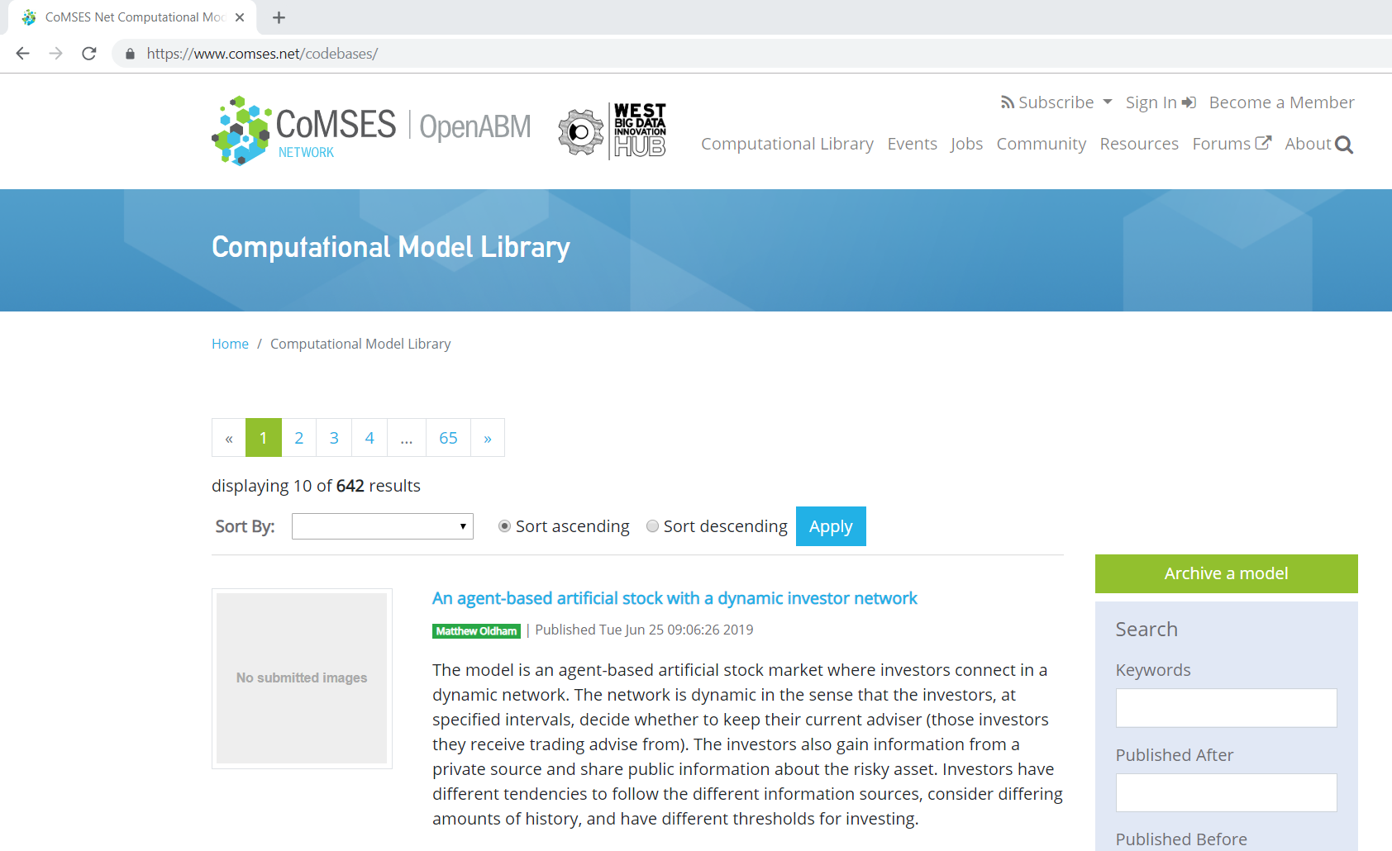
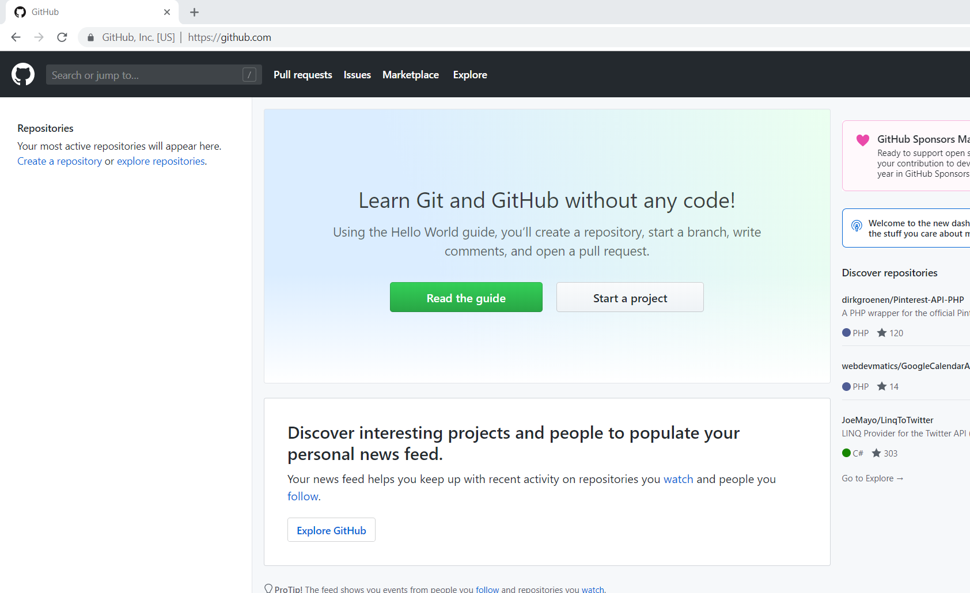
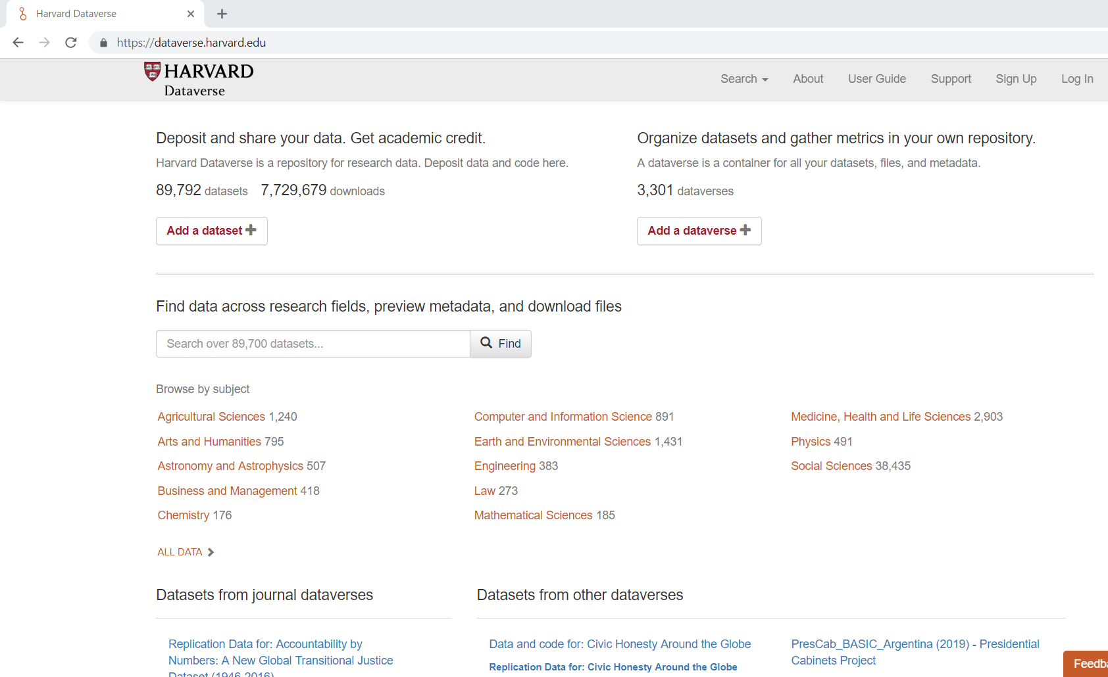
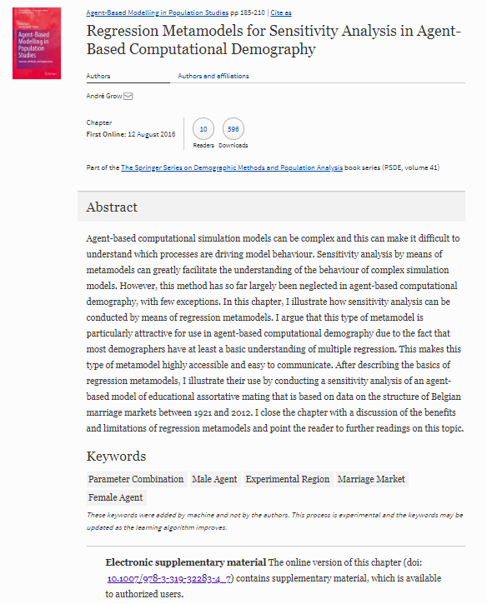
CoMSES Net/Open ABM
GitHub
https://www.comses.net/
https://github.com/
Harvard Dataverse
Publisher’s Webspace
Usually not
recommendable
https://dataverse.harvard.edu/

Slide 9
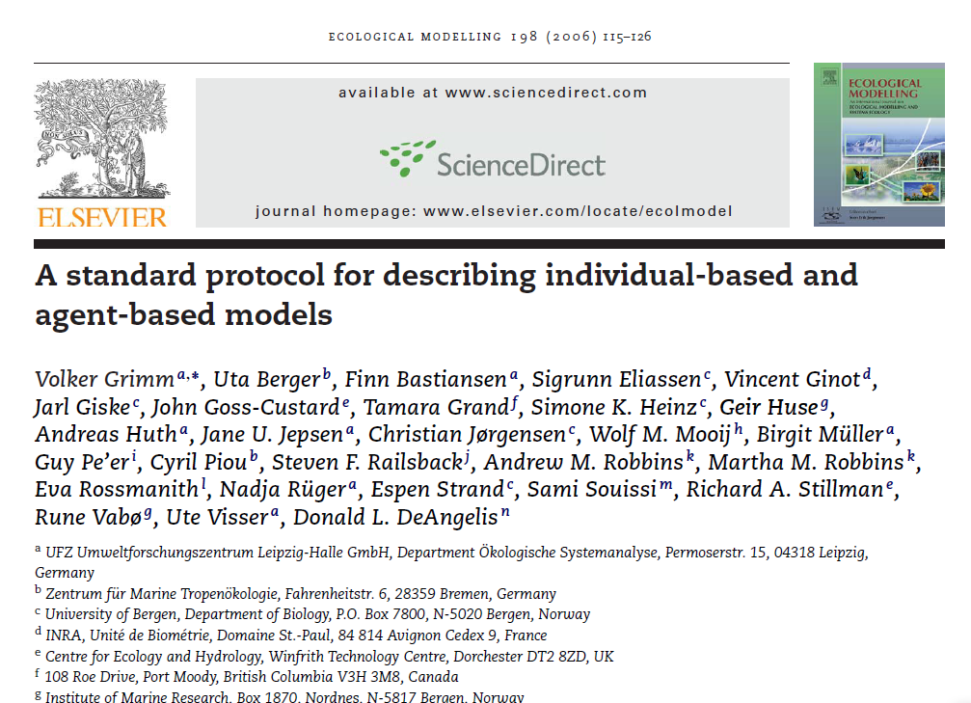
Solution 2: Model description in standardized format

Slide 10
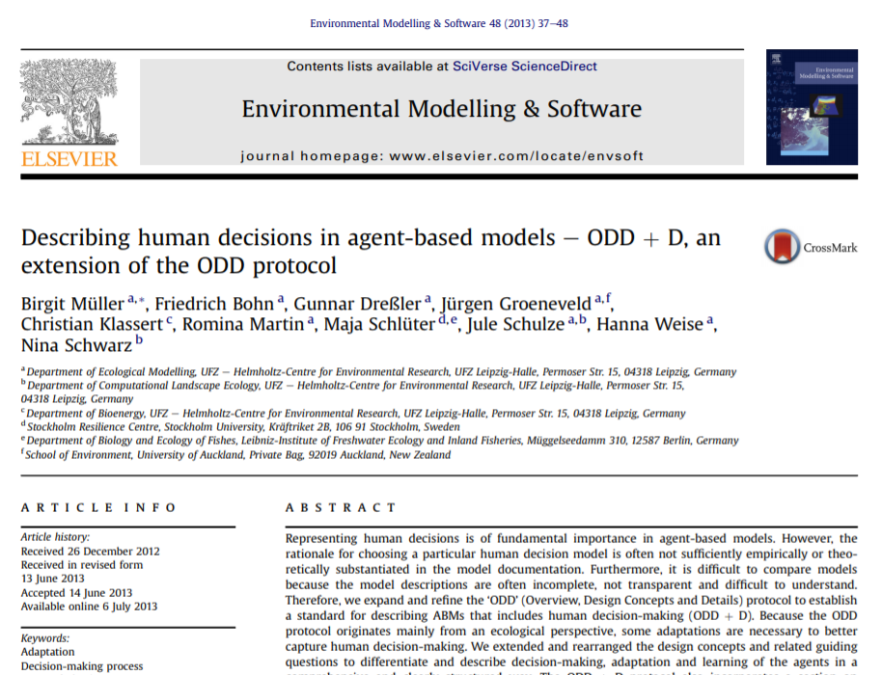
Solution 2: Model description in standardized format

Slide 11
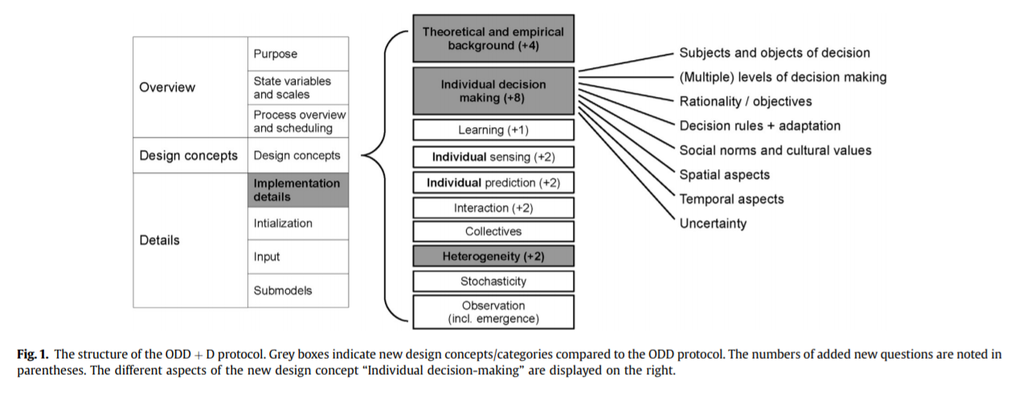
Solution 2: Model description in standardized format
Müller, B., Bohn, F., Dreßler, G., Groeneveld, J., Klassert, C., Martin, R., … Schwarz, N. (2013). Describing human decisions in agent-based models - ODD + D, an extension of the ODD protocol. Environmental Modelling & Software, 48, 37–48.

Slide 12
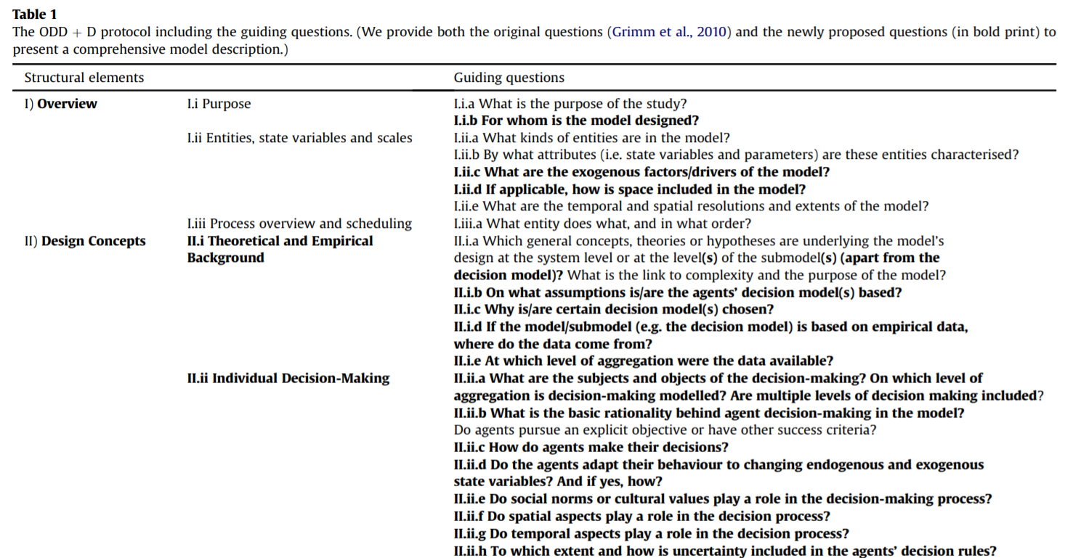
Solution 2: Model description in standardized format
Müller, B., Bohn, F., Dreßler, G., Groeneveld, J., Klassert, C., Martin, R., … Schwarz, N. (2013). Describing human decisions in agent-based models - ODD + D, an extension of the ODD protocol. Environmental Modelling & Software, 48, 37–48.

Slide 13
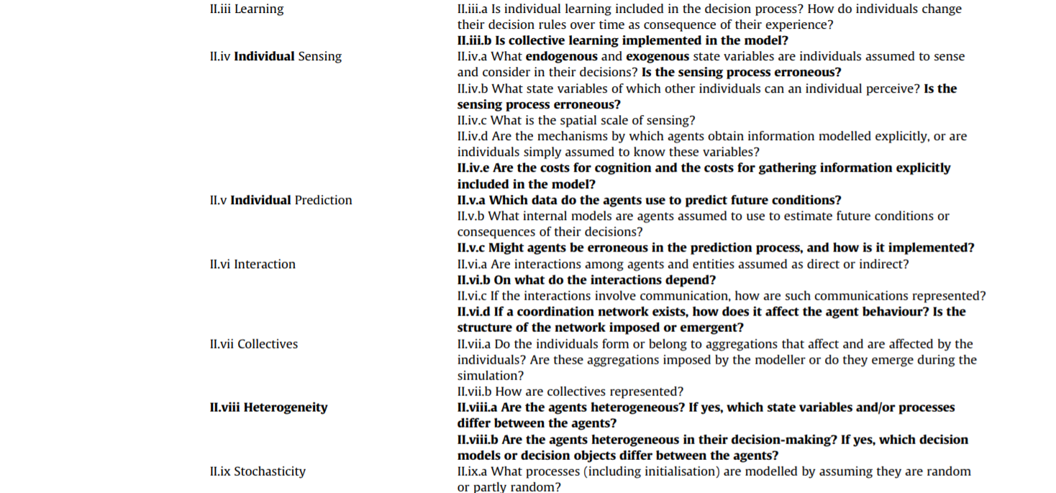
Solution 2: Model description in standardized format
Müller, B., Bohn, F., Dreßler, G., Groeneveld, J., Klassert, C., Martin, R., … Schwarz, N. (2013). Describing human decisions in agent-based models - ODD + D, an extension of the ODD protocol. Environmental Modelling & Software, 48, 37–48.

Slide 14
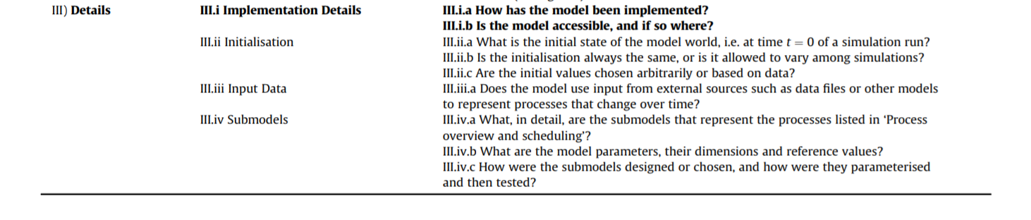
Solution 2: Model description in standardized format
Müller, B., Bohn, F., Dreßler, G., Groeneveld, J., Klassert, C., Martin, R., … Schwarz, N. (2013). Describing human decisions in agent-based models - ODD + D, an extension of the ODD protocol. Environmental Modelling & Software, 48, 37–48.

Slide 15
Comments or Questions?
Email: grow@demogr.mpg.de
Web: www.andre-grow.net
Twitter: @grow_andre

