Slide 1
Provenance for Simulation Studies
Adelinde M. Uhrmacher University of Rostock

Slide 2
Deficits of ODD (and many other reporting guidelines)
Overview | Purpose Entities, state variables, and scales Process overview and scheduling
Design concepts | Design concepts (basic principles, emergence, adaptation, objectives, learning, prediction, sensing, interaction, stochasticity, collectives, observation)
Details | Initialization Input data Submodels
No overview about the development process
No computer queryable, accessible format.
Grimm et al. “The ODD protocol: A review and first update”. Ecological Modelling, 2010.

Slide 3
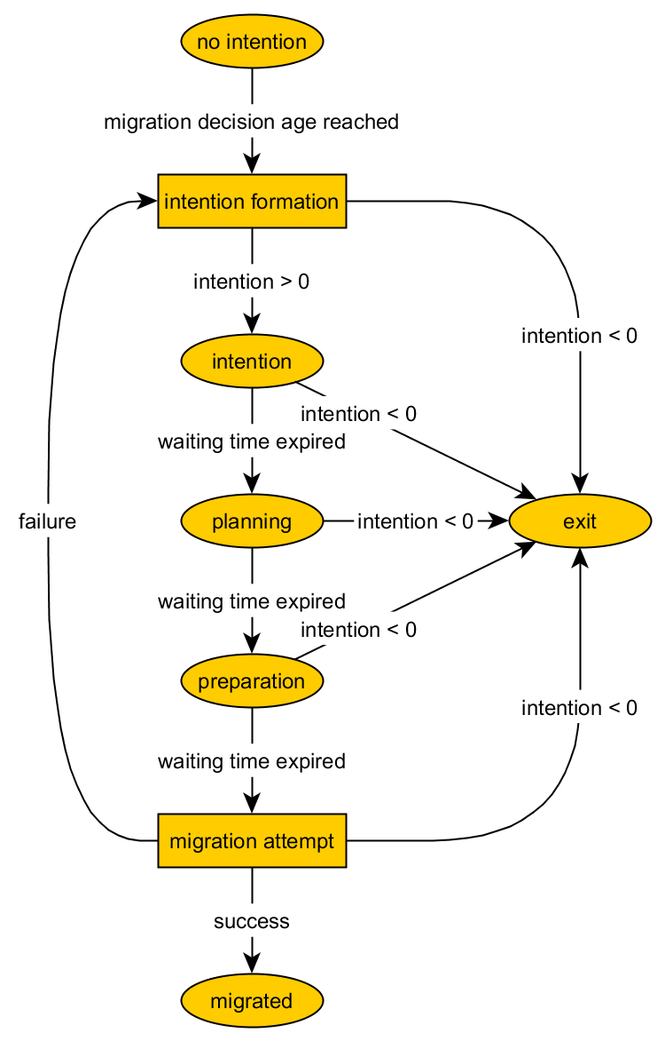
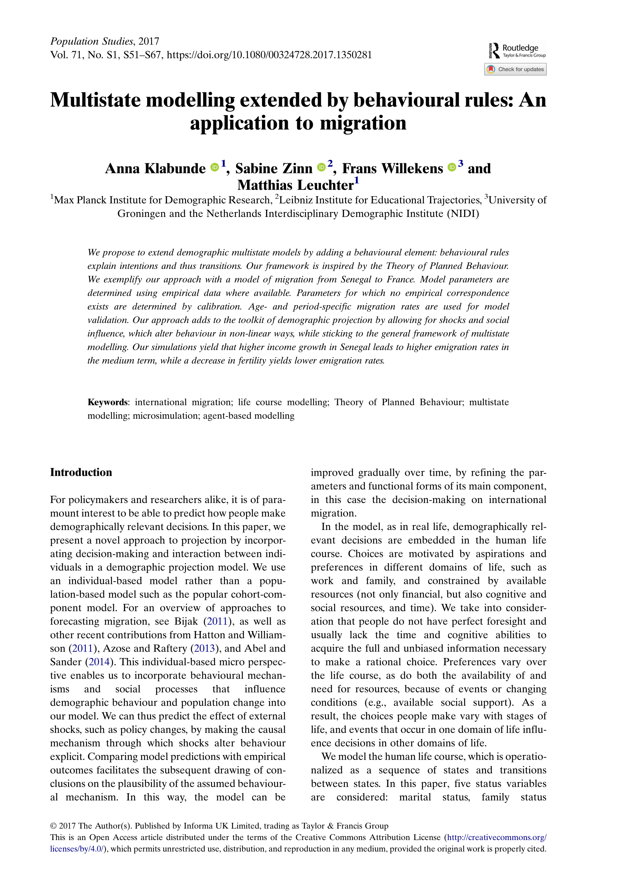
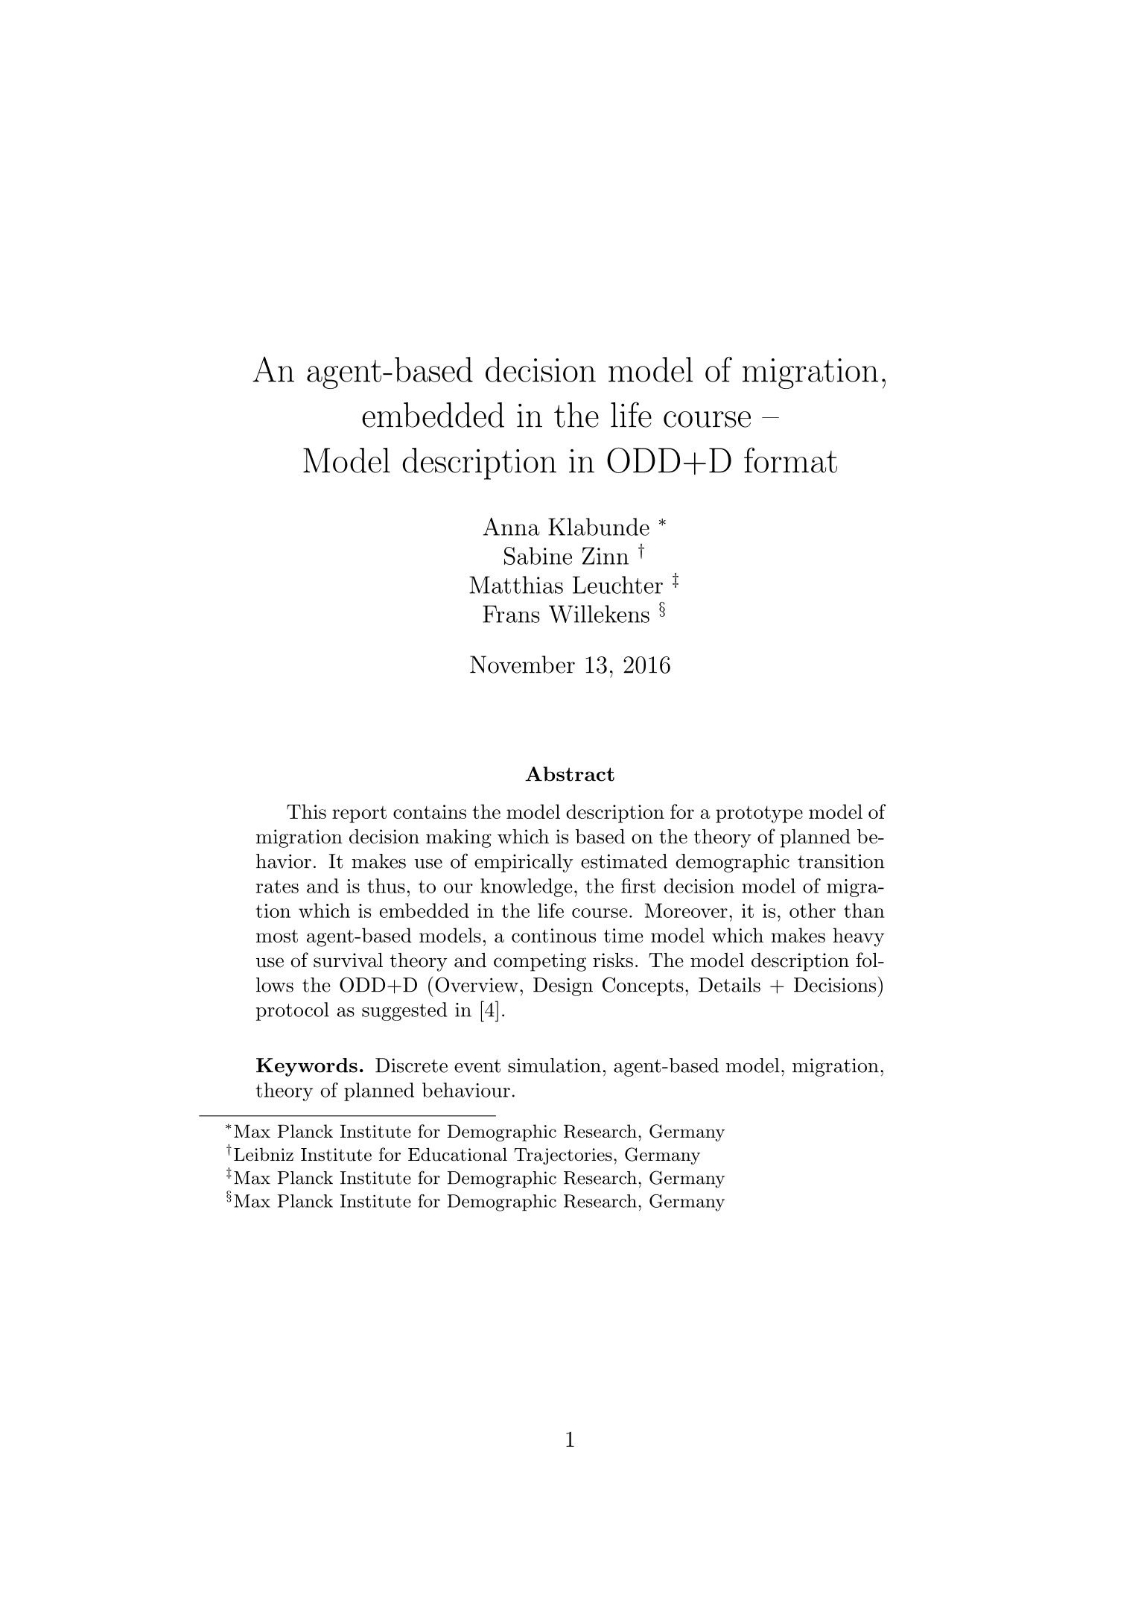
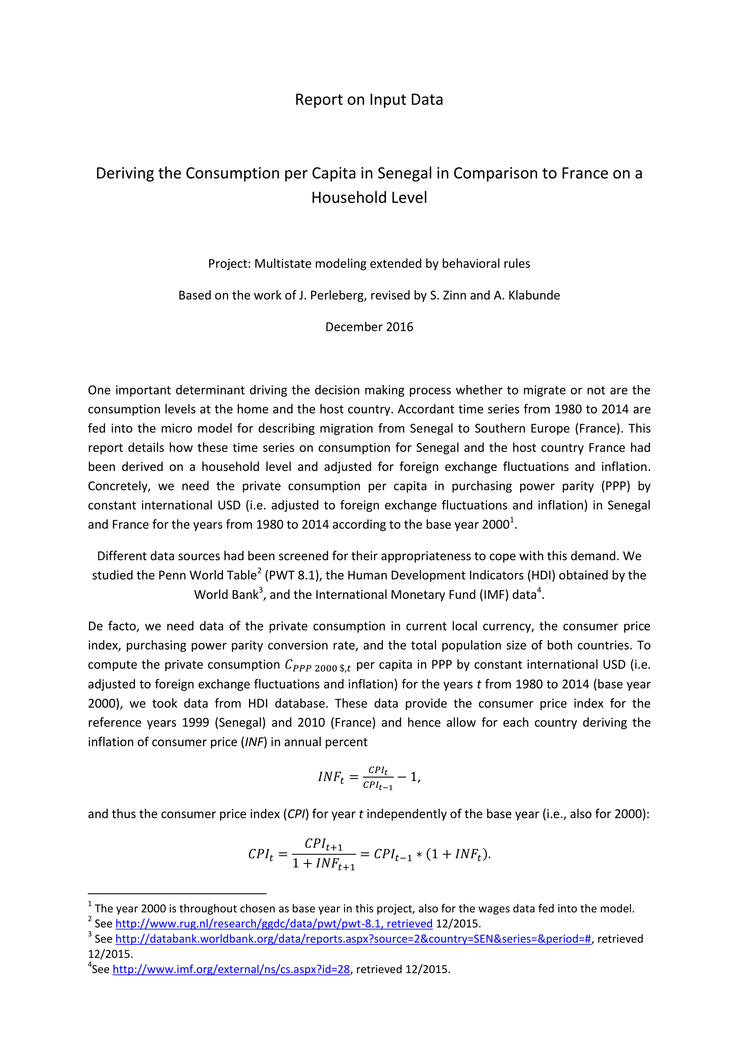
The result: a lot of ambiguous descriptions to sort through
Paper
ODD
Reports on inputs

Slide 4
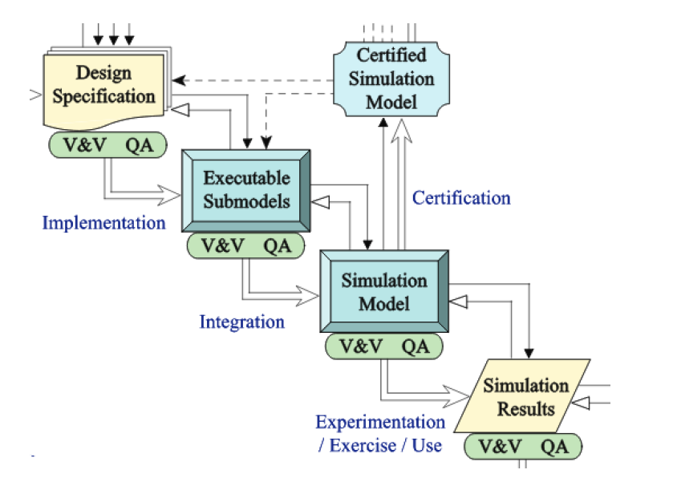
Can we do better?
Simulation studies are intricate processes. Let‘s model this process, so to include provenance, i.e.,
“. . . information about entities, activities, and people involved in producing a piece of data or thing, which can be used to form assessments about its quality, reliability, or trustworthiness.”
In a structured, computer accessible manner!
Balci, Osman. "A life cycle for modeling and simulation." Simulation 88.7 (2012): 870-883.
Groth, Paul, and Luc Moreau. "PROV-overview." W3C Working Group Note (2013).

Slide 5
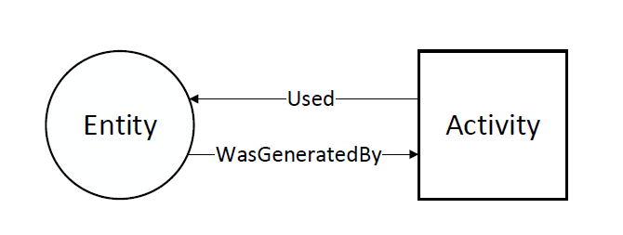
PROV - A standard to describe Provenance
... allows to describe provenance information as an annotated causality graph.
The nodes describe entities and processes
Entities: products, inputs in our simulation study
Activity: actions performed on or caused by entities resulting in new entities, model building, model validation model calibration ...
Missier, Paolo et al. "The W3C PROV family of specifications for modelling provenance metadata."
Proceedings of the 16th International Conference on Extending Database Technology. ACM, 2013.

Slide 6
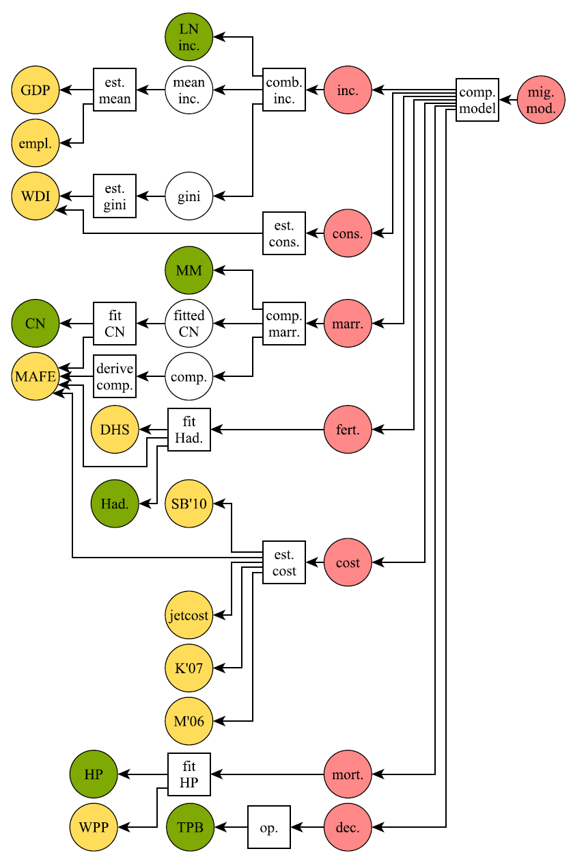
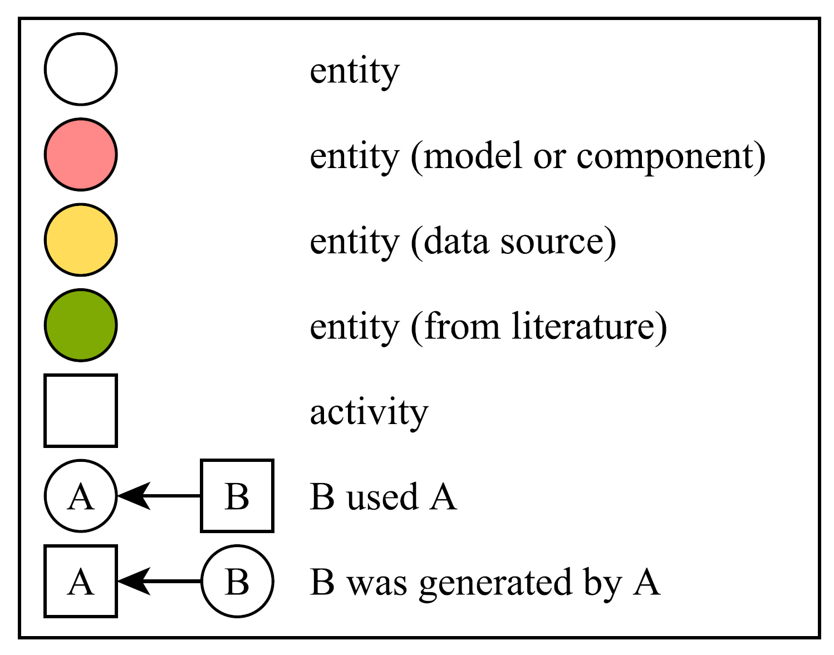
Back to our Case study

Slide 7
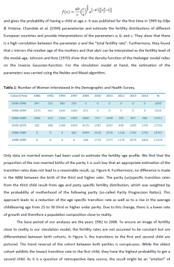
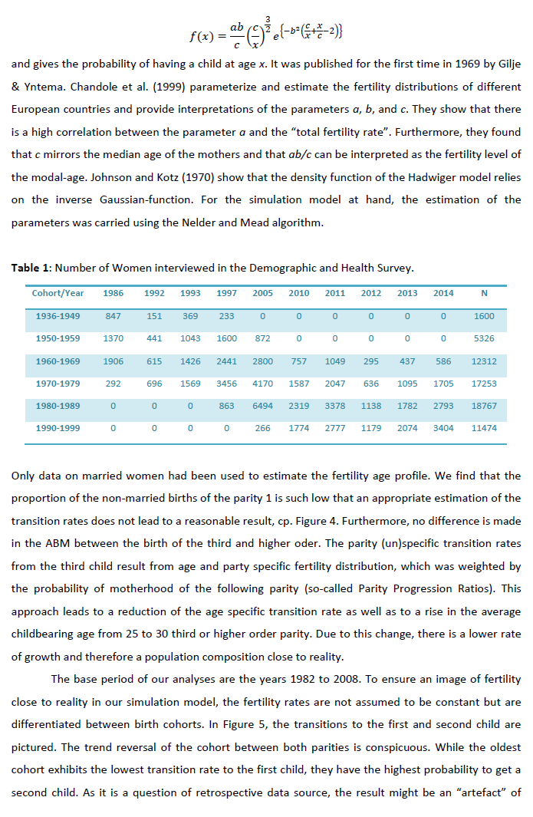
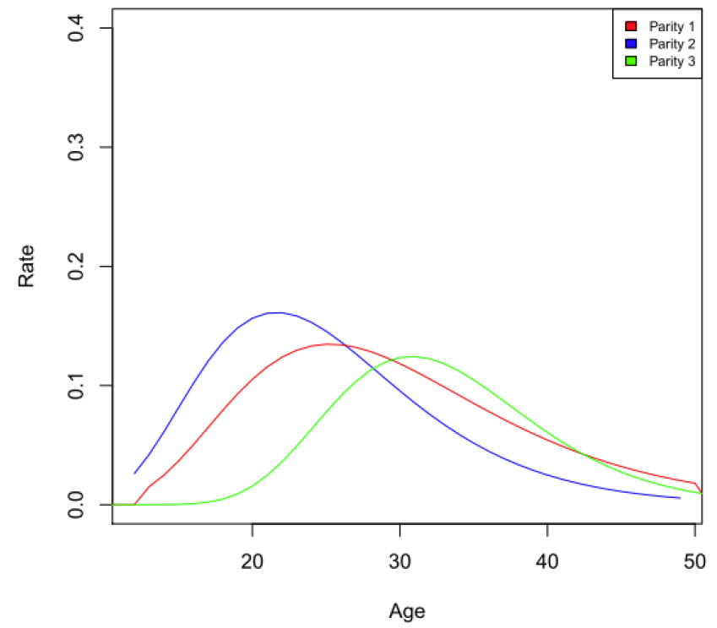
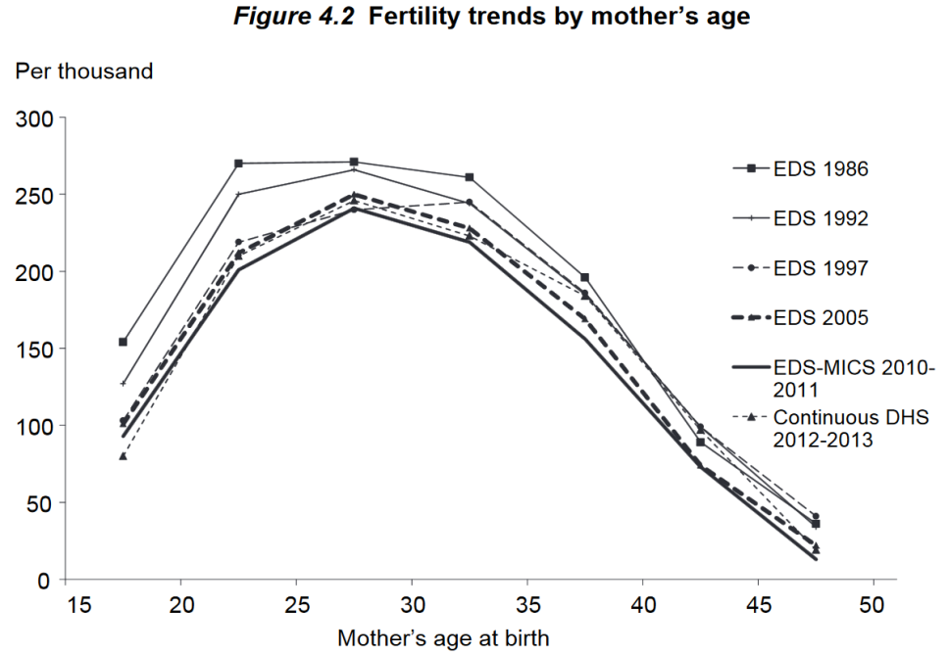
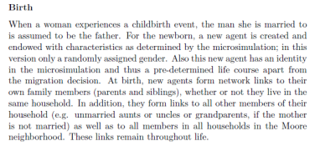
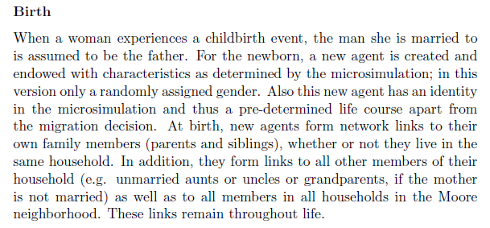
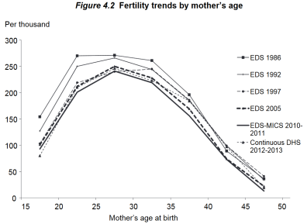
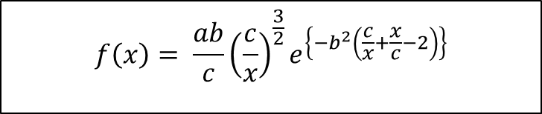

In detail
$$f\left(x\right)= \frac{ab}{c}{\left(\frac{c}{x}\right)}^{\frac{3}{2}}e^{\left\{−b^{2}\left(\frac{c}{x}+\frac{x}{c}−2\right)\right\}}$$
Had.
$$f\left(x\right)= \frac{ab}{c}{\left(\frac{c}{x}\right)}^{\frac{3}{2}}e^{\left\{−b^{2}\left(\frac{c}{x}+\frac{x}{c}−2\right)\right\}}$$
DHS
fit Had.
fert.
DHS: Senegal Continuous Demographic Health Survey 2012-2013
MAFE
DHS: Senegal Continuous Demographic Health Survey 2012-2013

Slide 8
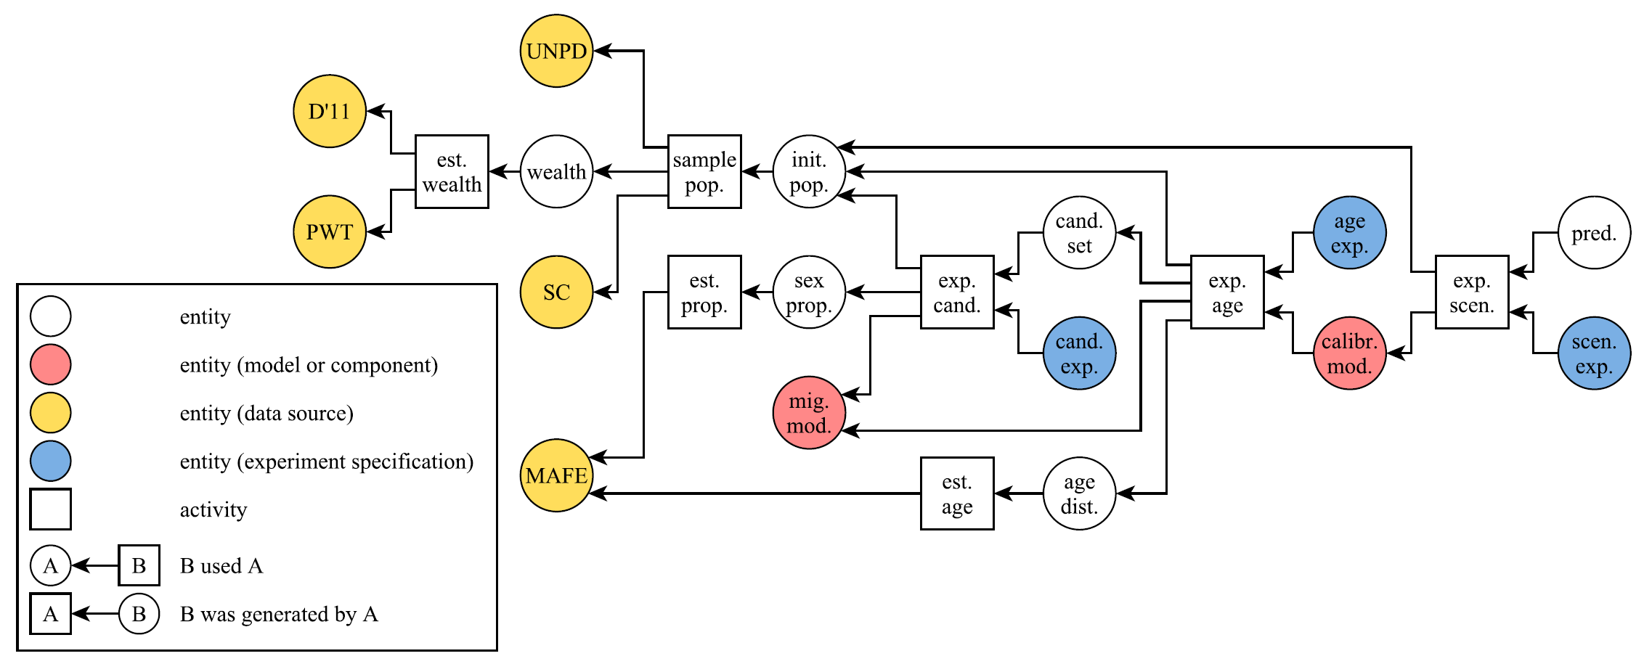
Conducting simulation experiments ...
Reinhardt, Oliver, Andreas Rucheinski, and Adelinde M. Uhrmacher. "Odd+ p: Complementing the odd protocol with provenance information." 2018 Winter Simulation Conference (WSC). IEEE, 2018.

Slide 9
PROV Ontology for Modeling Simulation Studies - PROV – OMOS
Entities | Activities | Roles
Requirements | Building simulation model | Calibration
Assumptions | Calibrating simulation model | Validation
Qualitative model | Validating simulation model | Exploration
Simulation model | Analyzing simulation model | Analysis
Simulation experiment | Statistical fitting | ....
Data | ....
Theory
....

Slide 10
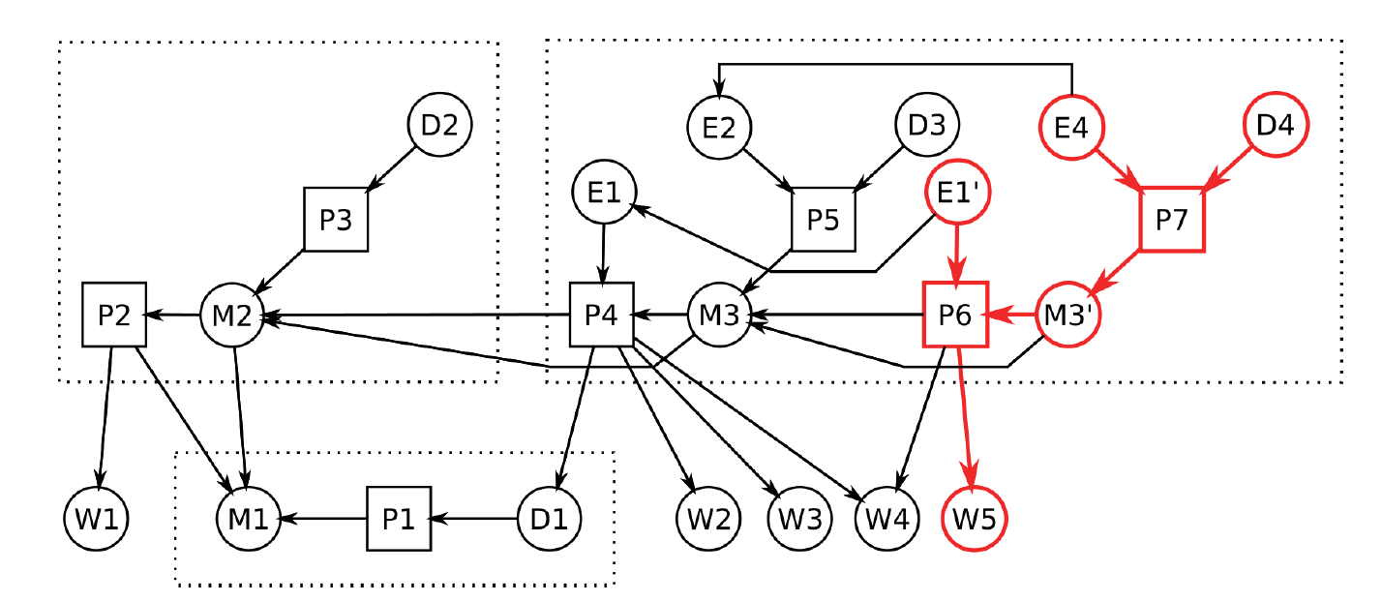
Information becomes queryable
If the data W5 are invalidated which products need to be revisited?
Ruscheinski, Andreas, and Adelinde Uhrmacher. "Provenance in modeling and simulation studies—Bridging gaps." 2017 Winter Simulation Conference (WSC). IEEE, 2017.

Slide 11
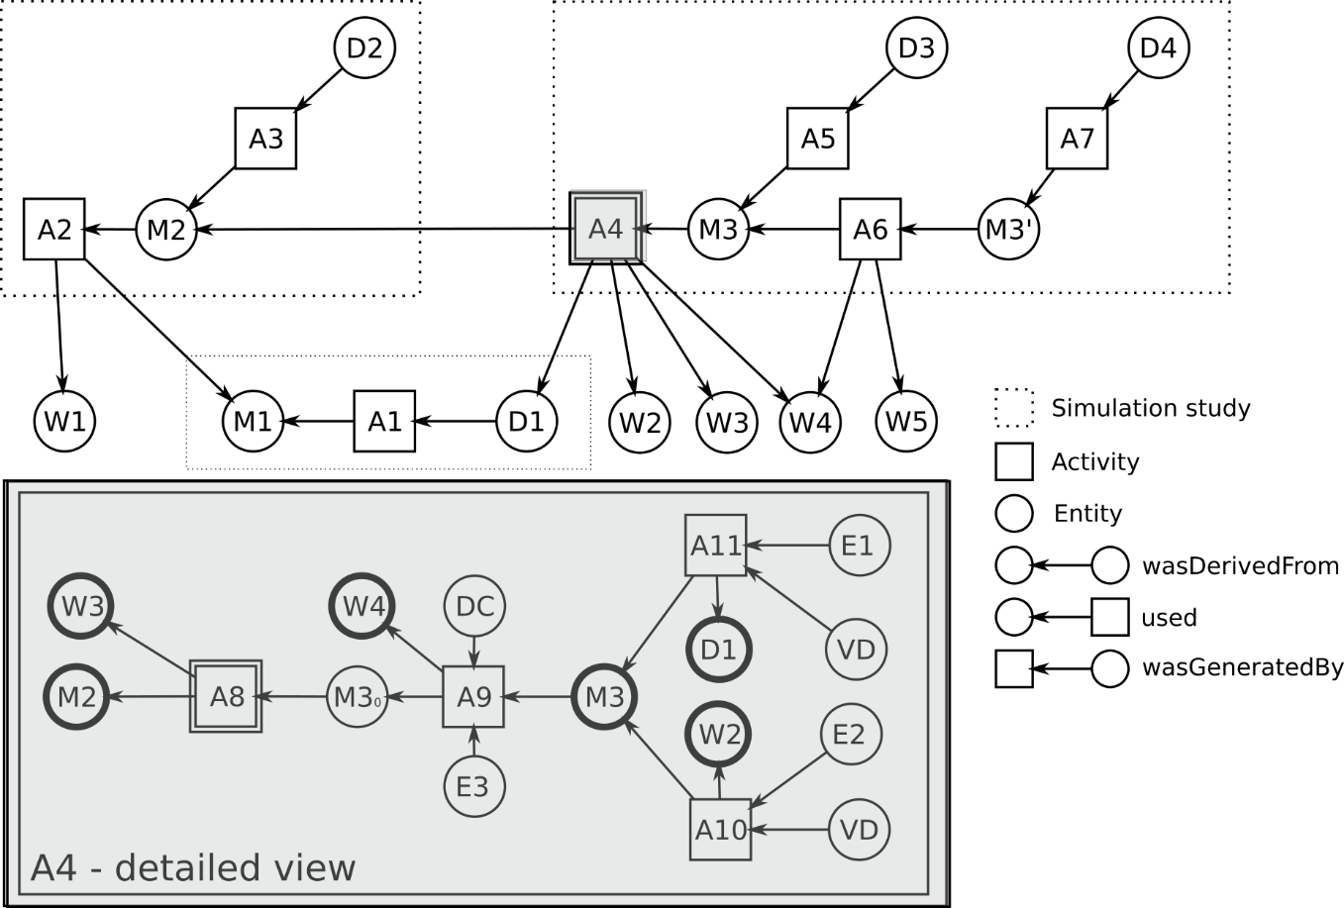
Master complexity by hierarchy
Ruscheinski, Andreas, et al. "Towards a PROV Ontology for Simulation Models." International Provenance and Annotation Workshop. Springer, Cham, 2018

Slide 12
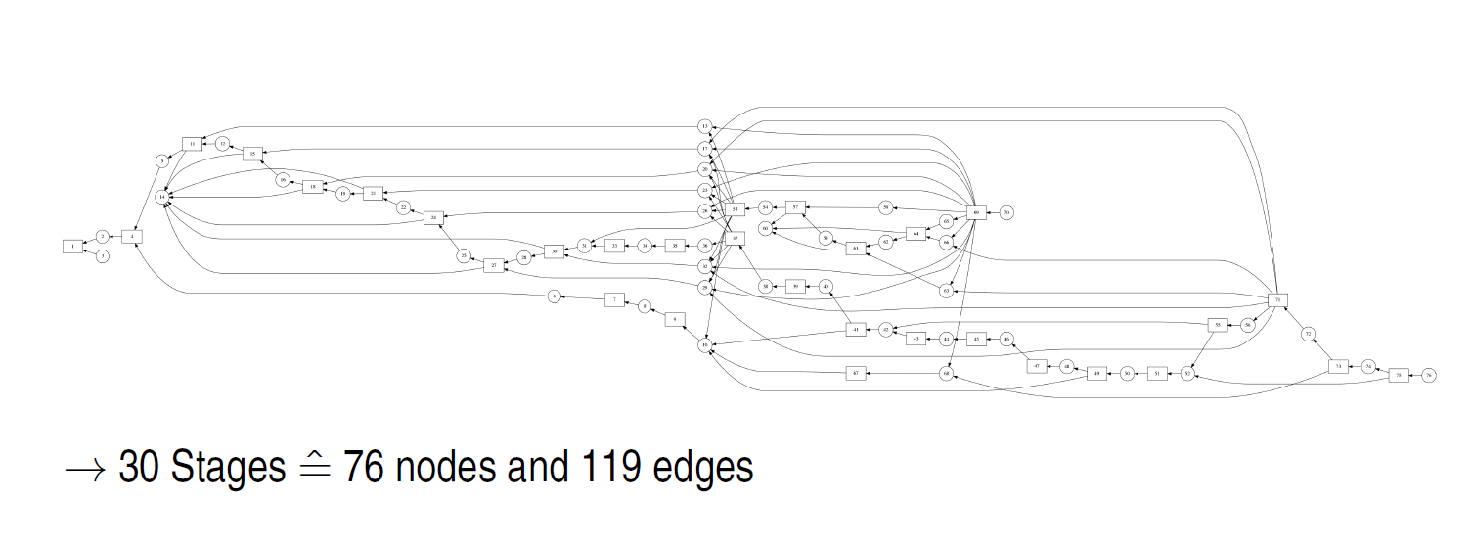
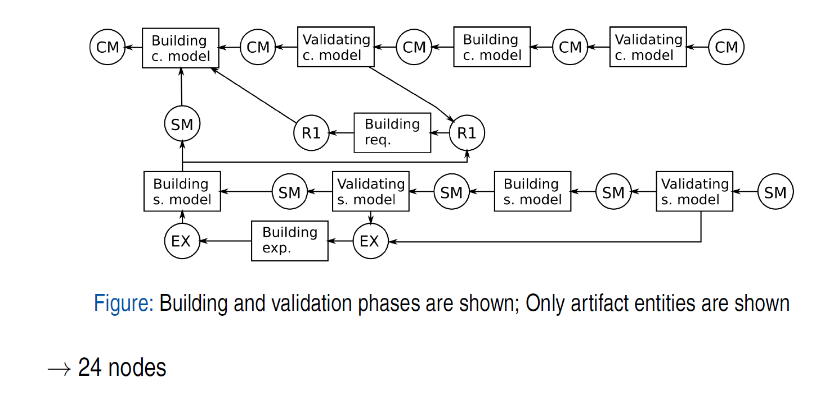
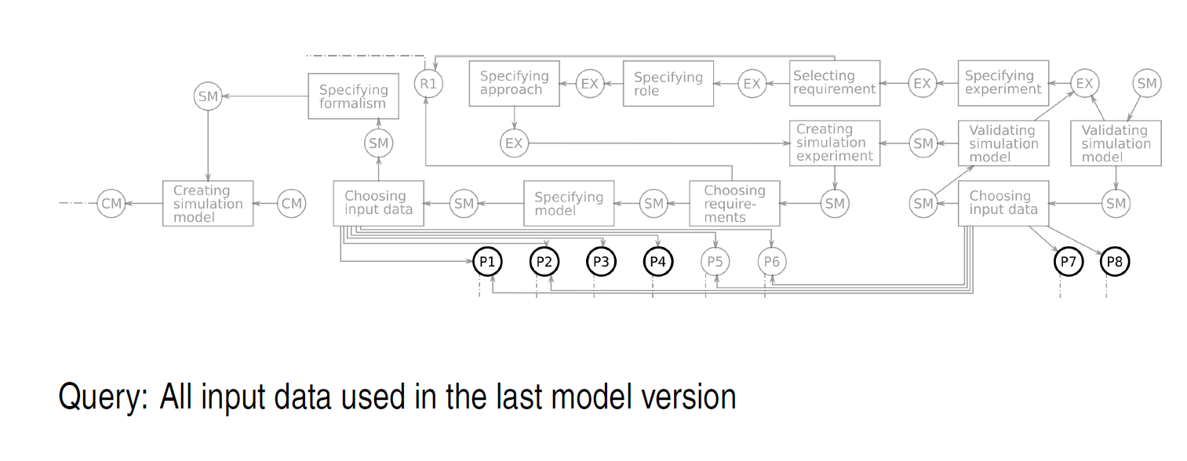
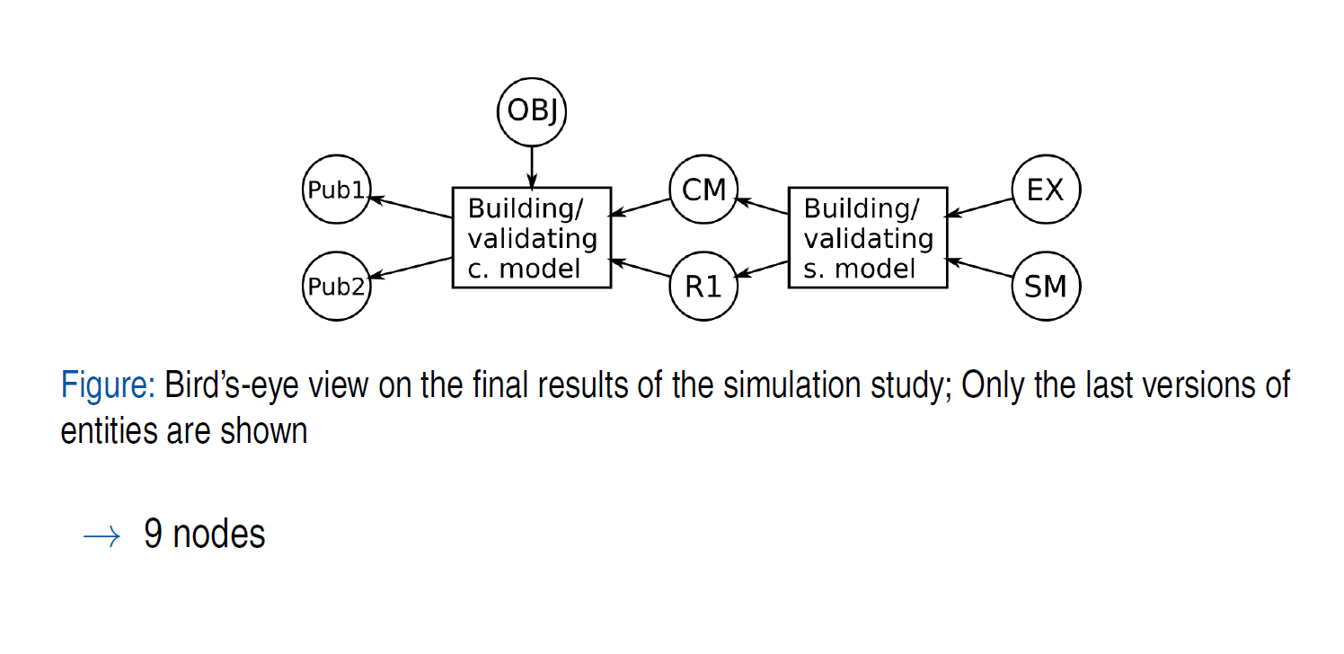
Provenance collected by an artifact-based workflow, abstraction on demand
Ruscheinski, Andreas, et al. "Capturing and Reporting Provenance Information of Simulation Studies Based on an Artifact-Based Workflow Approach." Proceedings of the 2019 ACM SIGSIM Conference on Principles of Advanced Discrete Simulation. 2019.

Slide 13
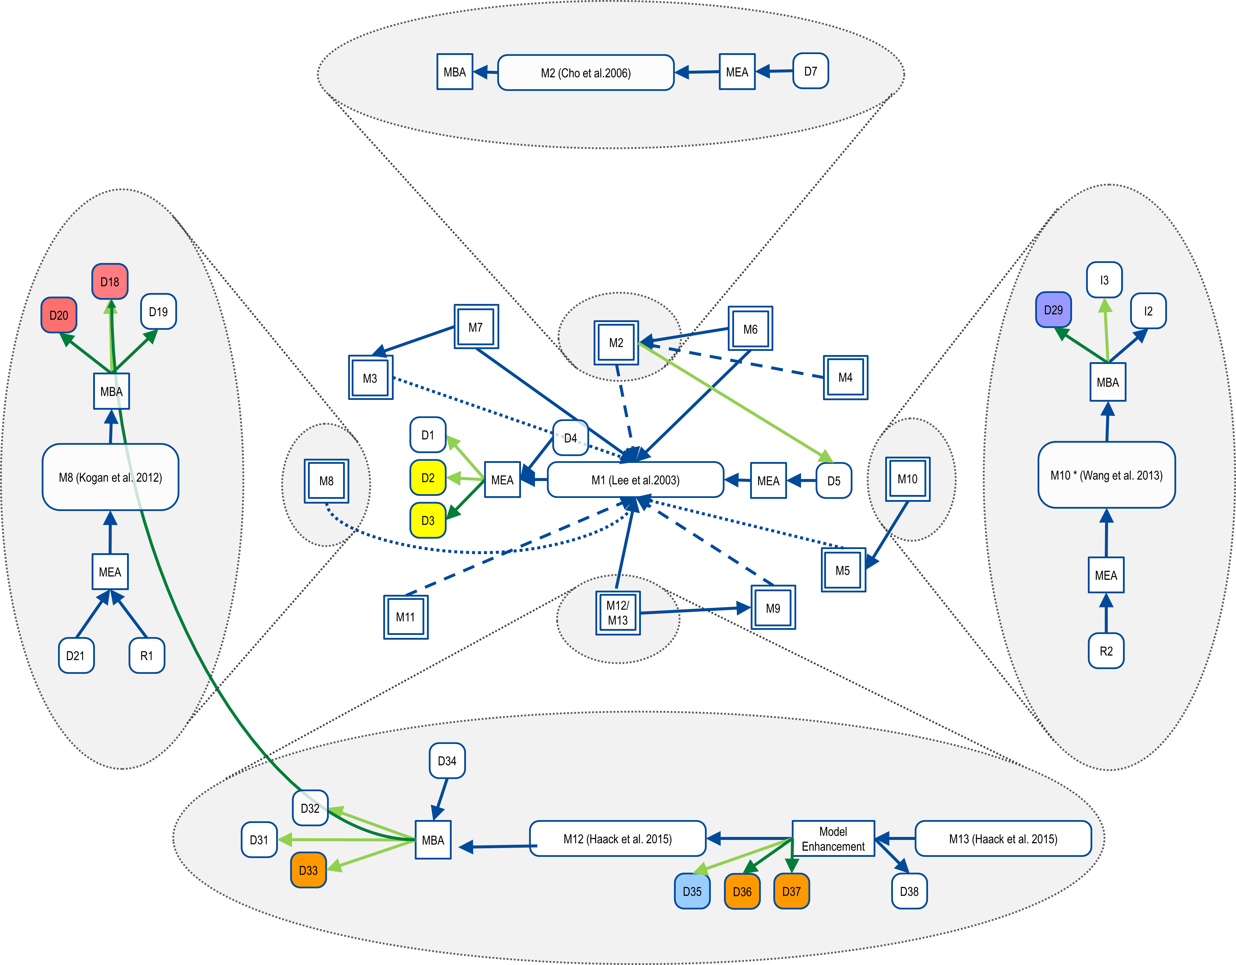
Relate different simulation studies
Kai Budde, et al. The Story Behind Wnt Simulation Models: Interrelating Wnt Models by Provenance Information, European Wnt Meeting 2018, Heidelberg

Slide 14
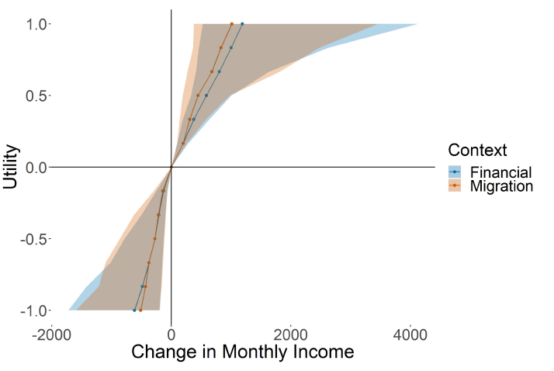
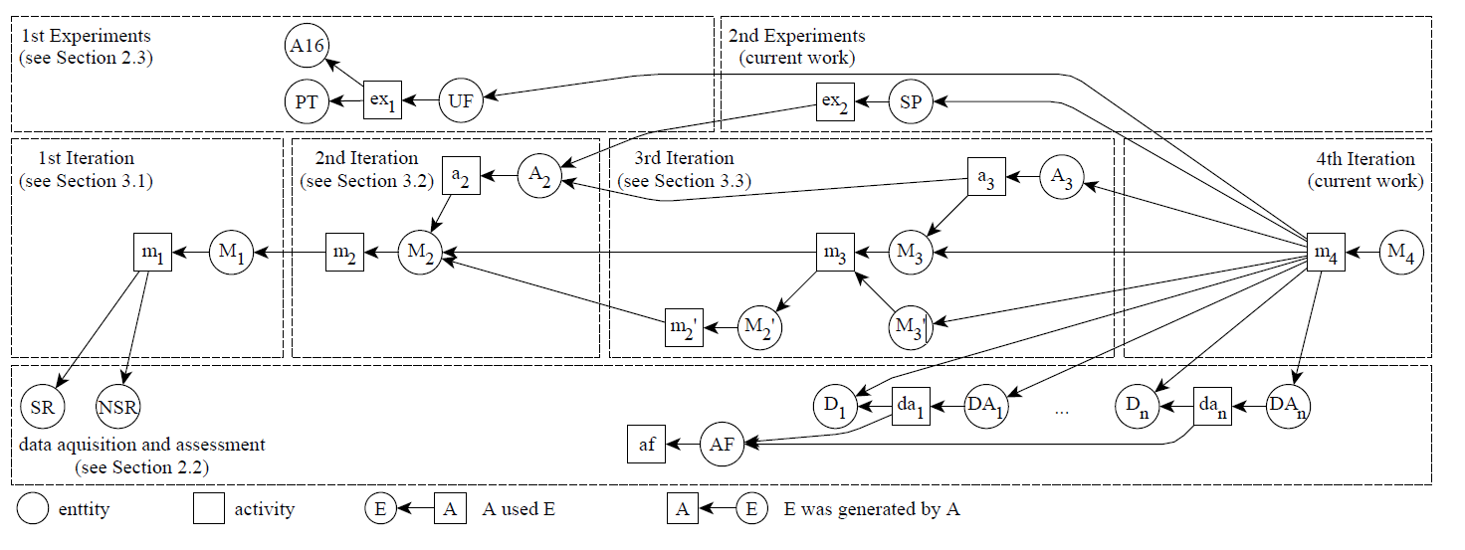
Beyond simulation studies
Bijak, Jakub et al. (2020) Modeling Migration: Decisions, Processes, and Outcomes. In: Winter Simulation Conference (WSC 2020), 13-16 Dec 2020, Orlando, Florida, USA. (In Press)

Slide 15
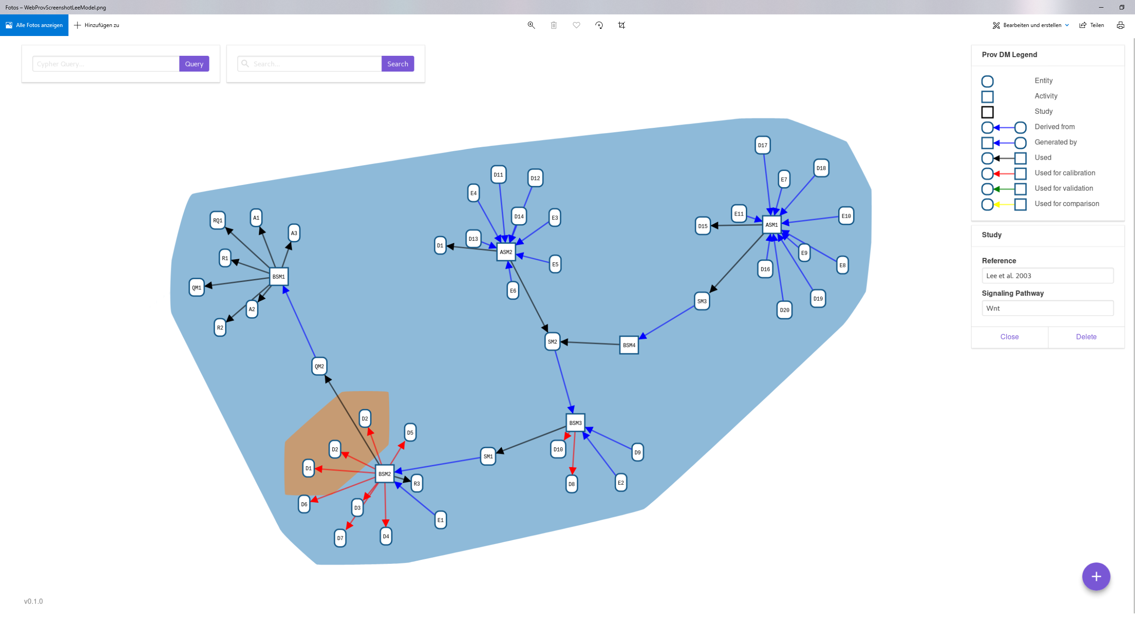
Software Support,e.g., WebProv
For manually specifying and for storing, displaying, and querying provenance information (Backend: graph data base Neo4J) (Prototype by Kai Budde (kai.budde@uni-rostock.de) and Jacob Smith (University of New Brunswick, Canada))

Slide 16
PROV Ontology for Modeling Simulation Studies
A more structured approach to conduct simulation studies!
A structured approach to model, report, and accompany simulation studies.
Essential ingredient: making the simulation experiment explicit
Accessible for filtering, analysis, and querying, e.g., are the same data used for calibration and validation?
Particularly of interest for building simulation families, e.g., about migration
Usefullness demonstrated in several simulation studies, e.g., cell biology, ecology, and demography
However:
Still ongoing research vs. ODD an established standard.

Slide 17
Provenance for Simulation Studies
Contact: adelinde.Uhrmacher@uni-rostock.de

