Slide 1
Statistical analysis of agent-based models
Dr Jason Hilton and Prof. Jakub Bijak
University of Southampton

Slide 2
Introduction to the design of experiments

Slide 3
Glossary
Model (simulator): “a representation of some real-world system, usually implemented as a computer program”; with inputs and outputs
Factor (input): “controllable variable of interest”, such as a model parameter
Response (output): variable representing “specific properties of the real system”, as
a result of a model run for a set of inputs
Source: Managing Uncertainty in Complex Models; http://www.mucm.ac.uk/
K-T Fang et al. (2006) Design and Modeling for Computer Experiments, p 4–5

Slide 4
Glossary
Calibration: “adjusting the inputs so as to make the simulator predict as closely as possible the actual observation points”
Calibration parameter: “an input which
has … a single best value” and can be used
for calibration
Model discrepancy (inadequacy): difference between reality and the output calibrated at best inputs
Source: Managing Uncertainty in Complex Models; http://www.mucm.ac.uk/

Slide 5
Model discrepancy
––– Real process: f(x) = 1.2 sin(8πx)
- - - Model: polynomial of order 6, fitted by using OLS
Calibration parameters: coefficients of the polynomial
Model discrepancy: difference between the two lines

Slide 6
Glossary
Meta-model (emulator, surrogate): statistical model of the underlying complex model
Design: “the set of points in the space of simulator inputs at which the simulator is run”
Training sample: data comprising inputs from
the design space, and the related outputs
Source: Managing Uncertainty in Complex Models; http://www.mucm.ac.uk/

Slide 7
Main Principles of Experimental Design

Slide 8
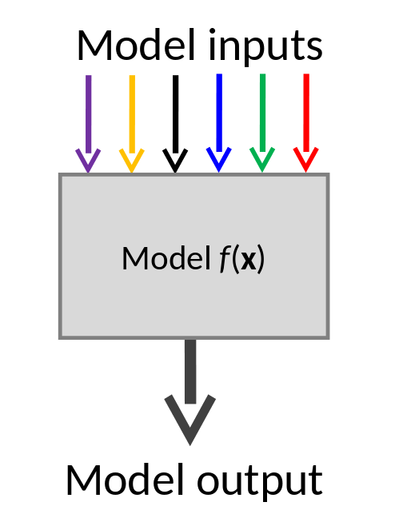
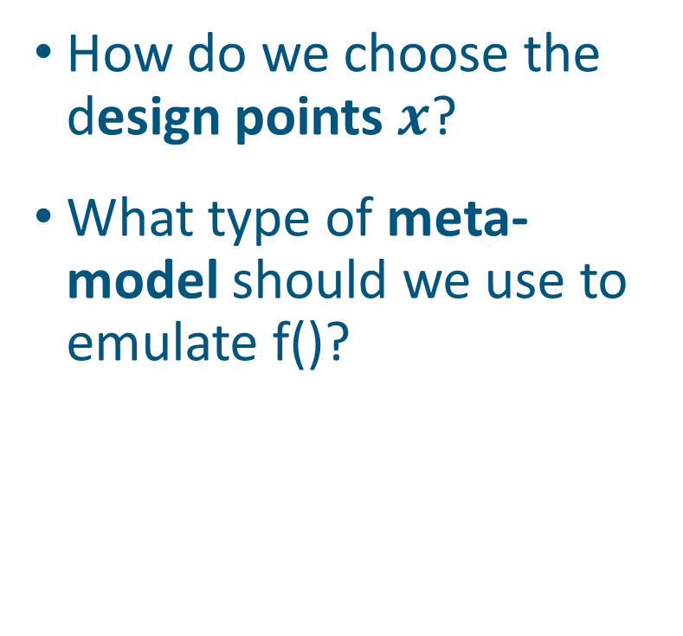
Models of Models
How do we choose the design points $x$?
What type of meta-model should we use to emulate f()?

Slide 9
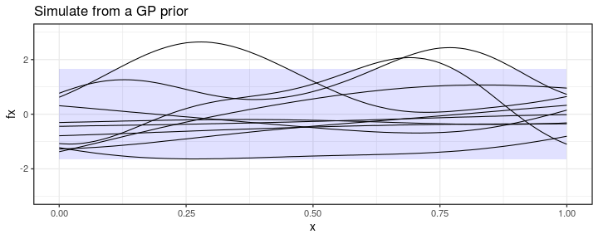
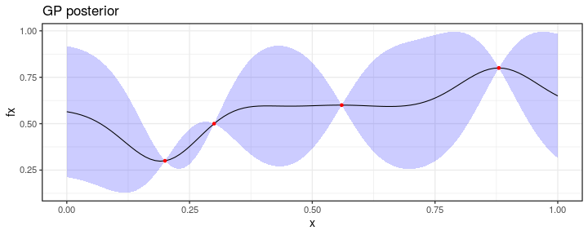
Gaussian Process Emulators
1. Outputs assumed to be smooth functions of inputs.
2. Fitted using data from training design points to approximate simulation.
Input 1
Input 1

Slide 10
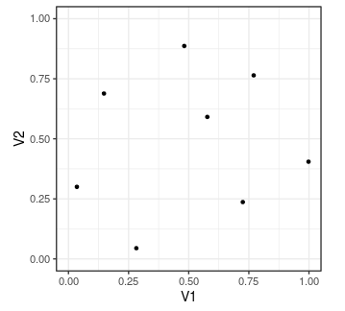
Latin Hypercube Sample
Space filling design
Works well with larger numbers of inputs
Allows flexible statistical models such as GPs to be used
Input 2
Input 1

Slide 11
Goals and methods of uncertainty quantification

Slide 12
Sources of uncertainty
Uncertainty about the simulation output
Simulation stochasticity: associated with random number generation in simulation code.
Response uncertainty: how will the simulation respond to changes in inputs?
Source: Managing Uncertainty in Complex Models; http://www.mucm.ac.uk/

Slide 13
Sources of uncertainty
Uncertainty about reality
Input uncertainty: Lack of knowledge about the true value of simulation inputs
Model discrepancy: Uncertainty about how well your model reflects reality.
Measurement error: How accurate are our measurements of reality?
Source: Managing Uncertainty in Complex Models; http://www.mucm.ac.uk/

Slide 14
Uncertainty Analysis and Sensitivity Analysis
Uncertainty analysis
Describes how uncertainty about simulation inputs results in uncertainty about simulation outputs
Sensitivity analysis
Describes how sensitive outputs are to changes in inputs
Global sensitivity analysis provides the proportion of variance due to each input

Slide 15
Calibration
Problem : Find the ‘true’ values of unknown simulation inputs.
Optimisation finds single point that comes closest to replicated observed values
Probabilistic calibration finds a set of points that could have generated observations

Slide 16
Statistical analysis of agent-based models
Contact:
J.D.Hilton@soton.ac.uk
J.Bijak@soton.ac.uk

