Slide 1
Understanding social data: An example of migration
Dr Sarah Nurse and Prof. Jakub Bijak University of Southampton

Slide 2
Assessing different aspects of data quality

Slide 3
Using imperfect data in models: the way forward

Slide 4
Some considerations
There are no perfect social data, so a quality assessment is always necessary
Sources of uncertainty need to be formally acknowledged, ideally through probabilities
The context of data collection, the social and ethical concerns, are also important

Slide 5
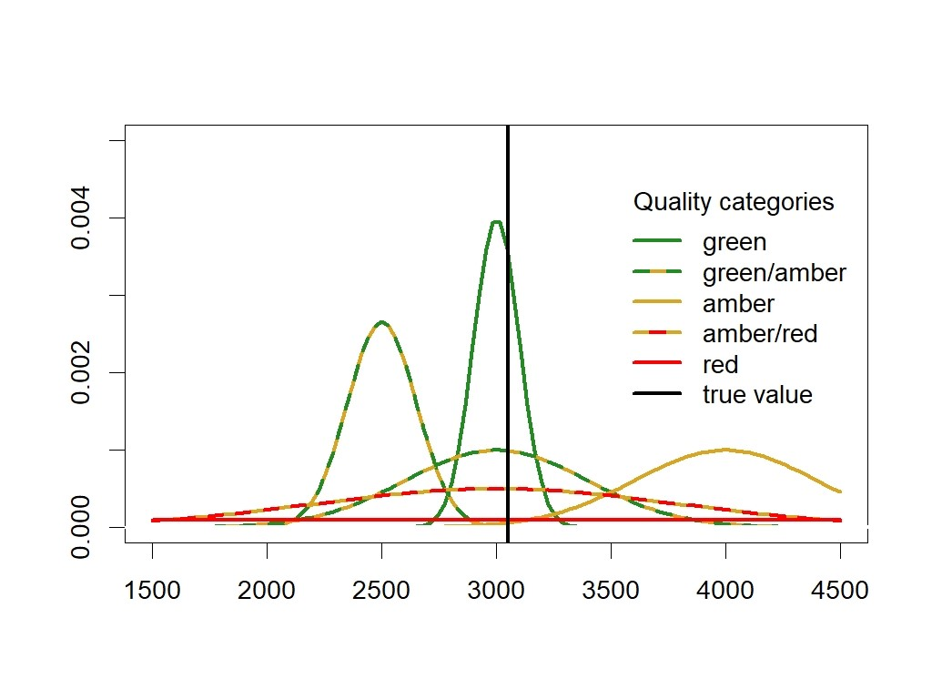
Describing data quality
General-purpose criteria, bias and variance

Slide 6
Using data in agent-based models
Type of data | Micro | Macro
Context | Input | Input
Process | Input | Output

Slide 7
Understanding social data: An example of migration
Contact: S.L.Nurse@soton.ac.uk
J.Bijak@soton.ac.uk

