Slide 1

Healthy Ageing in the 21st Century:
A Cross-Generational Life Course Approach
Notes:
Healthy longevity in the 21st century: A cross generational life course perspective

Slide 2

The Life Course Approach
Notes:
Health and the way health develops is not static, it does not stay “good” or “bad” over our lives, the development of health is a dynamic process, that is shaped by a multitude of factors.

Slide 3



National Study of Health
and Development 1946
National Child Development Study 1958
1970 British Cohort Study
Next Steps (formerly LSYPE)
Millennium Cohort Study
COVID Social Mobility and Opportunities Study (COSMO)
Children of the 2020s (COT2020s)
Generation New Era
1940 | 1960 | 1980 | 2000 | 2020

Slide 4

Notes:
George – the cohort family

Slide 5
Healthy ageing through the (cross generational) life course lens
Long term effects of early life circumstances
Intergenerational cycles in poverty and in health
Life course transitions
Intersectional inequalities over the life course
Quality of life, functioning and productivity, post the onset of chronic illness
Healthspan vs Lifespan through a life course lens
Life course determinants of positive ageing
Reversibility/Resilience
Changing experiences of different generations
External shocks (pandemic, cost of living crisis)

Slide 6
Types of information covered
Birth | School years | Adult
Household composition Parental social class Obstetric history Smoking in pregnancy Pregnancy (problems, antenatal care) Labour (length, pain relief, problems) Birthweight, length | Household composition Parental social class Parental employment Financial circumstances Housing Health Cognitive tests Emotions and behaviour School Views and expectations Attainment | Household composition Employment Social class Income Housing Health Well-being and mental health Health-related behaviour Training and qualifications Basic skills Cognitive tests Views and expectations

Slide 7
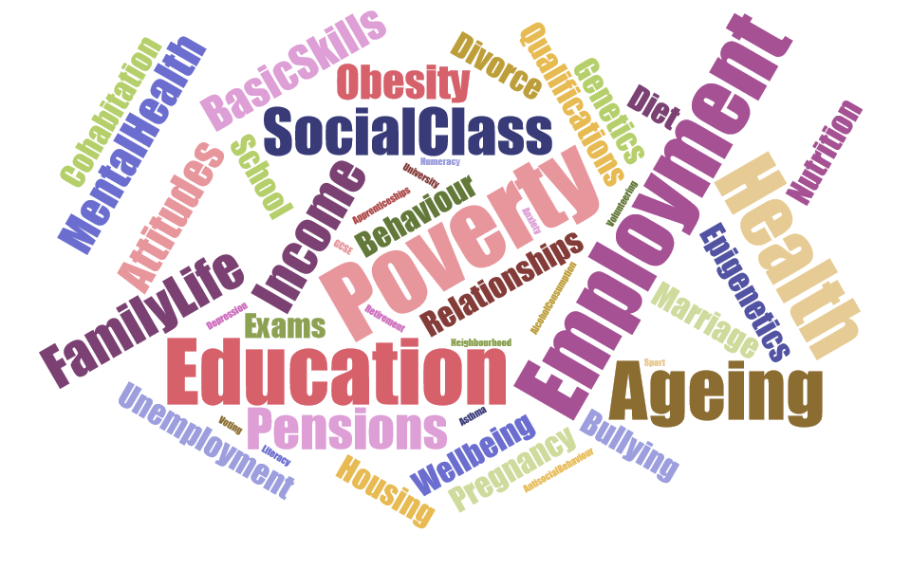

Slide 8


Slide 9
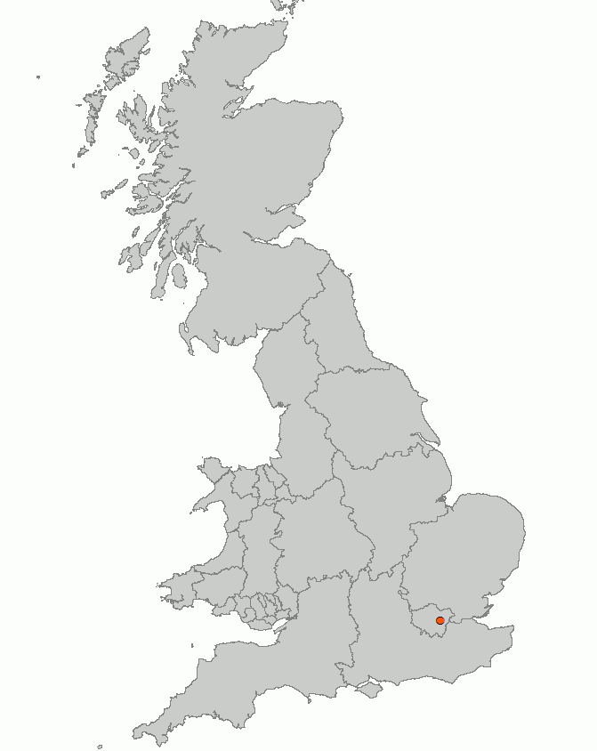

What is driving modern changes in population health?
“Normal physiology within a pathological environment”
(Egger and Swinburn, 1996)
Obesogenic Environments
“influences that the surroundings, opportunities or conditions of life have on promoting obesity in individuals and populations”
Lewis D & Cummins S (2014) Time-lapse of diffusion of McDonalds Restaurants in Great Britain 1974-2002. Accessed [Date] http://philab.lshtm.ac.uk/media/

Slide 10


Slide 11


Slide 12


Slide 13


Slide 14


Slide 15
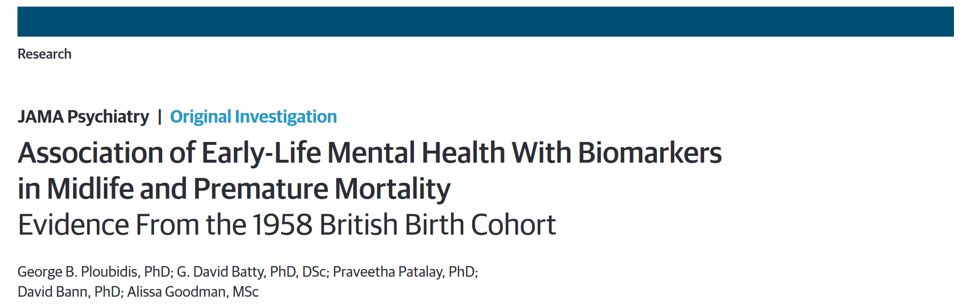
Early life determinants of mid-life health & mortality

Slide 16
Deaths of despair? Early life mental health trajectories and probability of survival

Slide 17
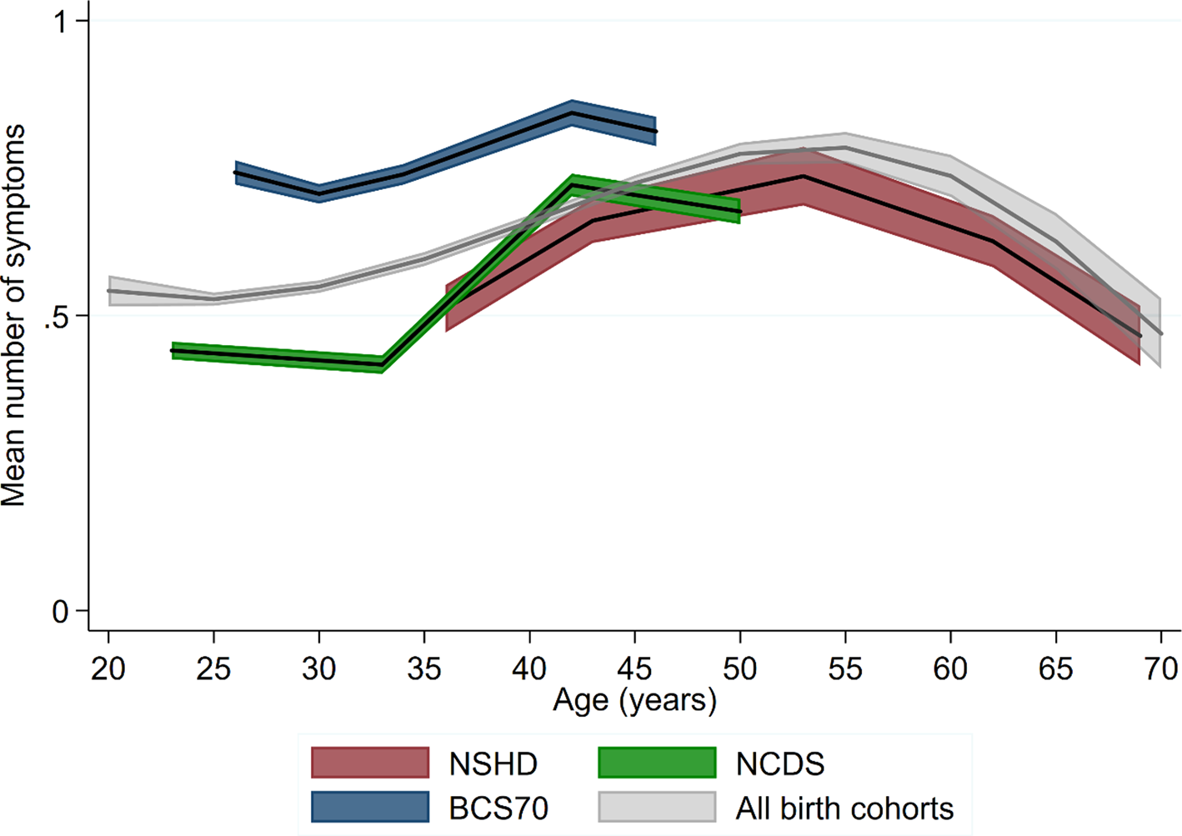
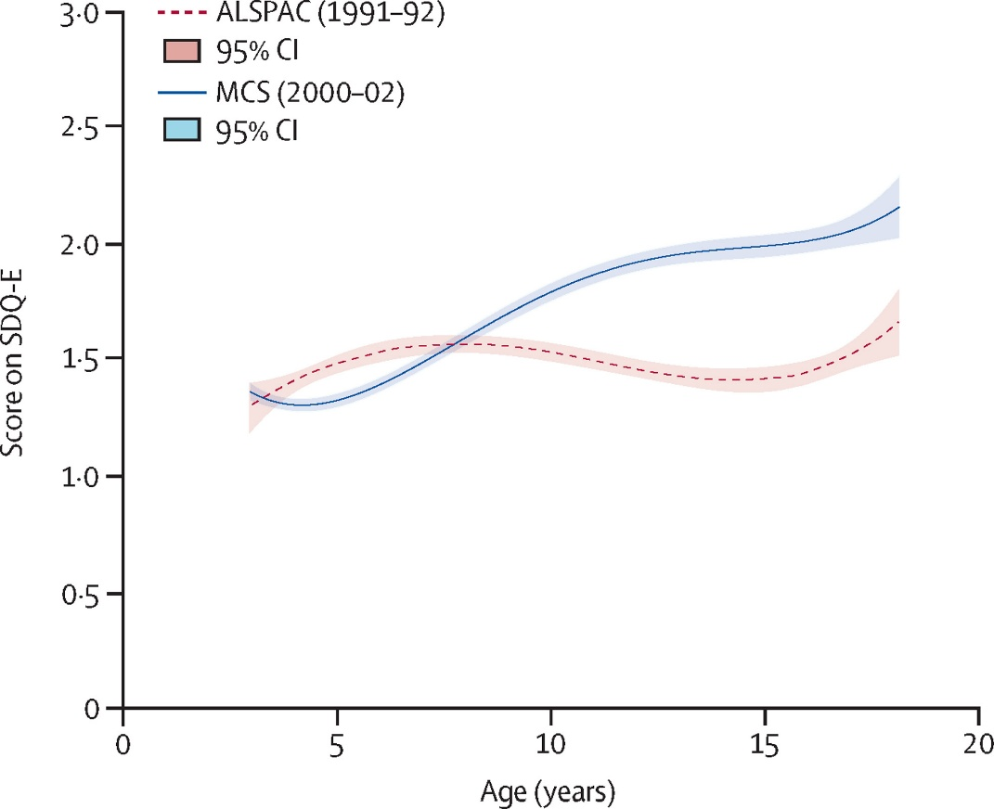
Poor mental health
In adulthood
In childhood and adolescence
1970
2000-02
1946
1991-92
1958
Gondek et al. (2020) Psychological distress from early adulthood to early old age: Evidence from the 1946, 1958 and 1970 British birth cohorts. Psychol Med, 52(8): 1471-1480. Armitage et al. (2023) Cross-cohort change in parent-reported emotional problem trajectories across childhood and adolescence in the UK. Lancet Psychiatry, 10(7): 509-517.

Slide 18
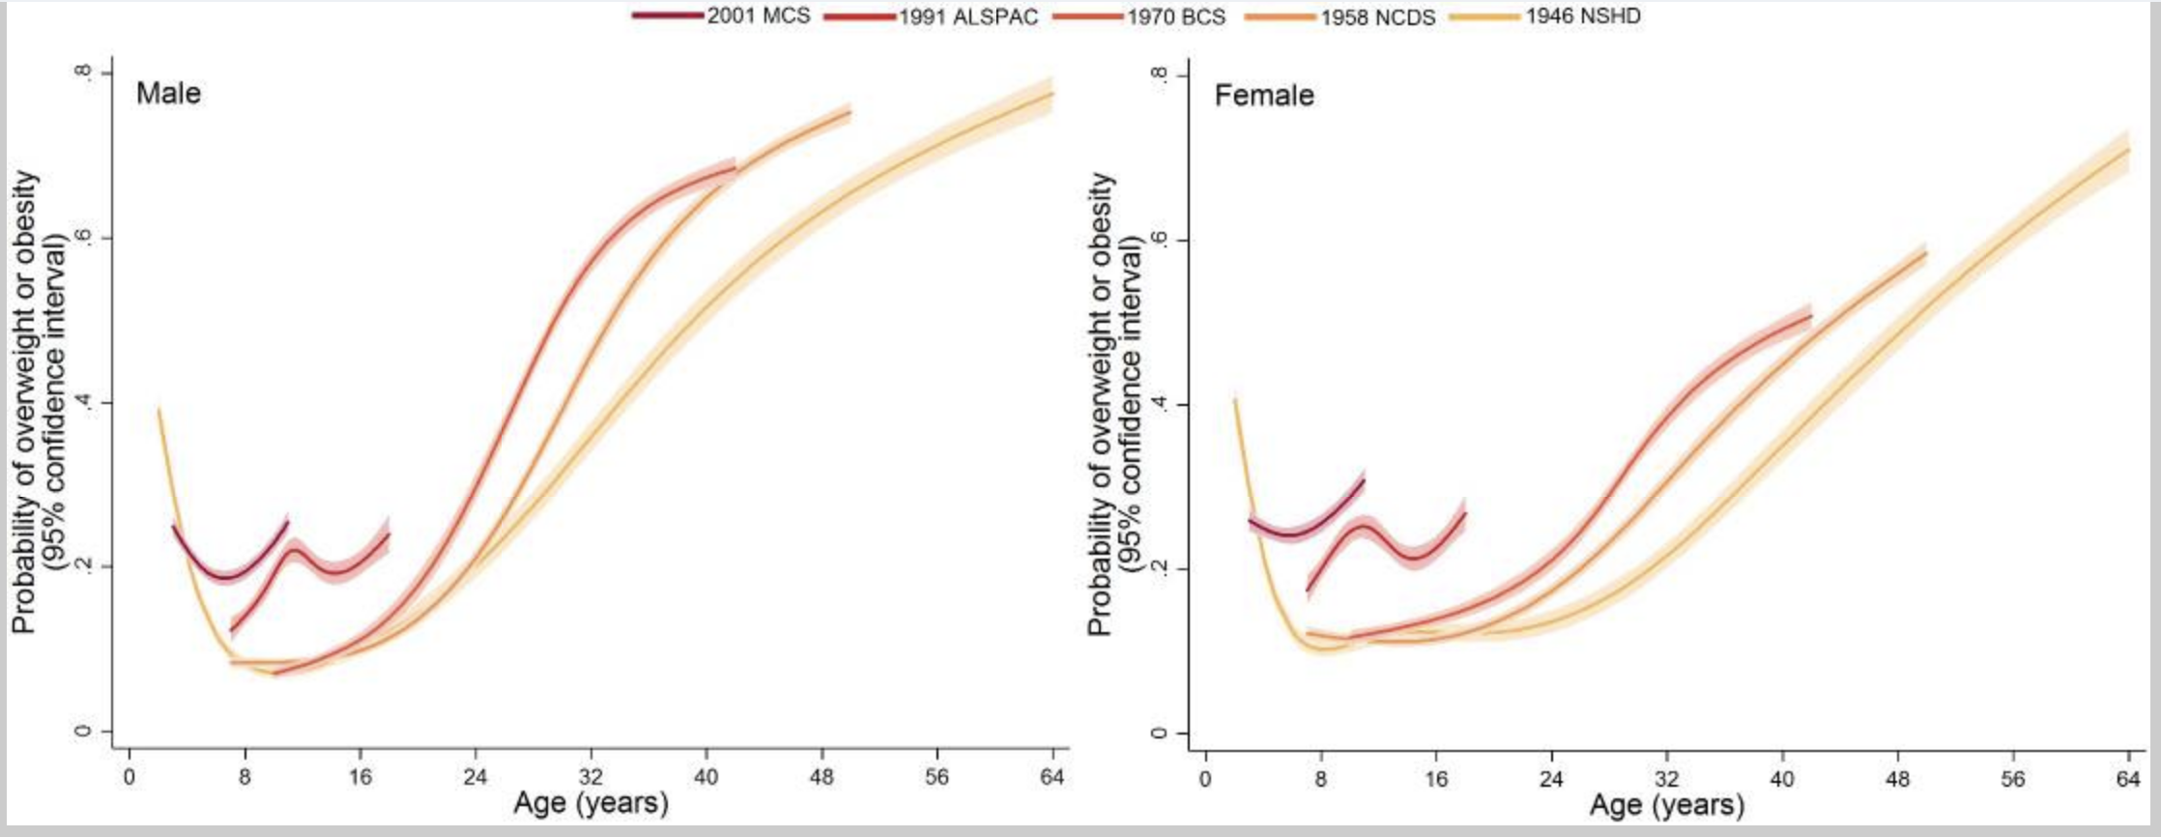
Obesity
Johnson et al. (2015) How has the age-related process of overweight or obesity development changed over time? Co-ordinated analyses of individual participant data from five United Kingdom birth cohorts 1970. PLOS Med, 12(5): e1001828

Slide 19
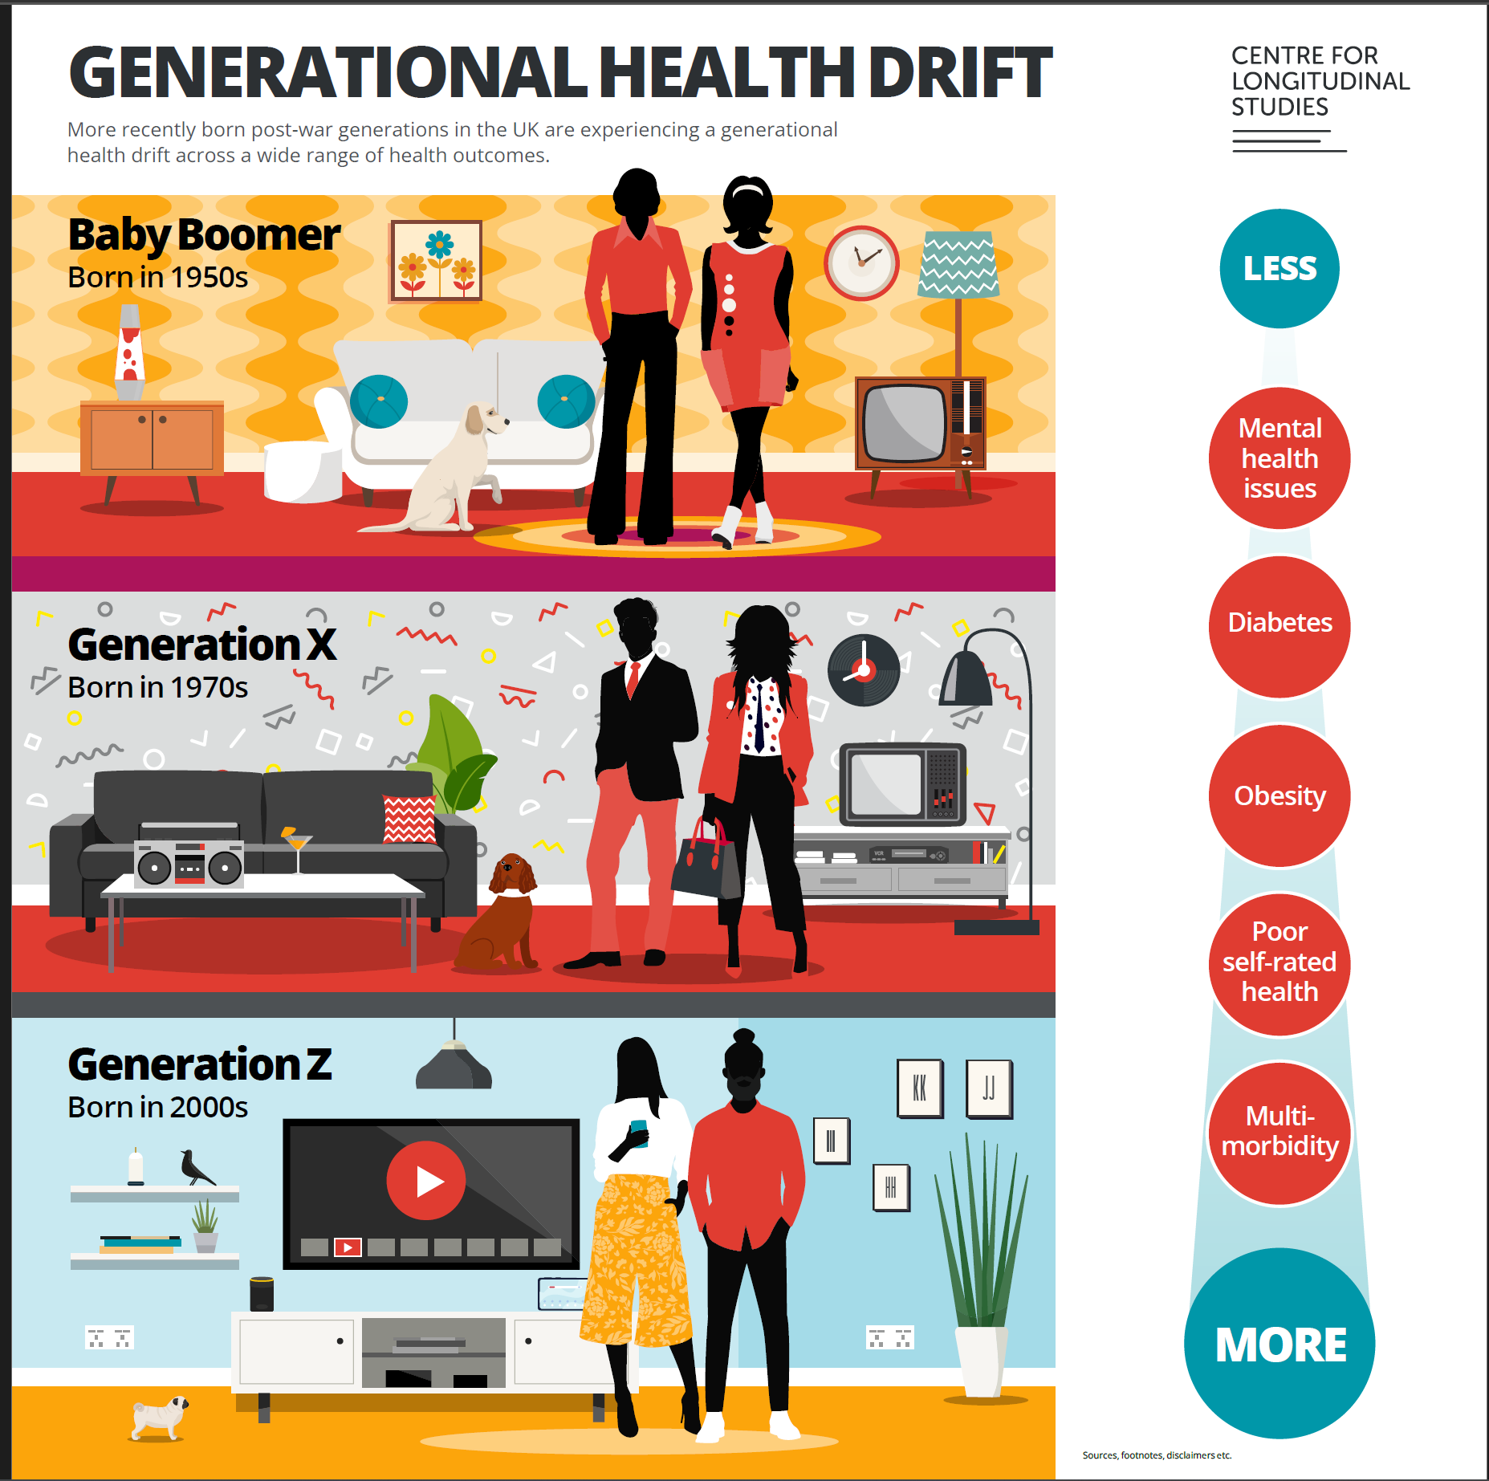

Slide 20
Men: Working life histories by age 55

Slide 21
Women: Working life histories by age 55

Slide 22
Net family income across a working lifetime
Notes:
Trends for women
Women’s work histories follow much different patterns, largely due to family responsibilities.
Once again, the majority of women have been employed since their late teens.
But the shape of the green shows the percentage of women staying home. It increases around the time most cohort members had young children at home. Most of the cohort (over 60%) were married by the time they reached their late 20s or early 30s and have stayed married. Relationship histories for the rest of the cohort are quite varied. Around 11-12% of the cohort have never married or cohabitated.
Once again, unemployment (red) was highest in the early 1980s, and sickness (purple) is putting a growing number of the cohort women out of work as they age.

Slide 23
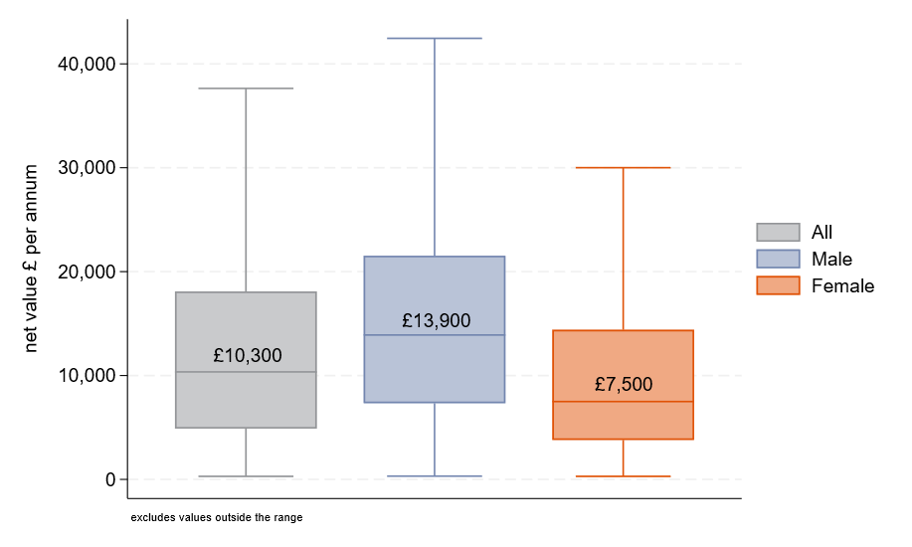
NCDS Age 62: Average net value of Defined Benefit pensions

Slide 24
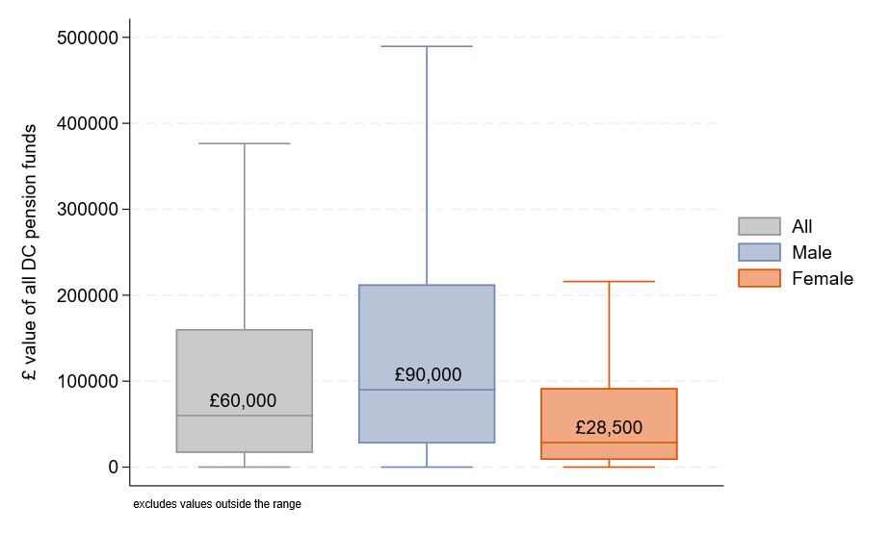
NCDS Age 62: Average net value of Defined Contribution pensions

Slide 25
Summary
British birth cohorts: Cross generational life course approach to healthy ageing
True life course approach with prospective data
Not “just” life course surveys – Various data enhancements
Rich life course data make assumptions on various methodological challenges more plausible
Policy relevant research
Notes:
Before we had studies like these that link across generations – we couldn’t answer even basic questions, about xx
& we relied on the narrow world of randomized trials to make causal inferences that now we do with confidence using longitudinal data

Slide 26

@georgeploubidis.bsky.social
g.ploubidis@UCL.ac.uk‬
Notes:
Long view for the common good and thank you slide

