Slide 1
UKDS survey data about youth transitions
Pierre Walthéry, UK Data Service
DRTN Webinar 10 November 2025
Copyright © 2025 UK Data Service.

Slide 2
Plan of the presentation
About the UK Data Service
What do we mean by youth transitions?
An overview of the data
Finding and accessing the data
Examples

Slide 3
1. The UK Data Service

Slide 4
What is the UK Data Service?
Main UK repository of secondary social science data
A single point of access
Provider of support, training and guidance
Key part of the UK social science
research infrastructure
Funded by the ESRC

Slide 5
Data curated by the UK Data Service
UK surveys:
  Large-scale cross-sectional government surveys series
  Major longitudinal surveys
  One off academic studies
Multinational data
  Cross-sectional surveys
  Aggregate databanks
Census data
  Modern and historical
  Aggregated and microdata
Business and administrative microdata
Range of multimedia qualitative data sources

Slide 6
User support and training
Supporting data literacy among undergraduate students and beyond
Helpdesk for data-related queries
Webinars, drop-ins and workshops:
  Datasets, methods and software focused
Online learning materials:
  Data Skills Modules, guides, recorded webinars
New forms of data ie computational social science.

Slide 7

2. Youth transitions

Slide 8
What do we mean by youth transitions?
Diversity of applications in research. Fundamentally:
  Transition from youth to adulthood
  Interconnected moves between socially defined states
Life course studies
  School to work
  Housing
  Family/relationship
  Health
From a quantitative data perspective
  Large scale longitudinal studies are best suited to examine these
  Within person change
  Large amount of data on factors associated with transitions

Slide 9
Longitudinal datasets
Longitudinal studies:
  Follows the same individuals over time
  Either representative of households or age cohorts
  Only real option for within person changes
  Good availability in the UK
Repeated cross-sectional
  Usually involves higher level units of observation (region or groups)
  Time series made of successive snapshots
  Specific to some discipline ie demography
  Risk of committing ecological fallacy

Slide 10

3. UKDS survey
microdata
for analysing
youth transitions

Slide 11
Understanding Society
Largest longitudinal study representative of the UK population
40K households, 100K individuals initially (2009)
14 waves so far: 2009-23. Includes BHPS data 1991-2009
Ethnic minority boost samples, innovation panel
Very wide range of topics covered:
  Employment, income, benefits, savings, debt, and assets
  Health, well-being, and health behaviours
  Housing, housing costs, and dwelling characteristics

Slide 12
The Birth Cohort studies
Follow a sample of individuals over their whole life
Born during a specific period of 1958(NCDS), 1970(BCS), 2000 (MCS), 2026 (?)
Within and between cohort analysis
Millenium Cohort Study (MCS)
  ~ 19K children (born June 2001 Jan 2003)
  7 'sweeps': 9 months then 3, 5, 7, 11, 14, 17 23 years old
  Parent and child interviews
  Data on education, skills, health, truancy, cognitive ability, biological measurements
  ... Traditional socio-economic and demographic variables

Slide 13
Next Steps
  16,000 people born in 1989-90, followed from age 13-14 onwards
  Annual sweeps between ages 13-20 (2004-2010), then at age 25 and 32
  Oversampling of ethnic minority groups and deprived schools
  Covers educational attainment and aspirations, employment trajectories, family formation, housing, health and wellbeing, and social attitudes
  Linked administrative data (via the UK Data Service SecureLab)
  Captures transitions from secondary education to post-16 pathways, higher education, and early labour market entry.

Slide 14
Is that everything?
Labour Force Survey (2/5 quarters longitudinal datasets)
Qualitative and deposited research data
  No qualitative data equivalent to the major quantitative studies but…
  ESRC requires that grantholders deposit their data with UKDS
  A growing treasure trove of qualitative (and quantitative ) research data on various topics, including work and employment
  Accessible via ReShare on the UKDS website, most freely accessible, sometimes authorisation of the PI is required

Slide 15
4. Finding and accessing data

Slide 16
How to find and access data from the UKDS 5
Data catalogue, either via
  The search tool
  Browse data pages (themes, data type, Teaching data)
Variable and Question Bank
Qualibank
HASSET Thesaurus
Notes:
Finally, we have the HASSET thesaurus

Slide 17
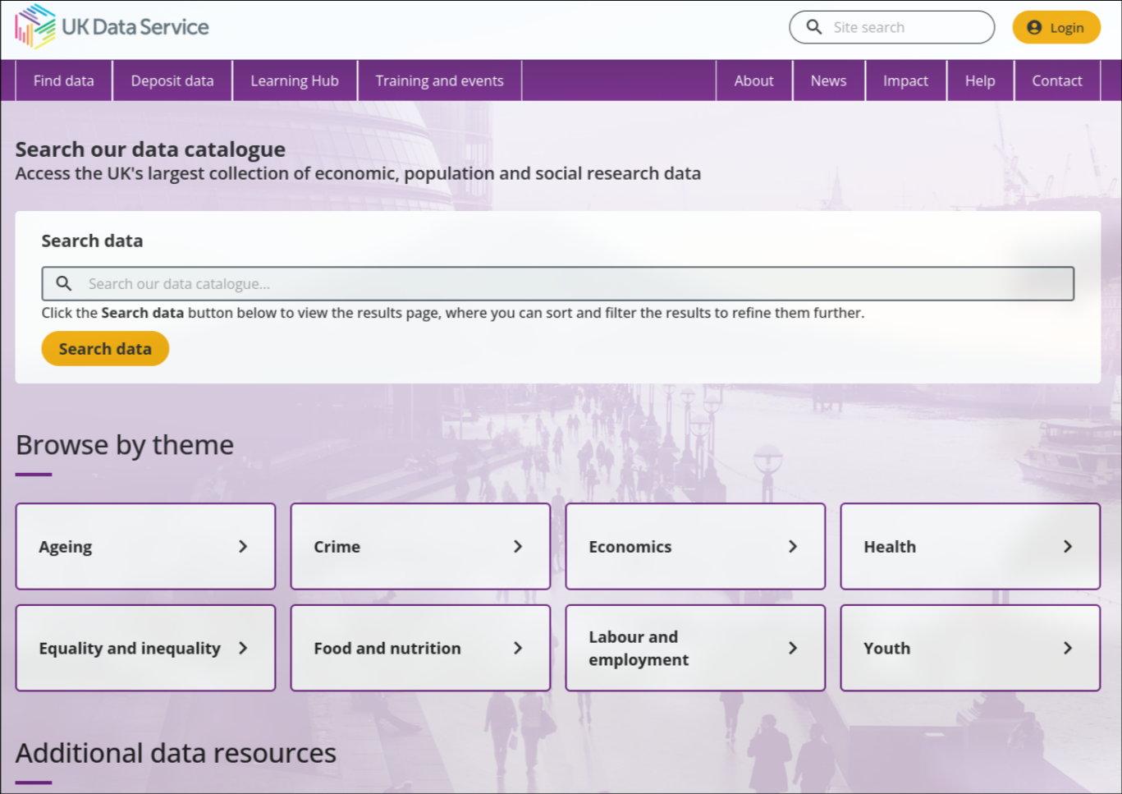
Searching the new data catalogue

Slide 18
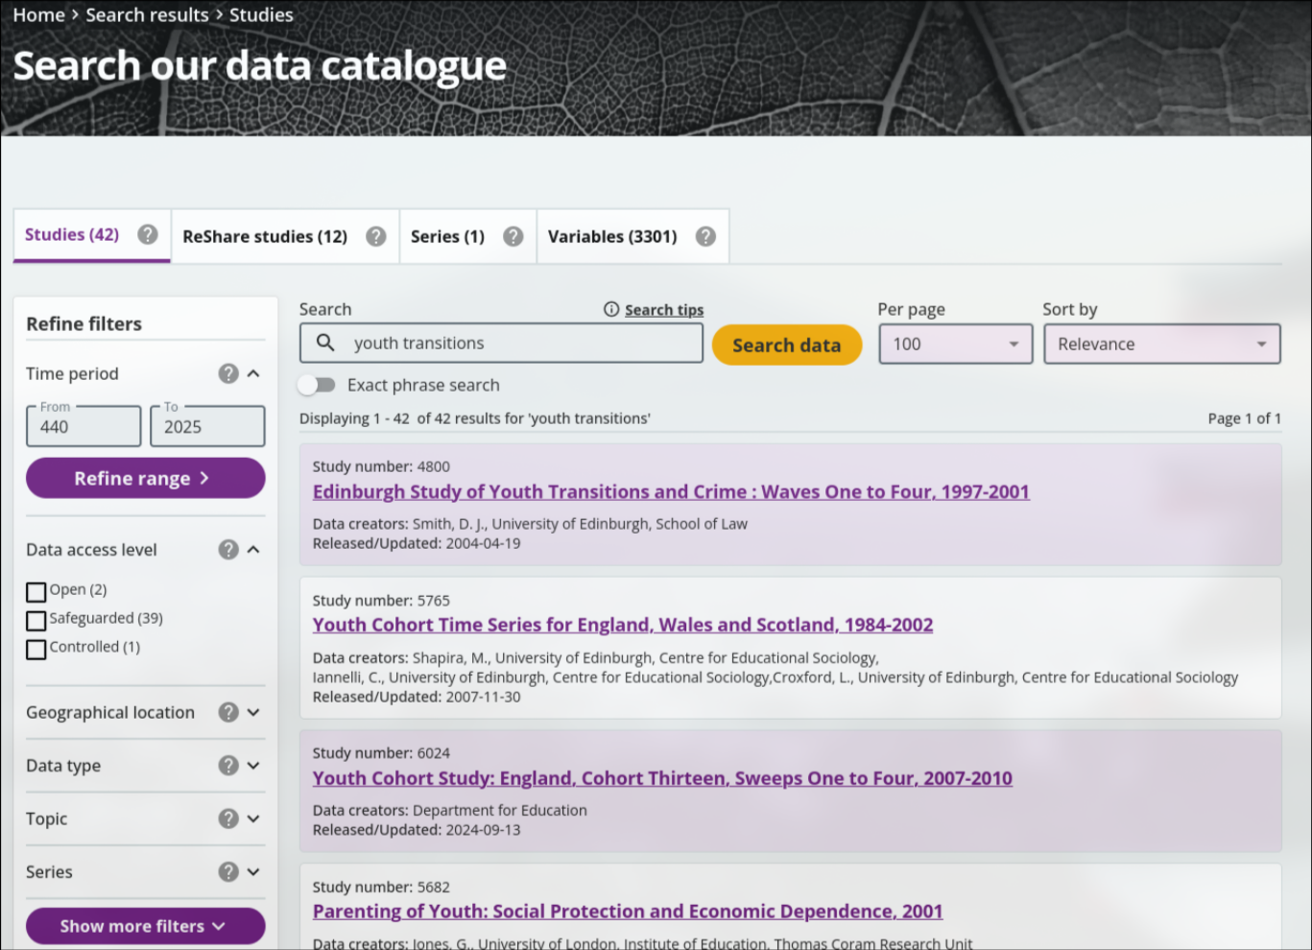
Youth transitions in the UKDS data catalogue

Slide 19
Essential questions to ask yourself
Data quality
  What was the phrasing of the question(s) (quantitative data)
  What was the research question/who funded the research?
  Is it representative, is the sample size large enough, what is the population of reference?
  When was it collected?
  Is there a data documentation – technical report
Are weights and survey design information available?
Is a special application required in order to access the data I am interested in?

Slide 20

Data access levels and conditions
Access via a Safe Room, SecureLab within the UK or the SafePod Network
Controlled data
Requires registration (special licence: requires a form)
Safeguarded data
ReShare data
Access rights set by the data owner and can vary
Open data
No registration required
Notes:
And just a quick point on the different data access levels.
So we have controlled data, also called secure access data, one of the most restricted types, which can only be accessed through a Safe Room, SecureLab within the UK or the SafePod network.
Safeguarded data which is EUL and requires registration, and also under this we have special licence data which has additional requirements. There’s also ReShare data, which is self-depositied access controls vary.
And then open data, which I mentioned earlier can be accessed by anyone without the need to register.

Slide 21
How to register
Logging in via OpenAthens or Shibboleth
  UK Universities
  Some further education colleges
  Some UK Government departments
  Local authorities
UK Data Archive username
  International researchers
  Charities
  Think tanks
  Schools
  Personal researchers
  Commercial organisations
Notes:
Finally, most of the data in our collections can be accessed free of charge, you simply need to register using your institutional log in. Or if you don’t have one, you can apply to get a UKDA username.

Slide 22
5. Examples

Slide 23
Have Britain’s rapid school-to-work transitions faded?
3 cohorts of young people from Understanding Society data, 10 years follow-up
Rapid school-to-work pattern remains prevalent:
  … For over half of men (54%) and nearly half of women (44%).
Decrease in full-time employment:
  Increase in part-time work and time spent in education.
Effects vary by gender and parental socioeconomic background:
  low-educated young people and those from lower socioeconomic backgrounds are more likely to transition to lower occupations, longer unemployment, and inactivity.
  The highly educated from disadvantaged backgrounds had lower chances of moving to professional and managerial occupations
  Women were more likely to experience turbulent transitions involving shorter speels of full-time work and longer ones of part-time work or inactivity.
Pelikh, A., & Rowe, F. (2024). Increasing diversity, precarity and prolonged periods of education in the transition from school to work in Britain. Population, Space and Place, 30, e2771. https://doi.org/10.1002/psp.2771
Notes:
If you’re more interested in attitudes to deprivation and poverty, you may be interested in the British Social Attitudes survey. In particular, we’ve put together a teaching dataset based on this.
So the BSA started in 1983
And it’s aim is to measure continuity and change in attitudes to social issues
It uses a representative sample
Covers social, political and moral issues
We created this teaching dataset from the original dataset, it contains a reduced number of variables and simplified documentation which make it more suitable for teaching.
Additionally, the data is open and therefore it can be downloaded and used by anyone, without the need to register (and I’ll go a bit more into registration later on).
This dataset is themed to focus on attitudes towards welfare and poverty. It includes views, political identification, and demographic information.
And if you’re interested in the full dataset, rather than the teaching one, these variables and more are included in the main BSA survey, again accessible through the UKDS.

Slide 24
2. Neighbourhood belonging and transitions to parenthood
Study characteristics
  Understanding Society data (UKHLS, 2009–2023).
  Childless individuals of childbearing age (18–45) with co-residential partners
  Outcome: Probability of first birth at the next wave
  Agreement with statement: I feel like I belong to this neighbourhood
  Time at current residence
Main findings
  Stronger sense of belonging is associated with higher likelihood of having a first child
  Recent short-distance movers with strong belonging likely to transition to parenthood
  Long-distance movers generally show a lower probability of becoming parents but...
    Those with a high sense of belonging as likely as short-distance movers to transition.
Buh, B., Beaujouan, E., & Berrington, A. (2025). Belonging to the neighbourhood, residential mobility, and the transition to parenthood. Population Studies, 1–19. https://doi.org/10.1080/00324728.2025.2478929

Slide 25
Thank you for your attention
Pierre Walthéry, UK Data Service
pierre.walthery@manchester.ac.uk

Slide 26
Resources:
Understanding Society series page (UKDS Data Catalogue)
Understanding Society study website
Millenium Cohort Study series page
Next Steps (also known as the Longitudinal Study of Young People in England) series page
The Cohort Studies pages on the Centre for Longitudinal Study website
The Labour Force Survey series page
UK Data Service survey data drop-in sessions

