Slide 1


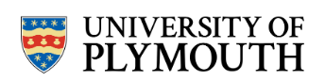
Researching Ethnicity with the Data First Criminal Justice Datasets
NCRM Exploring Ethnicity through National Datasets webinar, September 19, 2025.
Kitty.Lymperopoulou@plymouth.ac.uk

Slide 2

Why ethnicity and the Criminal Justice System?
Identify and address ethnic inequalities:
Ethnic minority people make up 27% of prisoners compared to 13% of population (Sturge, 2023). Black individuals more than four times as likely to be stopped and searched, 2.2 times as likely to be arrestedand receive 23% longer custodial sentences than white individuals (HM Government, 2024a; 2024b; MoJ, 2024).
Build public trust and accountability:
Only 49% of black Caribbean and white and black Caribbean people express confidence in the police, compared to 68% of population (HM Government, 2024c). Met police found to be institutionally racist (Casey, 2023).
Inform fair and effective policy-making:
‘Explain or reform’: evidence-based explanations for ethnic disparities underpinned by improvements in CJS data(Lammy, 2017).

Slide 3
The Data First criminal justice datasets

Slide 4
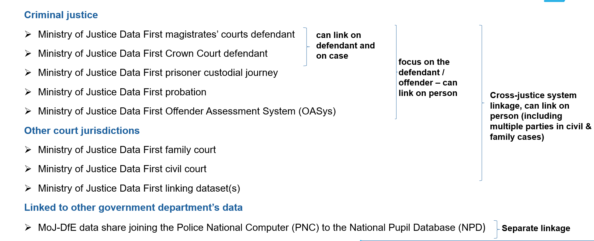
Data First Datasets

Slide 5
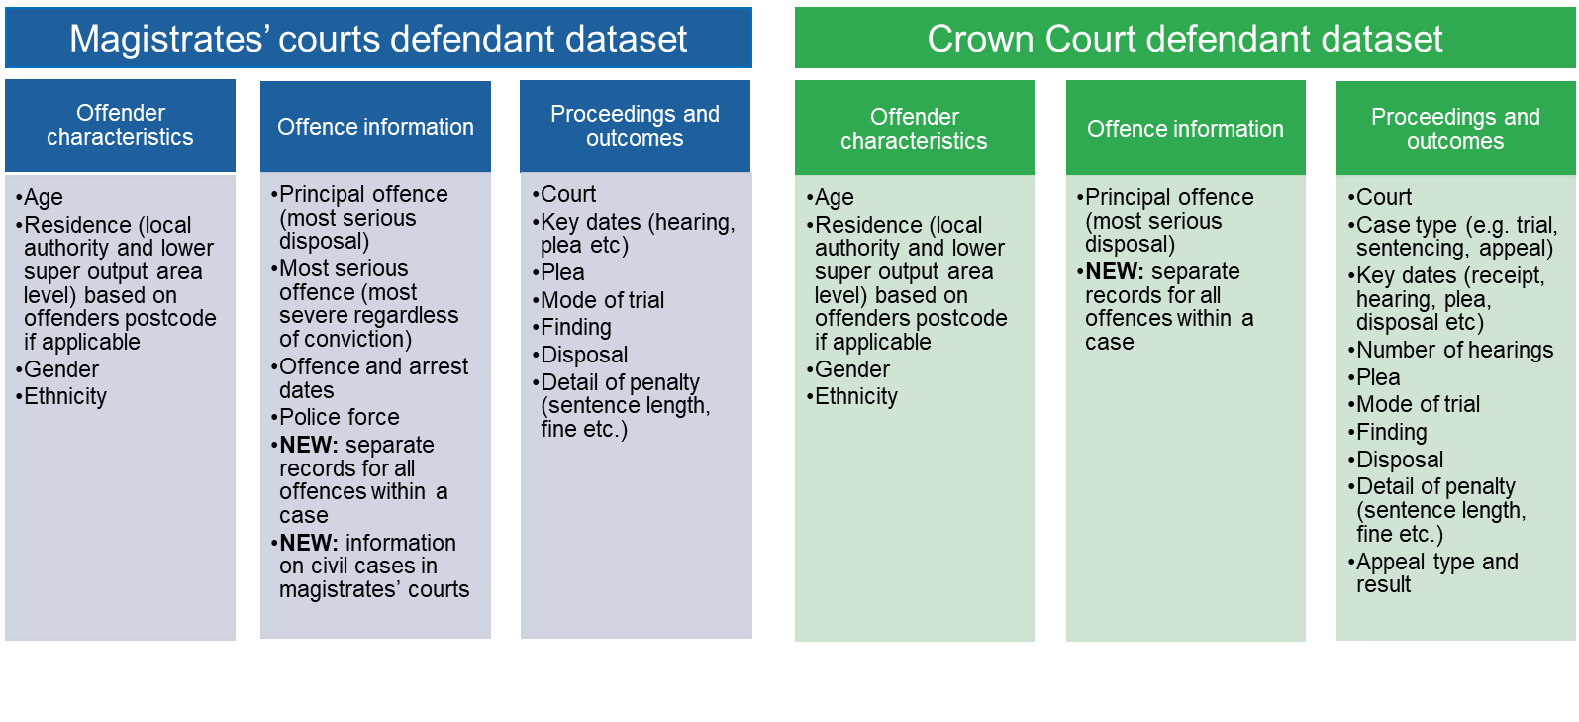
Data First criminal courts overview
Source: LIBRA, Period: 2011 to 31/3/2023 Source: Xhibit, Period: 2013 to 31/3/2023
For further details see the data catalogues on GOV.UK

Slide 6
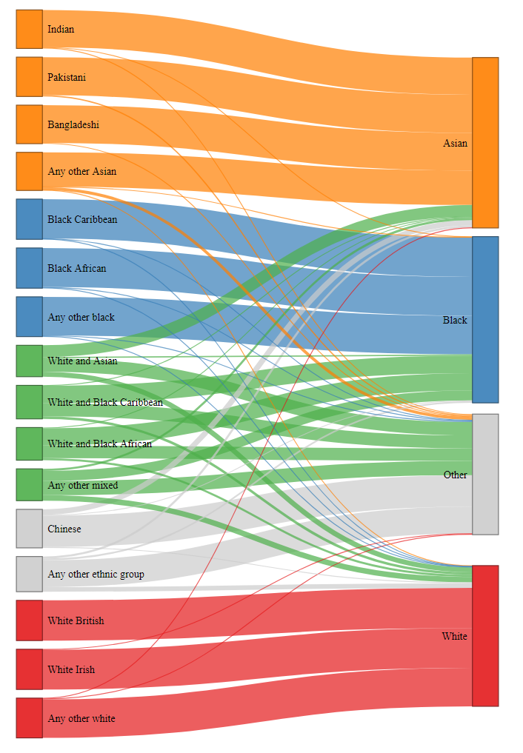
Ethnicity classifications
Police defined
ethnicity
Self-defined ethnicity
90% or more self-identifying as Asian, Black and white recorded by Police in same category.
75% of Chinese recorded in the other group, 13% in the Asian group.
40% of white and black African and white and black Caribbean groups recorded in black group, 30% to the other group.
Crown Court 2013-20

Slide 7
Ethnicity coverage (1)
65% of defendants in magistrates’ courts had missing self-identified ethnicity, 63% had missing police-defined ethnicity.
24% of defendants in the Crown Court had missing ethnicity.
There is variation in the recording of ethnicity across defendant and case characteristics (e.g. year, age, gender, court, offence type).

Slide 8
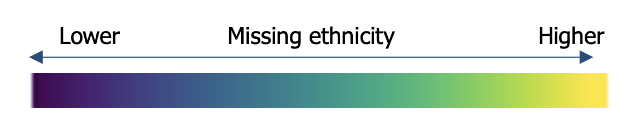
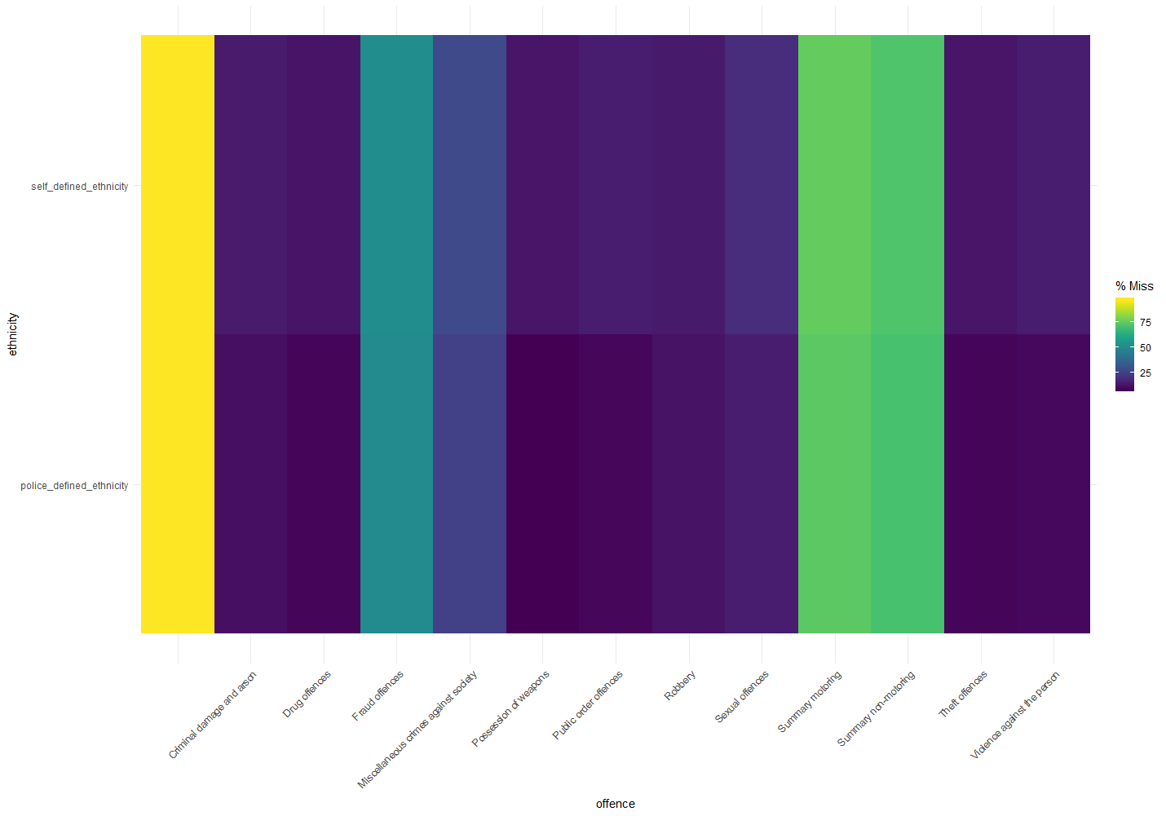
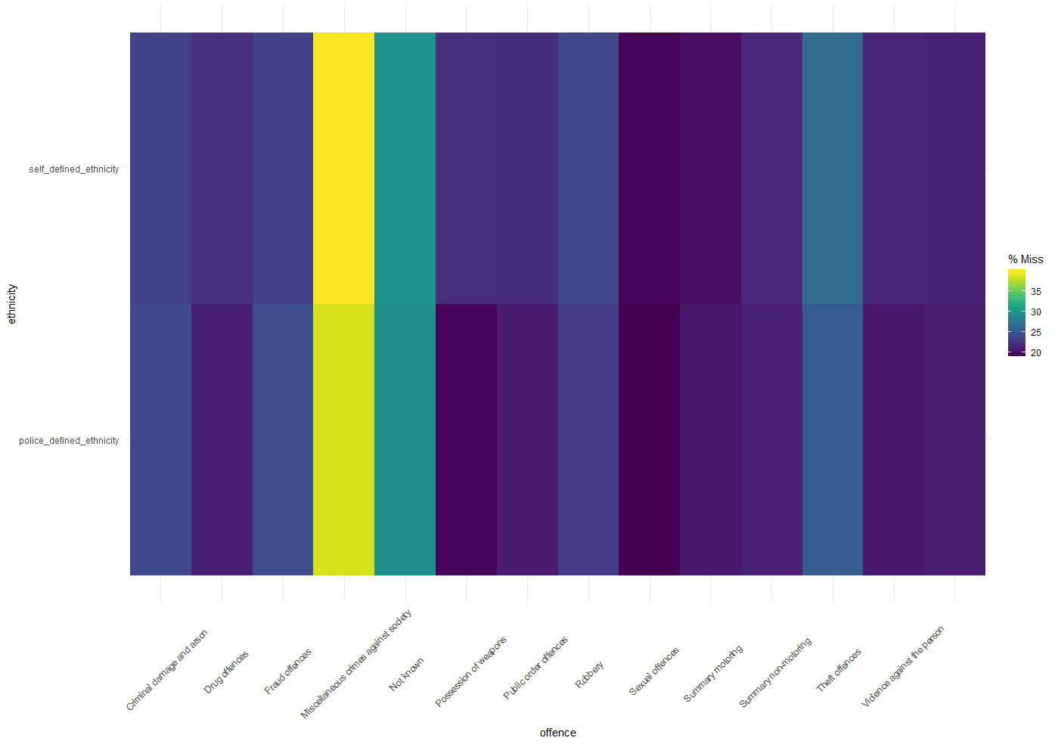
Ethnicity coverage (2)
magistrates’ courts 2011-20
Crown court 2013-20

Slide 9
Research insights: Ethnic Disparities in the Criminal Justice System

Slide 10
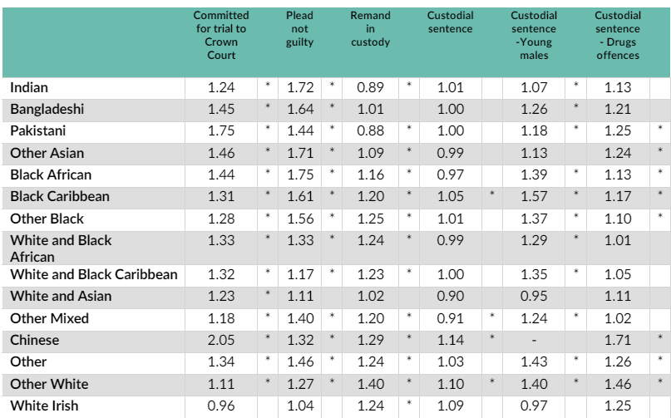
Ethnic disproportionality in court outcomes
Relative Rate Index (RRI)
RRI >1 indicates outcome is more likely in a given ethnic minority group compared to the white British group.
Magistrates’ and Crown courts excl. summary offences (2017-2020)

Slide 11
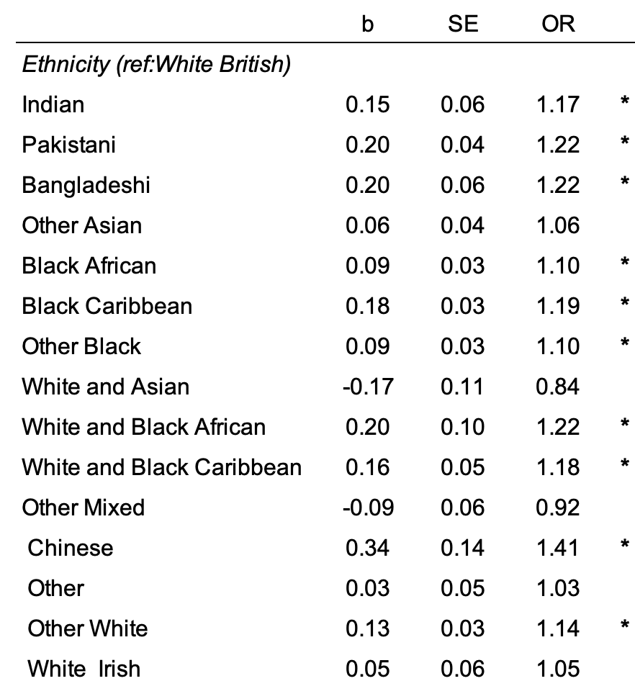
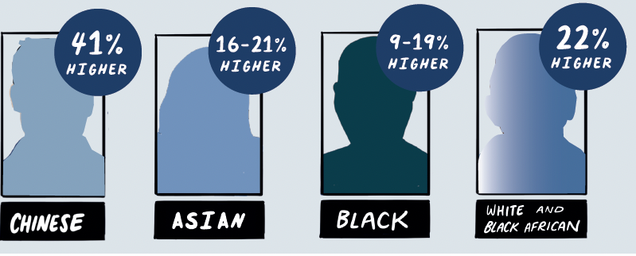

The effect of ethnicity on imprisonment (net of other factors )
Multi-level model results based on defendant appearances in the Crown court excl. summary offences between 2017-2020. The models control for
age, gender, deprivation, offence type & severity, previous convictions, remand, plea, no of defendants, court case workload and severity, ethnic density.

Slide 12
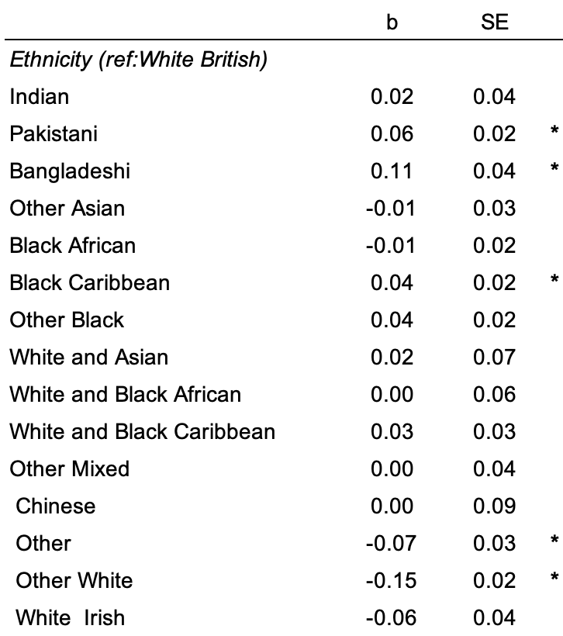
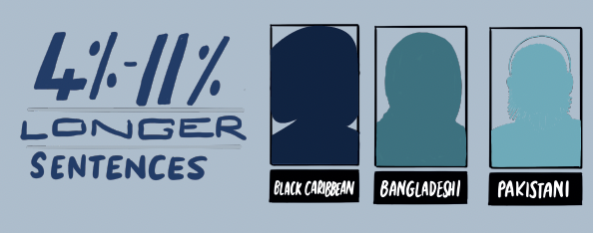
The effect of ethnicity on (logged) sentence length (net of other factors)
Multi-level model results based on defendant appearances in the Crown court excl. summary offences between 2017-2020. The models control for
age, gender, deprivation, offence type & severity, previous convictions, remand, plea, no of defendants, court case workload and severity, ethnic density.

Slide 13


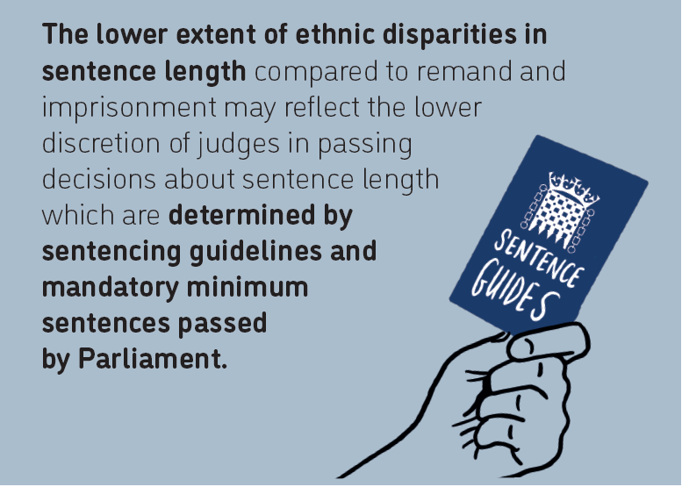

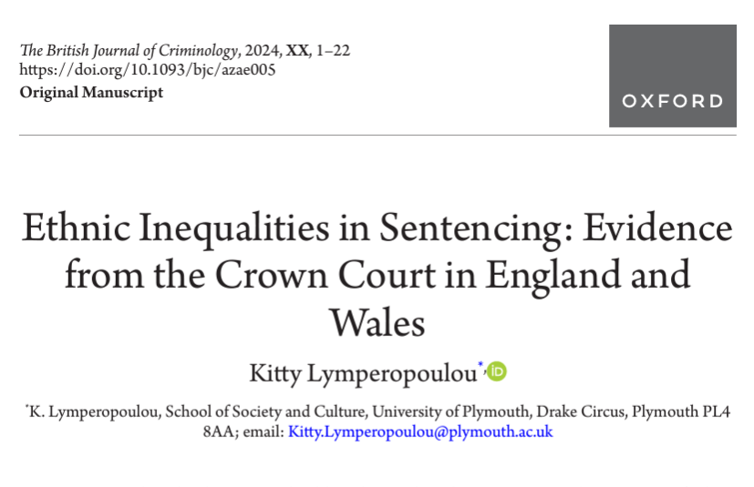

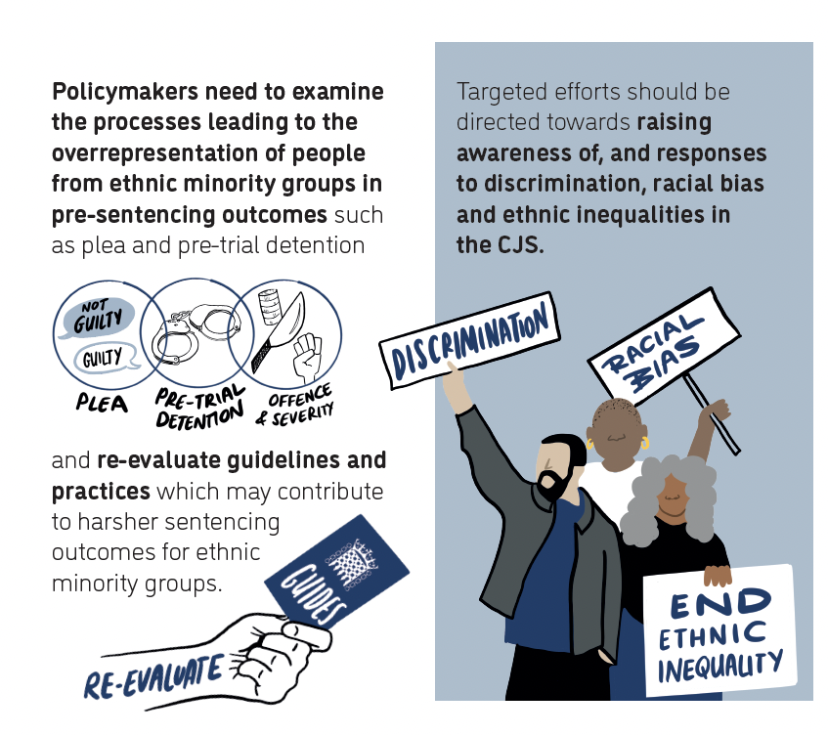

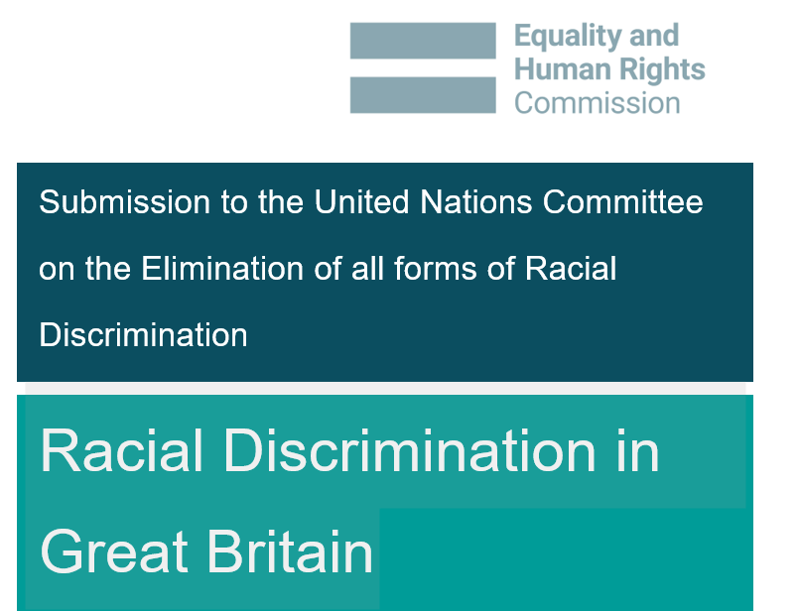
Ethnic Inequalities in the Criminal Justice System (CJS)
https://ethnicityandcriminaljustice.co.uk

Slide 14
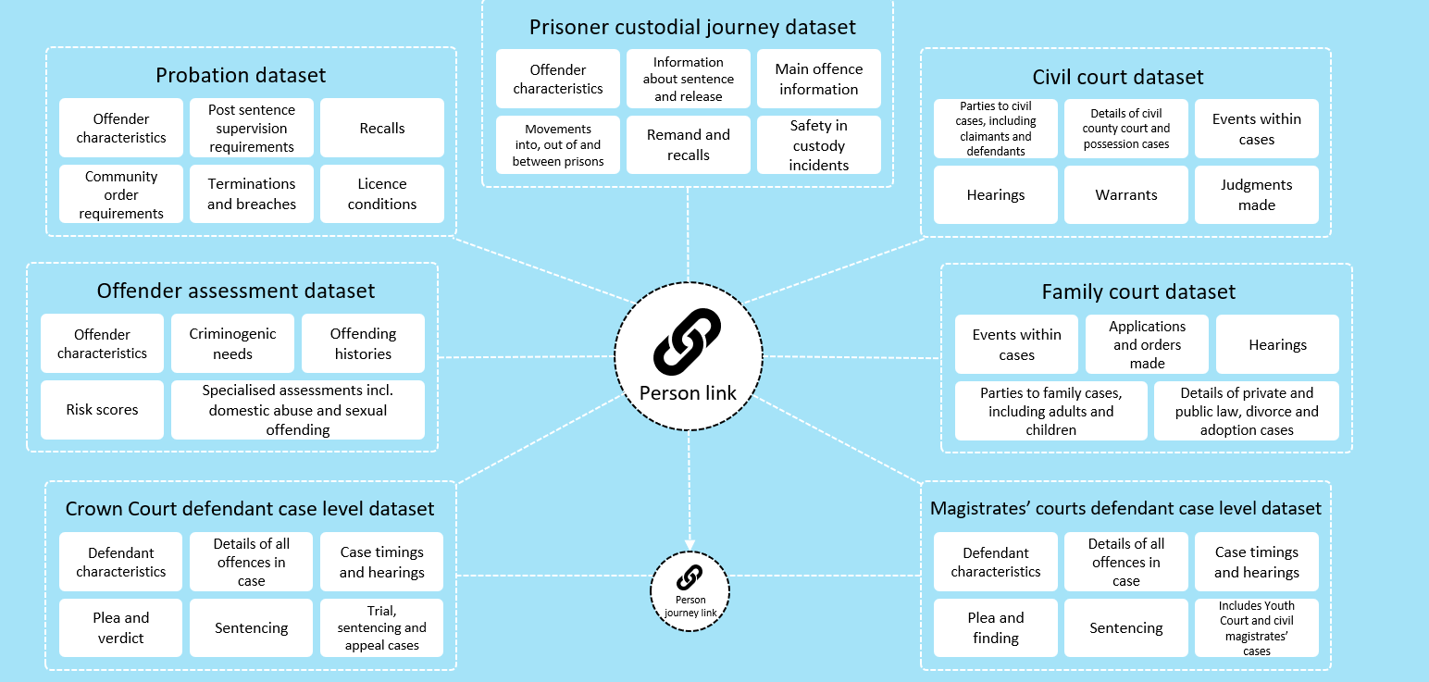
Opportunities for ethnicity research
Repeat appearances
Longitudinal analysis
Cross-justice insights into racial bias and cumulative disadvantage
Additional markers of ethnicity (e.g. nationality, religion).
Broader context of inequality (alcohol and drug abuse; exposure to poverty)

Slide 15
Applying for access to Data First datasets
Three steps for accessing data:
Become an accredited researcher.
Apply for access to the specific data required for a research project from relevant data owners using the MoJ and HMCTS ‘Secure access to data’ combined form for access to data held in the ONS SRS or complete the scoping form and Information Governance Review Panel (IGRP) form for data held by SAIL Databank.
Submit a research project application for accreditation in PASS (Project Accreditation Service for SRS) and receive final approval from UKSA RAP

Slide 16
Disclaimer
'This work was undertaken in the Office for National Statistics Secure Research Service using Data First linked administrative data. The use of the data in this work does not imply the endorsement of the ONS or data owners (e.g. MoJ and HM Courts and Tribunals Service) in relation to the interpretation or analyses of the statistical data. This work uses research datasets which may not exactly reproduce National Statistics aggregates. National statistics follow consistent statistical conventions over time and cannot be compared to Data First linked datasets’.
Thanks to the MoJ Data First team for providing the slides on the Data First Datasets.

Slide 17
Further Resources
Ministry of Justice: Data First
https://www.gov.uk/guidance/ministry-of-justice-data-first
Existing projects using the DF datasets
https://assets.publishing.service.gov.uk/government/uploads/system/uploads/attachment_data/file/1098054/approved-external-data-requests-log.ods
Funding opportunities
https://www.adruk.org/news-publications/funding-opportunities/
Application form and approved projects:
https://www.gov.uk/government/publications/moj-data-first-application-form-for-secure-access-to-data ​
ONS Secure Research Service:
https://www.ons.gov.uk/aboutus/whatwedo/statistics/requestingstatistics/secureresearchservice

Slide 18
References
Ethnicity and the Criminal Justice System
Casey, B. (2023). Final Report: an independent review into the standards of behaviour and internal culture of the Metropolitan Police Service.
HM Government (2024a) ‘Ethnicity facts and figures – Stop and Search’. HM Government.
HM Government (2024b) ‘Ethnicity facts and figures – Arrests’. HM Government.
HM Government (2024c) ‘Ethnicity facts and figures –Confidence in the Local Police’. HM Government.
Lammy, D. (2017). The Lammy Review: An Independent Review into the Treatment of, and Outcomes for, Black, Asian and Minority Ethnic Individuals in the Criminal Justice System. London: Ministry of Justice.
Sturge, G. (2024). UK Prison Population Statistics. London, UK: House of Commons Library.
Research Insights
Lymperopoulou (2022) Data Insight, Ethnic Inequalities in Sentencing in the Crown Court - Evidence from the MoJ Data First Criminal Justice datasets, ADR UK
Lymperopoulou (2022) Data Explained, Ethnic Inequalities in the CJS, ADR UK
Lymperopoulou (2022) Ethnic Inequalities in the CJS Data Comic
Lymperopoulou (2023) Ethnic Inequalities in the CJS, A policy briefing, EQUAL
Lymperopoulou (2024) Ethnic Inequalities in Sentencing: Evidence from the Crown Court in England and Wales, The British Journal of Criminology, 64 (5), pp1189–1210

Slide 19
References
Datasets
Crown Court
Ministry of Justice, released 08 May 2024, ONS SRS Metadata Catalogue, dataset, Ministry of Justice Data First Crown Court Iteration 2 - England and Wales, https://doi.org/10.57906/v08y-hb84
Magistrate’s courts
Ministry of Justice, released 21 May 2024, ONS SRS Metadata Catalogue, dataset, Ministry of Justice Data First Magistrates Court Iteration 2 - England and Wales, https://doi.org/10.57906/1yrt-zd35

