Slide 1


Ageing fast and slow
A longitudinal examination of the gap between subjective age and chronological age, and the role of functional limitations
El-Mouksitou Akinocho
Prof Dr Bram Vanhoutte
School of Public Health, Université Libre de Bruxelles

Slide 2
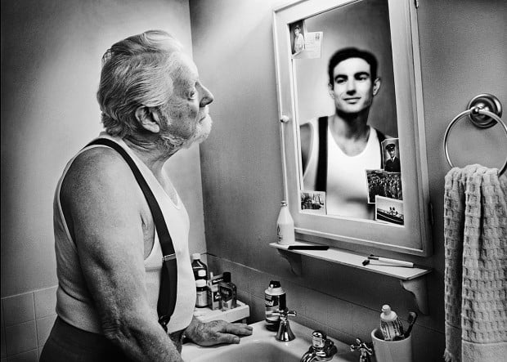
Subjective age – How old do you feel?
Age is not only an objective characteristic, but a key aspect of identity.
Age is internalised as a mental state, independent of chronological age.
Age norms are pervasive, as well as general stigma around ageing, so most people feel a different age than they are.

Slide 3
Why is subjective age relevant?
Remarkable absence in mainstream social sciences of theorising age and its measurement in a multidimensional way (Johfre and Saperstein 2023, Barrett 2022).
It shifts the study of ‘ageing’ from a medicalised biosocial perspective to a more psychosocial view of age as a construction.
Internalised dispositions can be as important as an objective indictors (eg. Self rated health, subjective social status), and sometimes carry more predictive power.
A robust association between lower subjective age and various health outcomes exists (Westerhof et al 2014, Westerhof et al 2023).

Slide 4
Cohort differences in the age gap ?
Each cohort ages under unique historical conditions, so it’s likely that they will age differently
Cohort differences imply
- Physical differences in health
- Cultural differences about age norms
- Material differences in living conditions (Gersdorf et al 2020)
But the context also changes:
-Digitalisation (potentially making people feel older earlier) (Caspi, Daniël & Kavé 2019)
-Ageism potentially more rampant (COVID, Biden) (Wahl et al 2022)

Slide 5

Health and subjective age
Health explains a large part of the variation in subjective age
Limited longitudinal evidence on the effect of physical health on subjective age
  But clear that less good health status associated with feeling closer to one’s age
Limited evidence about influence of cognitive versus physical health

Slide 6
Research Questions
How does the gap between subjective and chronological age evolve over time by cohort?
How do functional health issues affect the evolution of this subjective age gap?
What is the impact of onset of a functional limitation on the age differential?

Slide 7

Data: English longitudinal study of ageing
Longitudinal panel study of about 10,000 community residing people over 50 in England
Biannual data collection (11 waves since 2002, with nurse visit every other wave)
International family of studies (HRS, ELSA, CHARLS, …) : harmonisation through publicly available code on g2aging.org
Accessible through https://ukdataservice.ac.uk/
Notes:
The data we will be using to explore these RQ’s are the english longitudinal study of ageing. This longitudinal panel study of about 10,000 community residing people over 50 in England covers a wide array of subjects, from health and wellbeing to caring and social participation. Data collection for this panel takes place every two years, with a nurse visit to take blood and hair samples for biomarkers as well as performing certain tests every 4 years. The sample is updated every wave so that it remains representative of the population. It is part of a wider international framework of studies on ageing, and comparable such as helatyh and retirement study in the US or SHARE in europe It is freely accesible through the uk data service for researchers.

Slide 8
Descriptives: Subjective Age Gap
 | wave 2004 | wave 2008 | wave 2012 | wave 2014
Number of participants | 7496 | 9901 | 9407 | 8613
Age in year - mean(sd)
Chronological age | 65.4 (9.5) | 65.3 (9.5) | 66.6 (9.5) | 67.4 (9.6)
Subjective age | 56.5 (13.2) | 54.8(15.3) | 55.3 (15.1) | 56.7 (14.8)
Age differential | 8,9(10.1) | 10.5 (12.9) | 11.3(12.7) | 10.3 (12.2)
Notes:
Some descriptive statistics on Subjective age in the ELSA population :
As you see the number of participants was about 7500 to 10000, depending on the wave, and on average respondents were about 65 years old , but felt about 10 years younger. It is the difference between felt age and chronoligicla age that we will be examining here. Important to note is that we have a ten year follow up for repsondents who took part in all waves.

Slide 9

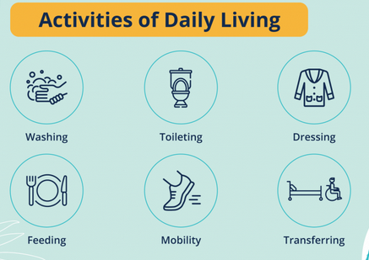
Functional Health Measure: IADL
Notes:
Our main measure of health is limitation in instrumental or general acitivitiues of daily living, rwo commonly used scales to assess fucntional health in later life. Whiel ADL is refer more diretcly to phycisal health, IADL refers to more instrumental , organisational aspects of health that also imply being in good cognitive health. We will assess the infleunce of each scale seperatdly in our study.

Slide 10
Methods
RQ1+RQ2: Age vector graphs (Mirowsky & Kim 2007) based on random intercept multilevel growth models
RQ3: Within person fixed effects model of onset of functional limitations
Notes:
In terms of methods, we will first investigate the evoluation of the subjective age gap over age, conditional on cohort, by using age vector graphs.,a n application of RI multilevel models. The last research question, on the effetc of onset of a health limitation, requires a fixed effetcs apporach, examining only change in the age gap within those respondents for whom there is a change in functional health status.

Slide 11
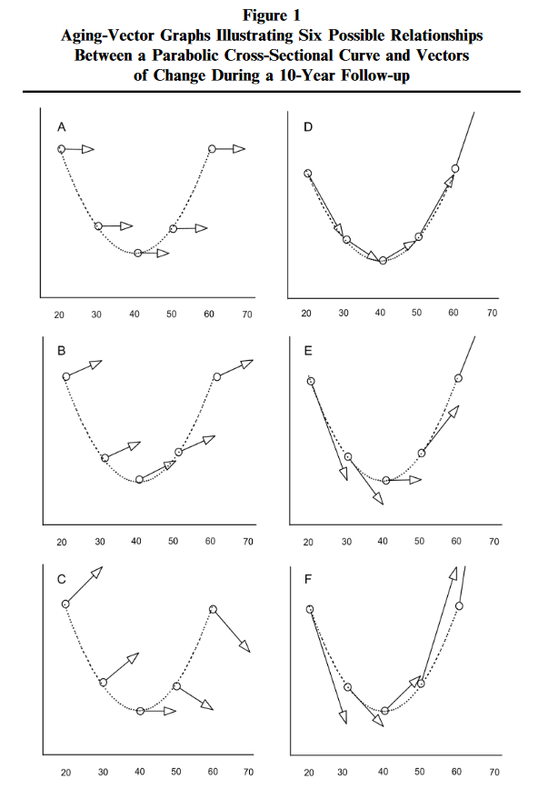
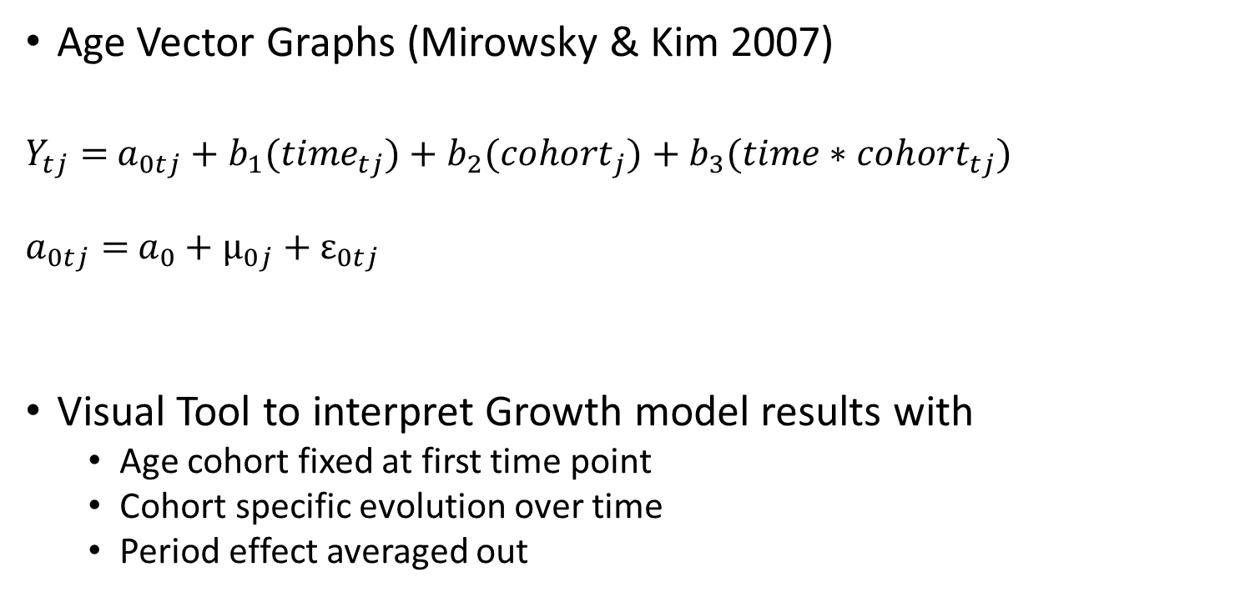
Cohort differences in the age gap?
Age Vector Graphs (Mirowsky & Kim 2007)
  $Y_{tj}=$ $a_{0tj}+b_{1}({time}_{tj})+{b_{2}(cohort}_{j})+{b_{3}(time∗cohort}_{tj})$
  $a_{0tj}=$ $a_{0}+μ_{0j}+ε_{0tj}$
Visual Tool to interpret Growth model results with
  Age cohort fixed at first time point
  Cohort specific evolution over time
  Period effect averaged out
Source: Mirowsky, J., & Kim, J. (2007). Graphing Age Trajectories: Vector Graphs, Synthetic and Virtual Cohort Projections, and Virtual Cohort Projections, and Cross-Sectional Profiles of Depression. Sociological Methods & Research, 35(4), 497-541. https://doi.org/10.1177/0049124106296015
Notes:
Age vector graphs are tool to create synthetic cohort trajectories over age, that enable visualising how an outcome evolves over age for each cohort. A key assumption here is that there is no period effect. As you can see tehcnically the mdoel without adjustment takes the form of a random intercept multilevel growth model that model time , cohort and their interaction.

Slide 12
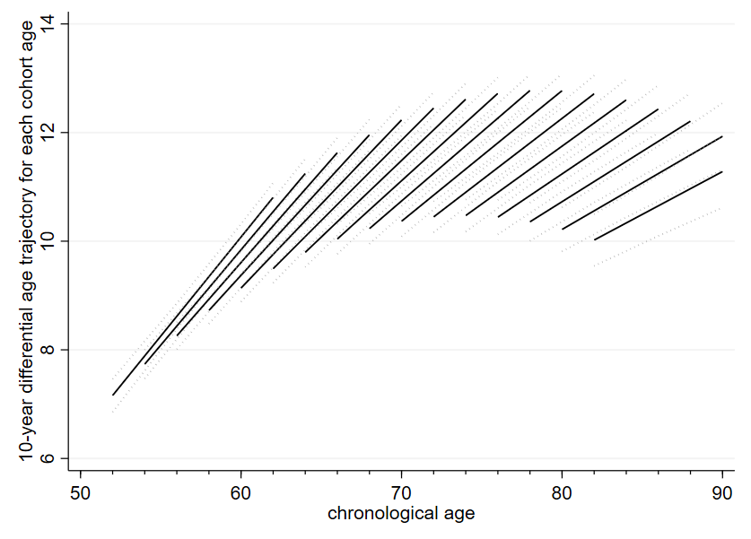

Age Vector model –Age effects
Age gap increases over age for all cohorts
  52 year olds W1 on average feel 45 (-7y)
  10 years later at 62, they feel about 51
  70 year olds feel 60
  10 years later at 80, they feel about 67.5
Steepest increase for younger ages, but stable gap of 10-12 years from 65 onwards
Notes:
Looking at the results in terms of age effects, we see that the gap between felt age and chronological age increases over age for all cohorts, but steeper so for the youngest cohorts. For example, Those aged 52 in the first wave in 2004, on avergae feel 7 years younger, but ten years later at 62 they feel on avergae 11 years younger. Those aged 70 in 2004 feel 60, and ten years later feel about 67,5. So we can state that on average we age slower subjectively than chronologically, and time passes faster than we age in our head. We age about a third slower subjectvEly

Slide 13
Age Vector model – Cohort effects
Increase in age gap between cohorts
  60 year olds 2004 on average feel 51 (-9y)
  10 years later, 60 year olds feel about 49 (-11y)
  80 year olds 2004 feel 70
  10 years later, 80 year olds feel 67.5
Later born cohorts feel younger
Notes:
Lookign at cohort effects, it is clear that at a given age later born cohorts feel younger than earlier born cohorts did at the same age. For example, 60 year olds in 2004 felt 9 years younger, while 60 year olds in 2014 felt 11 years younger. This trend is clear for all cohorts, and looks stronger for the older cohorts.

Slide 14






Socio-demographic influences
+ve effect: larger gap between chronological and subjective age (feeling younger)
Notes:
Here are some results from the adjusted regression models presented in a forest plot. On the left we see the model with IADL, on the right with ADL. Three remakrable associations here: firstly we see a very large effect of limitations, but they ar ein the same ballpark for IADL en ADL. Respondents with one limitation reported an age gap that was on average about 3 years less , or 6 years less if more than one imitation. Lower educated repsondents and men felt closer to their age in compoarison to middle levels or eduication and womean. Interestingly, respondents who report theya r edivorced feel a larger age gap and hance feel younger than people who are married or partnered.

Slide 15
Functional health
Very large effects on subjective age gap (-3 / -6 years ) in multilevel model for having a functional disability
But mixture of 2 mechanisms
  Selection into functional disability group (lower SA gap already before onset)
  Actual onset of functional disability (Causal effect)
Notes:
As stated functioanl health seems to be very important for the subjective age gap, but the reported association in the multilvel model is tyhe combination of 2 things, one the one hand the selection into a group that will have a ducntional disability, with possibly already a smaller SA gap before onset , and the actual causal effect of onset of functional disability in the panel.

Slide 16
Fixed Effects models
  To isolate the effect on onset of functional limitations, we only examining within person change
  This substantially reduces the sample to those with changes in (i)adl (from about 20.000 to 13.000)
 | IADL | ADL
To 1 | -1.25(.26) | -0.60 (.27)
To 2+ | -2.58(.34) | -2.46 (.34)
  While there is a clear and significant effect of onset of a limitation on the SA gap, it is less than half of the total effect
Notes:
To isolate this effect of onset; we used a fixed effect model whihc examines only within person change. This of course ssubstantially reduces our data set, as only people who report a chnage in adl or iadl in the panel remain in our sample.
As you see , onset of 1 iadl diminishes the gap with 1,25 , rom at least 2 iadl with more than 2,5 . Onset of 1 adl has a slightly more limited but significant effects, while 2 or more ADLs diminishes the gap with about 2,5 .
These results show that there is a clear causal effect of onset of a limitation, it is les than half of the total reported effect, so there is signifcant selection effetcs as well, with certian groups already reporting feeling closer to their age before experinceing a limitation. Important to interpret these effects is to understand that there is about two years between the waves, so that the reported effect is a change in the subjetcive age gap on the middle long term, and that the immediate effect of onset migth be larger.
But it does appear that osn,et of limitations, especially more than one at the same time, makes us feel substantially older.

Slide 17
Conclusions
Subjective ageing happens on average about a third to a quarter slower than chronological ageing in later life
With increasing age , gap between chronologic and subjective age increases, and for younger cohorts even more so
Functional health is a key determinant of how old we feel, especially in early old age
Onset of functional health issues makes us age (subjectively) 1 to 2,5 years ‘overnight’
Notes:
Some conclusions of this research – subjectvie ageing happen on avergae a third to a quarter slwoer than chronological ageing in later life, with insdreaisng age the gap between howold we feel and how aold we are increases; and even more so fo ryounger cohorts. Functional helath plays a key role in how old we feel , expecially in ealry old age , and the oinset of functional health limitations makes us age 1 to 2,5 years ‘overnight’

Slide 18
Limitations and future research
Influence of attrition and selection effects on trajectories?
Potential for mental marker of age, similar to subjective health status
Future work:
  Explore variability of subjective age trajectories
  Study links with the life course
    Divorce in later life makes you feel younger
Please find the published paper here
Notes:
An important limitation of this research is that these results might be affected by attrition, as healtier people stay in the apnel for longer, so there mighth be selection effetcs influencing our estimates.
But it is clear that subjectvie age has potential as a mental marker of age, Future work could stuyd the variabilit fo these trajectories, as here we have focused on the average,a s well as studying links with the lfie course.

